Slide 1
Machine Learning: The Connectionist
Prabhas Chongstitvatana
Faculty of Engineering
Chulalongkorn university

Slide 2

More Information
Search “Prabhas Chongstitvatana”
Go to me homepage

Slide 3
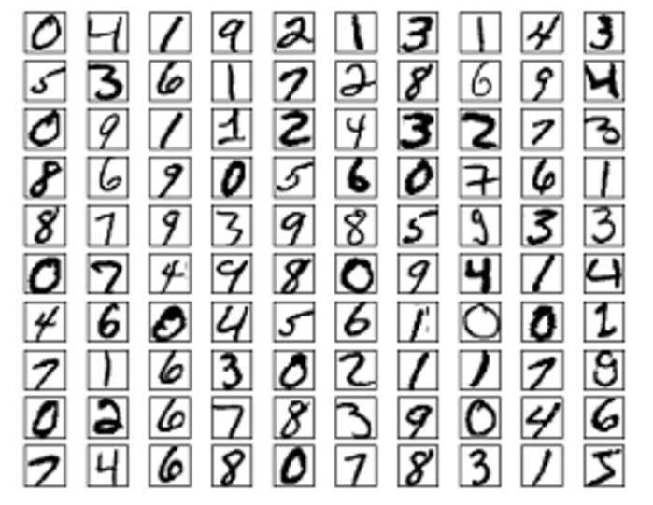

Slide 4
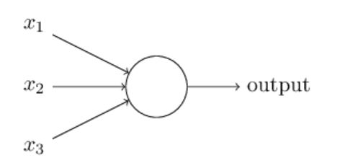
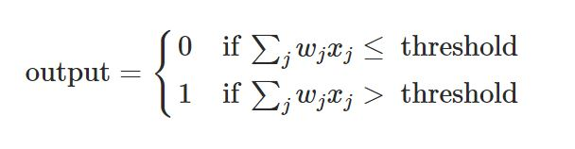
Perceptron
Rosenblatt, 1950

Slide 5
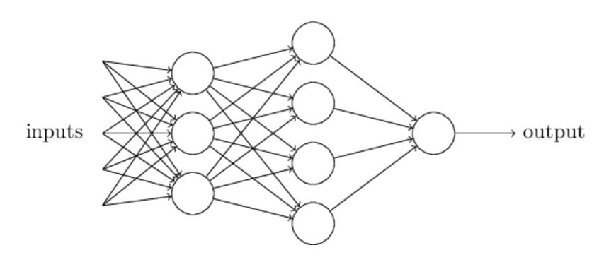
Multi-layer perceptron
Michael Nielsen, 2016

Slide 6
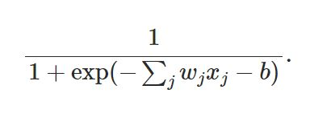
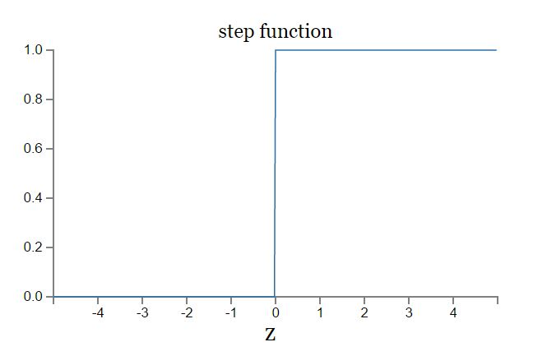
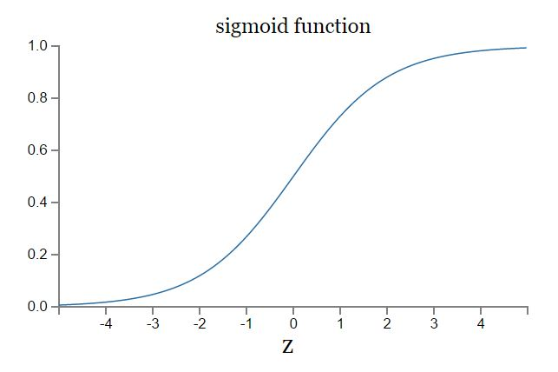
Sigmoid function

Slide 7
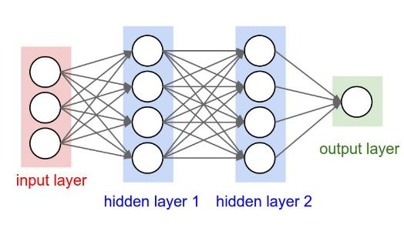
Artificial Neural Network 3-layer

Slide 8
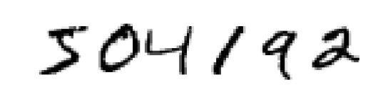
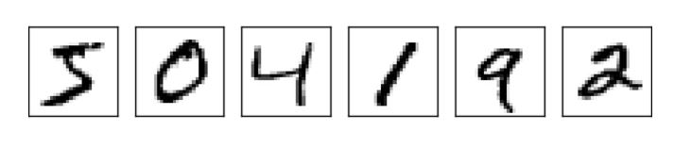

Slide 9
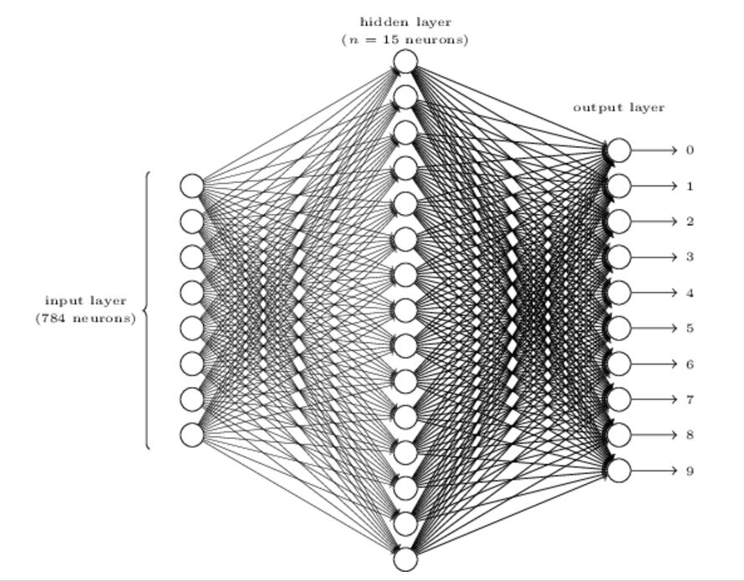
Digit recognition NN
24x24 = 784
0.0 white 1.0 black

Slide 10
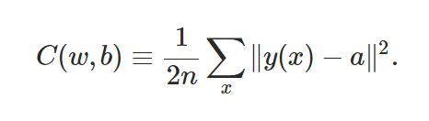
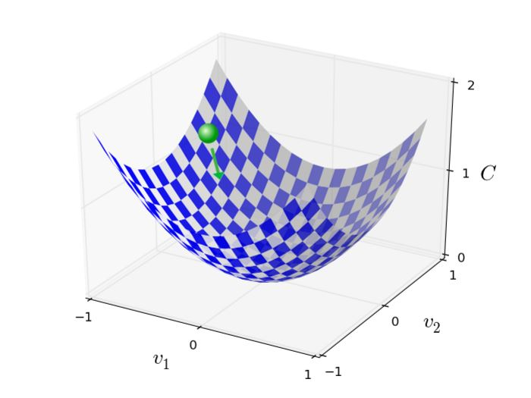
Training NN
Backpropagation is a fast way to compute this, 1986

Slide 11
Convolutional Neural Network
3 main types of layers
Convolutional layer
Pooling layer
Fully Connected layer

Slide 12
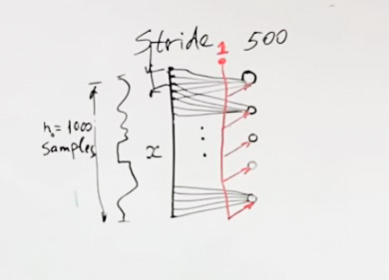
First layer
Drawing by Michael Zibulevsky

Slide 13
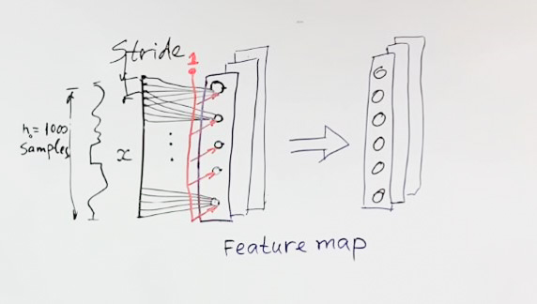
Feature map

Slide 14
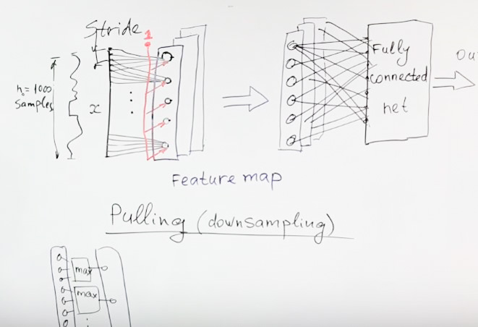
Pooling operation

Slide 15
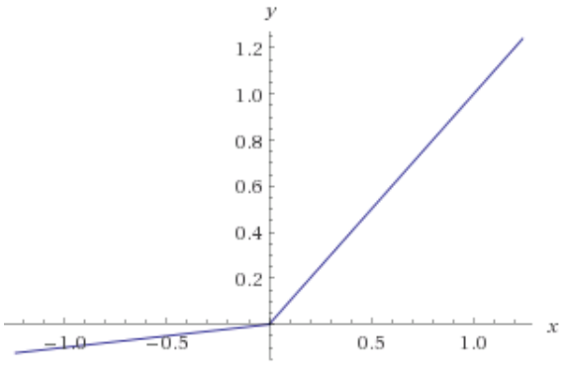
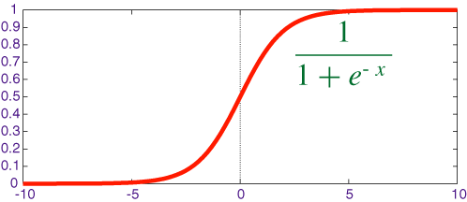
Activation function

Slide 16
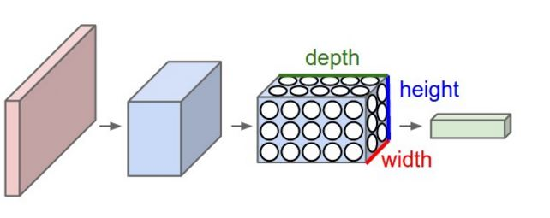
Convolutional Neural Network

Slide 17
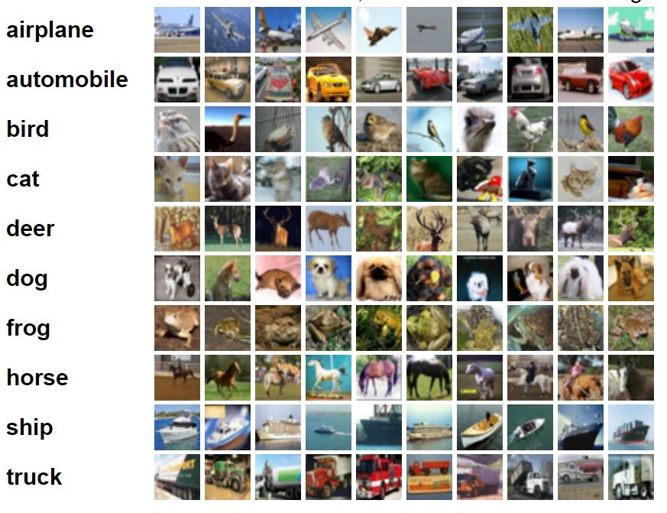
CIFA-10 image dataset

Slide 18
CIFA-10 dataset
CIFAR-10 dataset consists of 60000 32x32 colour images in 10 classes, with 6000 images per class. There are 50000 training images and 10000 test images.

Slide 19
Example (CIFA-10 images)
input 32x32x3 32x32 pixel with 3 color R G B
conv 32x32x12 12 filter
relu max(0,x) same size 32x32x12
pool down sampling 16x16x12
fc compute class score (10 classes for CIFA-10)

Slide 20
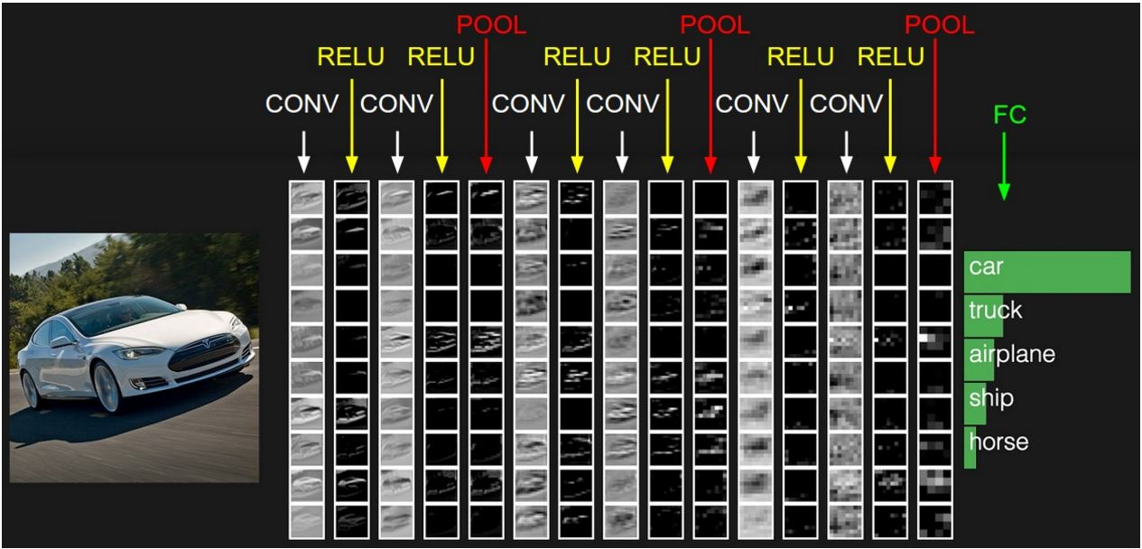
Example of CNN layer

Slide 21
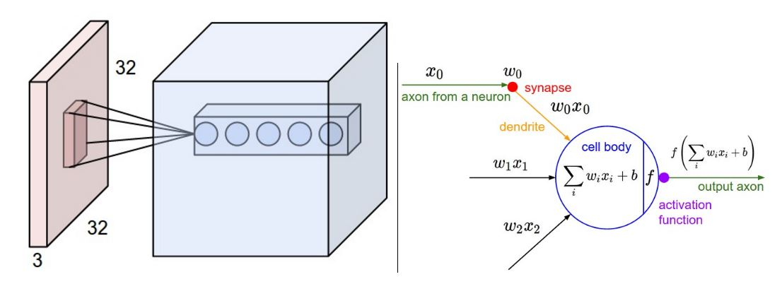
Convolutional layer

Slide 22
Parameters
ImageNet challenge in 2012
images 227x227x3
convolutional layer
receptive field F = 11, S = 4, with 96 filters
55x55x96 = 290,400 neurons
each neuron connects to 11x11x3 = 363+1 bias weights
total 290400*364 = 105,705,600 parameters

Slide 23
Parameter sharing
Volume 55x55x96 has
96 depth slices of size 55x55 each
Each slice uses the same weights
Now
Total 96x11x11x3 = 34,848 + 96 bias

Slide 24
each depth slice be computed as a convolution of the neuron’s weights with the input volume

Slide 25
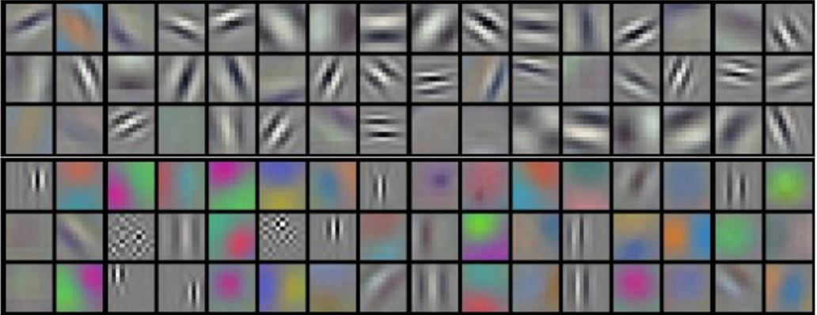
96 filters of 11x11x3 each
Krizhevsky et al. 2012

Slide 26
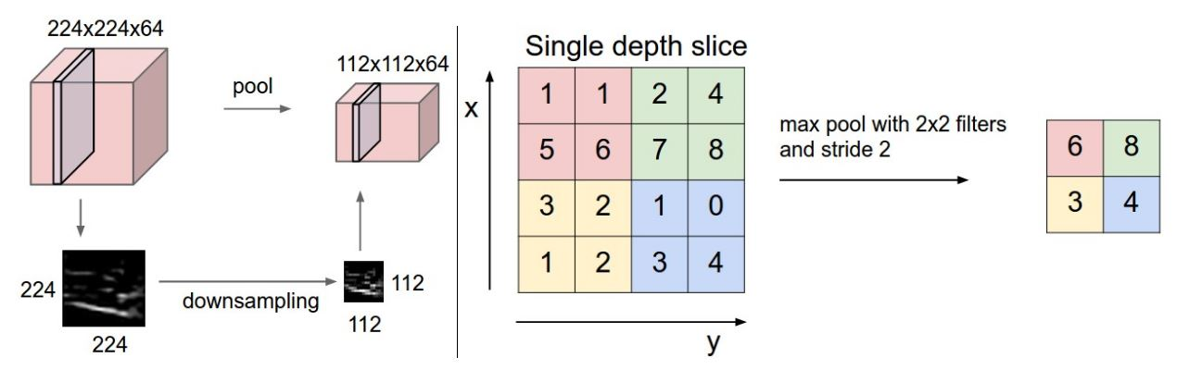
Pooling or downsampling

Slide 27
Case studies
LeNet. The first successful applications of Convolutional Networks were developed by Yann LeCun in 1990’s, was used to read zip codes, digits, etc.

Slide 28
AlexNet
The first work that popularized Convolutional Networks in Computer Vision was the AlexNet, developed by Alex Krizhevsky, Ilya Sutskever and Geoff Hinton. The AlexNet was submitted to the ImageNet ILSVRC challenge in 2012. deeper, bigger, and featured Convolutional Layers stacked on top of each other

Slide 29
ZF Net
The ILSVRC 2013 winner was a Convolutional Network from Matthew Zeiler and Rob Fergus. expanding the size of the middle convolutional layers and making the stride and filter size on the first layer smaller.

Slide 30
VGGNet
The runner-up in ILSVRC 2014 was the network from Karen Simonyan and Andrew Zisserman that became known as the VGGNet. Its main contribution was in showing that the depth of the network is a critical component for good performance.

Slide 31
ResNet
Residual Network developed by Kaiming He et al. was the winner of ILSVRC 2015. It features special skip connections and a heavy use of batch normalization.
ResNets are currently by far state of the art Convolutional Neural Network models and are the default choice for using ConvNets in practice (as of May 10, 2016).

Slide 32
Sample of work done by Connectionist

Slide 33
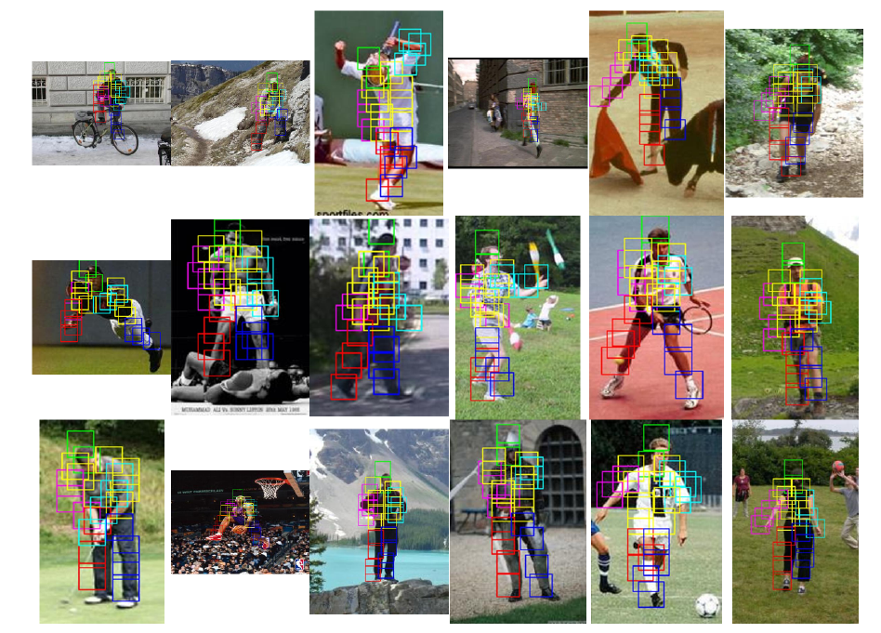
Object Recognition

Slide 34
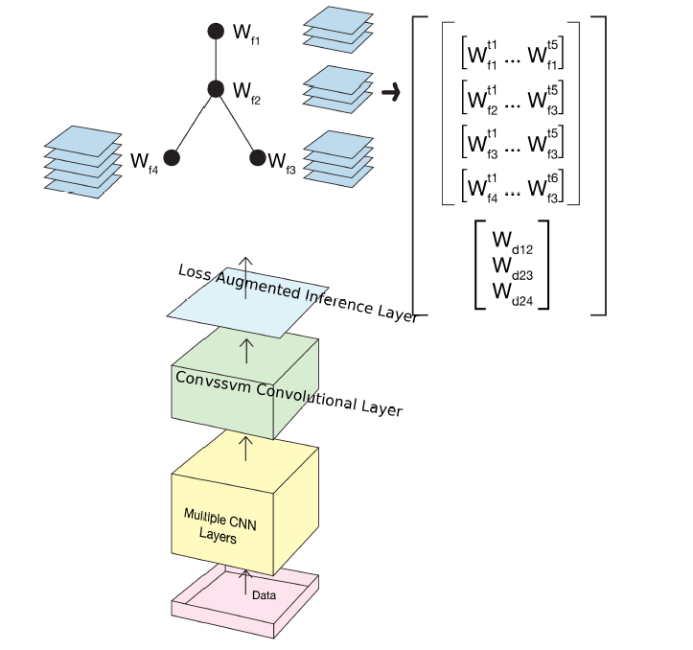

Slide 35
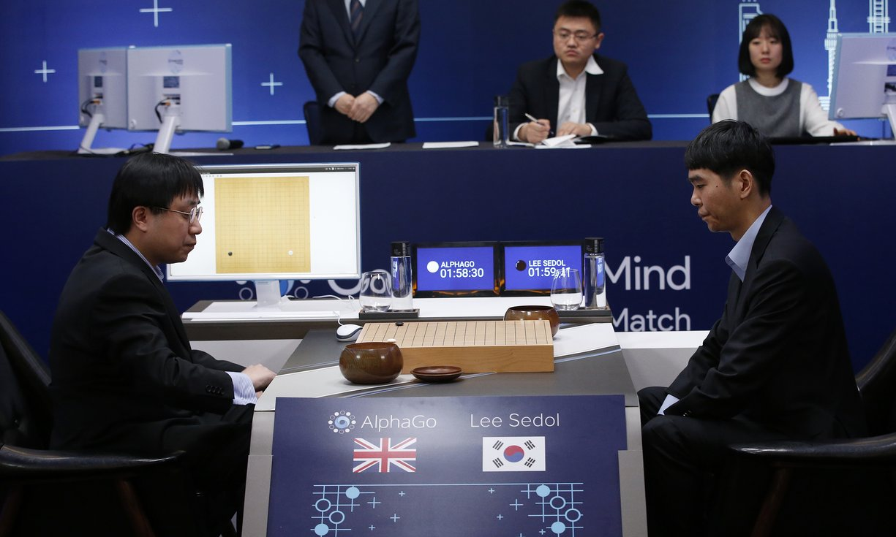
AlphaGo vs Lee Seidol, March 2016

Slide 36
Alpha Go
"Mastering the game of Go with deep neural networks and tree search". Nature. 529 (7587): 484–489.
Deep learning
Monte Carlo Tree search

Slide 37
Tools for convolutional neural network
convnet mathlab
theano cpu/gpu
pylearn2 in python
tensorflow google, open source
caffe
wavenet generate human speech, by deep‌mind
catapult microsoft, special hardware

Slide 38
More Information
Search “Prabhas Chongstitvatana”
Go to me homepage

