Slide 1
Research and Innovation
Prabhas Chongstitvatana

Slide 2
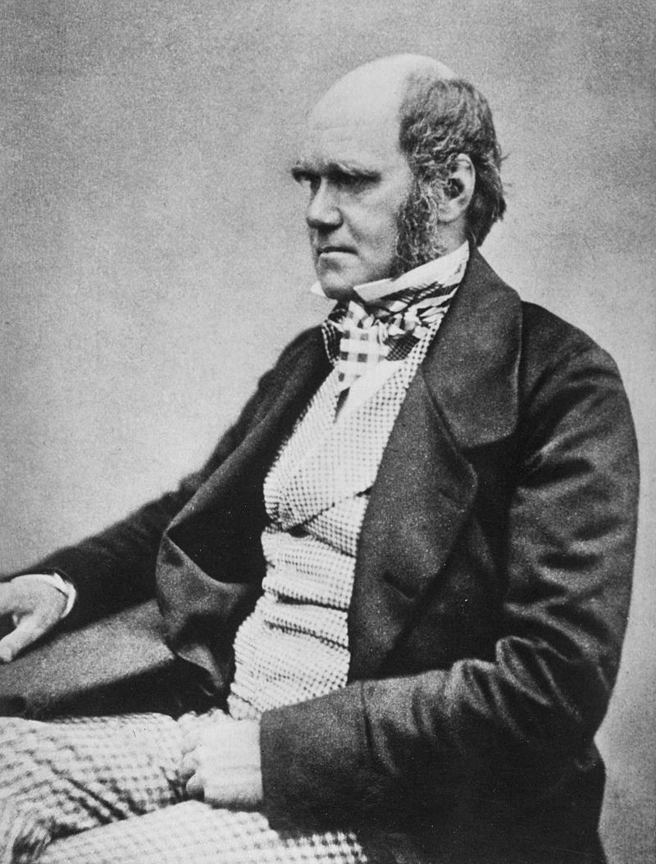
Charles Darwin
12 February 1809 – 19 April 1882

Slide 3
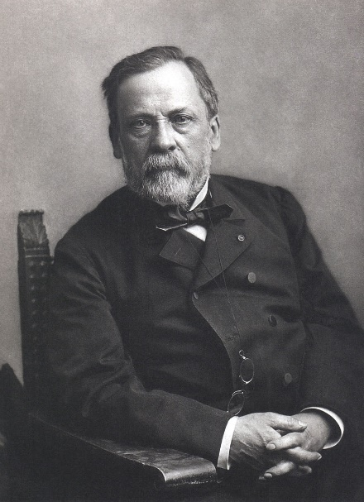
Louis Pasteur
December 27, 1822 – September 28, 1895

Slide 4
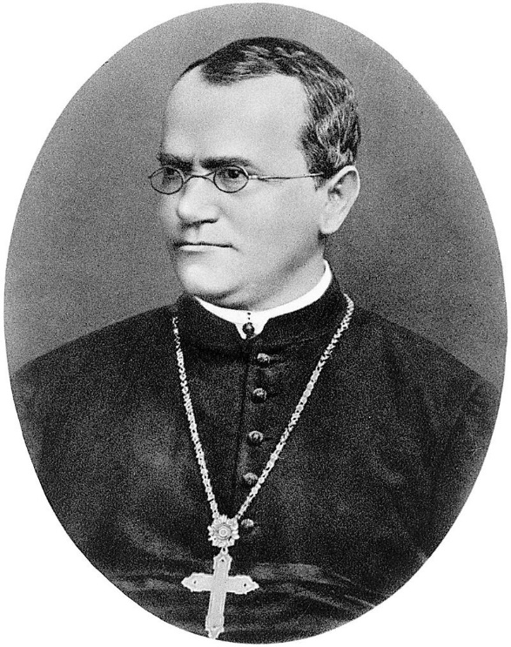
Gregor Mendel
20 July 1822 – 6 January 1884

Slide 5
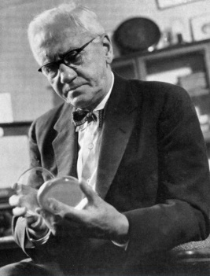
Alexander Flemming
6 August 1881 – 11 March 1955
Penicillin
"When I woke up just after dawn on September 28, 1928, I certainly didn't plan to revolutionise all medicine by discovering the world's first antibiotic, or bacteria killer," Fleming would later say, "But I suppose that was exactly what I did."

Slide 6
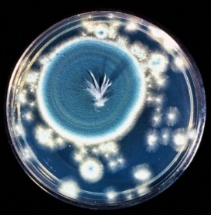
Penicillin mould, courtesy of the Wellcome Library, London (CC BY-ND-NC)
Notes:
Howard Florey and Ernst Boris Chain at the Radcliffe Infirmary in Oxford took up researching and mass-producing it, with funds from the U.S. and British governments. They started mass production after the bombing of Pearl Harbor. By D-Day in 1944, enough penicillin had been produced to treat all the wounded with the Allied forces.
"Without Fleming, no Chain; without Chain, no Florey; without Florey, no Heatley; without Heatley, no penicillin.“

Slide 7
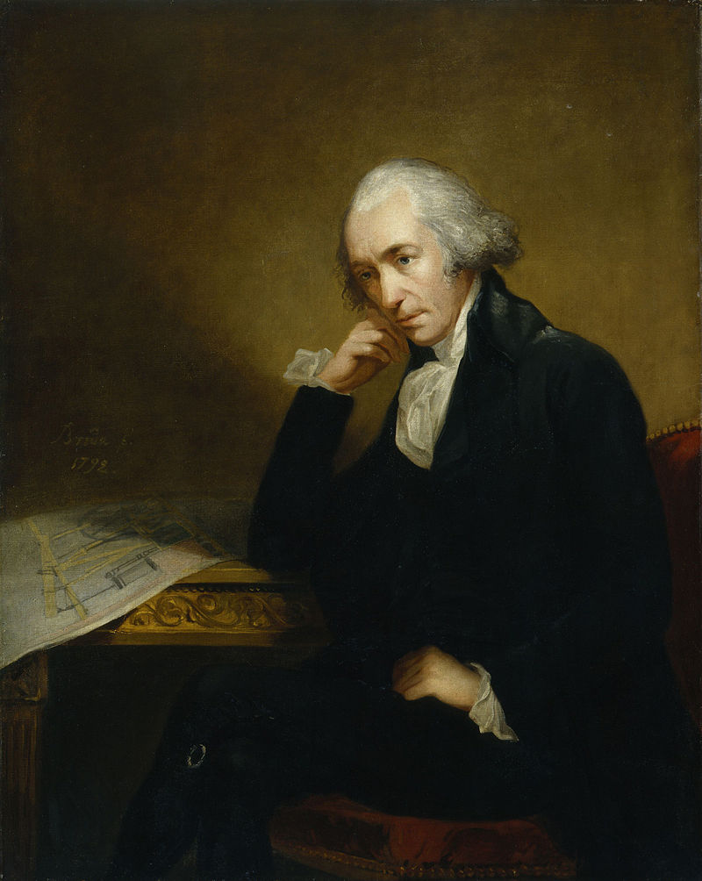
James Watt
30 January 1736 – 25 August 1819

Slide 8
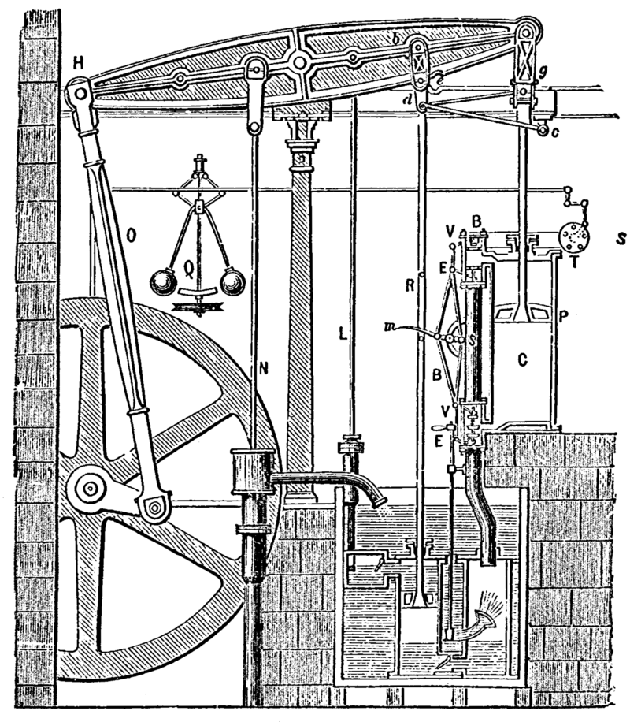
1784 Steam engine by Boulton and Watt

Slide 9
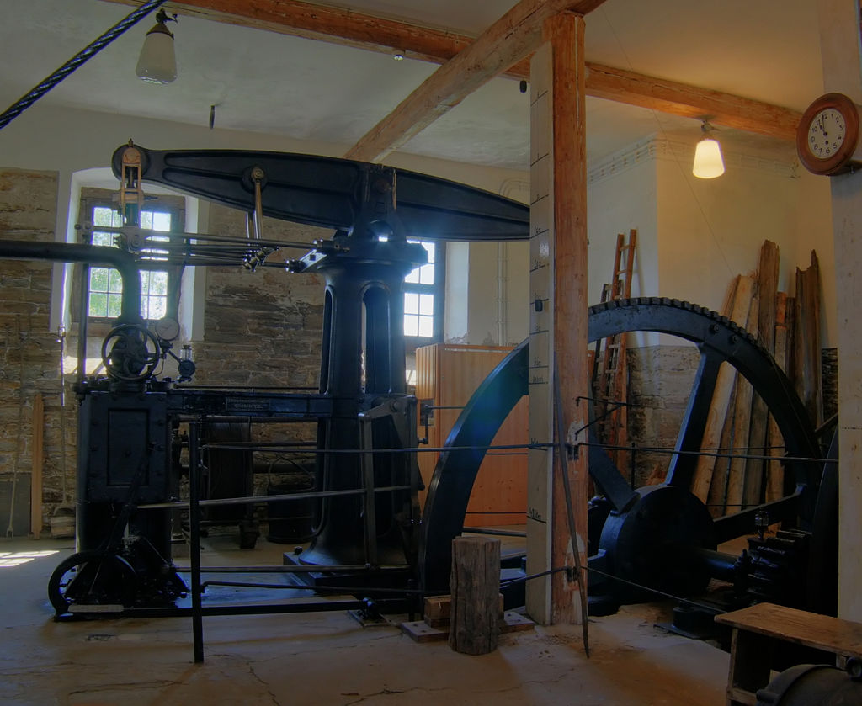
A steam engine built to James Watt's patent in 1848 at Freiberg in Germany

Slide 10
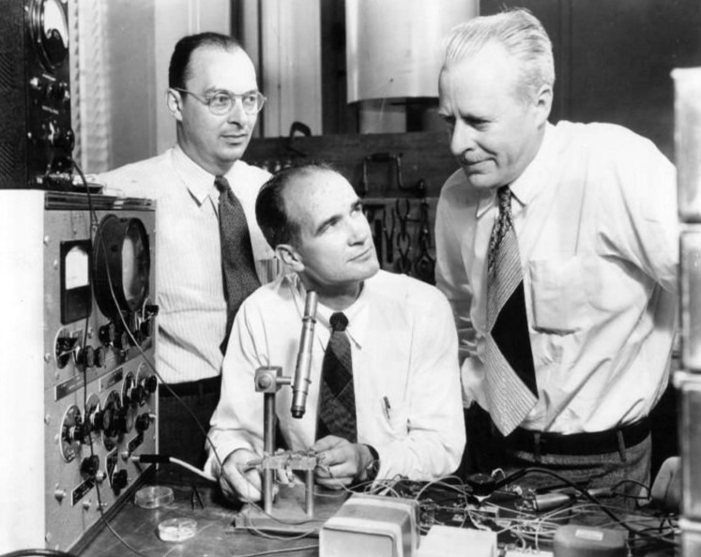
Transistor
John Bardeen, William Shockley and Walter Brattain at Bell Labs, 1948.

Slide 11
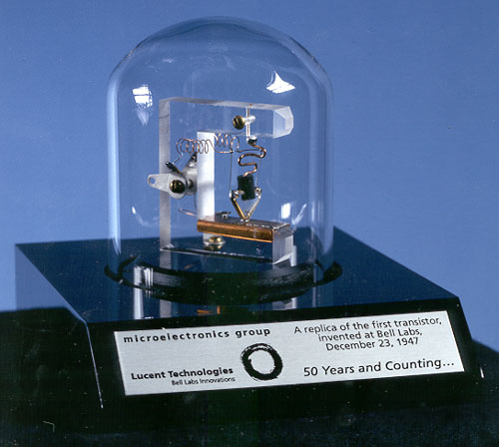

Slide 12
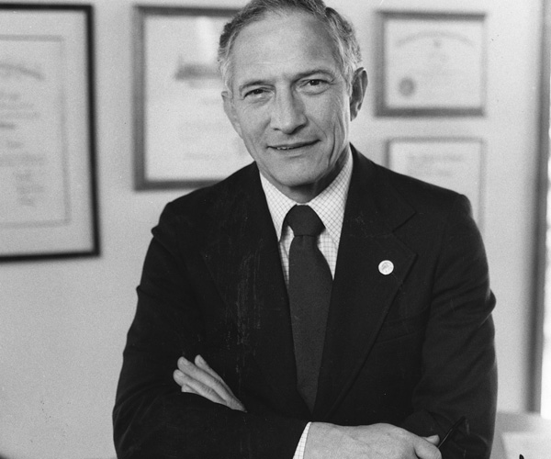
Robert Noyce
December 12, 1927 – June 3, 1990

