Slide 1
AI empowering business
Prabhas Chongstitvatana
Faculty of Engineering
Chulalongkorn

Slide 2

You can get this presentation
Search “Prabhas Chongstitvatana”
Go to me homepage

Slide 3
Outline
AI is a multi-dimension tool
how a program can be intelligent?
reasoning = logic
automatic execution of business logic
use "past-experience" by learning from data
pro and con of AI

Slide 4
What is intelligence?
intelligence = human-like decision
Intelligence = human-like reasoning

Slide 5
Intelligence
reasoning = logic
if this then that
represent domain of interest in computer
search for optimal condition in "state-space"

Slide 6
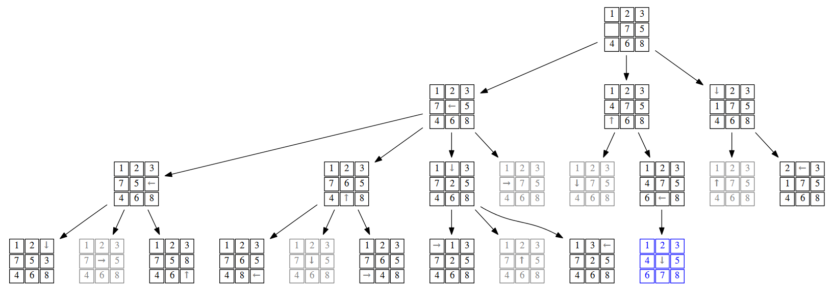
State space of 15-puzzle game

Slide 7
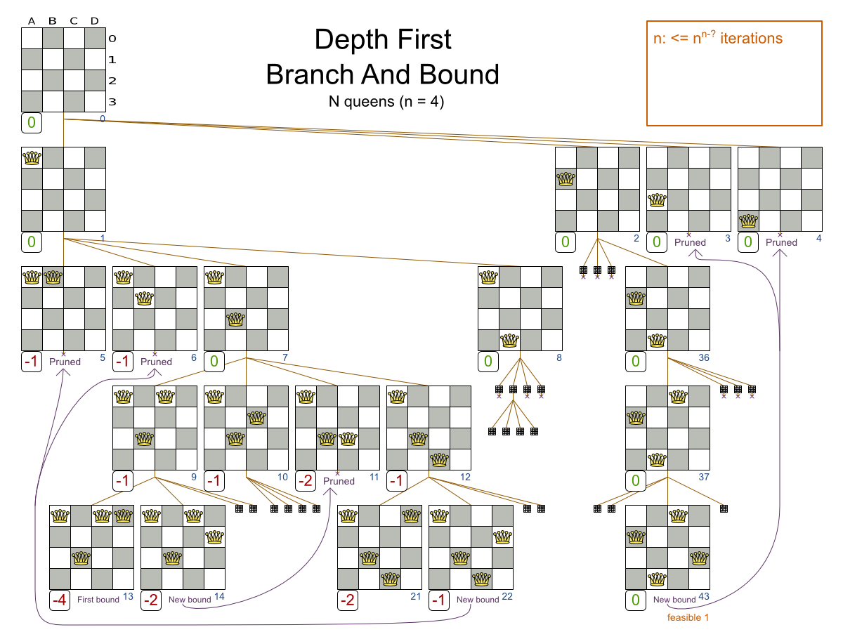

Slide 8
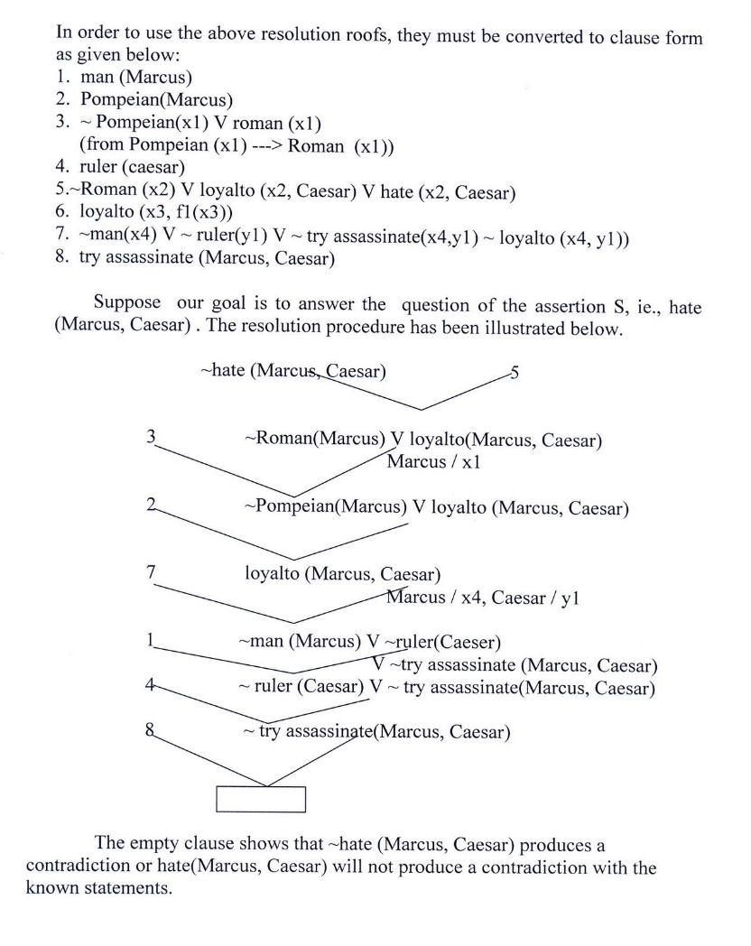
Reasoning by logic

Slide 9
Examples of AI
automatic execution of business logic
Monitoring real-time events
example
checking sale-promotion conditions
evaluate loan application
verify human-user of bank account

Slide 10
Learning
Learning = use past experience
neural network
deep learning = many layers of NN

Slide 11
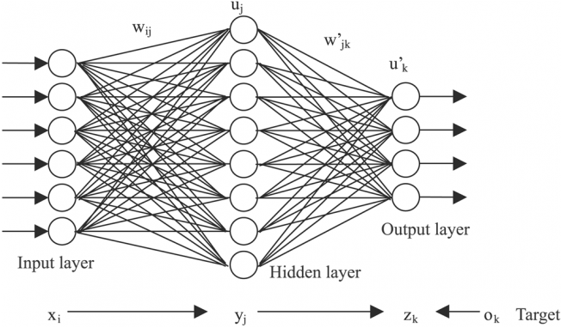

Slide 12
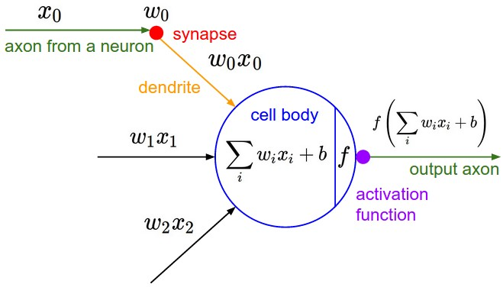
Neuron model

Slide 13
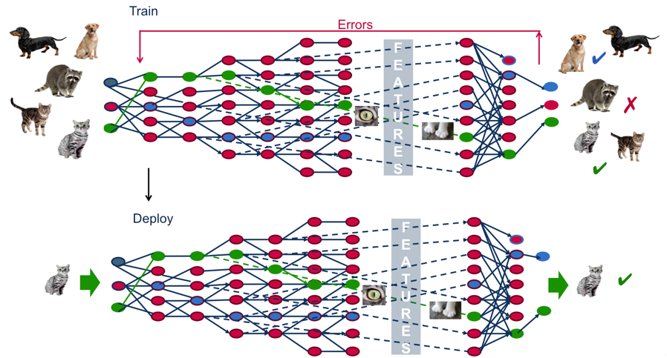
Deep learning

Slide 14
Applications of NN
person identification
speech recognition
automatic assistance

Slide 15
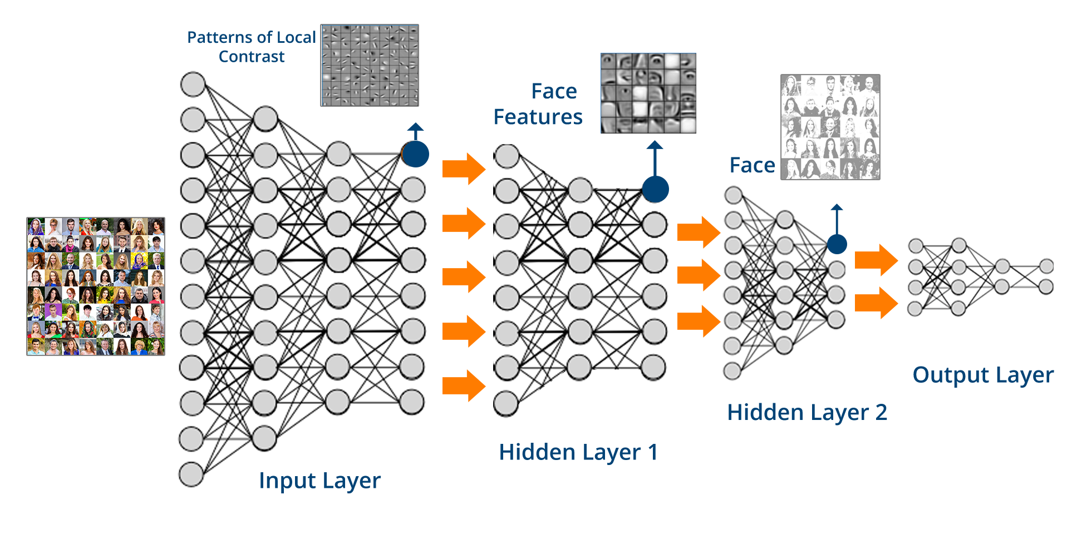

Slide 16
AI advantages
pro
new service innovation
efficient business operation
support management decision in real-time

Slide 17
Difficulty in using AI
con
data and privacy
accountability
expensive

Slide 18
More Information
Search “Prabhas Chongstitvatana”
Go to me homepage
Thank you

