Slide 1
Artificial Intelligence and Future of Education
Prabhas Chongstitvatana
Faculty of Engineering
Chulalongkorn University

Slide 2

More Information
Search “Prabhas Chongstitvatana”
Go to me homepage

Slide 3
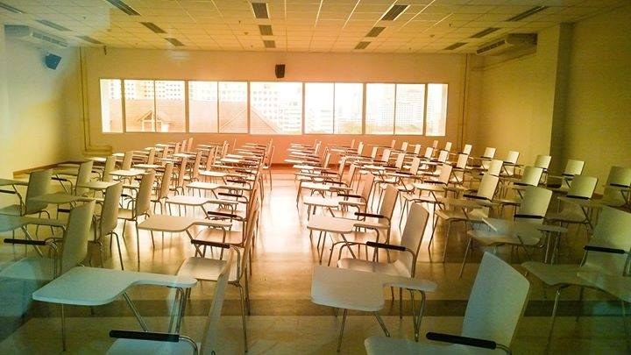

Slide 4
What is Artificial Intelligence?
an intelligent agent that acts like human.
this includes software services (aka Apps) and automated machines (think smart robot vacuum, automated factory etc.).

Slide 5
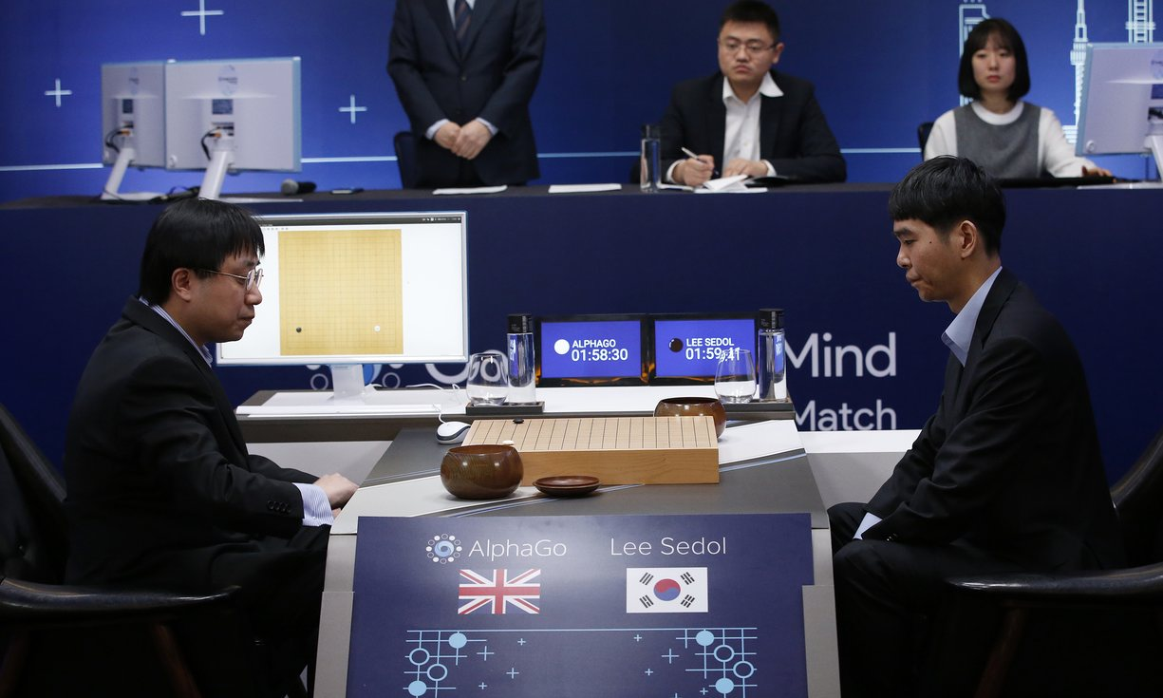
AlphaGo vs Lee Seidol, March 2016

Slide 6
Alpha Go
"Mastering the game of Go with deep neural networks and tree search". Nature. 529 (7587): 484–489.
Deep learning
Monte Carlo Tree search

Slide 7
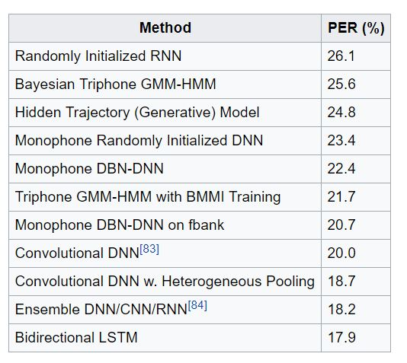
Automatic Speech Recognition
Notes:
Long Short Term Memory 2007, Recurrent NN,

Slide 8
Wish list
Personalized Learning
Global Learning
Intelligent Content
Automated Administrative Tasks

Slide 9
Personalized Learning
helping students choose the best courses
customizes in-class assignments

Slide 10
Global learning
facilitate the learning of any course from anywhere across the globe and at any time

Slide 11
Intelligent Content
customized textbooks
instant feedback
smart tutoring systems
Textbook summarization
simulations and virtual reality software to help students to learn

Slide 12
Automated Administrative Tasks
grading exams
automate the grading tasks
assessing homework
providing valuable responses to students

Slide 13
AI capabilities
learning : memorize generalize
reasoning : inference, deductive, inductive
problem solving : systematic search through a range of possible actions in order to reach some predefined goal or solution
perception
language

Slide 14
How a computer program be intelligent?
Two approaches in the development of AI
  Logic
  Memory an learning

Slide 15
First, using logical reasoning.
Computer program can perform deductive reasoning such as
  socrates is a human
  human are motal
  therefore socrates is mortal
We can use logic to encode situation in the real world
  when it rains, you cannot play tennis outdoor.

Slide 16
Artificial Neuron Network
This is the most popular method today.
Multiple layers (update few hundreds) of this Network can be constructed
It is called Deep learning

Slide 17



Slide 18
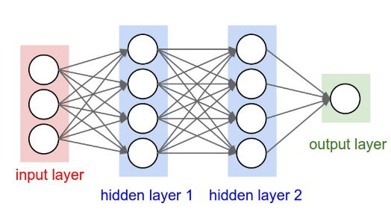
Artificial Neural Network 3-layer

Slide 19
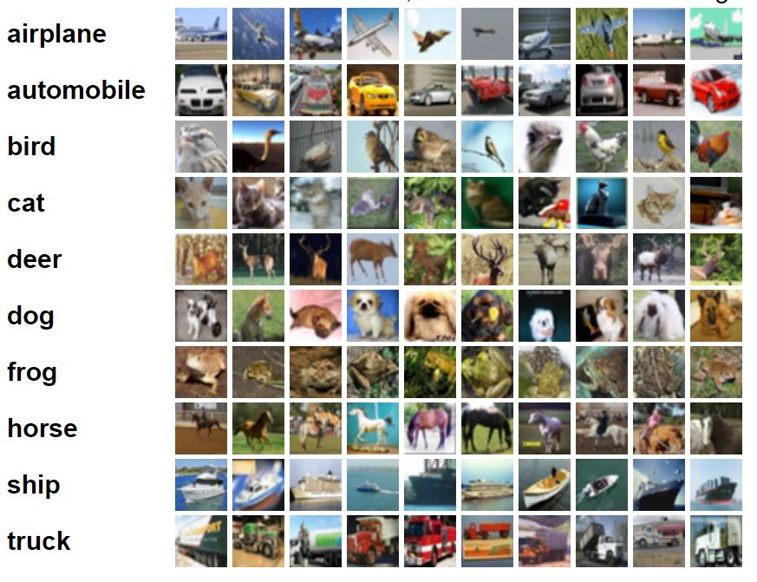
CIFA-10 image dataset

Slide 20
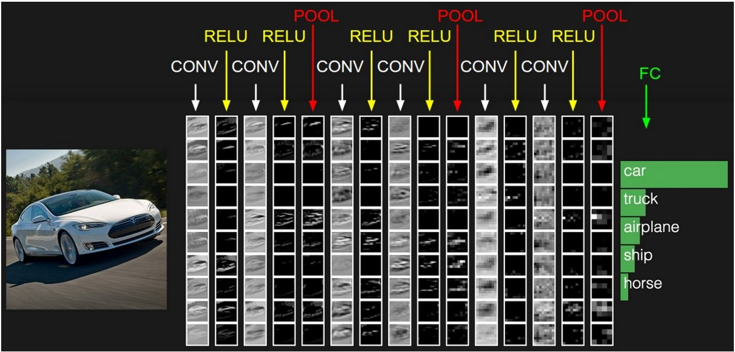
Example of CNN layer

Slide 21
Case studies
Programming 101 at Chulalongkorn Engineering

Slide 22
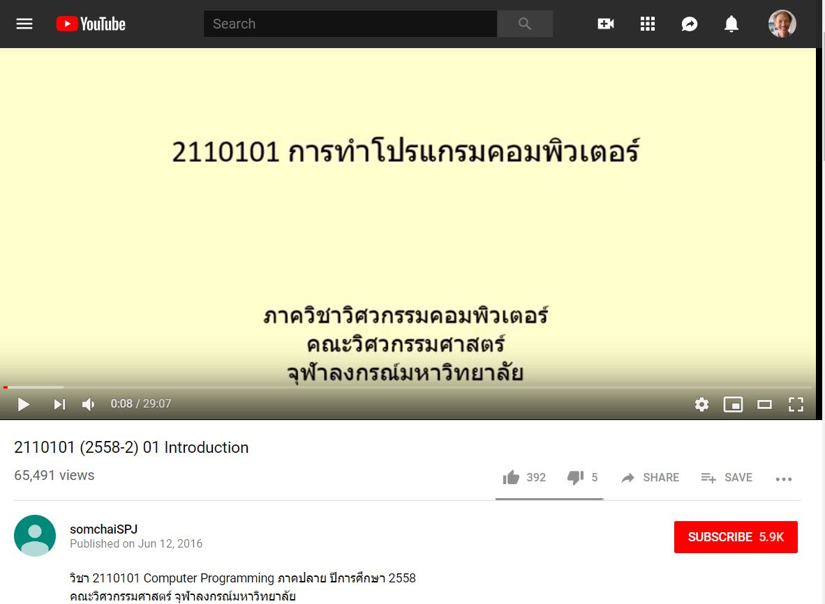

Slide 23
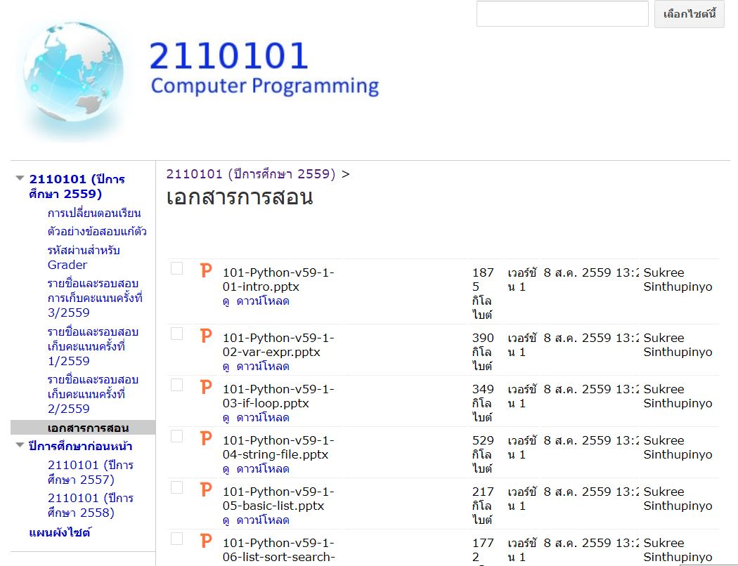

Slide 24
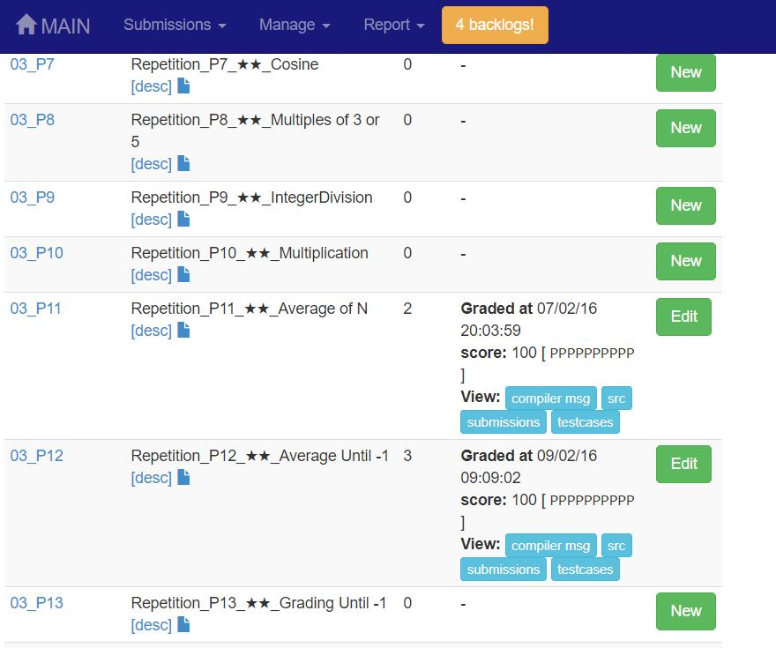

Slide 25


Slide 26
AI Worries
AI will shift the role of the teacher to that of facilitator
Teachers will supplement AI lessons
Assist students who are struggling

Slide 27
Threat
Essay services etc.

Slide 28
Summary
Artificial Intelligence will be employed in every fields
Education will change dramatically
This will bring forth rapid advance in they way we learn
Teachers have to adopt and adapt their skills

Slide 29
More Information
Search “Prabhas Chongstitvatana”
Go to me homepage

