Slide 1
Botnet of Things: Cybersecurity
Prabhas Chongstitvatana
Faculty of Engineering
Chulalongkorn University

Slide 2
A botnet is a collection of internet-connected devices, which may include PCs, servers, mobile devices and internet of things devices that are infected and controlled by a common type of malware. Users are often unaware of a botnet infecting their system.

Slide 3
Botnets can be used to perform distributed denial-of-service attack (DDoS attack), steal data, send spam, and allows the attacker to access the device and its connection. The owner can control the botnet using command and control (C&C) software.
Wikipedia

Slide 4
What is Internet of Things
Network of Physical Objects
Embedded systems with electronics, software, sensors
Enable objects to exchange data with manufacturer, operator, other devices through network infrastructure

Slide 5
Allow remote control
Direct integration = computer + physical world
Result: Automation in all fields

Slide 6
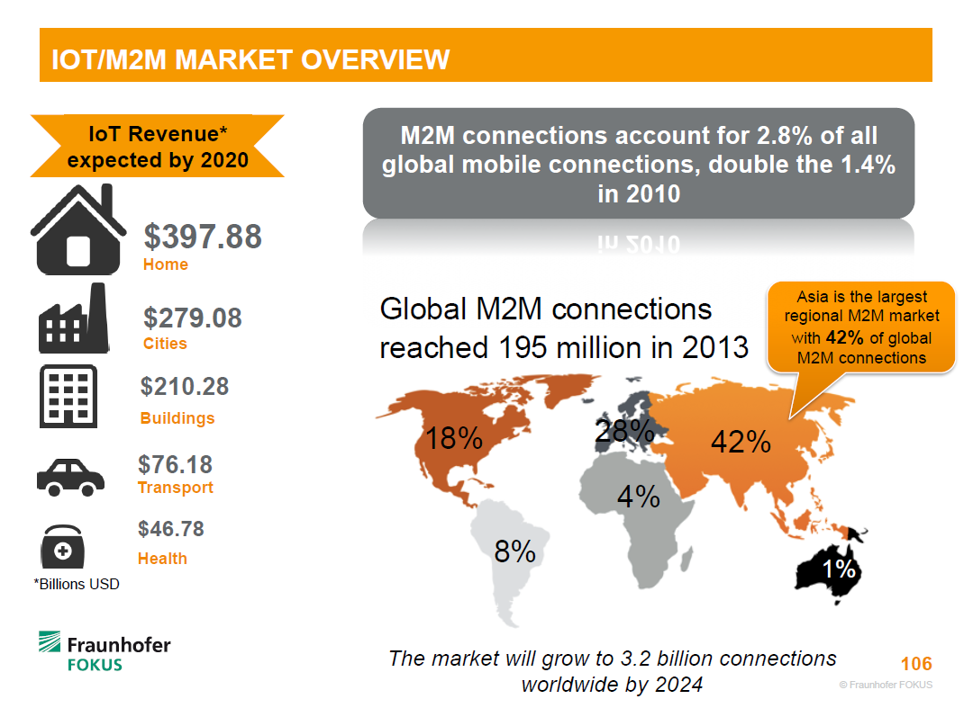

Slide 7
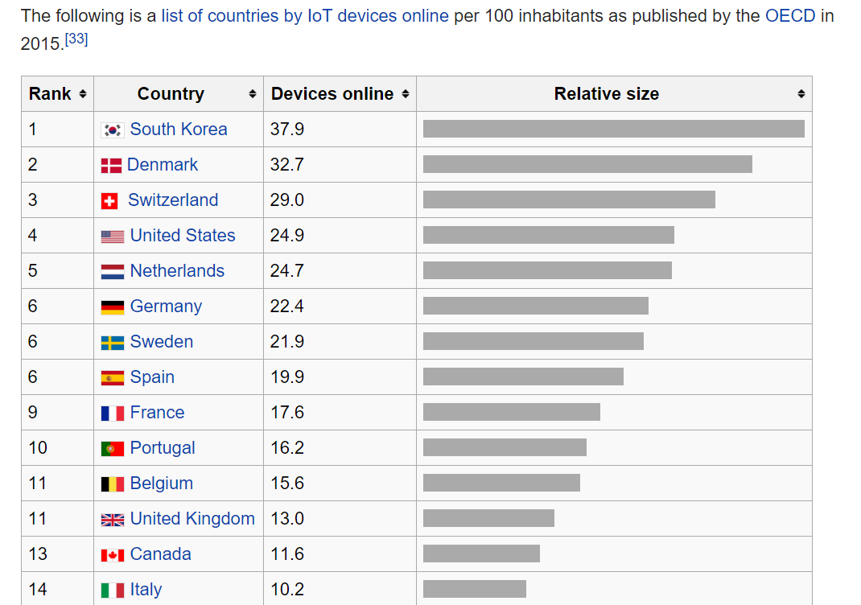

Slide 8
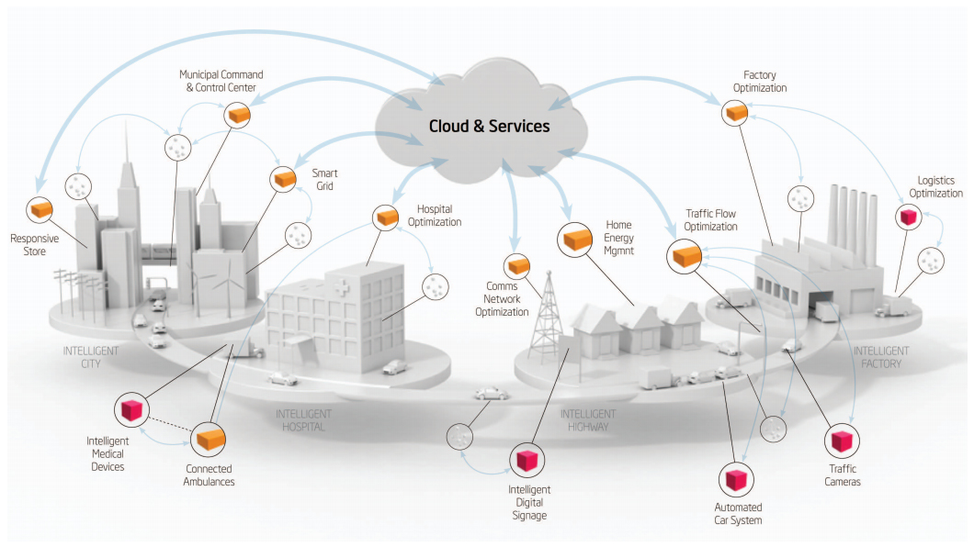
Smart Cities

Slide 9
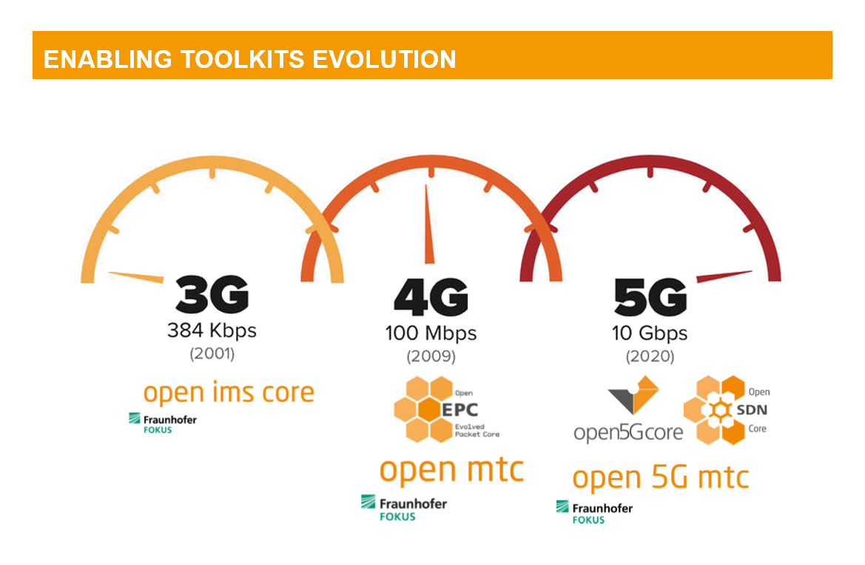

Slide 10
Cybersecurity

Slide 11
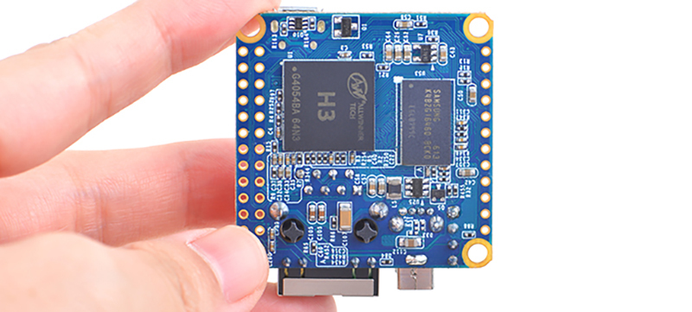

Slide 12
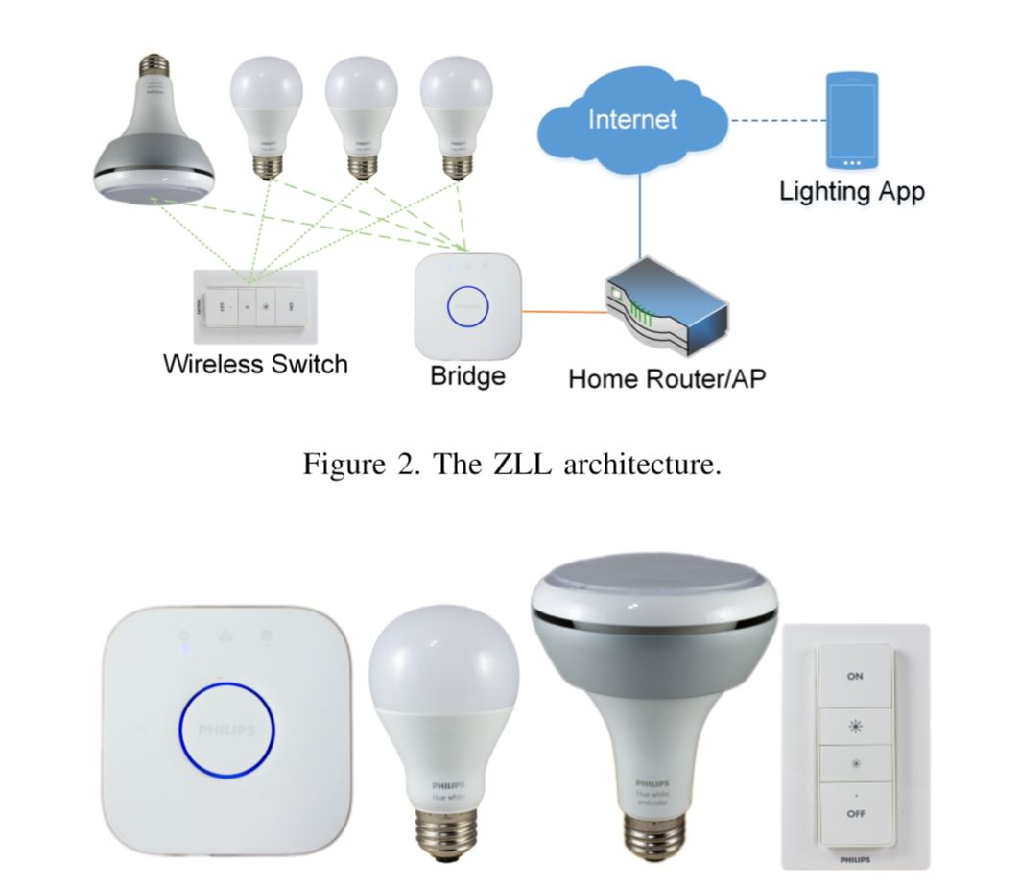

Slide 13


Slide 14
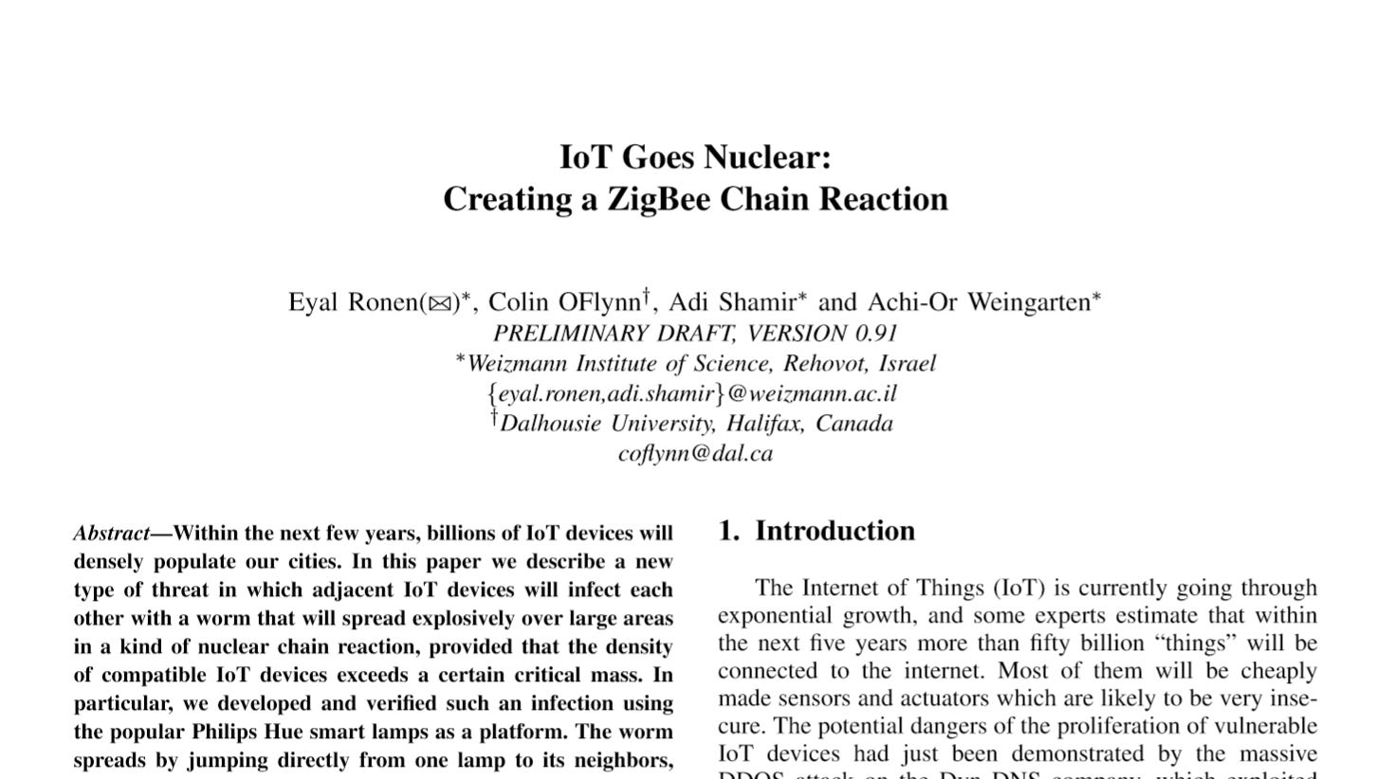

Slide 15
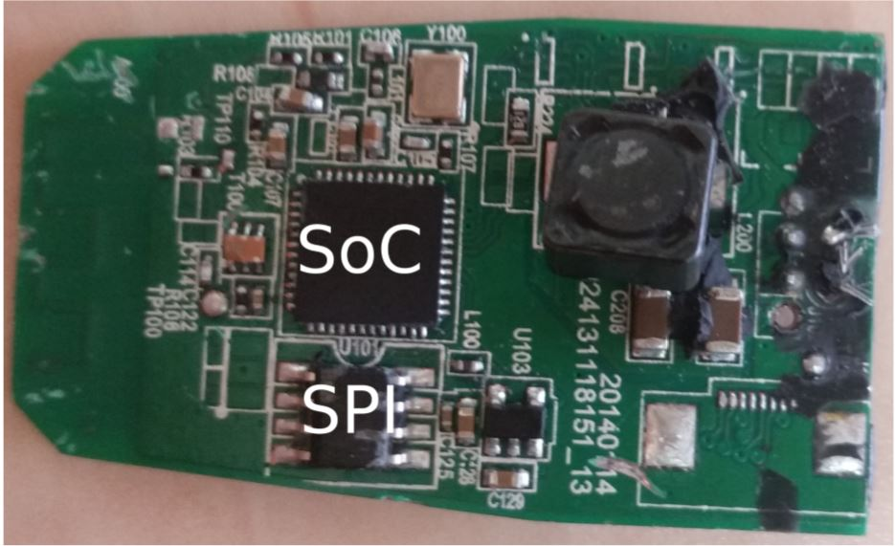

Slide 16
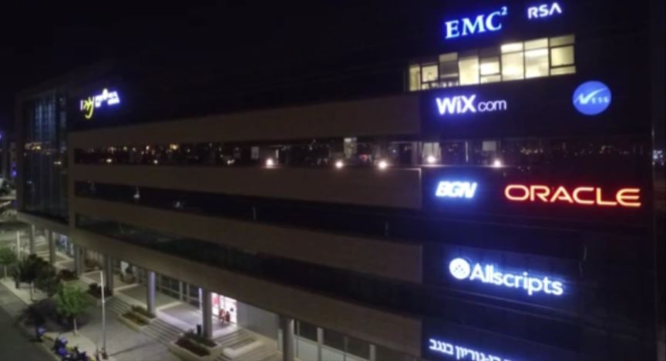

Slide 17
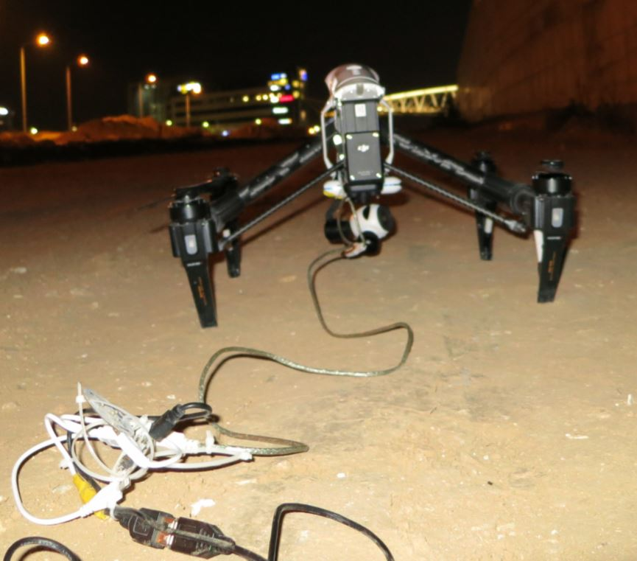

Slide 18
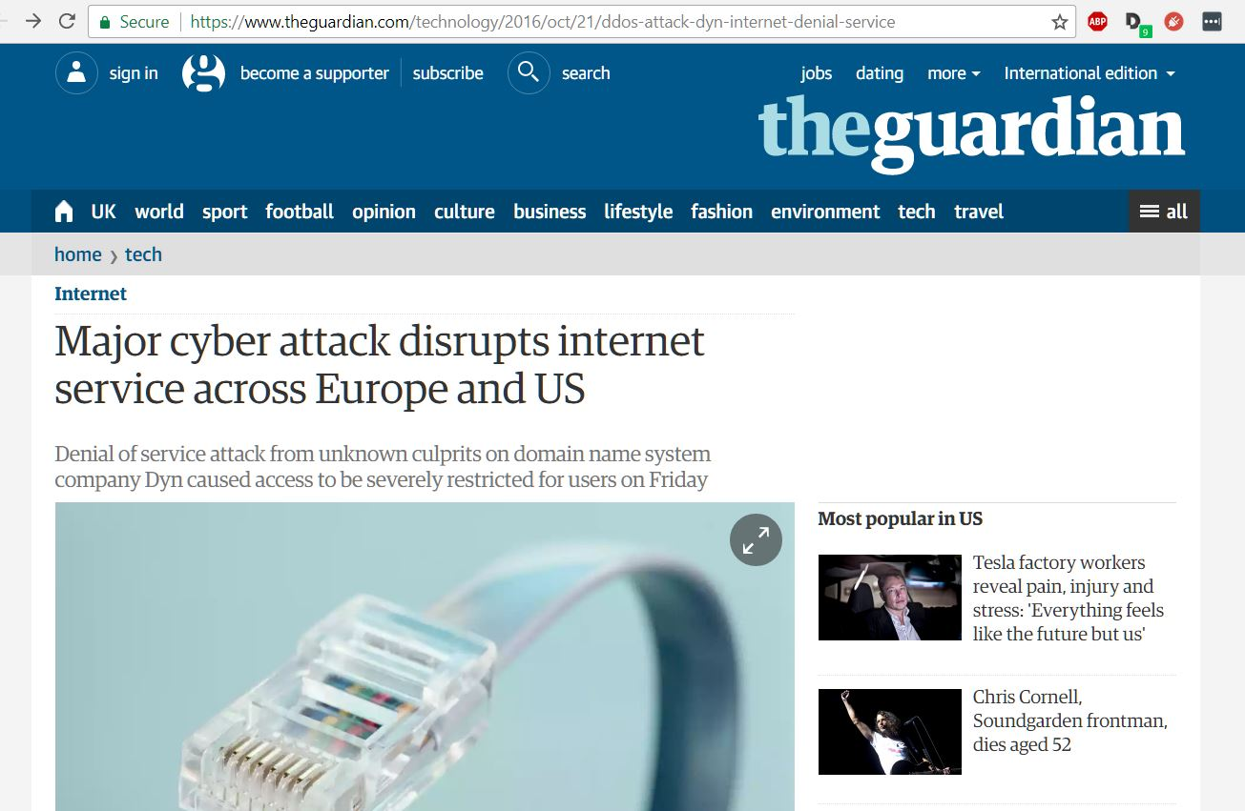
Friday 21 October 2016

Slide 19
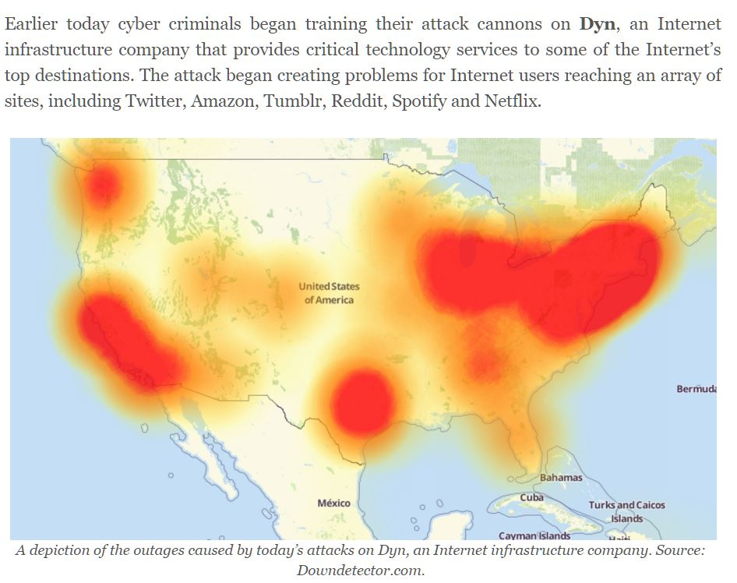
Mirai

Slide 20
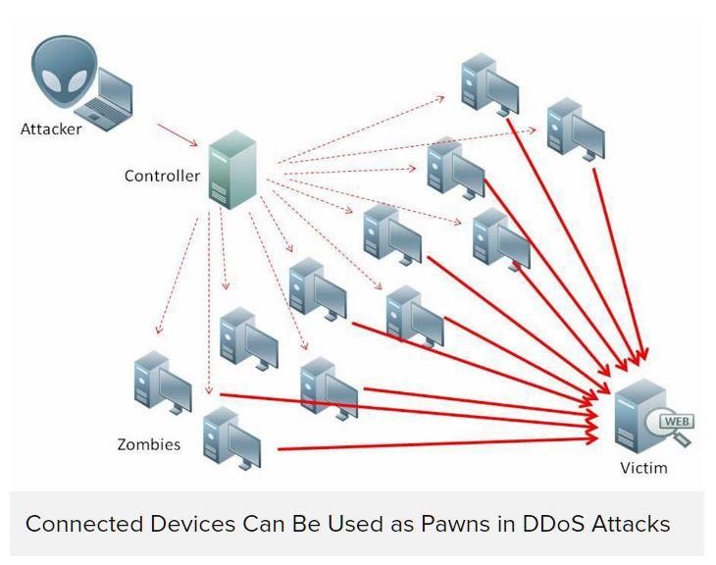

Slide 21
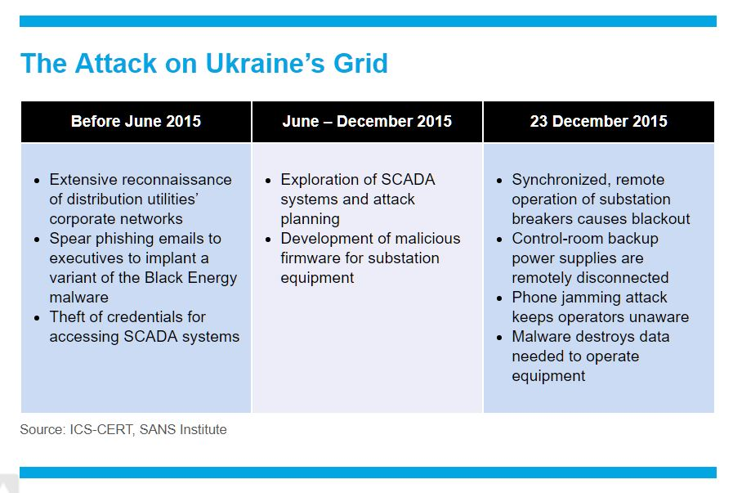
23 December 2015
Most affected were consumers of «Prykarpattyaoblenergo» (Ukrainian: Прикарпаттяобленерго; servicing Ivano-Frankivsk Oblast): 30 substations were switched off, about 230 thousands people were left without electricity for a period from 1 to 6 hours.

Slide 22

More Information
Search “Prabhas Chongstitvatana”
Get to my homepage

