Slide 1
What is the impact of AI in the society?
Now that AI programs can do many work that human do that required intelligence.
A lot of work that nowadays are performed by human will be done by these AI programs.
There is economic benefit in doing so.

Slide 2
This is similar to the change in the last decade that many human jobs are replaced computers.
For example, you don't need typist as speech recognition allow you to create text message using voice.

Slide 3
Many manual labor job in the factory will be replaced by robots.
A case of Chinese t-shirt factory.
Human drivers are not necessary and replaced by robot drivers (in driverless car).
Finance traders on the trading floor are being replaced by automated trading.
Department store becomes more self-serving and e-buying, using less and less store workers.

Slide 4
However, there are plenty of jobs that are for humans.
  Rearing your children
  Education
  Arts, music
  Sports
  Service for elderly people

Slide 5
As the shift of technology bring about the change in the way we work, we need to change the way we prepare our next generation.

Slide 6
AI in Society principle
Satya Nadella talked in June 2016, 6 principles
  1 AI must be designed to assist humanity.
  2 it must be transparent
  3 It must maximize efficiencies without destroying the dignity of people.
  4 It must be designed for intelligent privacy.
  5 It must have algorithmic accountability.
  6 It must guard against bias.
Human must be in control.

Slide 7
Human creates
Human consumes
So, our next generation must be ready for "creativity", "caring for people"

Slide 8
Future of AI
As computers become faster, cheaper, there will be more and more powerful AI program.
Software that provide services will be driven by AI in almost every aspect imaginable.

Slide 9
The strength of AI are in logic and memory.
This advantage will be even greater as technology progress.

Slide 10
Summary
The strength of human is compassion, creativity.
People will serve other people better.
Technology can divide rich/poor but also it can empower and democratise.

Slide 11
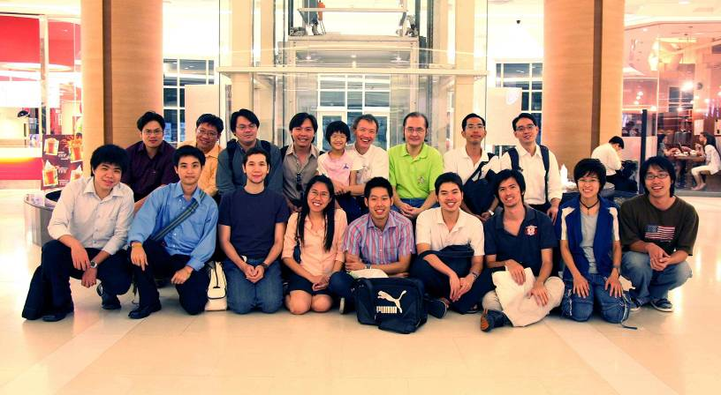
Team work

Slide 12
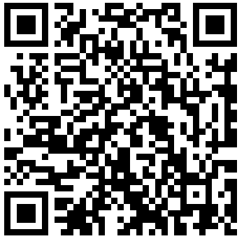
More Information
Search “Prabhas Chongstitvatana”
Go to me homepage

