Slide 1
Machine Learning
Prabhas Chongstitvatana
Chulalongkorn University

Slide 2
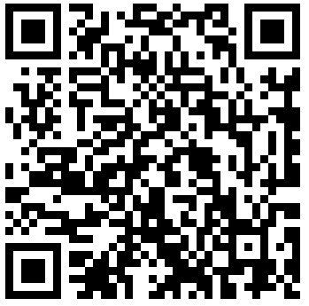
More Information
Search “Prabhas Chongstitvatana”
Get to my homepage

Slide 3
Machine Learning
Learning from data
Task : classification
Learn:
Association rule
Decision tree
Self improvement (reinforcement learning)

Slide 4
Artificial Neural Networks
Deep learning

Slide 6
Perceptron
Rosenblatt, 1950

Slide 7
Multi-layer perceptron
Michael Nielsen, 2016

Slide 8
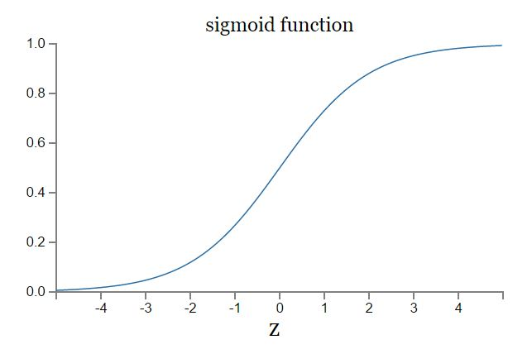
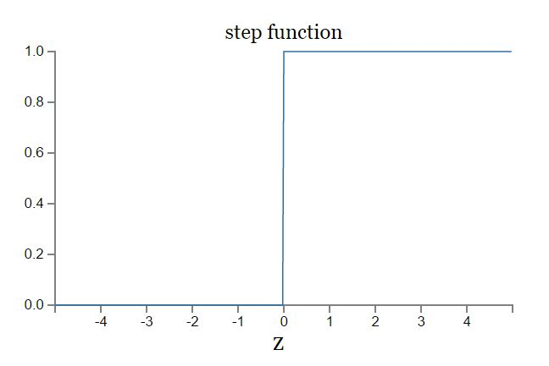
Sigmoid function

Slide 9
Artificial Neural Network 3-layer

Slide 11
Digit recognition NN
24x24 = 784
0.0 white 1.0 black

Slide 12
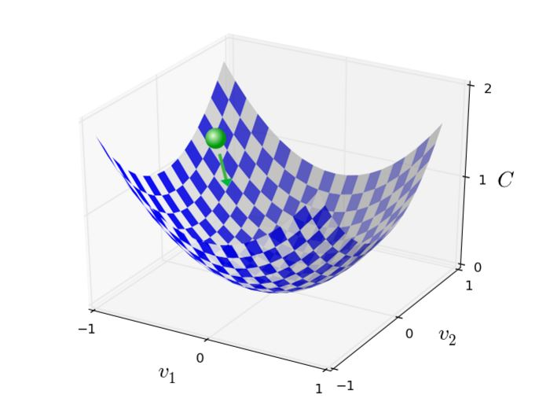
Training NN
Backpropagation is a fast way to compute this, 1986

Slide 13
Convolutional Neural Network
3 main types of layers
Convolutional layer
Pooling layer
Fully Connected layer

Slide 14
Convolutional Neural Network

Slide 15
CIFA-10 image dataset

Slide 16
Example of CNN layer

Slide 17
Parameters
ImageNet challenge in 2012
images 227x227x3
convolutional layer
receptive field F = 11, S = 4, with 96 filters
55x55x96 = 290,400 neurons
each neuron connects to 11x11x3 = 363+1 bias weights
total 290400*364 = 105,705,600 parameters

Slide 18
Human Pose Estimation

Slide 20
Automatic Speech Recognition
Notes:
Long Short Term Memory 2007, Recurrent NN,

Slide 21
Long Short Term Memory

Slide 23
AlphaGo vs Lee Seidol, March 2016
Notes:
may 2017 win against Ke Jie
presently 9 dan
<picture future-go-summit>
alpha go use Monte Carlo tree search
select, expand, simulate, backpropagate
<picture MCT>
learn previous games by Neural Network

Slide 24
Future of Go Summit 2017

Slide 25
Alpha Go
"Mastering the game of Go with deep neural networks and tree search". Nature. 529 (7587): 484–489.
Deep learning
Monte Carlo Tree search

Slide 26
Monte Carlo Tree Search

Slide 27
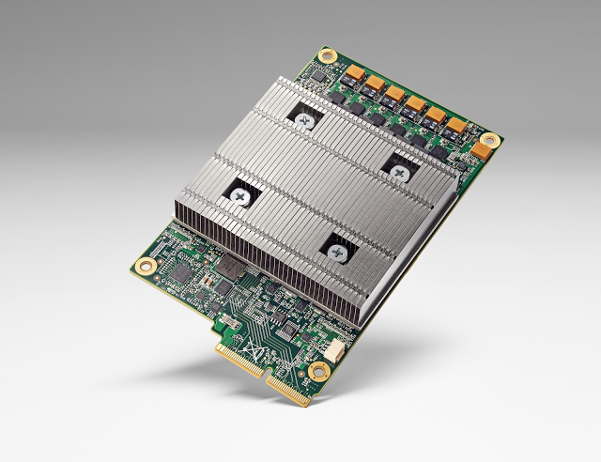
Computation power
The second generation TPU was announced in May 2017. The individual TPU ASICs are rated at 45 TFLOPS

Slide 30
Top500.org
cores TFlop/s Power kW
1 Sunway 10M 93K 15K
...
5 Sequoia 1M 15K 7.8K
..
10 Trinity 0.3M 8K 4K
...
500 Bull 0.01M 0.4K 0.2K

Slide 31
DriverLess car

Slide 32
State of the art
Learn everything
No user program
Self improvement

Slide 33
Team work 2010

Slide 34
Students 2019

Slide 35
More Information
Search “Prabhas Chongstitvatana”
Get to my homepage

