Slide 1


Quantum Circuits for Compact Genetic Algorithm
By Kamonluk Suksen, Naphan Benchasattabuse, and Prabhas Chongstitvatana

Slide 2




Outline
Problem Statement
Objectives
Compact Genetic Algorithm
Grover’s Search Algorithm
Problem : Travelling Salesman
Proposed Methodology
Experimental Results & Analysis
Conclusion

Slide 3
SECTION 1 Problem Statement
Moore's Law
Doubling the number of transistors on a chip every 2 to 3 years.
We are reaching a level beyond which we cannot go.
Once the number of atoms in a transistor drops below a certain level, the dopants will no longer be able to influence the electrons properly and we won't be able to build smaller transistors.
Quantum computing is one such technology to go "post-silicon“.

Slide 4
SECTION 1 Problem Statement
Background
Quantum computing proper began as a purely intellectual exercise in the 1980s, Richard Feynman, David Deutsch, Paul Benioff, and Charles Bennett striving to understand how the equations that govern our universe affect what can and cannot be computed efficiently.
Experimental physicists such as David Wineland, Serge Haroche, Alan Aspect, and others were pushing the boundaries of our ability to control and manipulate individual atoms.
1994, Peter Shor figured out how to factor efficiently on a quantum computer.
1996, Lov Grover found a quantum algorithm framework, that allows quantum computing to be applied to almost any problem such as search problems with polynomial speed up over the classic method.

Slide 5
SECTION 1 Problem Statement
Background
Genetic algorithms (GAs) are one of the most widely used type of evolutionary algorithms.
Compact genetic algorithm (cGA), stores the population as a probability distribution over a set of solutions.
There have been attempts to combine quantum computing and genetic algorithms in the hope that their quantum versions would provide speed up or new ideas to the classical algorithms.

Slide 6
SECTION 2 Objectives
Objectives
Use Grover’s algorithm to enhance the performance of cGA.
Grover-assisted compact genetic algorithm (cGA*) solves some real-world problems with quantum computer.

Slide 7
SECTION 3 Evolutionary Algorithms
Genetic Algorithm
Initial Population
Fitness Function
Selection
A1 | 0 | 0 | 0 | 0 | 0 | 0
A1 | 0 | 0 | 0 | 0 | 0 | 0 | 5
A1 | 0 | 0 | 0 | 0 | 0 | 0 | 5
A2 | 1 | 1 | 1 | 1 | 1 | 1
A2 | 1 | 1 | 1 | 1 | 1 | 1 | 6
A2 | 1 | 1 | 1 | 1 | 1 | 1 | 6
A3 | 1 | 0 | 1 | 1 | 0 | 0
A3 | 1 | 0 | 1 | 1 | 0 | 0 | 3
A4 | 0 | 1 | 1 | 0 | 1 | 0
A4 | 0 | 1 | 1 | 0 | 1 | 0 | 3
Mutation
Offspring
Crossover
A5 | 1 | 1 | 1 | 0 | 0 | 0 | before
A5 | 1 | 1 | 1 | 0 | 0 | 0
A1 | 0 | 0 | 0 | 0 | 0 | 0
A5 | 1 | 1 | 0 | 1 | 0 | 0 | after
A6 | 0 | 0 | 0 | 1 | 1 | 1
A2 | 1 | 1 | 1 | 1 | 1 | 1

Slide 8
SECTION 3 Compact Genetic Algorithm
Compact Genetic Algorithm
Initial Probability Vector
Generate Two Candidates
Fitness Function
 | 0.5 | 0.5 | 0.5 | 0.5 | 0.5 | 0.5
A | 1 | 0 | 0 | 1 | 0 | 0
A | 1 | 0 | 0 | 1 | 0 | 0 | 2
B | 0 | 0 | 1 | 1 | 1 | 0
B | 0 | 0 | 1 | 1 | 1 | 0 | 3
Update Probability Vector
 | 0.4 | 0.5 | 0.6 | 0.5 | 0.6 | 0.5

Slide 9
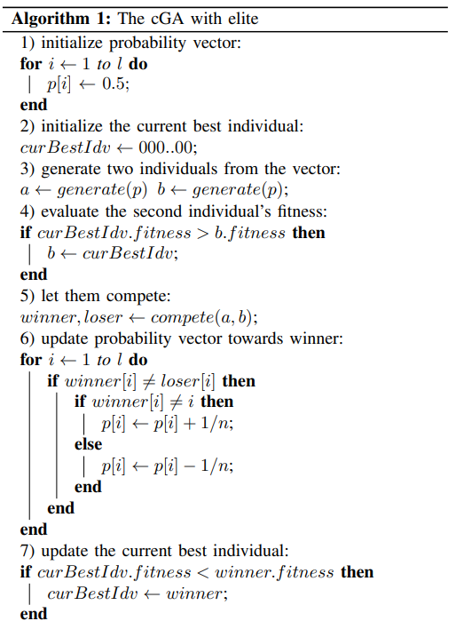
SECTION 3 Evolutionary Algorithms
Compact Genetic Algorithm
with Elite

Slide 10
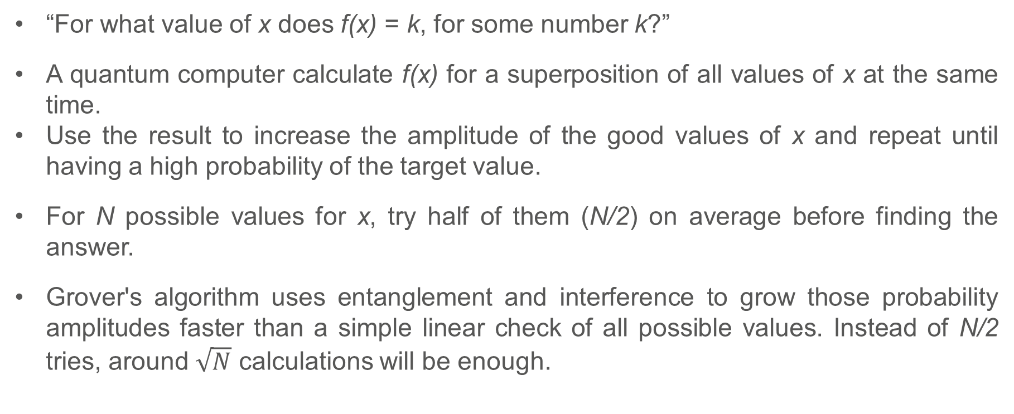
SECTION 4 Grover’s Search Algorithm
Grover’s Search Algorithm
“For what value of x does f(x) = k, for some number k?”
A quantum computer calculate f(x) for a superposition of all values of x at the same time.
Use the result to increase the amplitude of the good values of x and repeat until having a high probability of the target value.
For N possible values for x, try half of them (N/2) on average before finding the answer.
Grover's algorithm uses entanglement and interference to grow those probability amplitudes faster than a simple linear check of all possible values. Instead of N/2 tries, around $\sqrt{N}$ calculations will be enough.

Slide 11
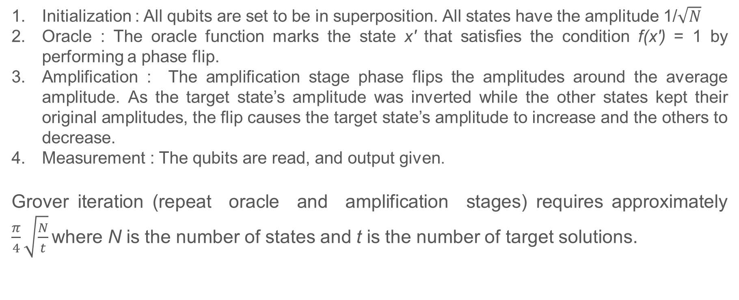
SECTION 4 Grover’s Search Algorithm
The Stages of Grover’s Search Algorithm
Initialization : All qubits are set to be in superposition. All states have the amplitude 1/$\sqrt{N}$
Oracle : The oracle function marks the state x′ that satisfies the condition f(x′) = 1 by performing a phase flip.
Amplification : The amplification stage phase flips the amplitudes around the average amplitude. As the target state’s amplitude was inverted while the other states kept their original amplitudes, the flip causes the target state’s amplitude to increase and the others to decrease.
Measurement : The qubits are read, and output given.
Grover iteration (repeat oracle and amplification stages) requires approximately $\frac{π}{4}\sqrt{\frac{N}{t}}$ where N is the number of states and t is the number of target solutions.

Slide 12
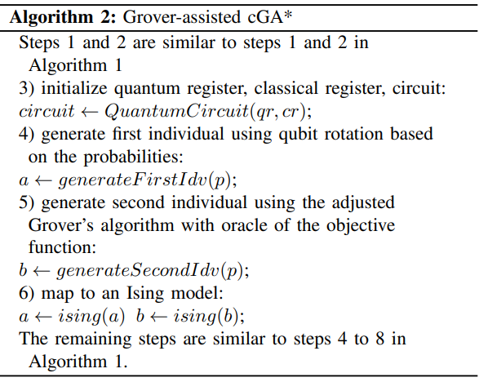



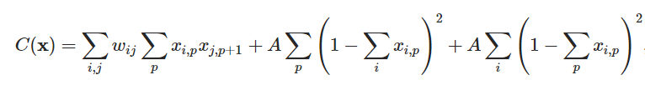
SECTION 5 Proposed Method
Grover-assisted Compact Genetic Algorithm
An arbitrary single-qubit state is defined:
The qubit rotation for angle(θ) is defined:
Mapping to Ising model for TSP:
System energy for TSP:
Total distance
The constraints to check a feasible path

Slide 13
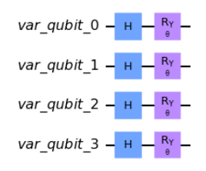
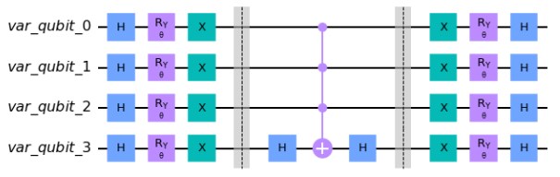
SECTION 5 Proposed Method
Grover-assisted Compact Genetic Algorithm
An arbitrary single-qubit state is defined:
The qubit rotation for angle(θ) is defined:
A circuit to initial the state based on the probability which encoding problem with 4 qubits.
A diffuser circuit which encoding problem with 4 qubits.

Slide 14

SECTION 6 Testing Problem
Travelling Salesman Problem
The objective function is to find a shortest route that a salesman visits every city exactly once and returns to the starting point.
Defining an oracle to recognize all feasible solutions.
TSP is mapped to an Ising model with scales ${(N−1)}^{2}$ spins are required, where N is the number of cities, designate city 1 to appear first in the route.
 | 1 | 2 | 3
1 | 1 | 0 | 0
2 | 0 | 1 | 0
3 | 0 | 0 | 1
Matrix represents the route 1→ 2 → 3 → 4 → 1

Slide 15
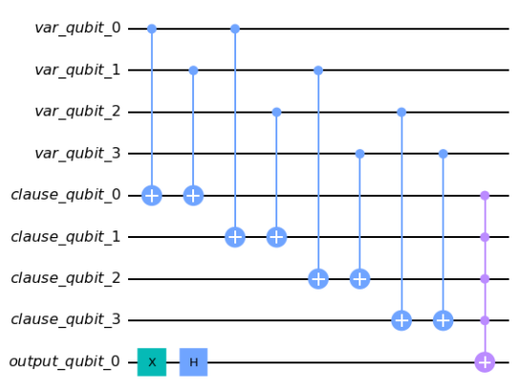
SECTION 6 Testing Problem
Travelling Salesman Problem
The oracle to check a feasible solution on the quantum state:
An example of oracle circuit for TSP 3-city

Slide 16
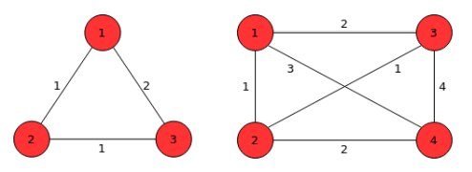

SECTION 6 Testing Problem
Travelling Salesman Problem
Demonstrate small size TSP (limit by the number of qubits supported by the simulator)
Minimize the number of required bits to address the problem on the classical cGA by adapting the path representation model which represents a feasible tour as possible permutations of the N cities.
Total number of feasible edges is a set of l-bit binary string.
TSP 3-city and 4-city.

Slide 17
SECTION 7 Experimental Results & Analysis
Experimental Setup
Classic cGA and Grover-assisted cGA* were compared in terms of solution quality and number of function evaluations
Population size 4–50 for TSP 3-city and population size 4–100 for TSP 4-city with increments of 2.
Grover iterations for TSP 3-city is approximately 2 iterations at maximum and 7 Grover iterations at maximum for TSP 4-city.
The data were averaged over 25 runs and used tournament selection with s = 2.
All runs ended when the vector fully converges.

Slide 18
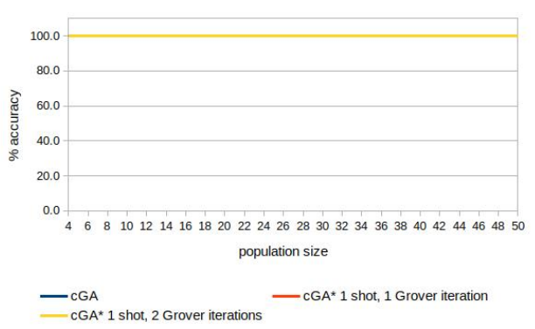
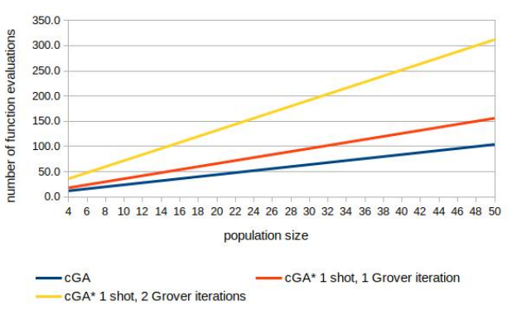
SECTION 7 Experimental Results & Analysis
Experimental Results
Comparison of the solution quality (number of correct bits in percentage at the end of the run) achieved by the classical cGA and the cGA* on TSP 3-city.
Comparison of the classical cGA and the cGA* in the number of function evaluations needed to achieve convergence on TSP 3-city.

Slide 19
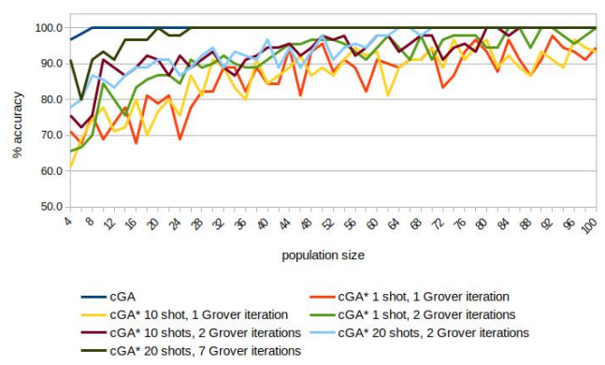
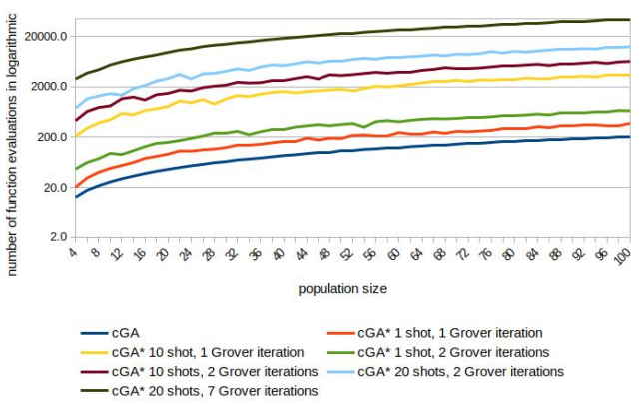
SECTION 7 Experimental Results & Analysis
Experimental Results
Comparison of the solution quality (number of correct bits in percentage at the end of the run) achieved by the classical cGA and the cGA* on TSP 4-city.
Comparison of the classical cGA and the cGA* in the number of function evaluations needed to achieve convergence on TSP 4-city.

Slide 20
SECTION 7 Experimental Results & Analysis
Experimental Results
Classical cGA
Grover-assisted (cGA*)
 | 1 | 2 | 3
1 | 1 | 0 | 0
2 | 0 | 1 | 0
3 | 0 | 0 | 1
1 → 2 | 1 → 3 | 1 → 4 | 2 → 3 | 2 → 4 | 3 → 4
1 | 0 | 1 | 1 | 0 | 1
Set of l-bit binary string represents the route
1→ 2 → 3 → 4 → 1
Matrix represents the route 1→ 2 → 3 → 4 → 1
TSP 4-city requires 6 qubits to encode the problem
on a classical computer. Search space is 64 solutions.
TSP 4-city requires 9 qubits to encode the problem
into a quantum state. Search space is 512 solutions.

Slide 21
SECTION 8 Conclusion
Conclusion
Study TSP using different encoding schemes between the classical cGA and the Grover-assisted cGA* to minimize the number of bits and qubits necessary.
Result: Grover-assisted cGA* achieve 100% accuracy of the solution quality with a higher number of function evaluations than the cGA on small problem size.
For larger size, Grover’s algorithm could play a key role in achieving benefits over a classical computer, which would necessitate
Future work: Binary encoding strategy and the quantum resources required in quantum hardware.

Slide 22
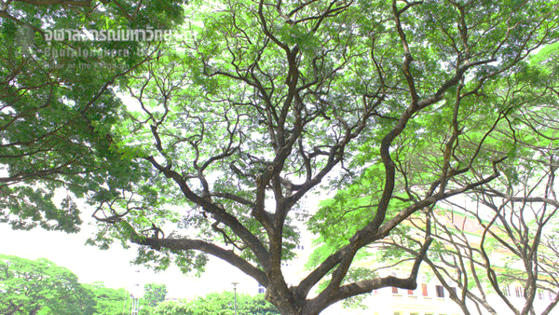
Q & A

Slide 23
SECTION 1 Problem Statement
Related Works
Quantum-inspired genetic algorithms are one of the attempt where the algorithms are still executed purely in the classical computers but took some of the ideas of quantum phenomena and translate them into classical analogue.
Quantum-assisted genetic algorithms are to delegate some tasks of the algorithm like mutation operator or probabilistic elements to quantum computers while still performing crossover and population update on the classical side.
Quantum-assisted compact genetic algorithm represents the population as a a probability distribution in a quantum register. The quantum variable is then updated toward the winner via qubit rotation
Redefining the GA in the context of quantum computation by creating a population with superposition of all states, measuring the fitness to reduce the dimension of the space, applying crossover while parts of the population are still entangled, and re-expanding the space into a superposition of larger dimension.

