Slide 1

Future Technology
Prabhas Chongstitvatana
Faculty of Engineering
Chulalongkorn University

Slide 2
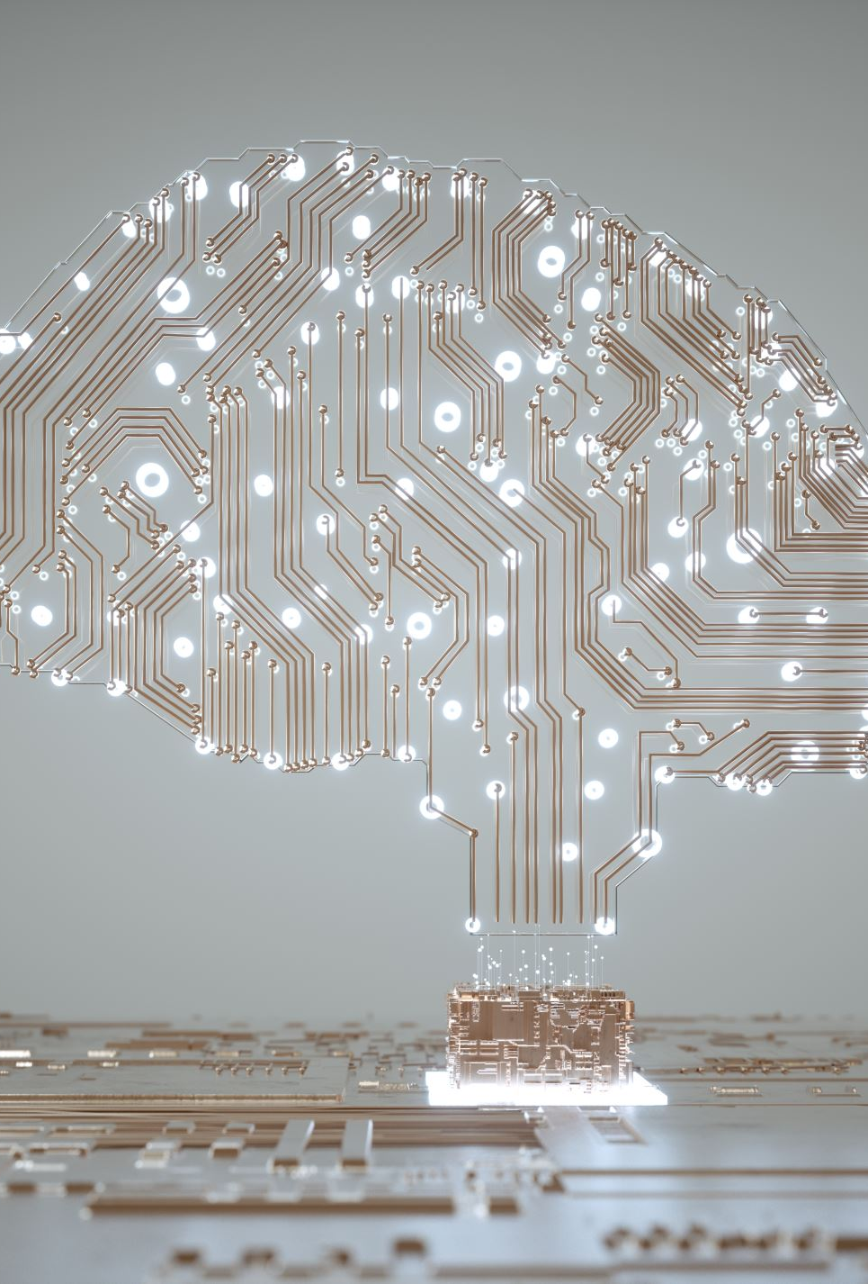
Outline
Artificial Intelligence
Robotics
Quantum Computer
Space industry

Slide 3

More Information
Search “Prabhas Chongstitvatana”
Go to me homepage

Slide 4
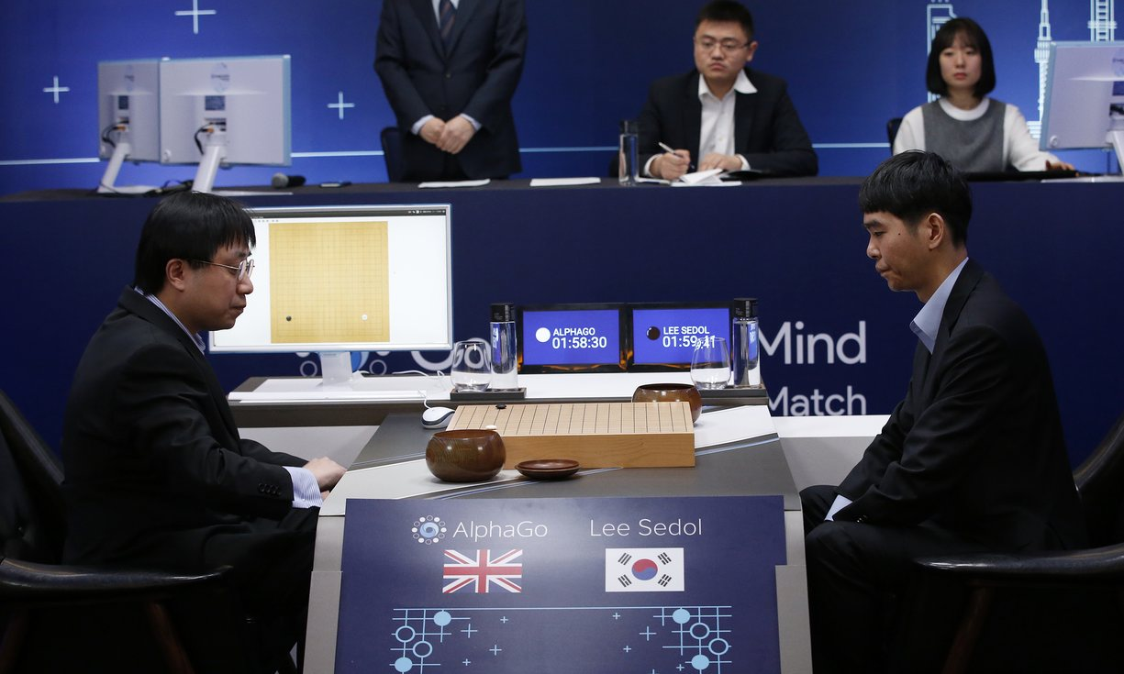
AlphaGo vs Lee Seidol, March 2016

Slide 5
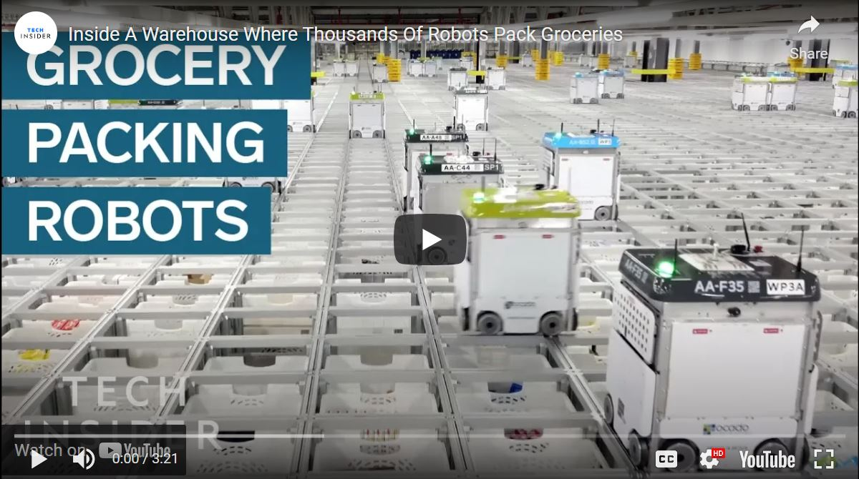
Grocery packing robots
https://www.youtube.com/watch?v=4DKrcpa8Z_E

Slide 6
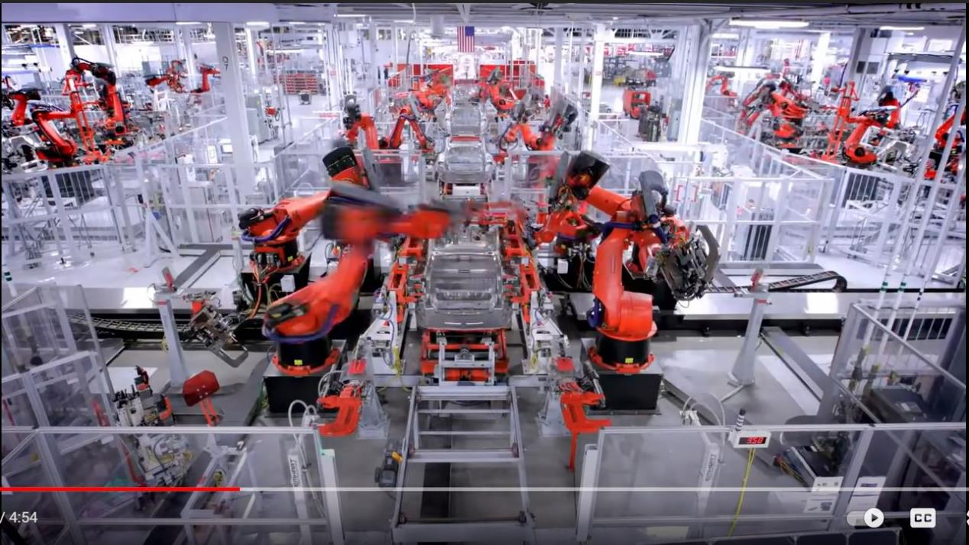
How Tesla car is built
https://www.youtube.com/watch?v=8_lfxPI5ObM

Slide 7
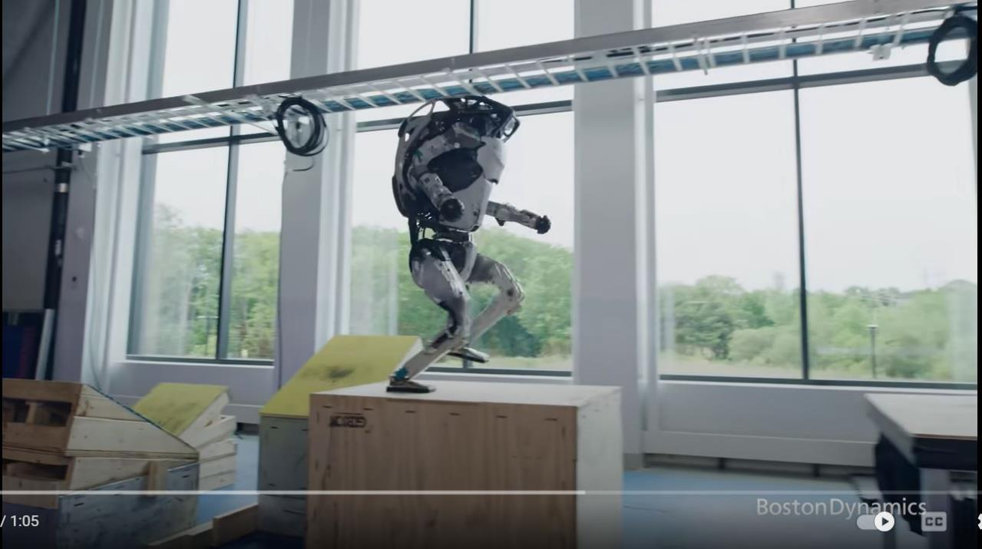
Boston Dynamics humanoid robots
https://www.youtube.com/watch?v=tF4DML7FIWk

Slide 8
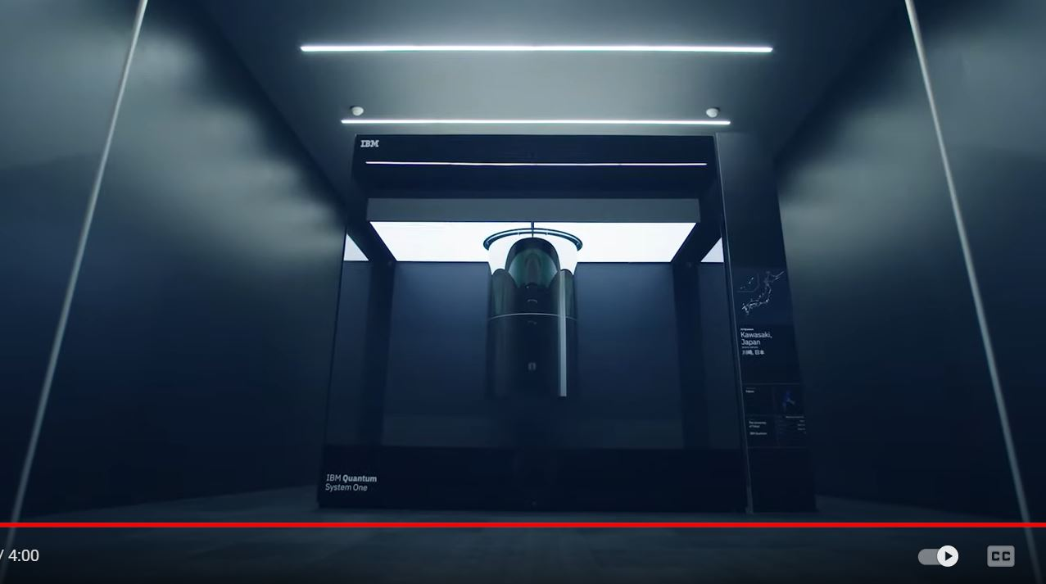
IBM quantum computer system one
https://www.youtube.com/watch?v=tPMY4oP3Qgk

Slide 9
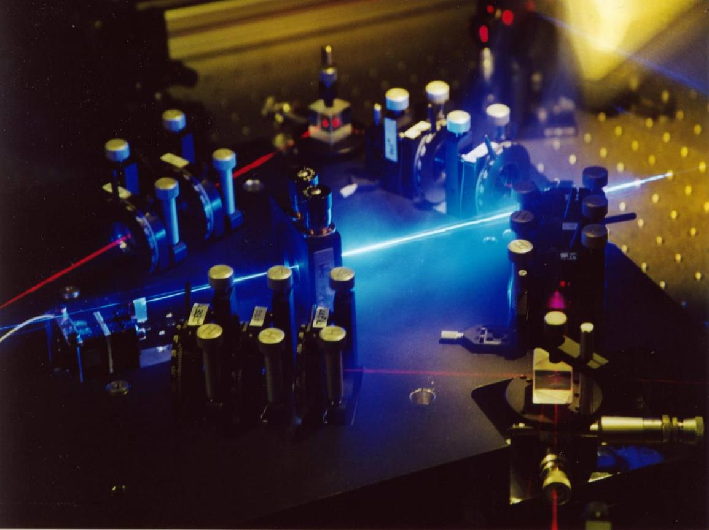
Linear optics quantum computing (LOQC)
Experimental setup to generate up to four entangled photons. These photons are typically entangled in polarization and can be further manipulated by simple optical devices. Recently a four-photon cluster state was realized with this setup. http://homepage.univie.ac.at/robert.prevedel/test_research_LOQC.html

Slide 10
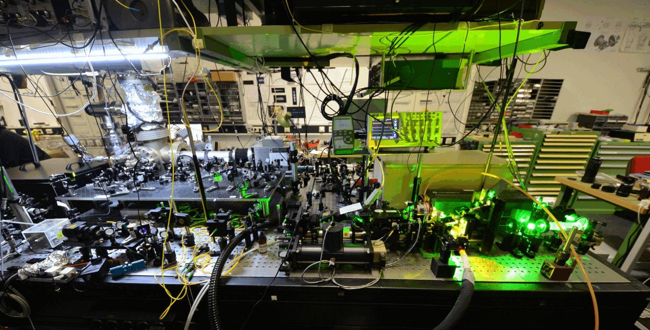

Slide 11
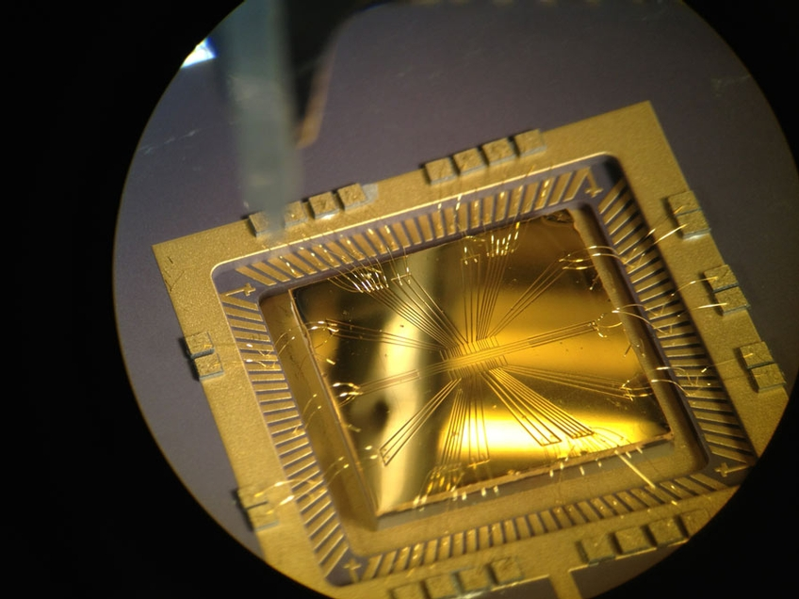

Slide 12
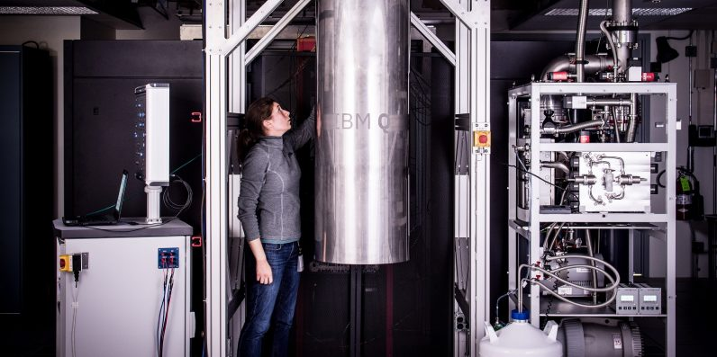
IBM 50 qubits quantum computer

Slide 13
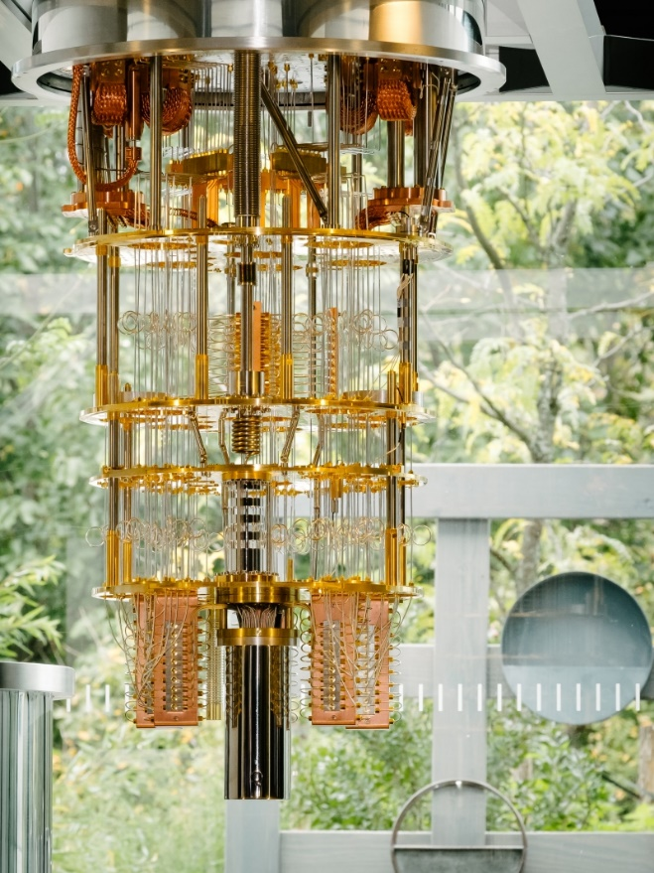

Slide 14
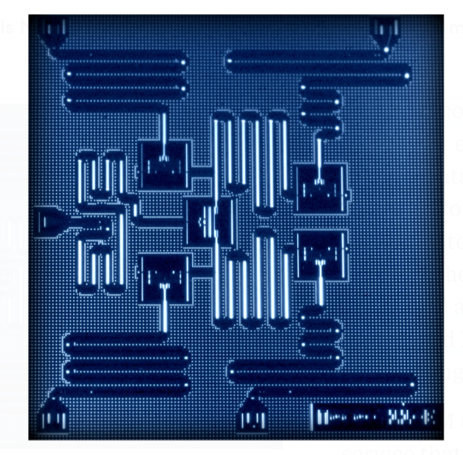
IBM 5 qubits processor

Slide 15
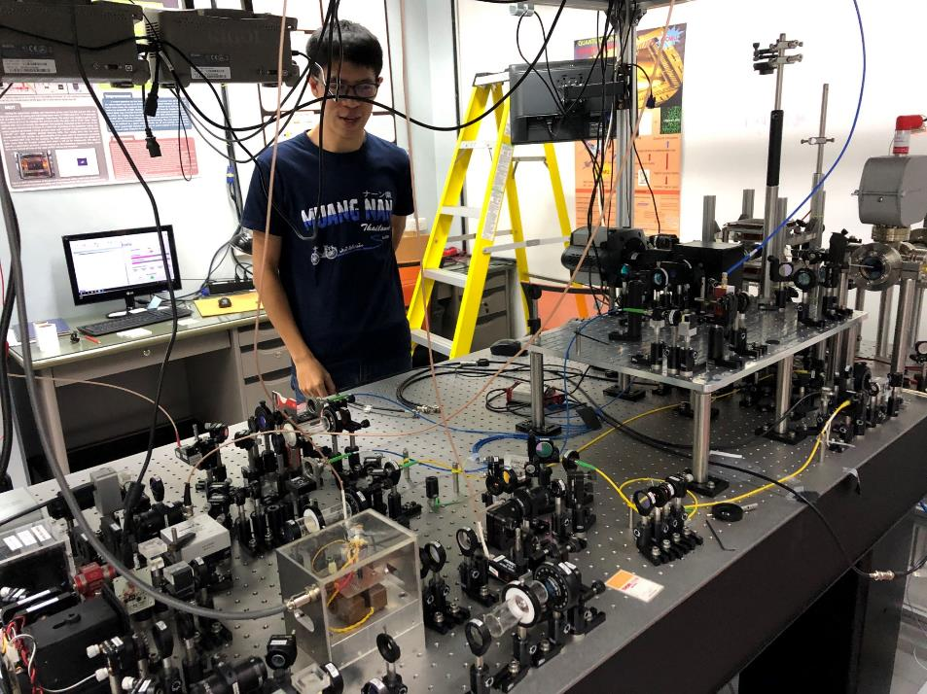
Capturing an atom at Chiengmai university

Slide 16
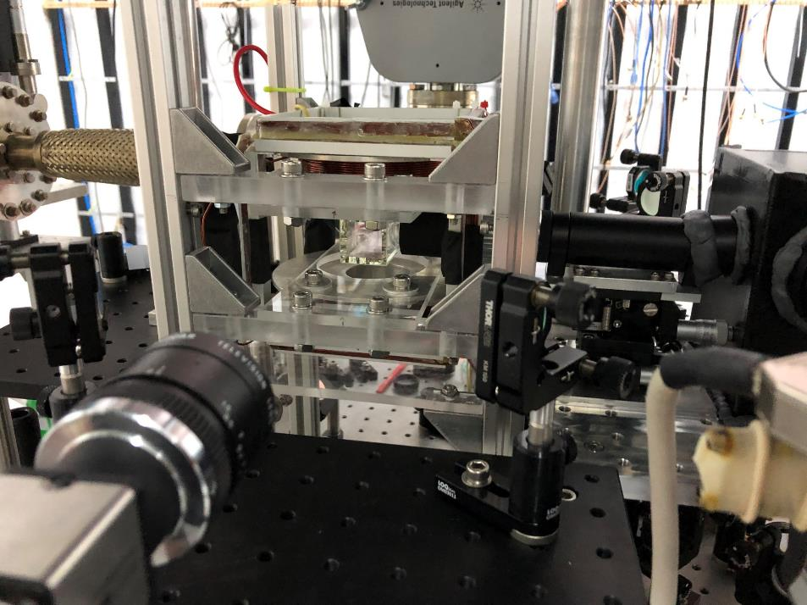

Slide 17
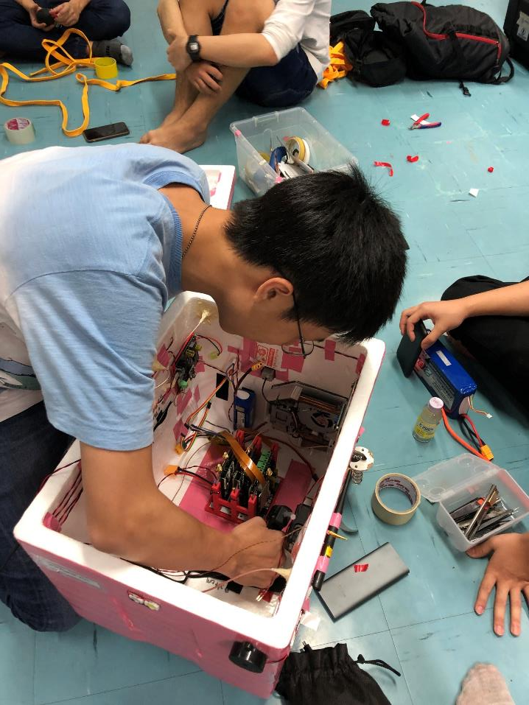

Slide 18
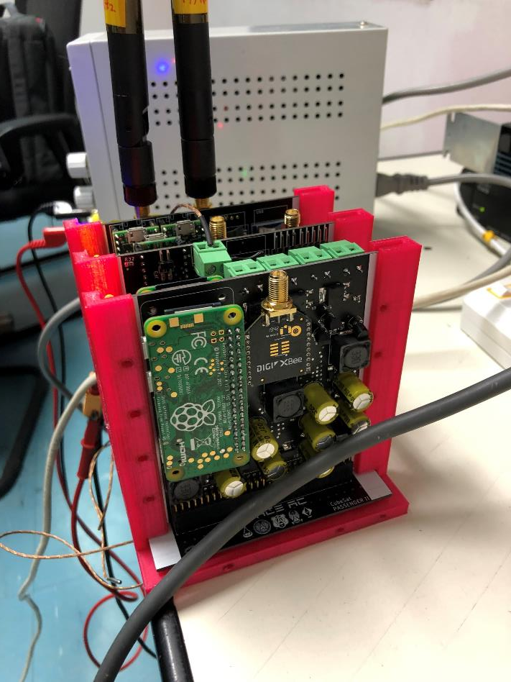

Slide 19
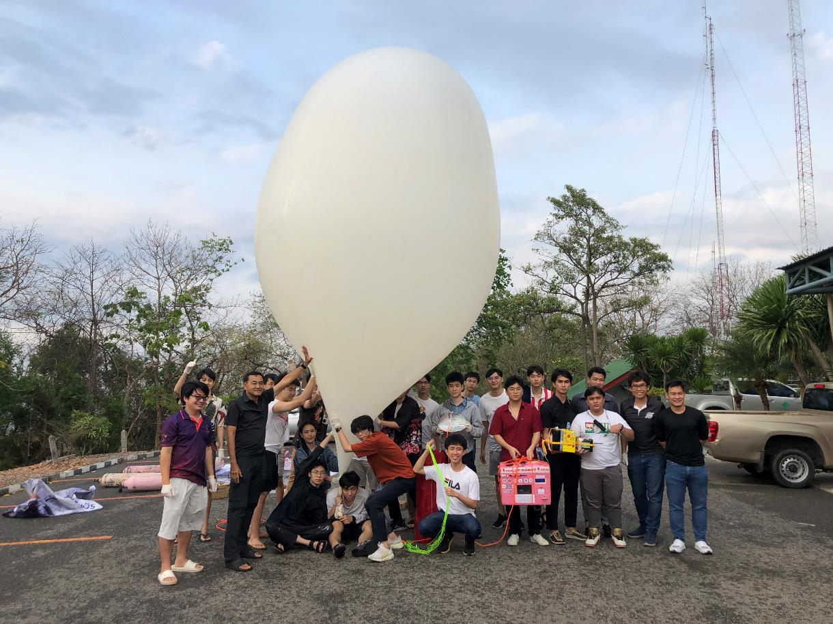

Slide 20
Small rocket take off

Slide 21
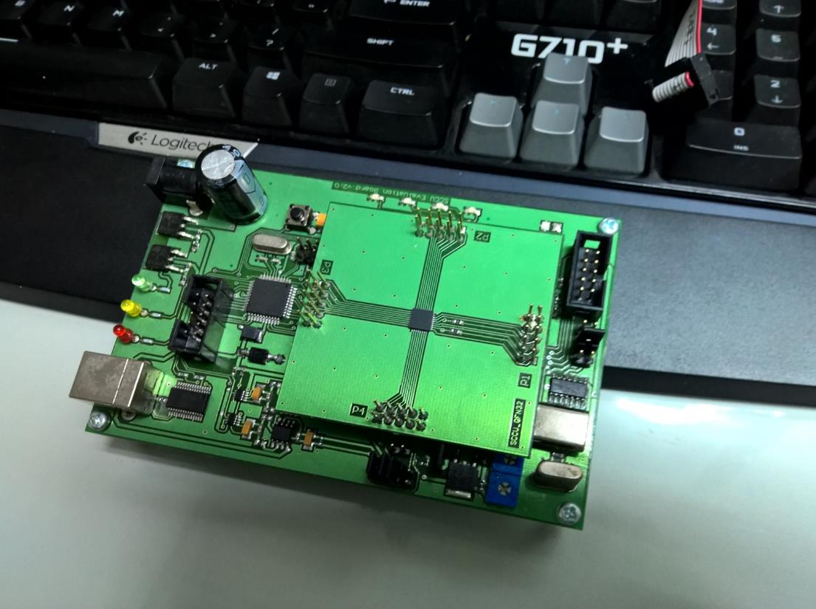
Low power small processor (all Thais)

Slide 22
Alpha Go
"Mastering the game of Go with deep neural networks and tree search". Nature. 529 (7587): 484–489.
Deep learning
Monte Carlo Tree search

Slide 23
References
Yingchareonthawornchai, S., Aporntewan, C., and Chongstitvatana, P., "An Implementation of Compact Genetic Algorithm on a Quantum Computer," Int. Joint Conf. on Computer Science and Software Engineering (JCSSE), 30 May - 1 June 2012, pp.131-135.
http://www.cp.eng.chula.ac.th/~piak/paper/2012/jcsse-quantum-cga.pdf
Suksen, K. and Chongstitvatana, P., "Experiments on Quantum Circuits for Compact Genetic Algorithm," Int. Computer Science and Engineering Conference, 18-20 Nov, 2021, Thailand.
McKinsey & Company, Quantum computing: an emerging ecosystem and industry use cases, December 2021

Slide 24
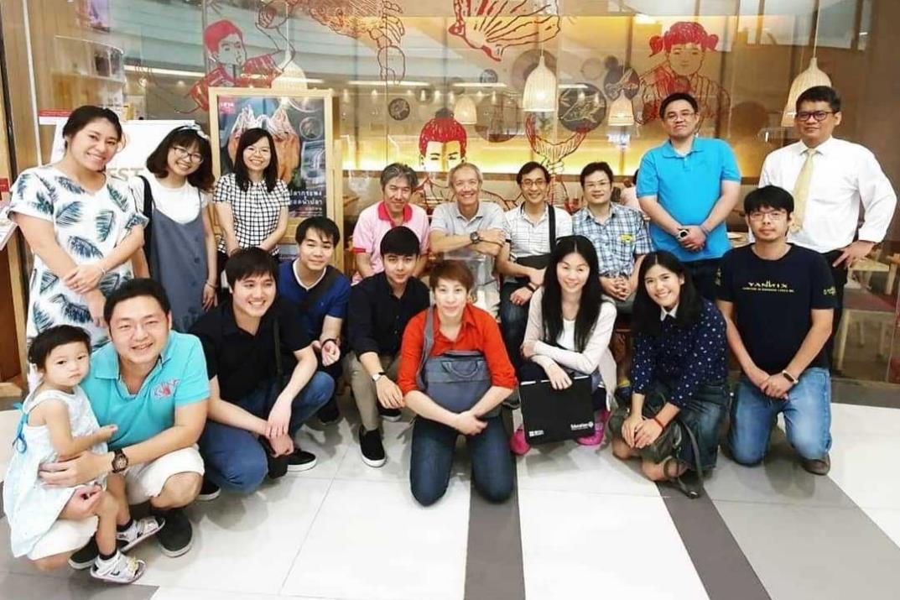
Contributors (student team 2019)

Slide 25
More Information
Search “Prabhas Chongstitvatana”
Go to me homepage

