Slide 1


Quantum Computing and Artificial Intelligence
By Kamonluk Suksen, Naphan Benchasattabuse, and Prabhas Chongstitvatana

Slide 2
Story line
Quantum computing promises huge increase in computing power
Many algorithms related to AI can be done in Quantum computer
Quantum optimization promises near term benefit
Evolution algorithms are subfield of AI
Quantum version of Compact Genetic Algorithm (QcGA)
Use QcGA to solve Travelling Salesman Problem

Slide 3
What is a quantum computer?
a computer that relies on special memory, "quantum bit", to perform massively parallel computing.

Slide 4
How to “program” a quantum computer

Slide 5
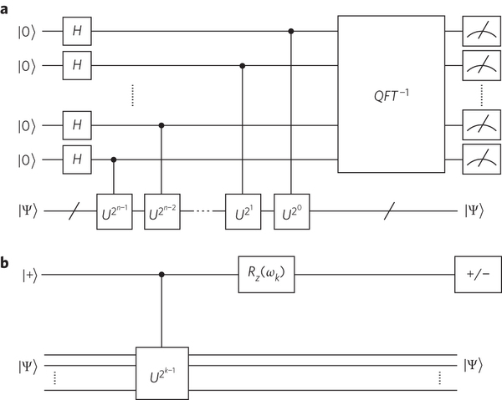
Quantum circuits

Slide 6
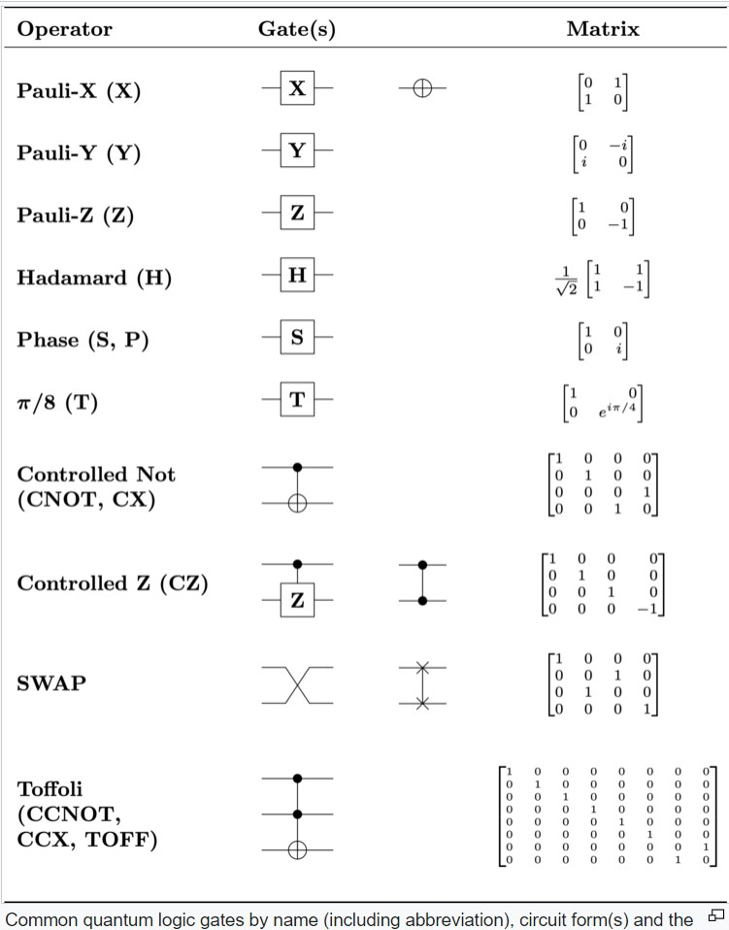
Quantum Gates

Slide 7
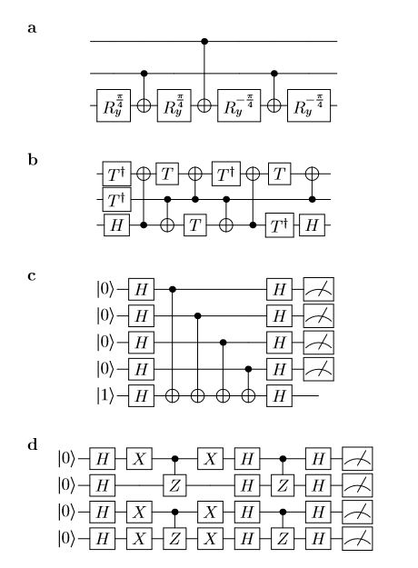

Slide 8
Quantum algorithms
computer programs that work on quantum computers

Slide 9
Quantum Optimization
Solving optimization problems with quantum computers

Slide 10
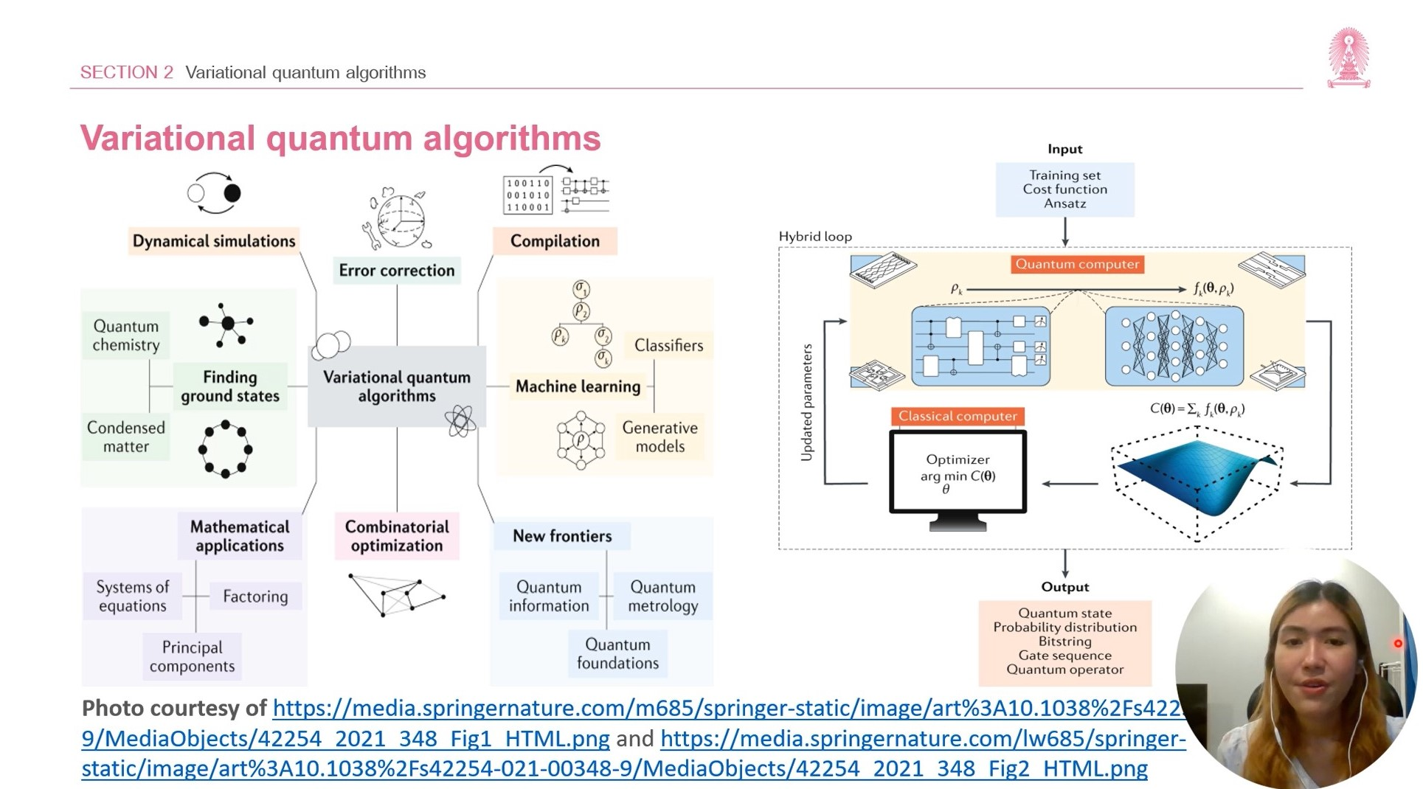

Slide 11
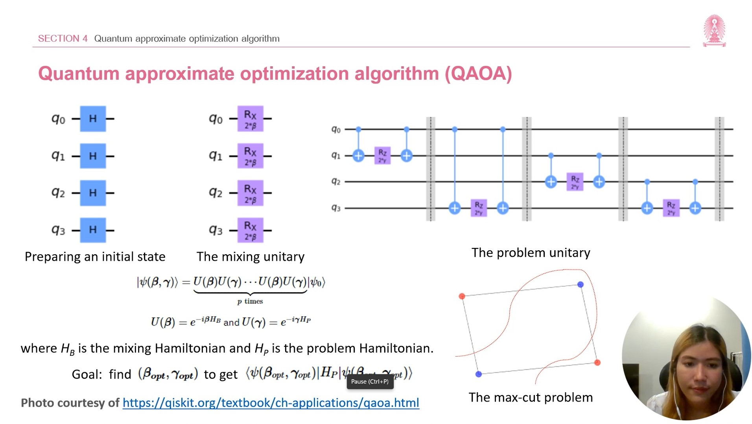

Slide 12
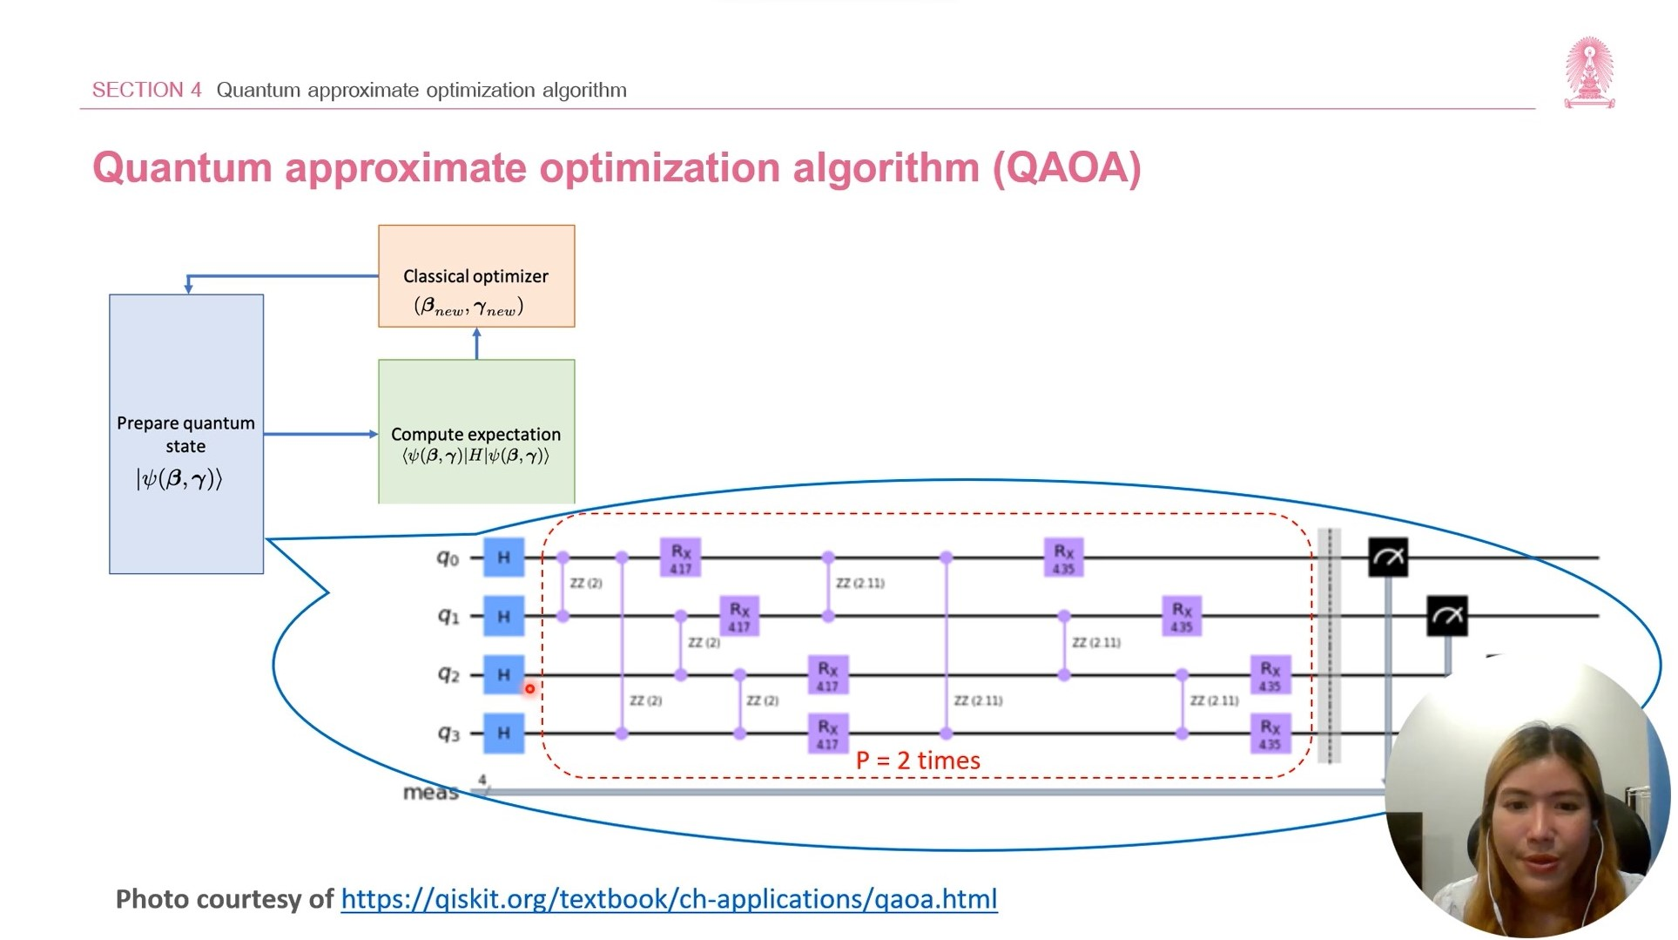

Slide 13
My own example of quantum computation
compact genetic algorithm by quantum computers
exponential speedup

Slide 14
Background
One approach to tackle the optimization problem is to use evolutionary algorithms.
Genetic algorithms (GAs) are one of the most widely used type of evolutionary algorithms.
Compact genetic algorithm (cGA) represents the population as a probability distribution over a set of solutions.

Slide 15
Genetic Algorithm
Initial Population
Fitness Function
Selection
A1 | 0 | 0 | 0 | 0 | 0 | 0
A1 | 0 | 0 | 0 | 0 | 0 | 0 | 5
A1 | 0 | 0 | 0 | 0 | 0 | 0 | 5
A2 | 1 | 1 | 1 | 1 | 1 | 1
A2 | 1 | 1 | 1 | 1 | 1 | 1 | 6
A2 | 1 | 1 | 1 | 1 | 1 | 1 | 6
A3 | 1 | 0 | 1 | 1 | 0 | 0
A3 | 1 | 0 | 1 | 1 | 0 | 0 | 3
A4 | 0 | 1 | 1 | 0 | 1 | 0
A4 | 0 | 1 | 1 | 0 | 1 | 0 | 3
Mutation
Offspring
Crossover
A5 | 1 | 1 | 1 | 0 | 0 | 0 | before
A5 | 1 | 1 | 1 | 0 | 0 | 0
A1 | 0 | 0 | 0 | 0 | 0 | 0
A5 | 1 | 1 | 0 | 1 | 0 | 0 | after
A6 | 0 | 0 | 0 | 1 | 1 | 1
A2 | 1 | 1 | 1 | 1 | 1 | 1

Slide 16
Compact Genetic Algorithm
Initial Probability Vector
Generate Two Candidates
Fitness Function
 | 0.5 | 0.5 | 0.5 | 0.5 | 0.5 | 0.5
A | 1 | 0 | 0 | 1 | 0 | 0
A | 1 | 0 | 0 | 1 | 0 | 0 | 2
B | 0 | 0 | 1 | 1 | 1 | 0
B | 0 | 0 | 1 | 1 | 1 | 0 | 3
Update Probability Vector
 | 0.4 | 0.5 | 0.6 | 0.5 | 0.6 | 0.5

Slide 17
Normal
1) initialze qureg x
2) generate two individuals from qureg
3) let them compete
4) update qureg x with the winner
5) repeat step for k times
6) generate the final result

Slide 18
quantum speedup
1) initialze qureg x
2) generate the first individual from qureg x
3) generate the second individual with condition that fitness is greater than the first
4) let them compete
5) update qureg x with the winner
6) repeat step for k times
7) generate the final result

Slide 19
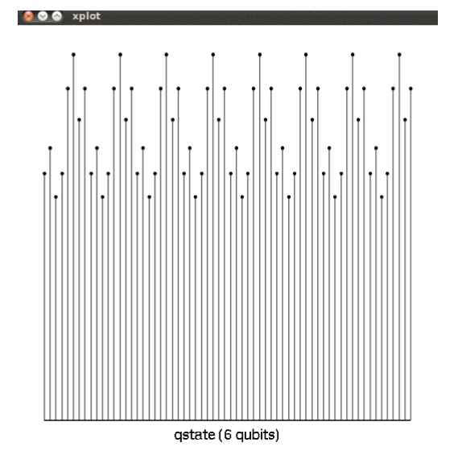
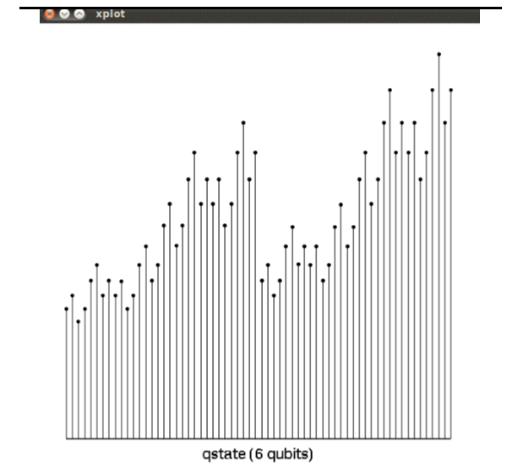
output

Slide 20
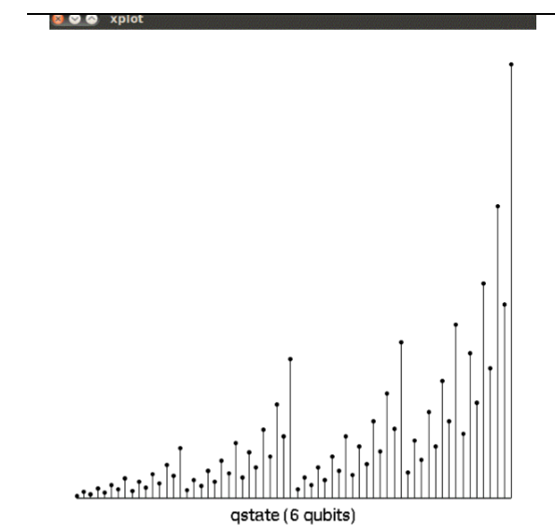
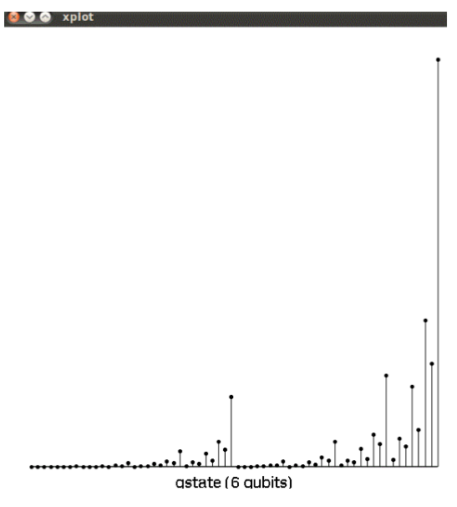
output

Slide 21
Quantum Compact Genetic Algorithm to Solve TSP

Slide 22
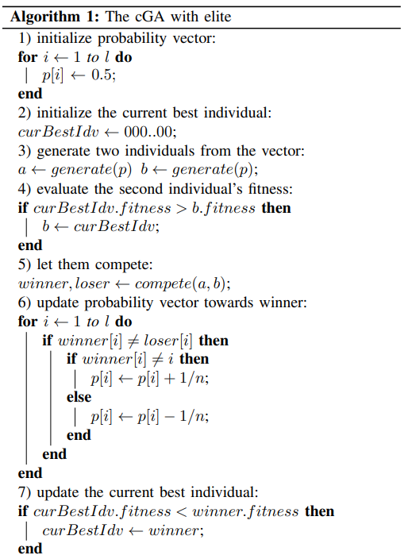
Compact Genetic Algorithm
with Elite

Slide 23
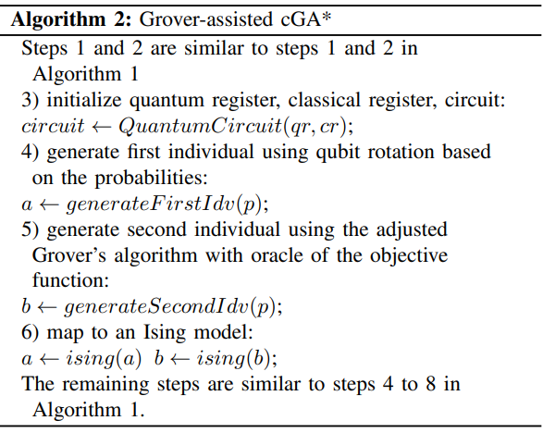
Grover-assisted Compact Genetic Algorithm (cGA*)

Slide 24
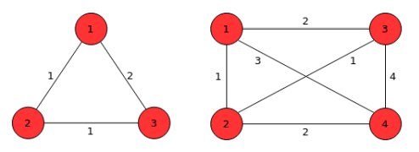

Travelling Salesman Problem
We only demonstrate small size TSP because the limitation of the number of qubits.
We use the path representation model which represents a feasible tour as possible permutations of the N cities.
A total number of feasible edges is a set of l-bit binary string.
TSP 3-city and 4-city.

Slide 25

Travelling Salesman Problem
Find a shortest route that a salesman visits every city exactly once and returns to the starting point.
In our oracle, we define an oracle to recognize all feasible solutions.
TSP is mapped to an Ising model with scales ${(N−1)}^{2}$ spins are required, where N is the number of cities, and we designate city 1 to appear first in the route.
 | 1 | 2 | 3
1 | 1 | 0 | 0
2 | 0 | 1 | 0
3 | 0 | 0 | 1
Matrix represents the route 1→ 2 → 3 → 4 → 1

Slide 26
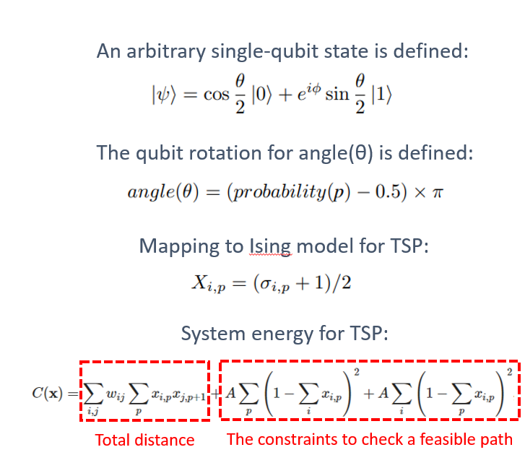
Quantum cGA* for TSP

Slide 27


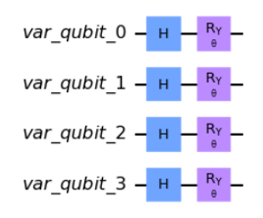
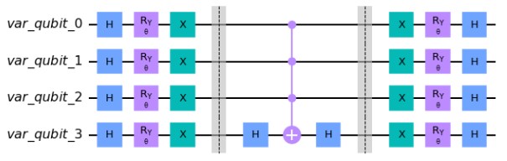
Grover-assisted Compact Genetic Algorithm (cGA*)
An arbitrary single-qubit state is defined:
The qubit rotation for angle(θ) is defined:
A circuit to initial the state based on the probability which encoding problem with 4 qubits.
A diffuser circuit which encoding problem with 4 qubits.

Slide 28
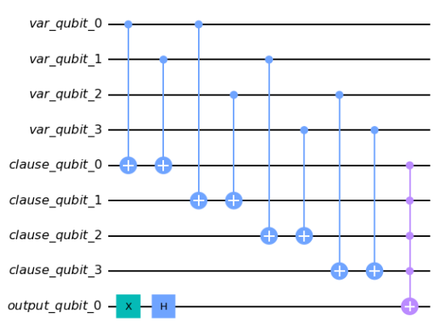
Travelling Salesman Problem
The oracle to check a feasible solution on the quantum state:
An example of oracle circuit for TSP 3-city

Slide 29
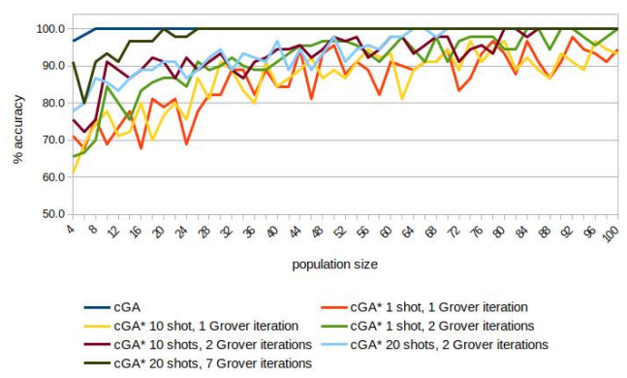
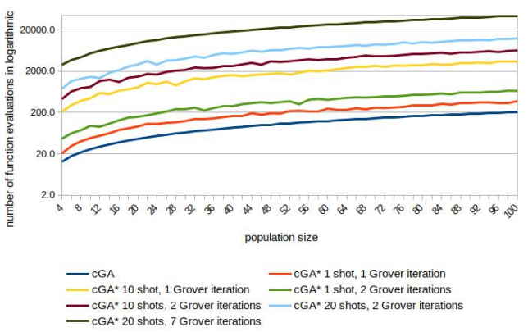
SECTION 7 Experimental Results & Analysis
Experimental Results
Comparison of the solution quality (number of correct bits in percentage at the end of the run) achieved by the classical cGA and the cGA* on TSP 4-city.
Comparison of the classical cGA and the cGA* in the number of function evaluations needed to achieve convergence on TSP 4-city.

Slide 30
Looking into the future
Studying quantum computer give rise to new ideas
Quantum “thinking” promises a new kind of method to solve really difficult problems
We have high confidence that building quantum computer will bear practical results
We do know that it will change the face of computing forever

Slide 31
References
Yingchareonthawornchai, S., Aporntewan, C., and Chongstitvatana, P., "An Implementation of Compact Genetic Algorithm on a Quantum Computer," Int. Joint Conf. on Computer Science and Software Engineering (JCSSE), 30 May - 1 June 2012, pp.131-135.
http://www.cp.eng.chula.ac.th/~prabhas//paper/2012/jcsse-quantum-cga.pdf
Suksen, K., Benchasattabuse, N., Chongstitvatana, P., "Compact Genetic Algorithm with Quantum-Assisted Feasibility Enforcement," ECTI Trans. on Computer and Information Technology, Vol.16, No.4, December 2022, pp.422-435.
https://www.cp.eng.chula.ac.th/~prabhas//paper/2022/compact_genetic_algorithm_with_quantum_assisted_feasibility_enforcement.pdf

Slide 32

More Information
Search “Prabhas Chongstitvatana”
Go to me homepage

Slide 33

Q & A

