Slide 1
Generative Adversarial Networks and Large Language Models
Lecture series in Artificial Intelligence Perspective
Prabhas Chongstitvatana
Faculty of Engineering
Chulalongkorn University

Slide 2
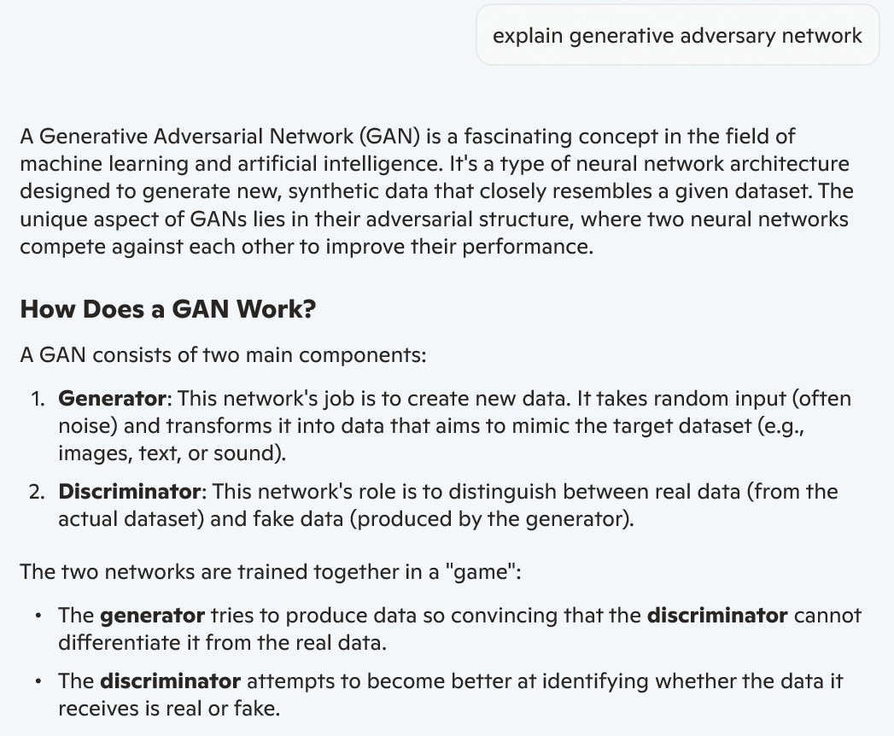

Slide 3
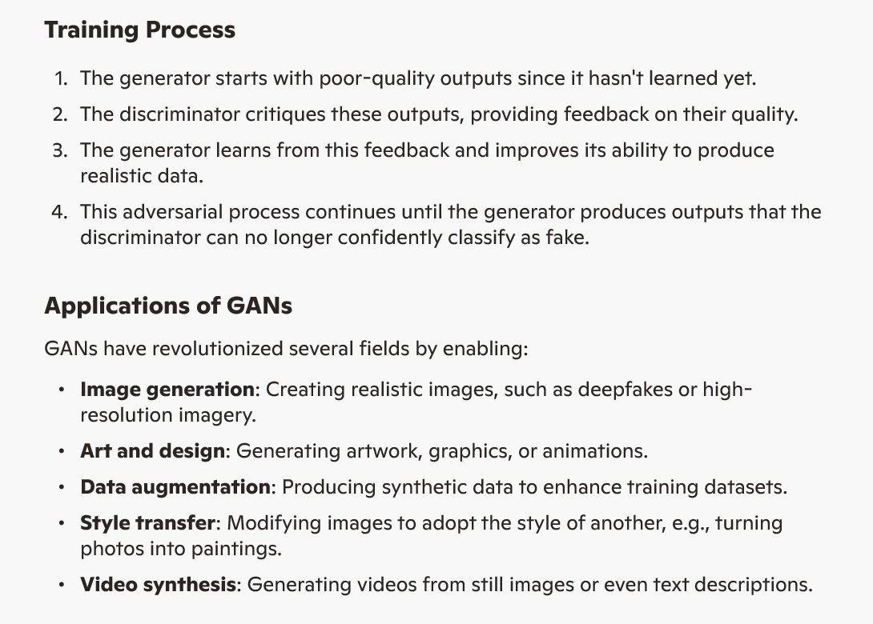

Slide 4
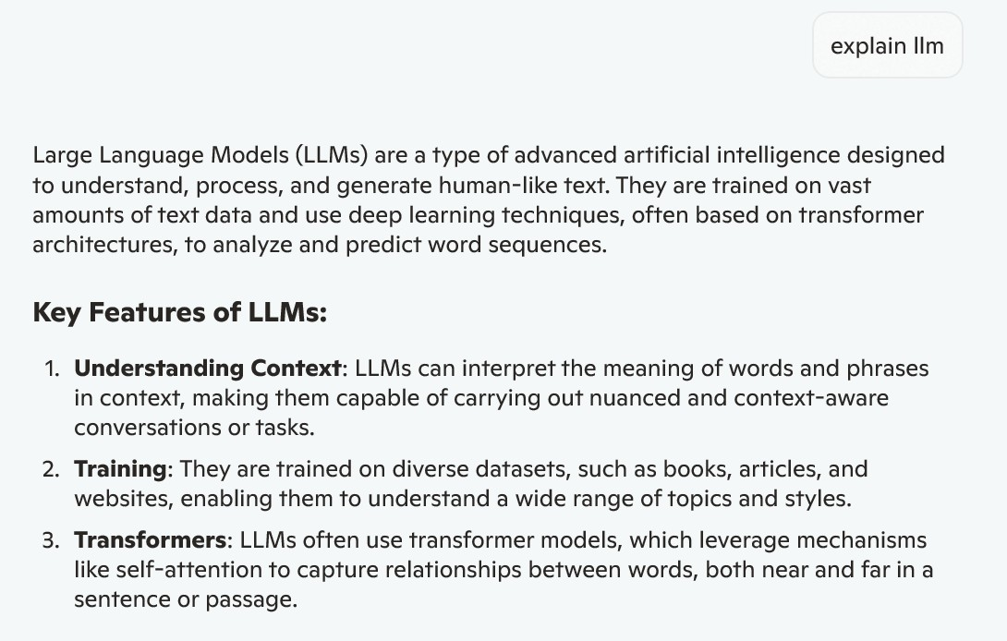

Slide 5
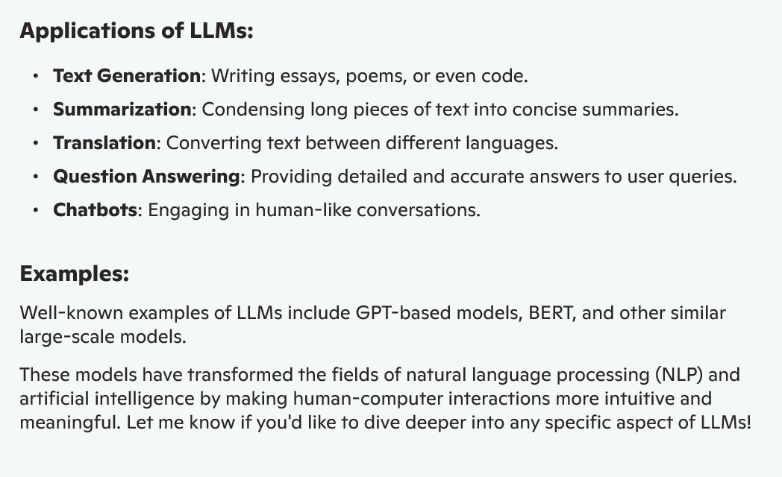

Slide 6
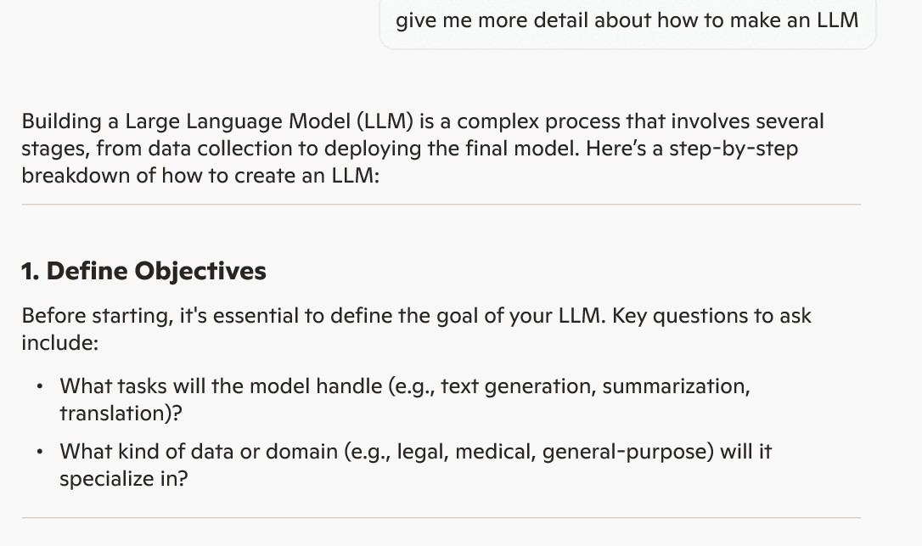

Slide 7
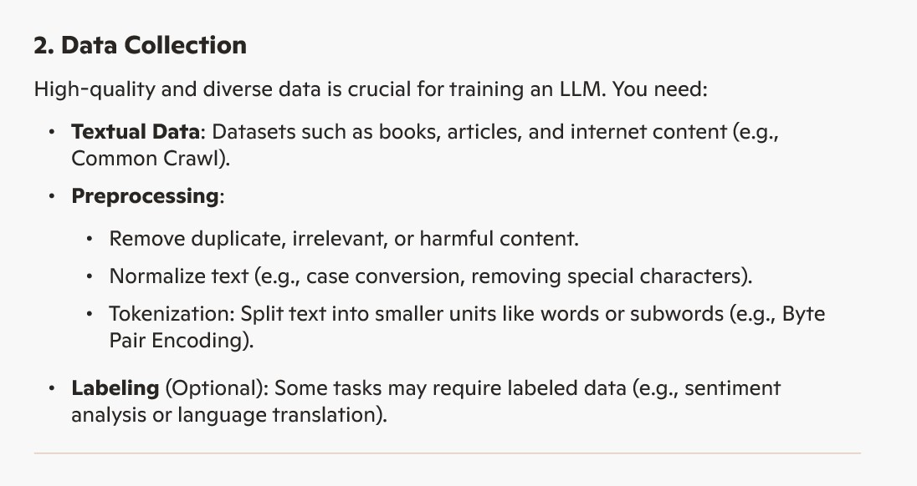

Slide 8
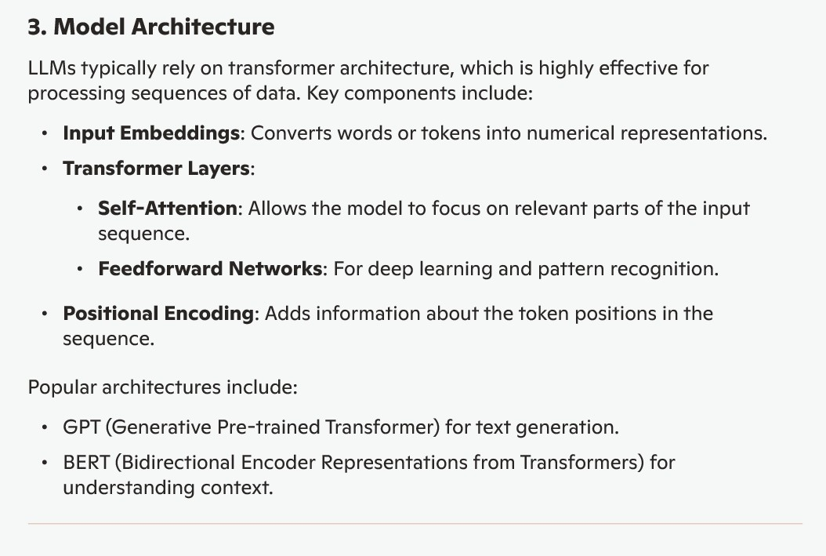

Slide 9
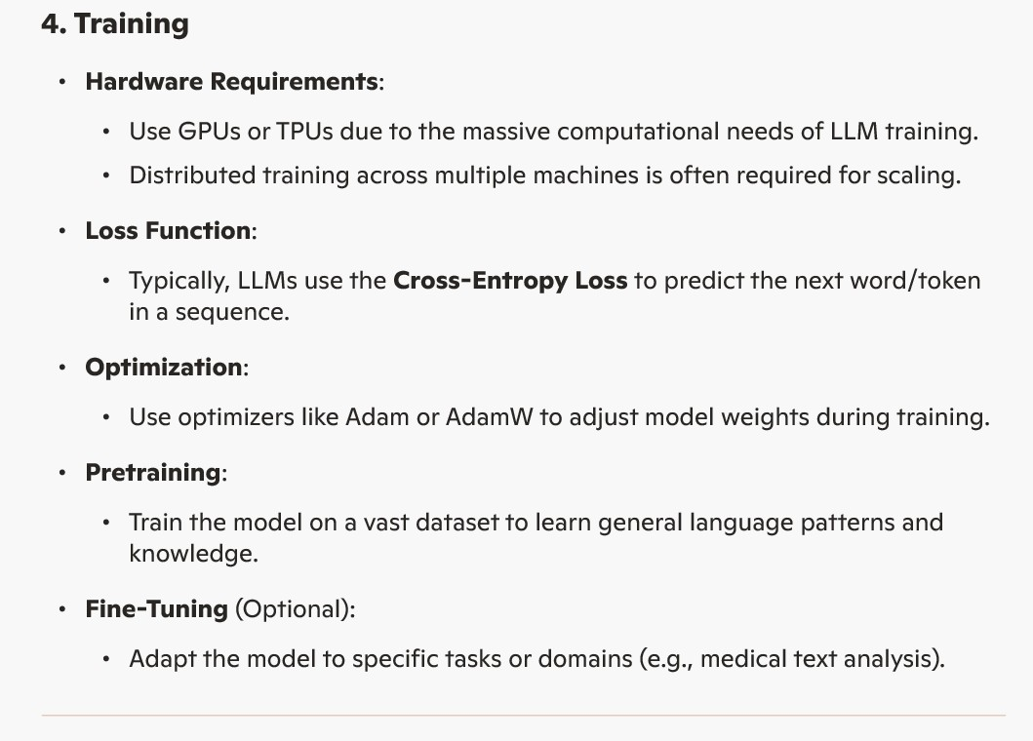

Slide 10
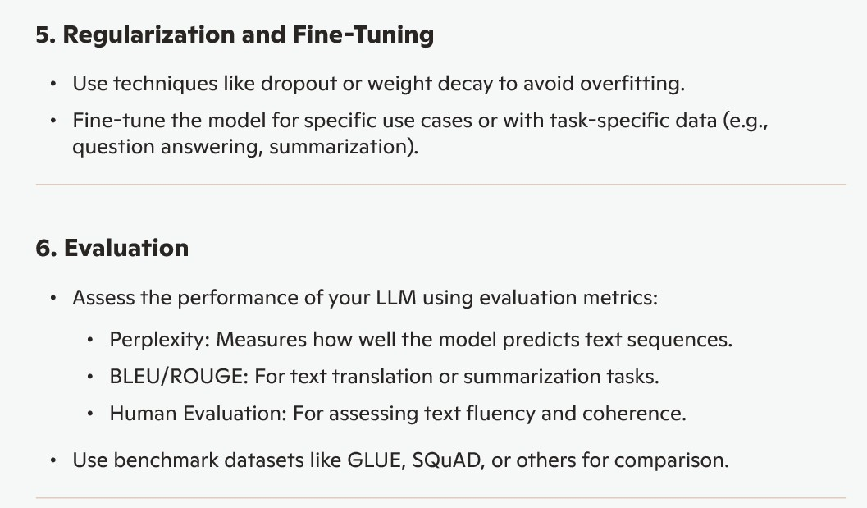

Slide 11
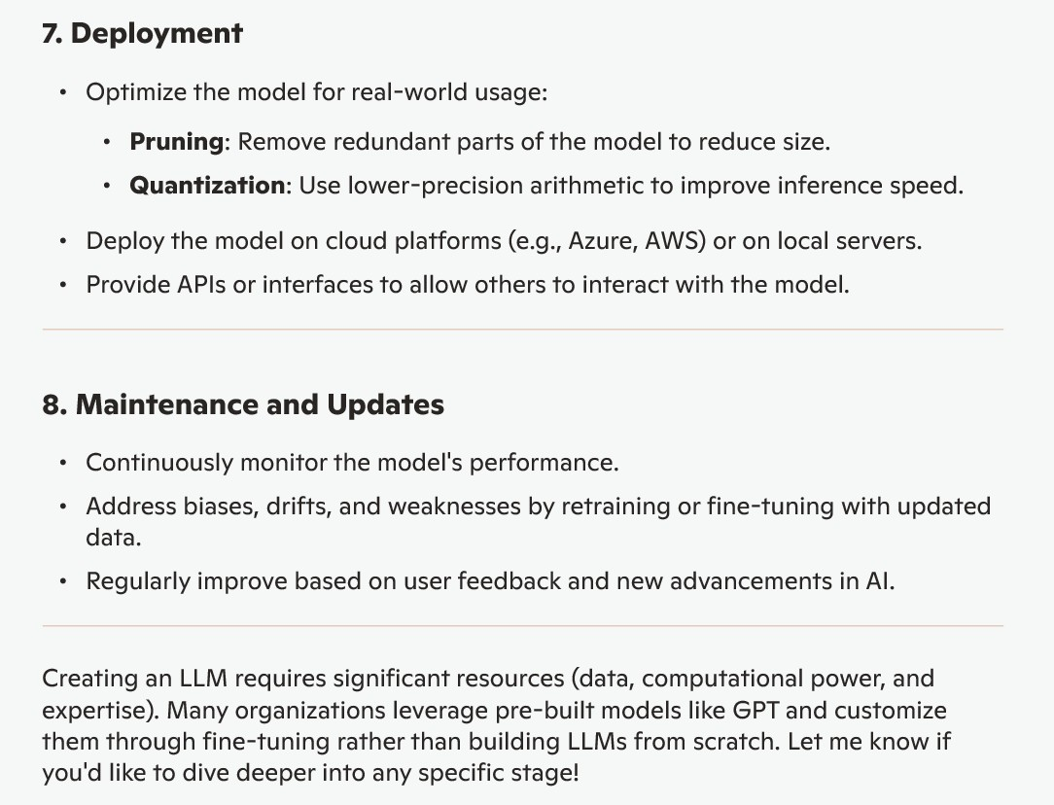

Slide 12
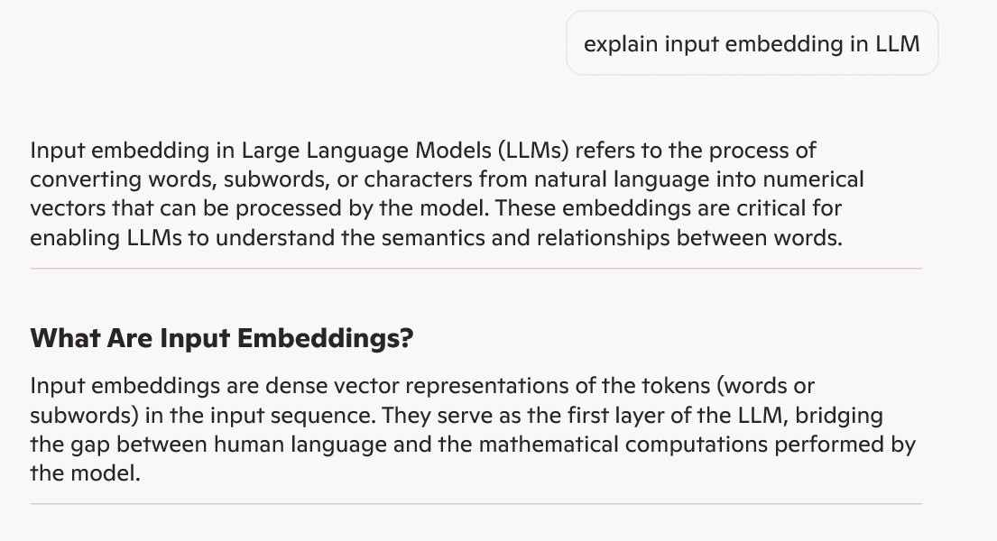

Slide 13
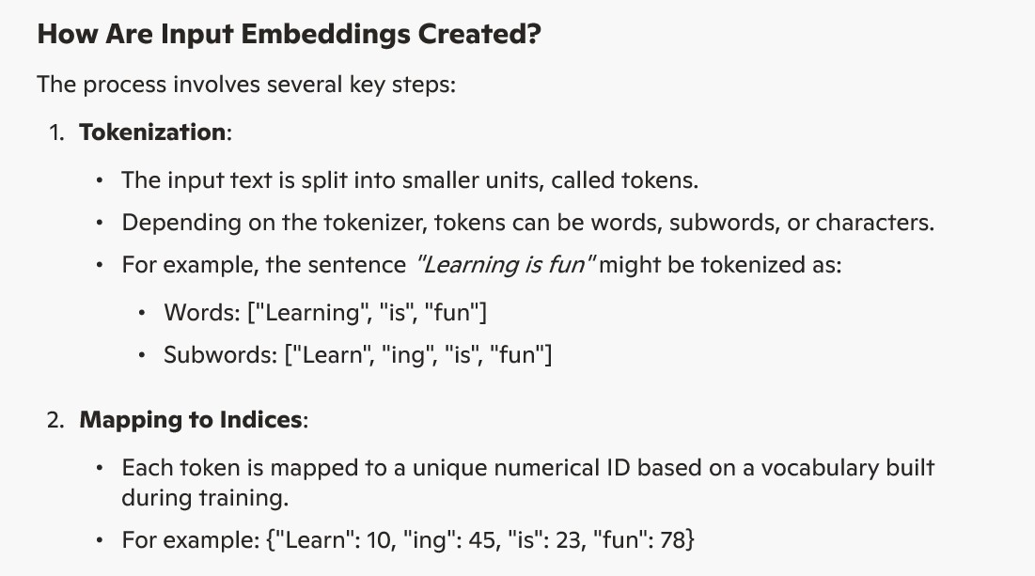

Slide 14
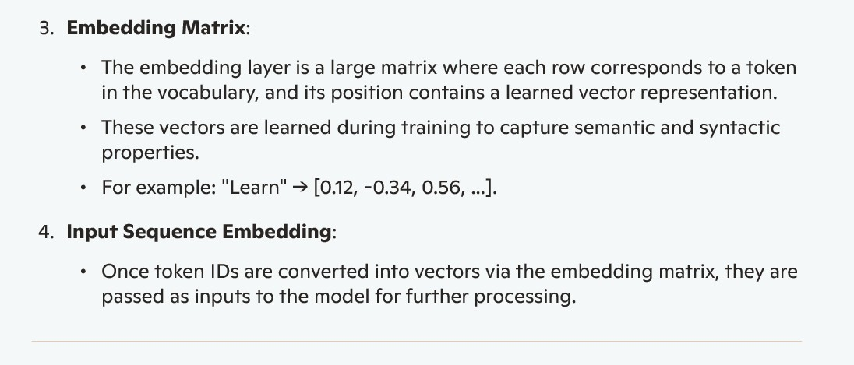

Slide 15
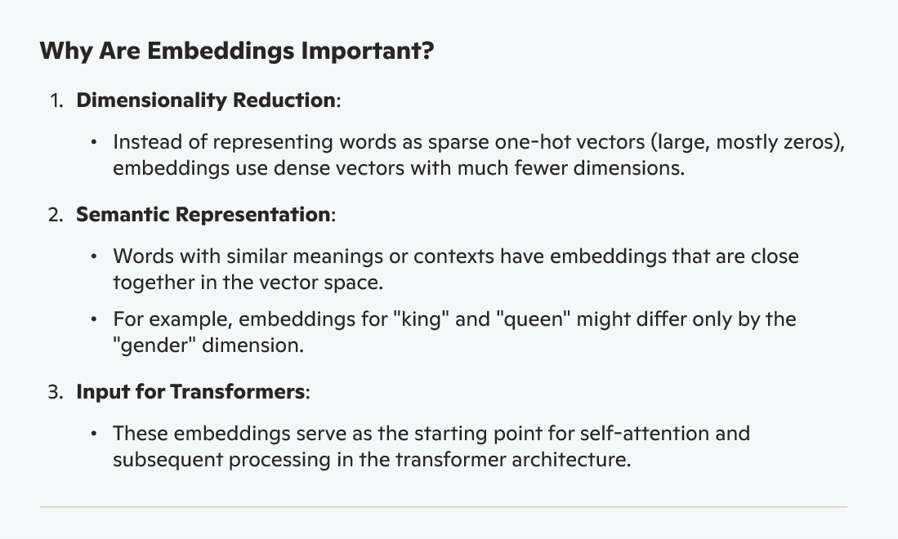

Slide 16
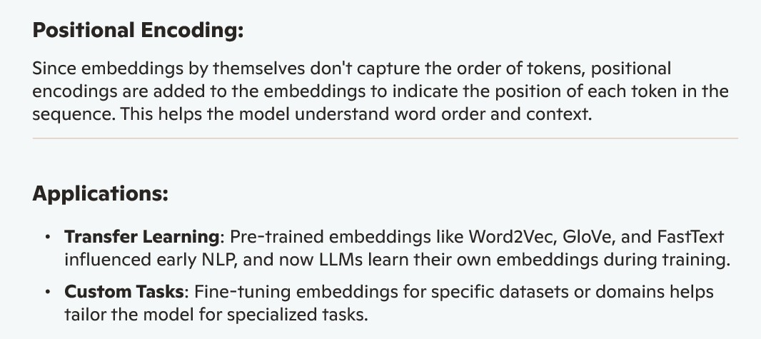

Slide 17
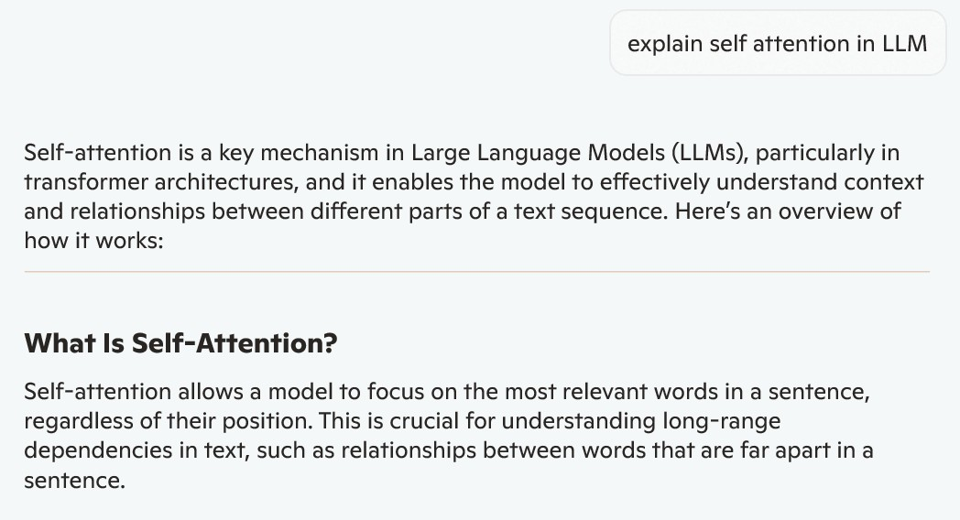

Slide 18
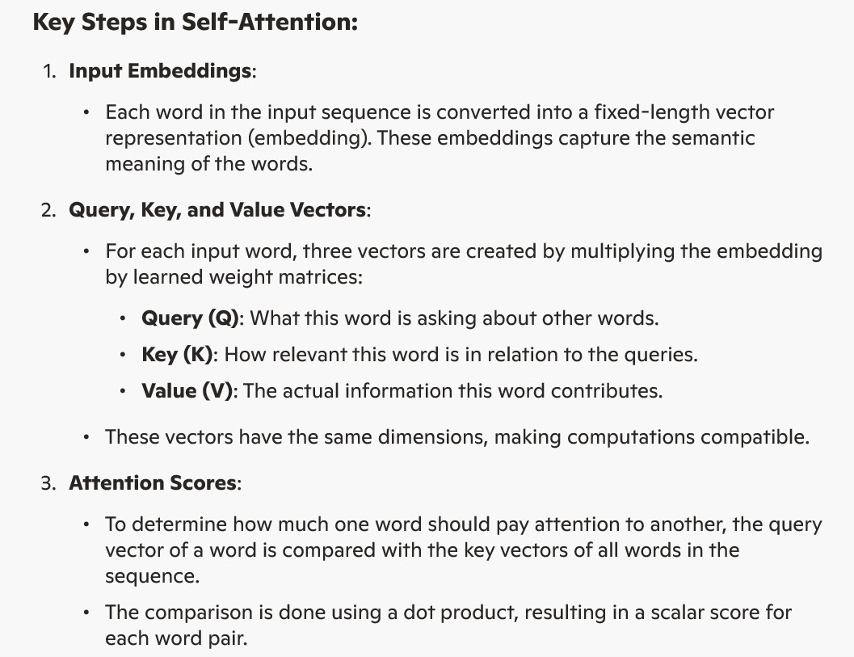

Slide 19
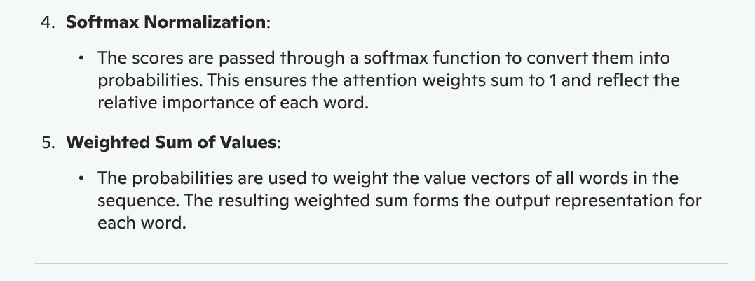

Slide 20
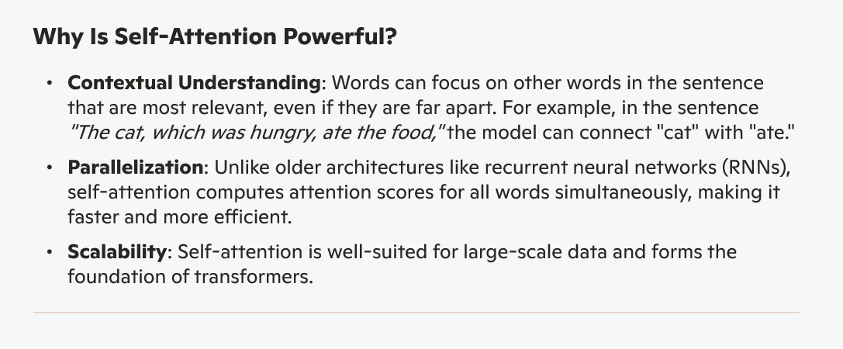

Slide 21
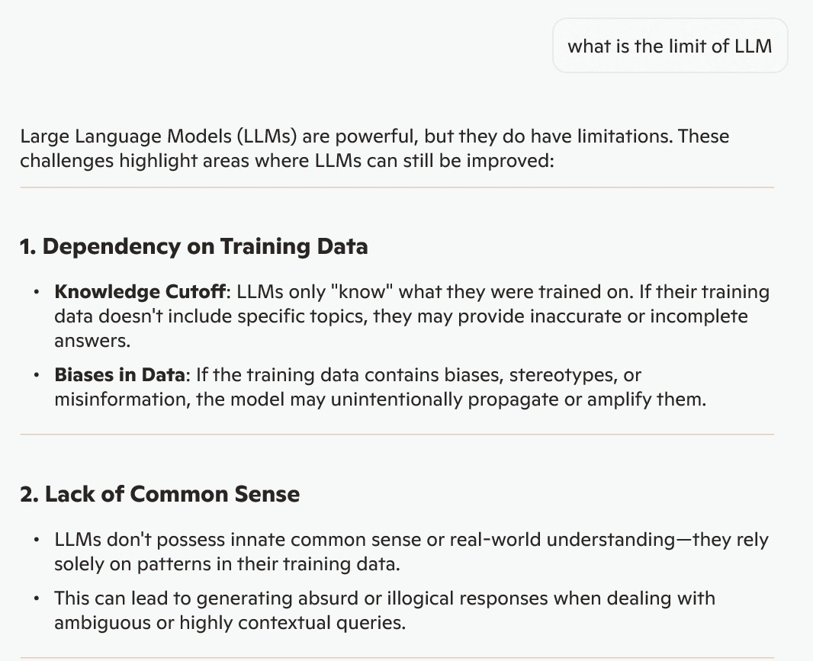

Slide 22
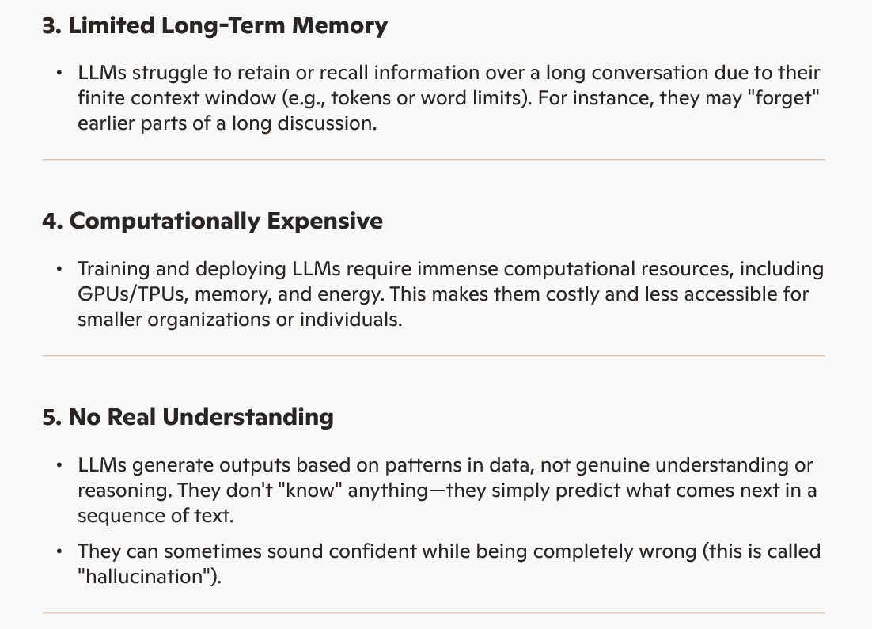

Slide 23
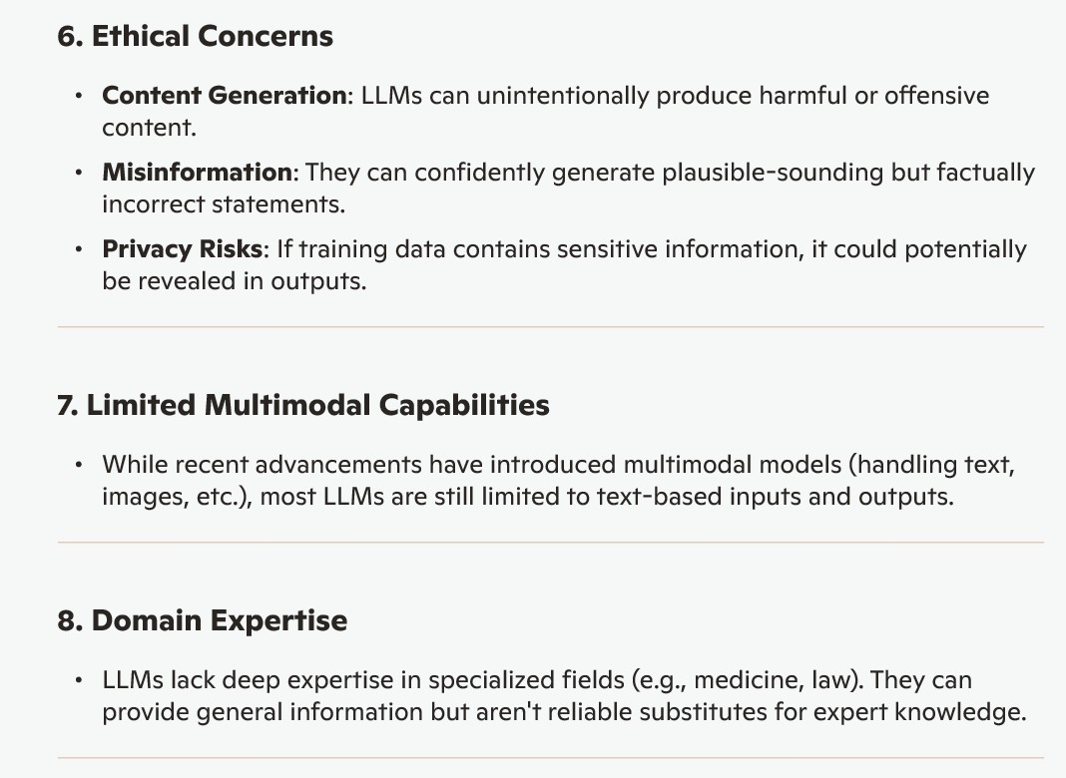

Slide 24
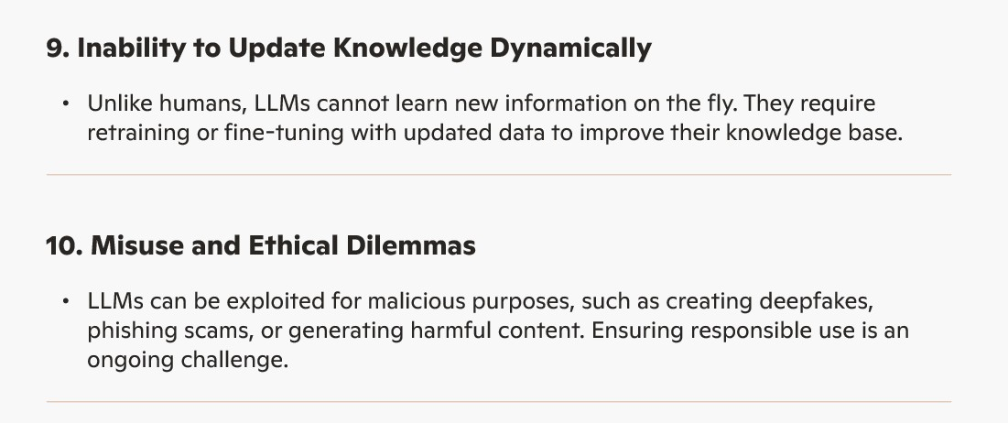

Slide 25
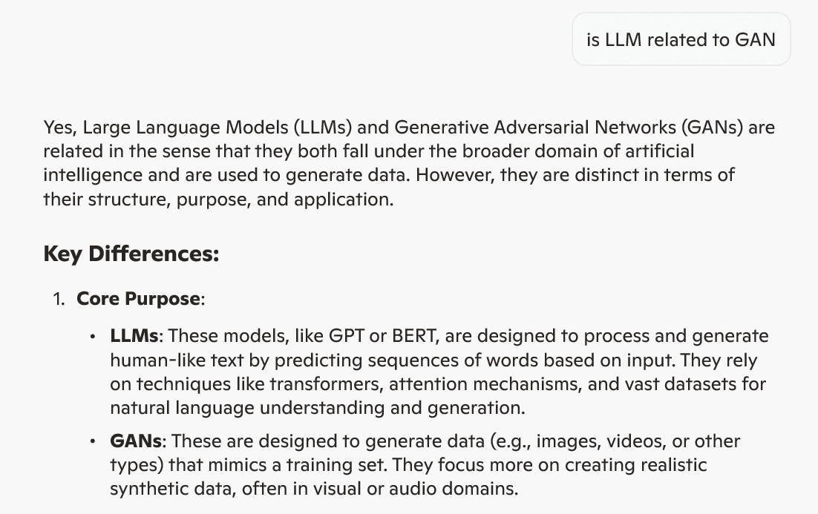

Slide 26
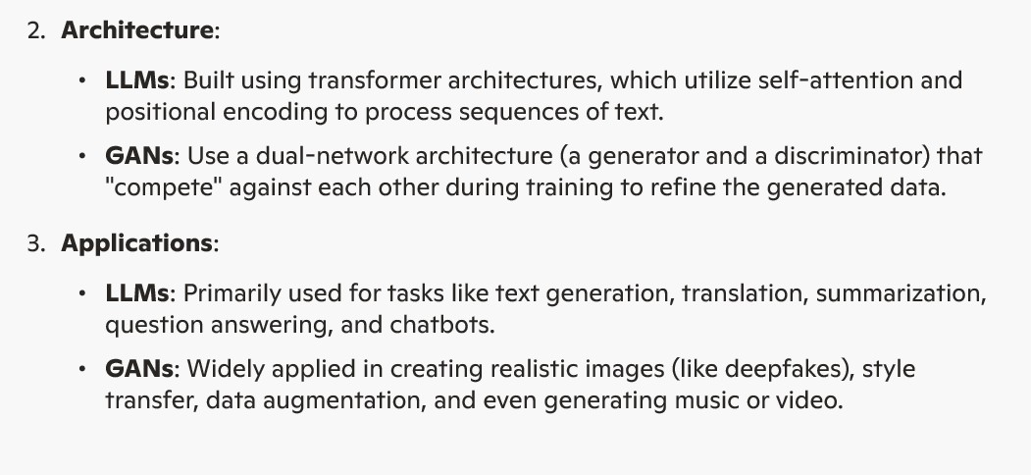

Slide 27
Additional information
make LLM
https://medium.com/sciforce/step-by-step-guide-to-your-own-large-language-model-2b3fed6422d0
https://symbl.ai/developers/blog/a-guide-to-building-an-llm-from-scratch/
https://medium.com/@iamamellstephen/how-to-build-a-private-llm-a-comprehensive-guide-296eae0e7db9
coding
Langchain
LangChain is an open-source framework designed to simplify the development of applications powered by large language models (LLMs), allowing developers to easily integrate LLMs with external data sources and build complex, context-aware applications.
https://python.langchain.com/docs/tutorials/llm_chain/

