Slide 1
Make Large Language Models
Prabhas Chongstitvatana

Slide 2
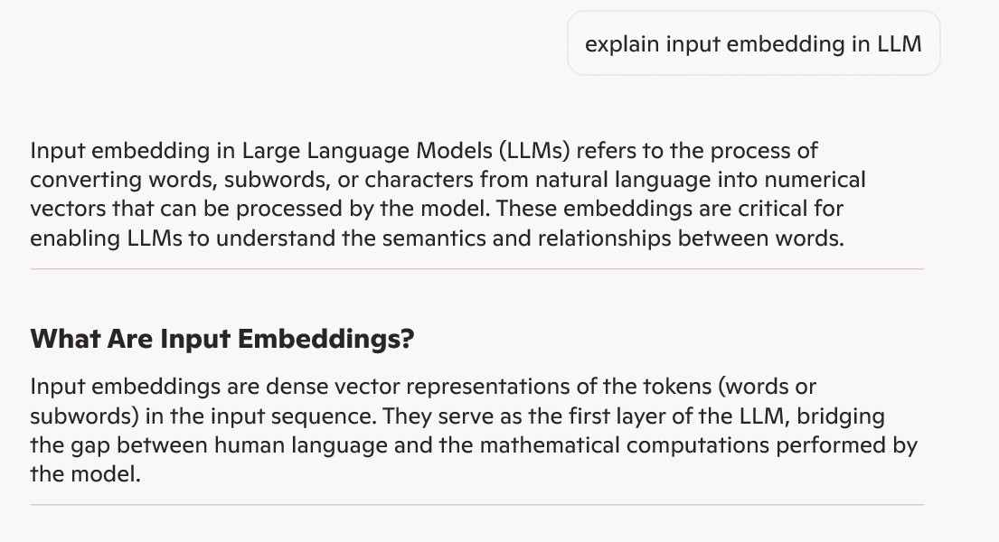

Slide 3
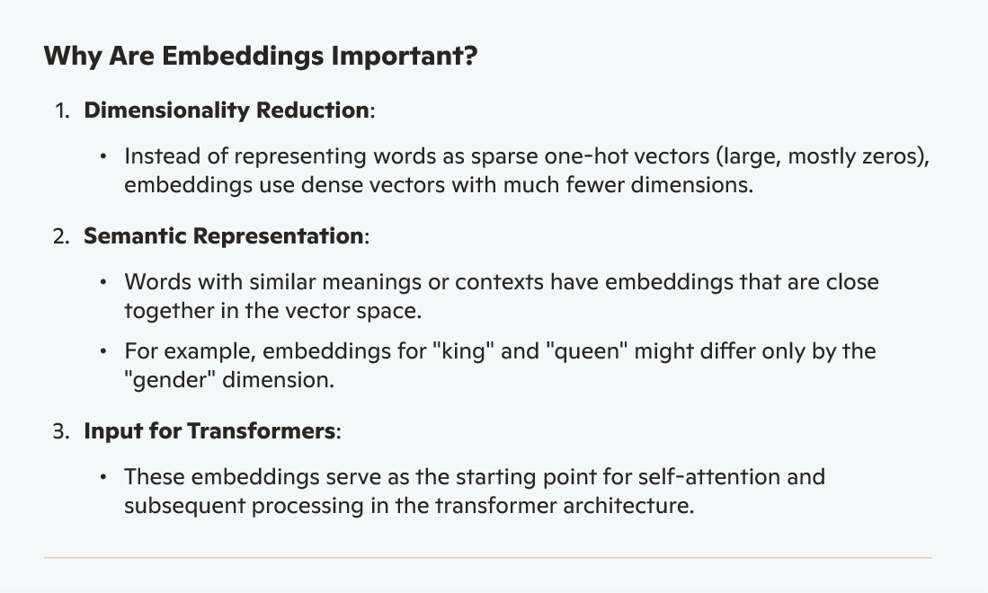

Slide 4
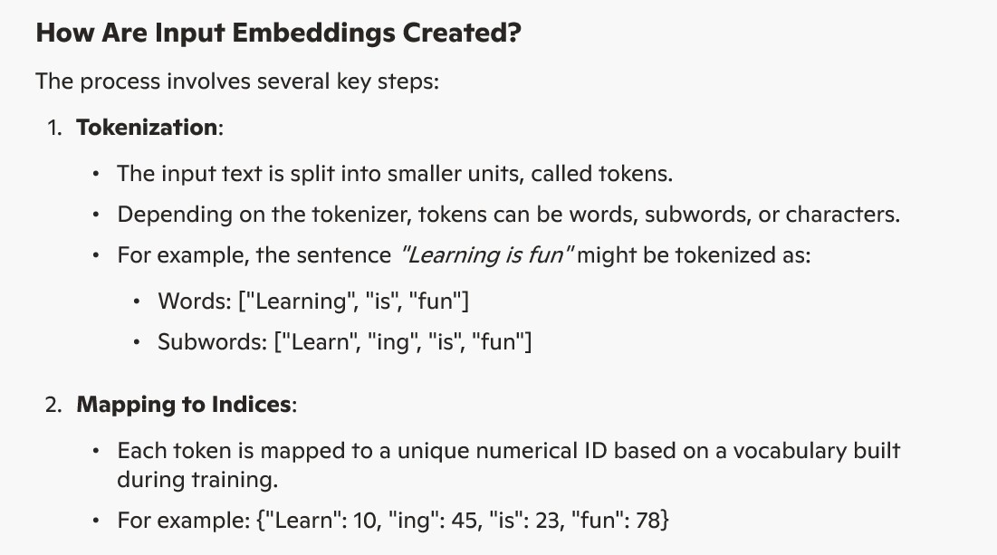

Slide 5
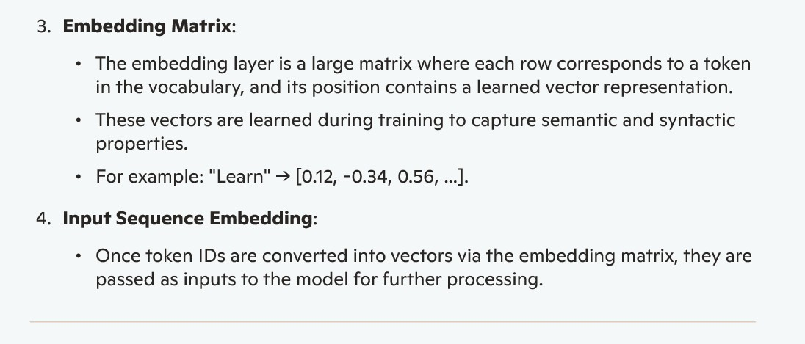

Slide 6
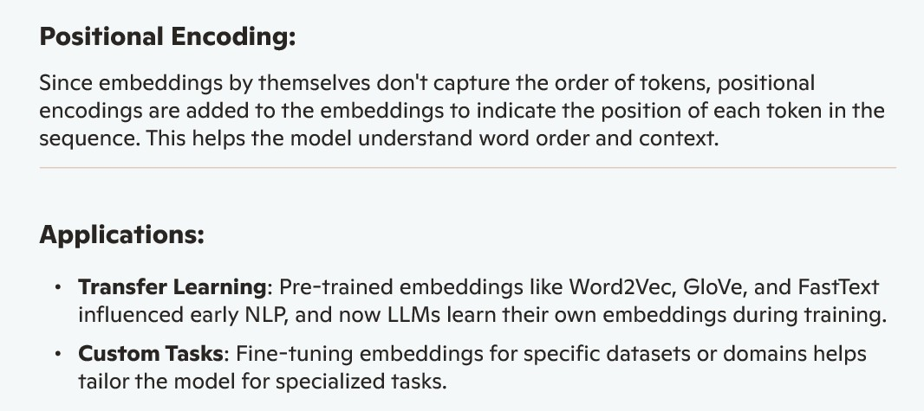

Slide 7
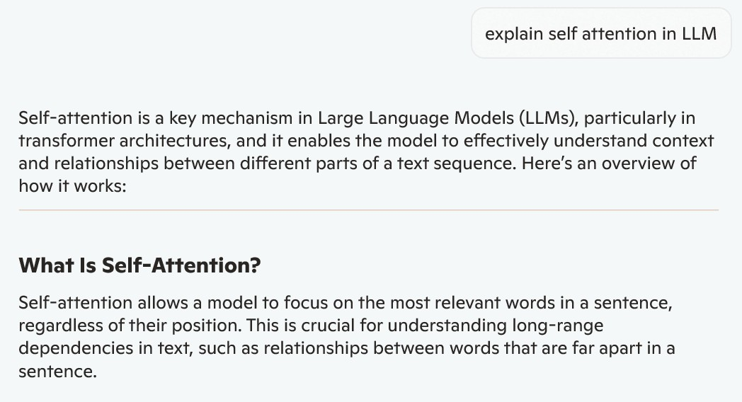

Slide 8
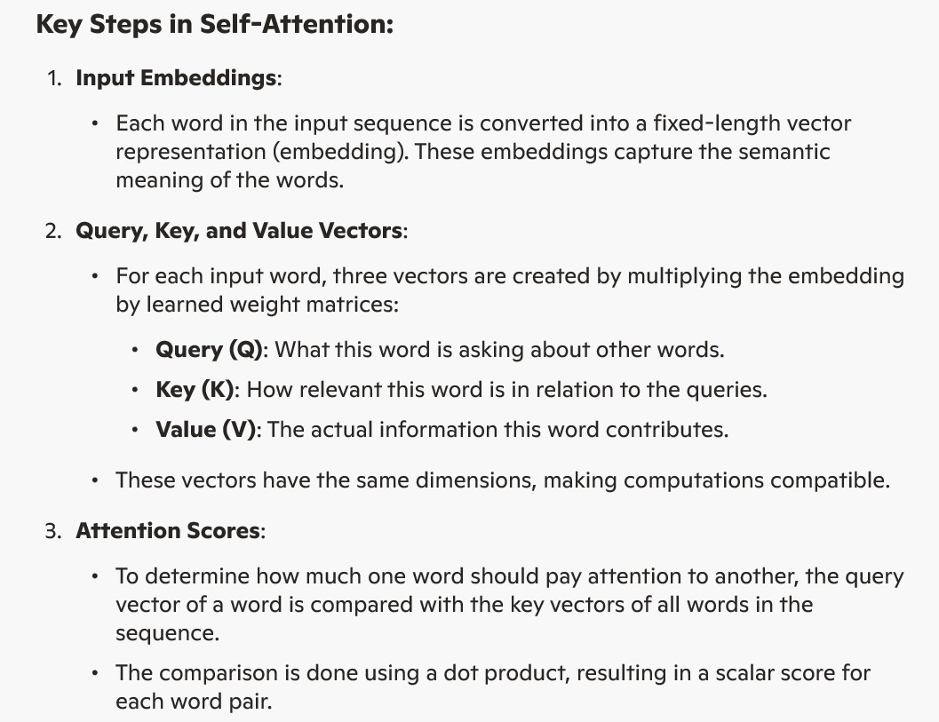

Slide 9
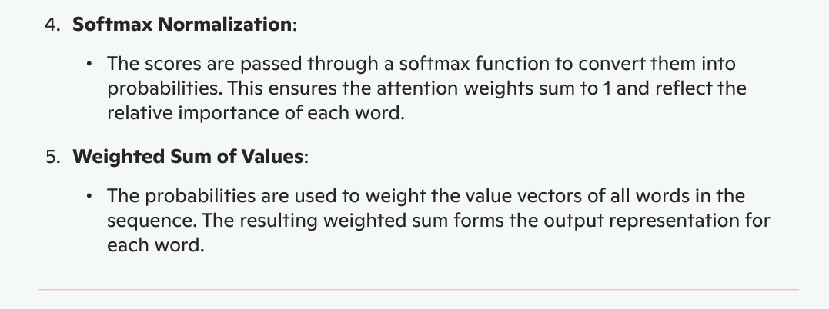

Slide 10
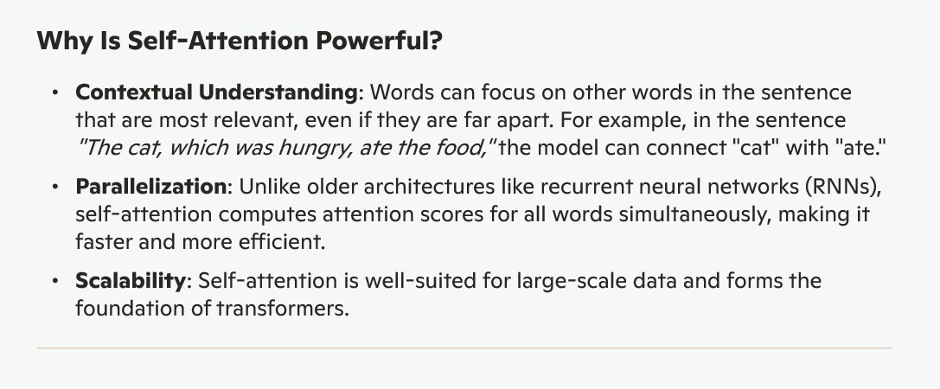

Slide 11
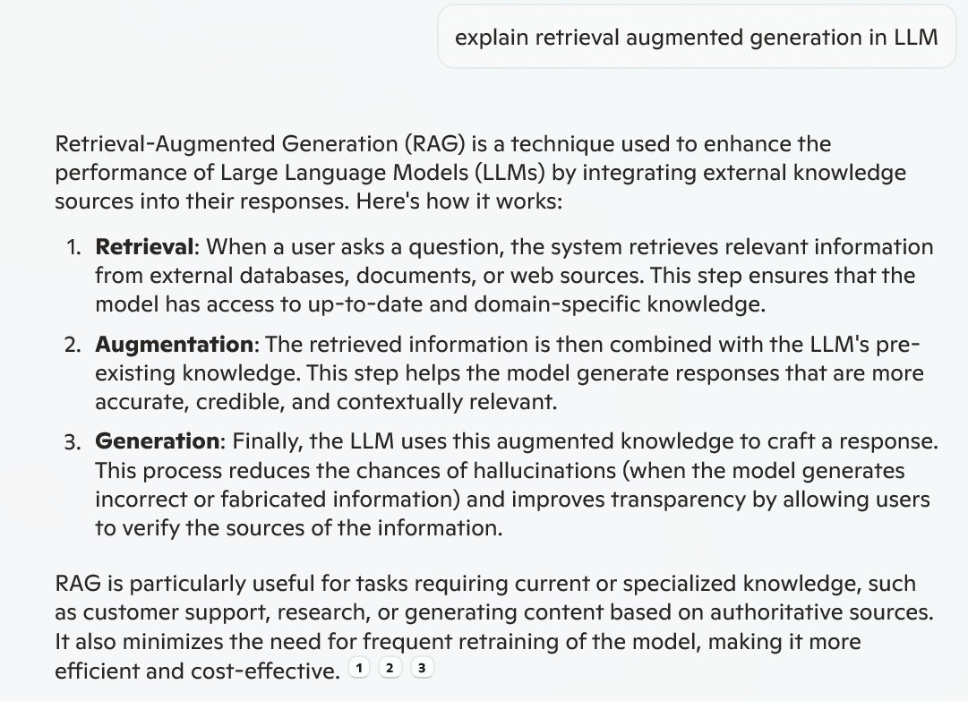
Retrieval Augmented Generation

Slide 12
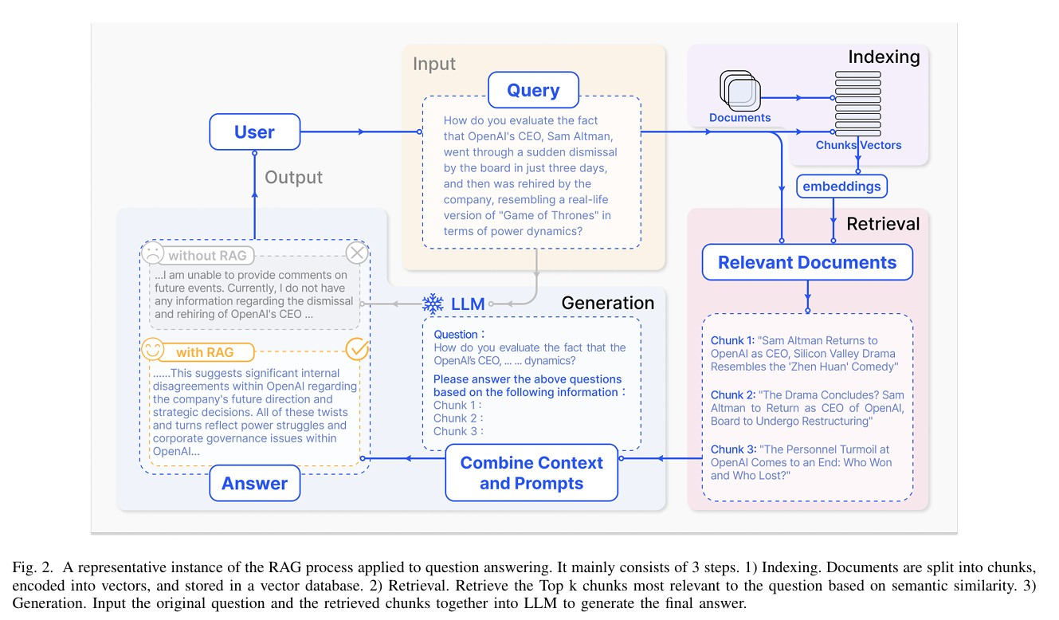

Slide 13
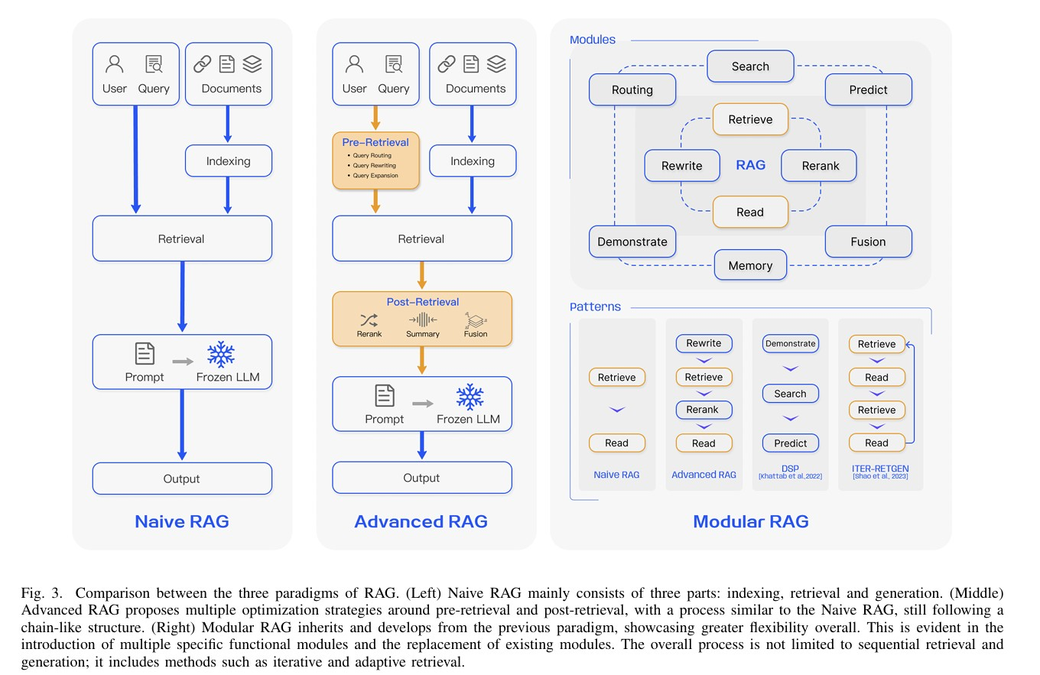

Slide 14
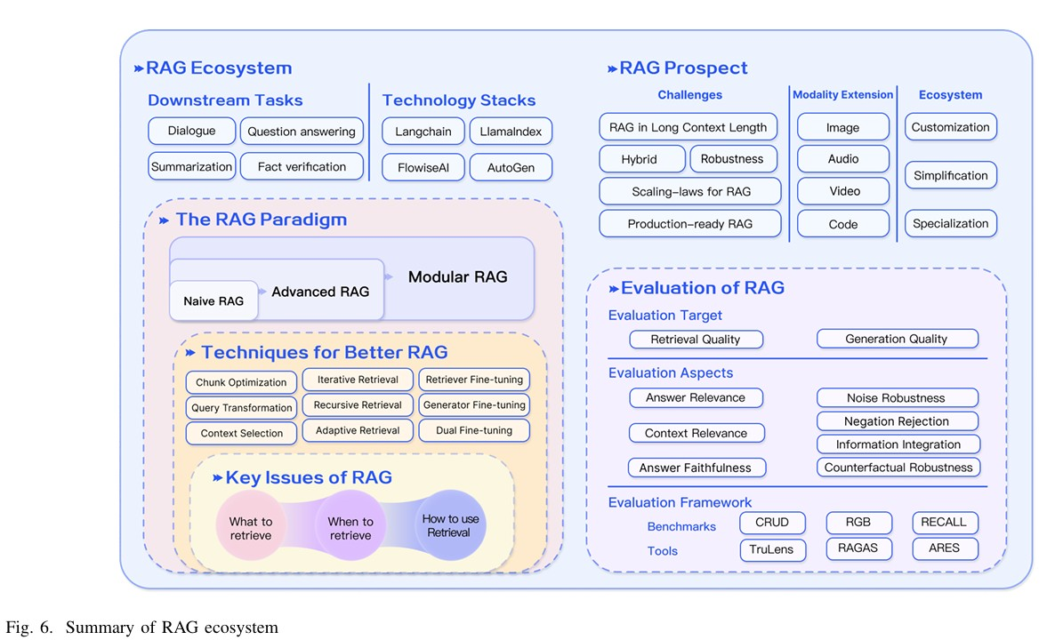

Slide 15
Additional information
make LLM
https://medium.com/sciforce/step-by-step-guide-to-your-own-large-language-model-2b3fed6422d0
https://symbl.ai/developers/blog/a-guide-to-building-an-llm-from-scratch/
https://medium.com/@iamamellstephen/how-to-build-a-private-llm-a-comprehensive-guide-296eae0e7db9
coding
Langchain
LangChain is an open-source framework designed to simplify the development of applications powered by large language models (LLMs), allowing developers to easily integrate LLMs with external data sources and build complex, context-aware applications.
https://python.langchain.com/docs/tutorials/llm_chain/

