Slide 1
Symbolic AI vs Connectionism
Lecture series in Artificial Intelligence Perspective
Prabhas Chongstitvatana
Faculty of Engineering
Chulalongkorn University

Slide 2
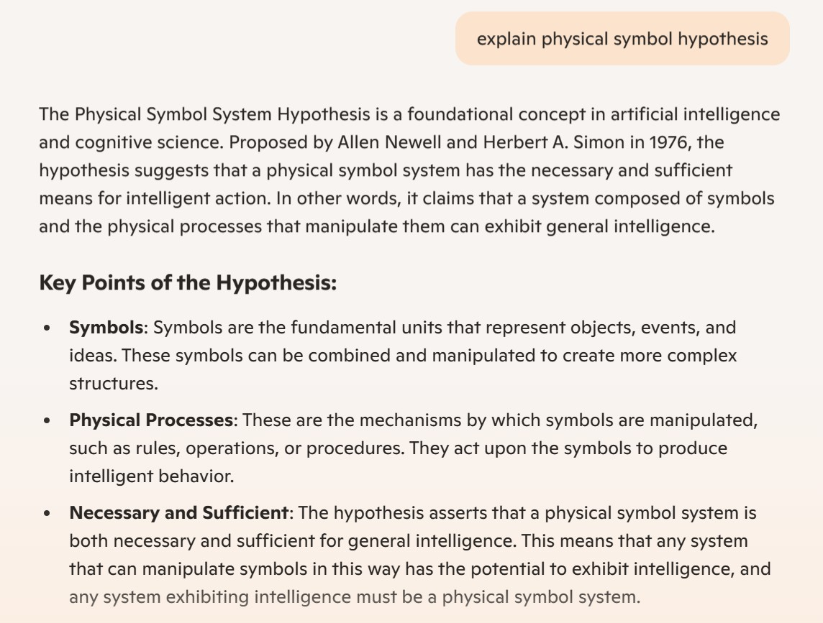
Symbolic AI: Physical Symbol Hypothesis

Slide 3
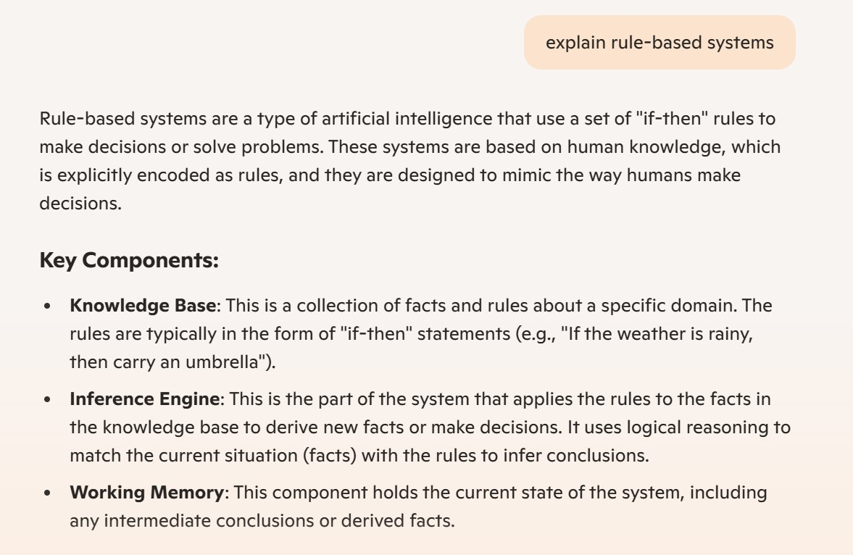
Rule-based Systems

Slide 4
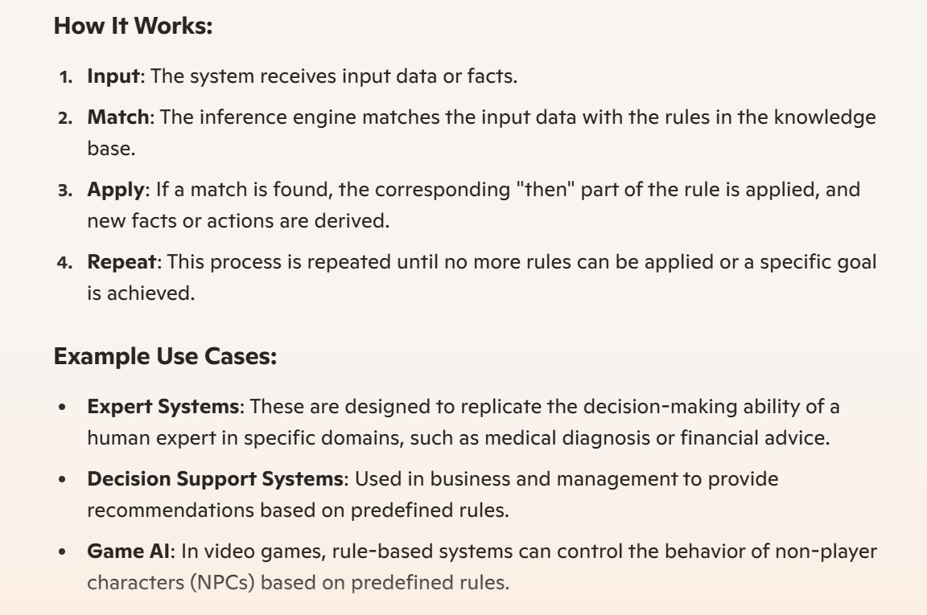

Slide 5
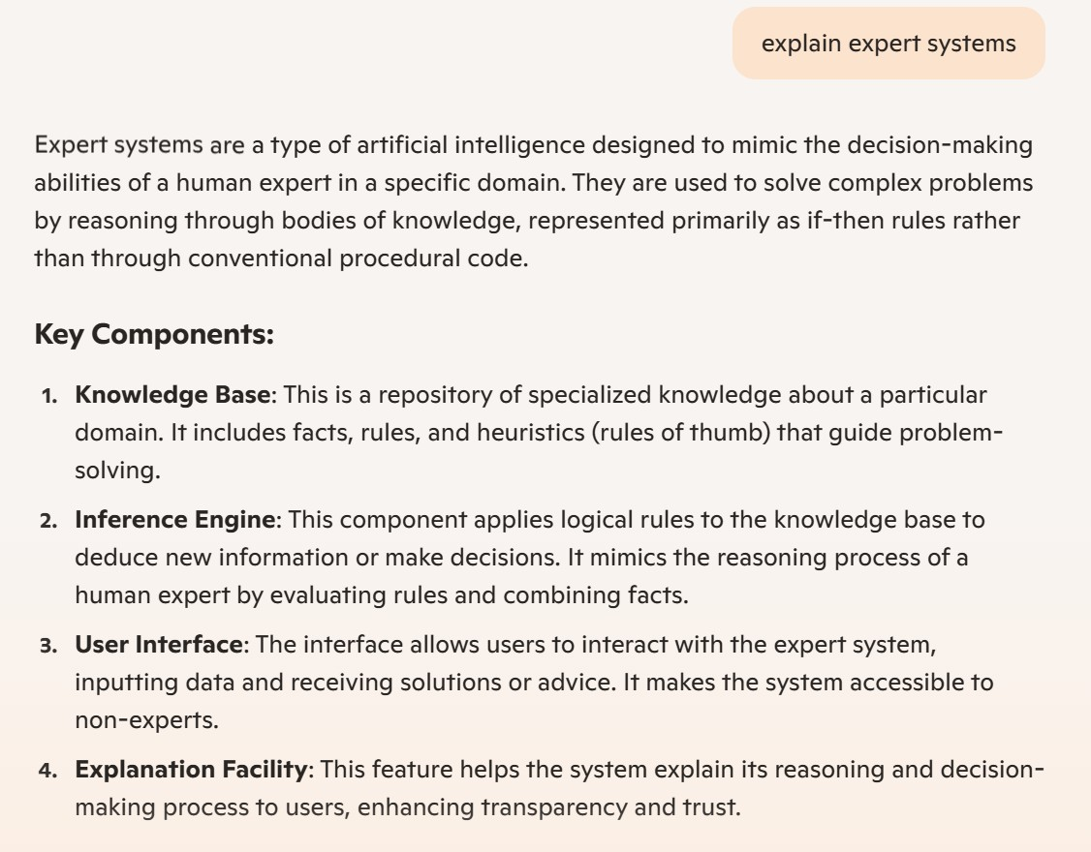
Expert Systems

Slide 6
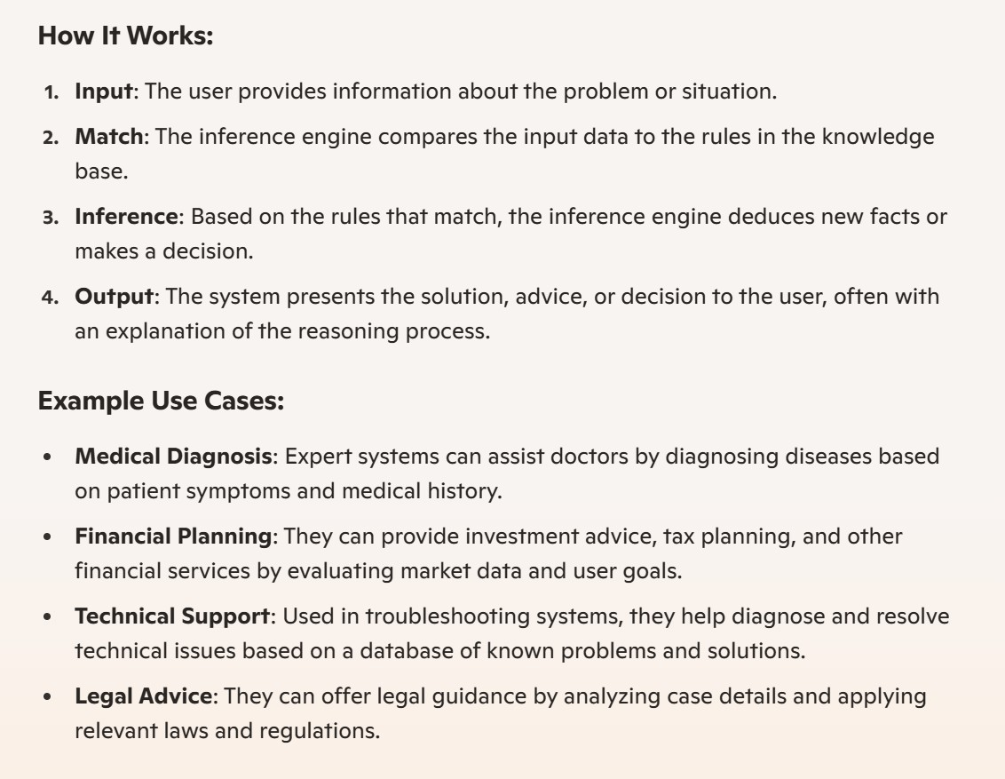

Slide 7
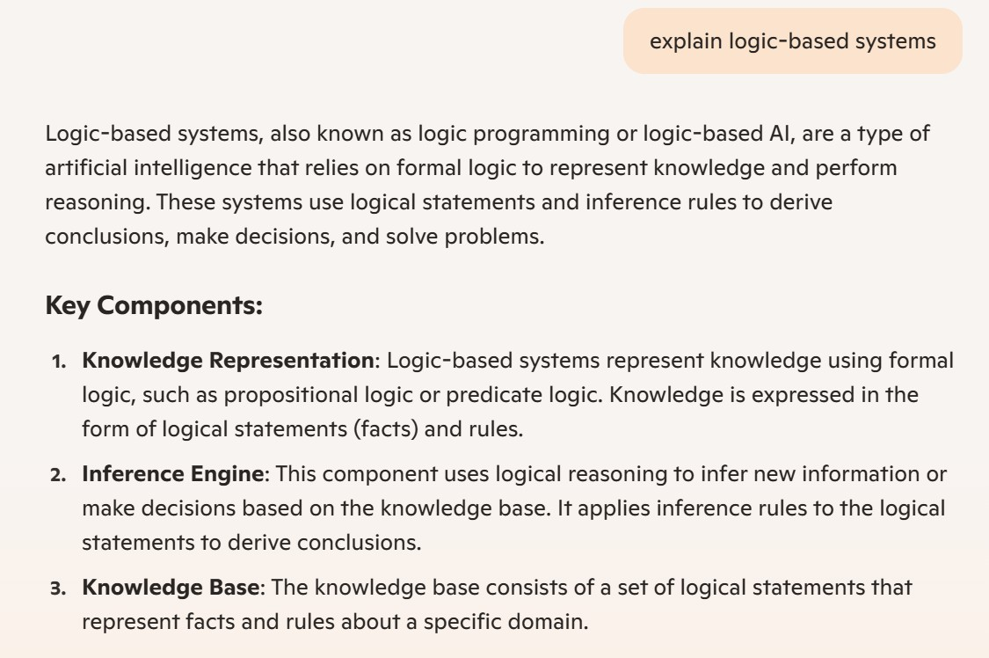
Logic-based Systems

Slide 8
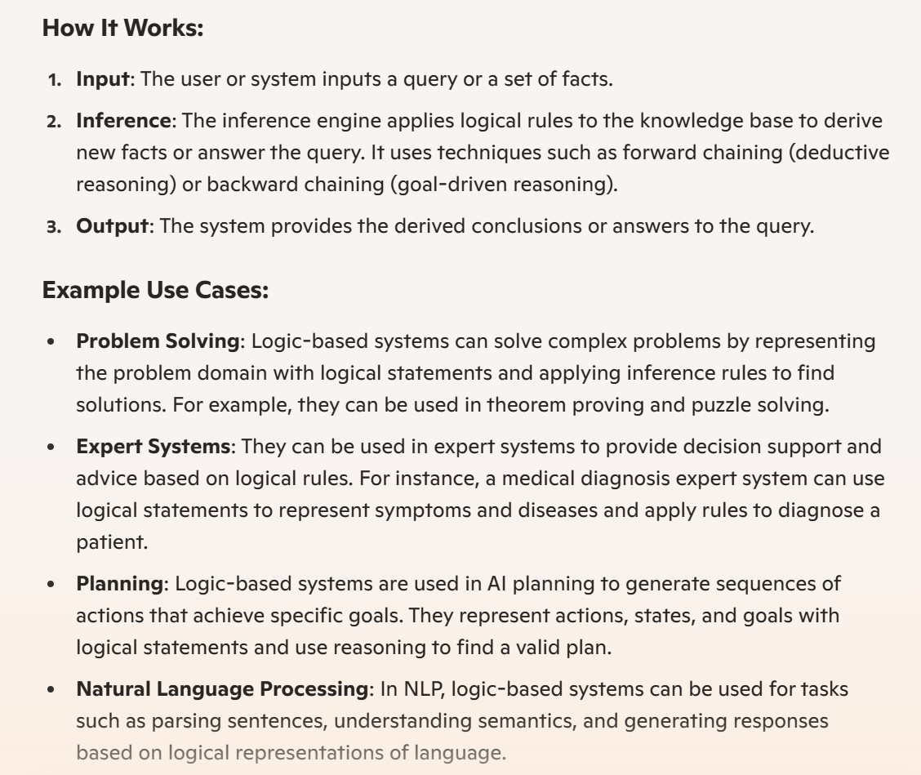

Slide 9
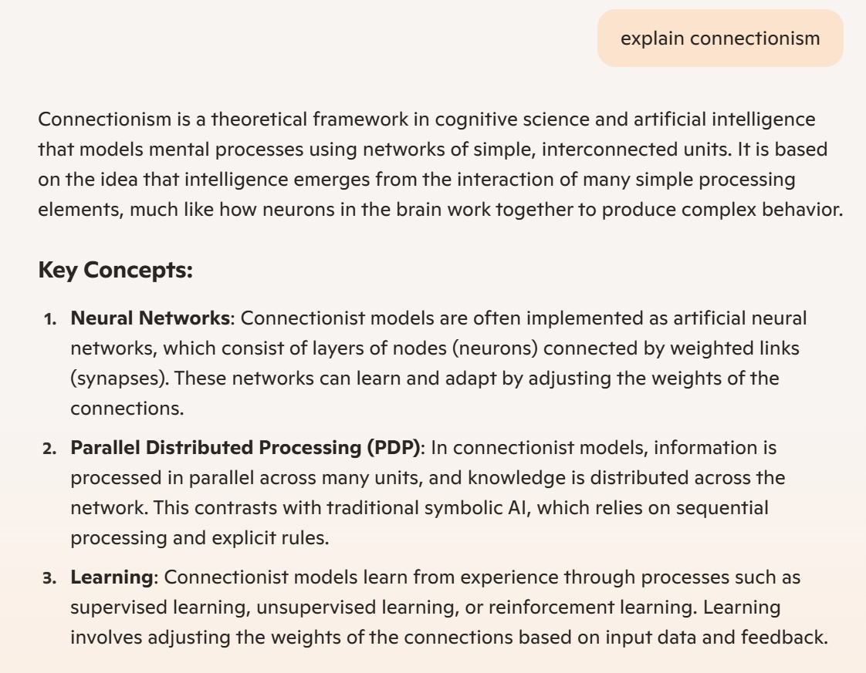
Connectionism

Slide 10
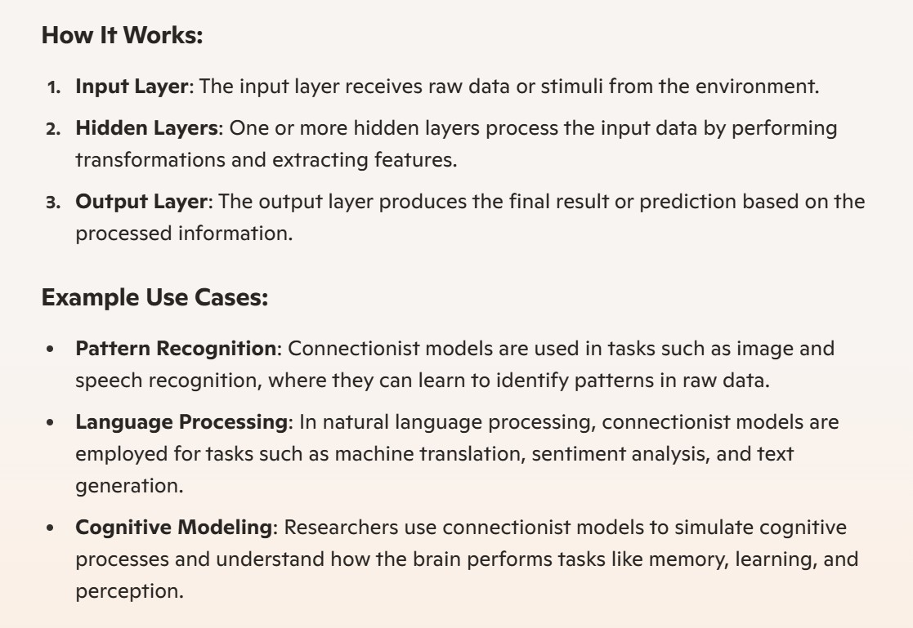

Slide 11
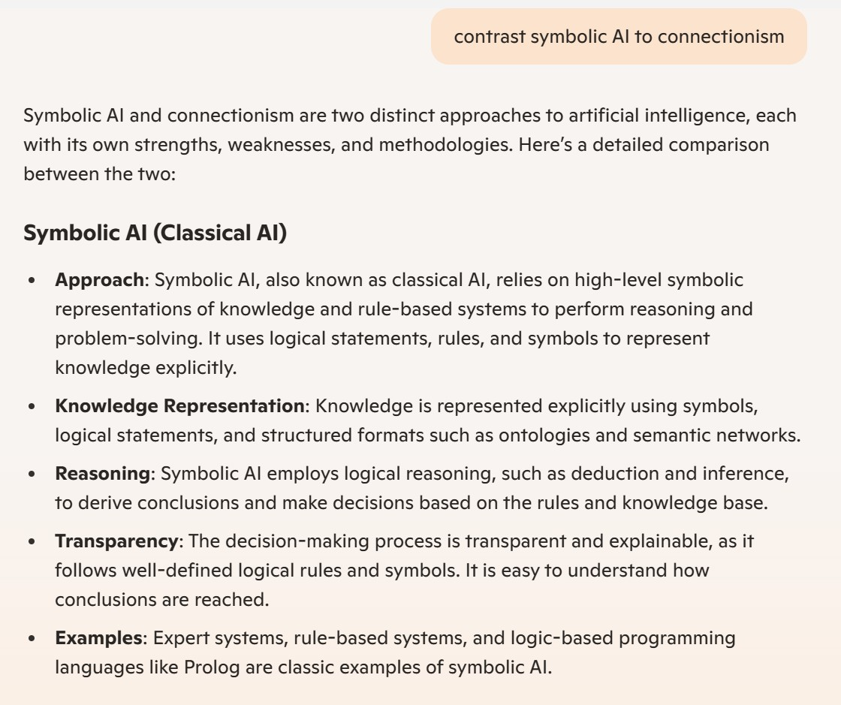
Symbolic AI vs Connectionism

Slide 12
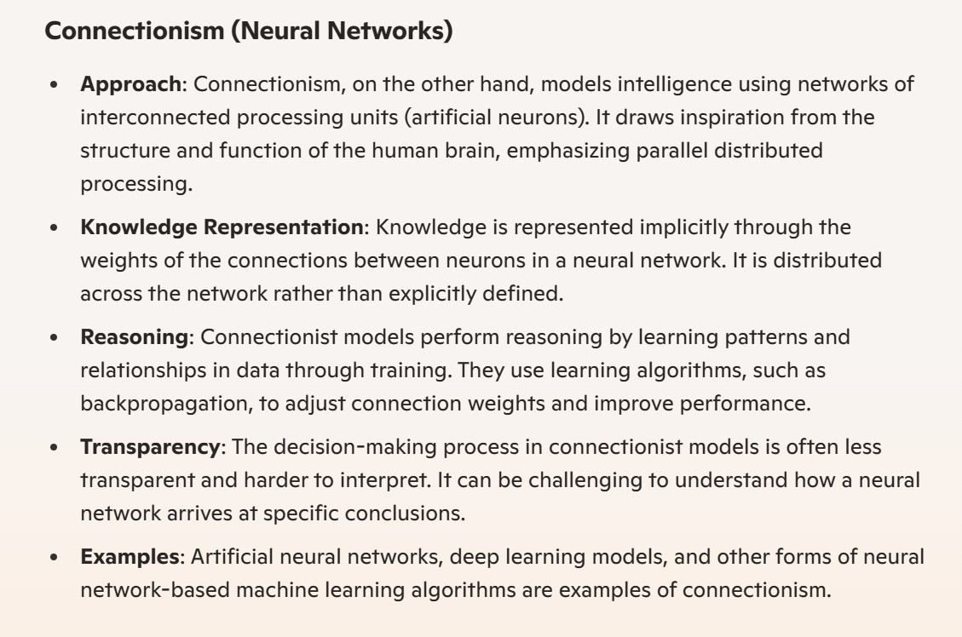

Slide 13
