Slide 1
Alternative AI:
Evolutionary Computation
Lecture series in Artificial Intelligence Perspective
Prabhas Chongstitvatana
Faculty of Engineering
Chulalongkorn University

Slide 2
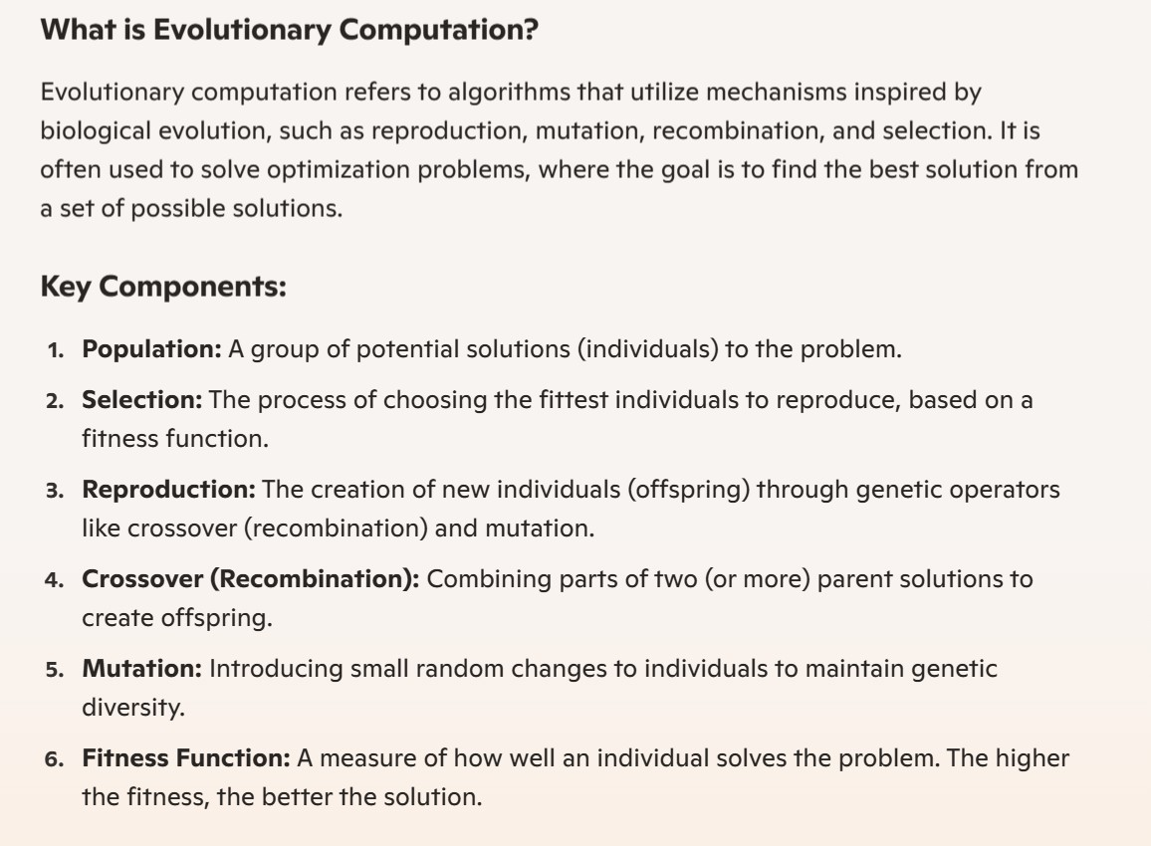

Slide 3
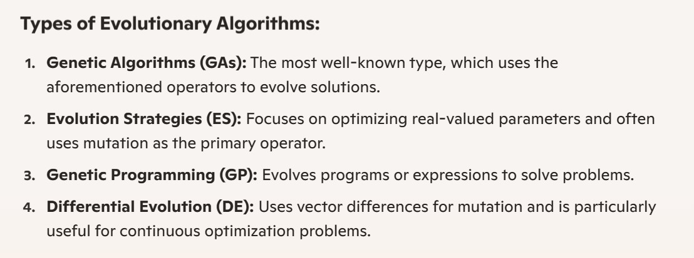

Slide 4
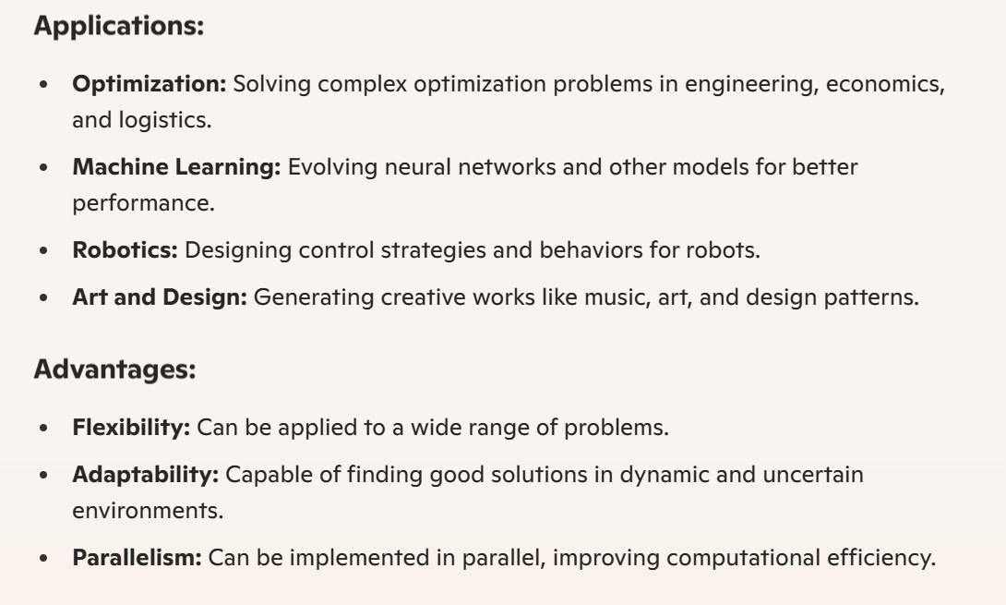

Slide 5
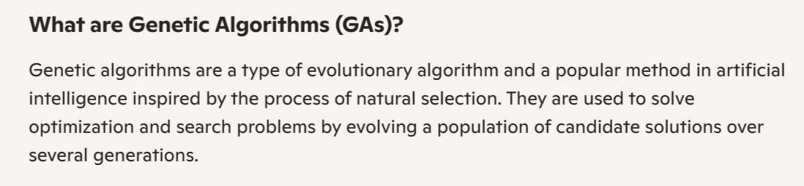

Slide 6
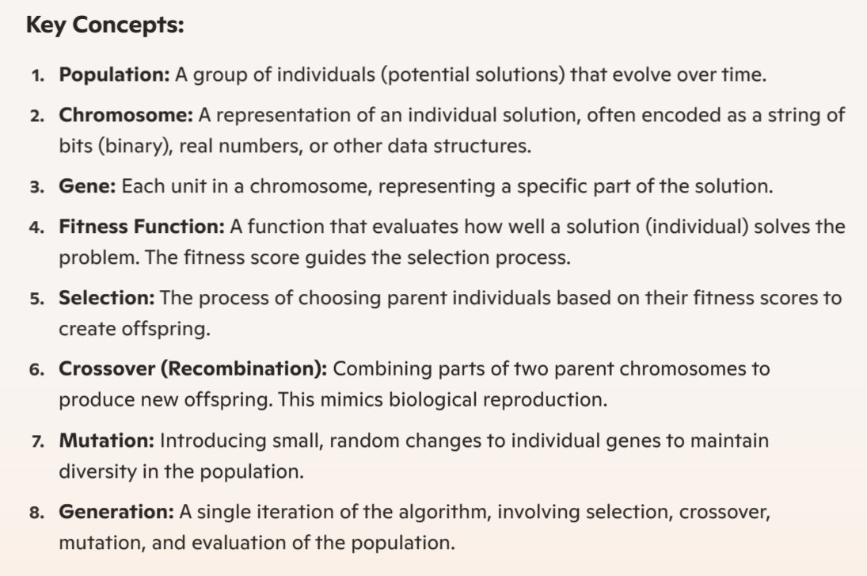

Slide 7
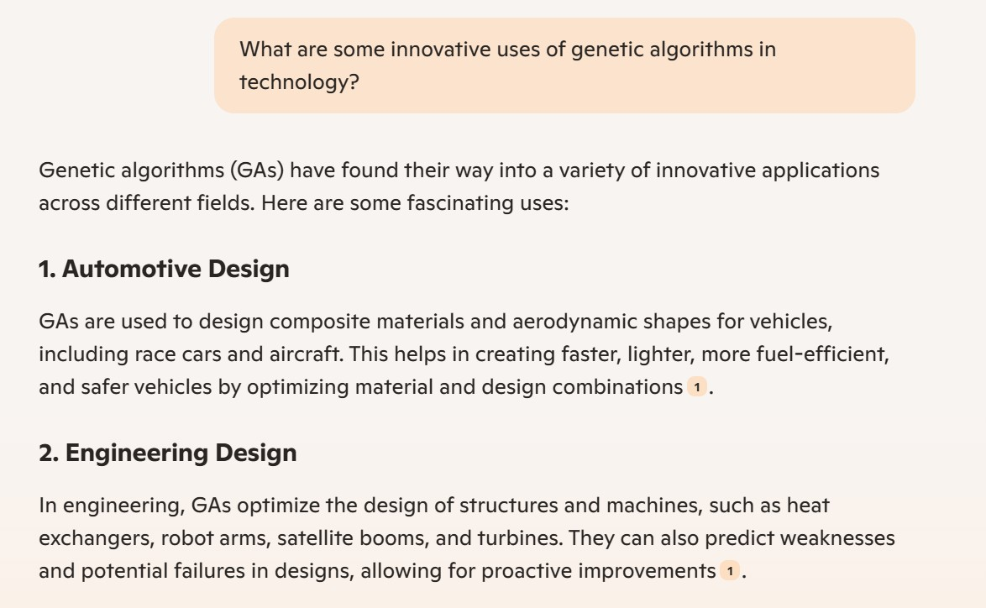

Slide 8
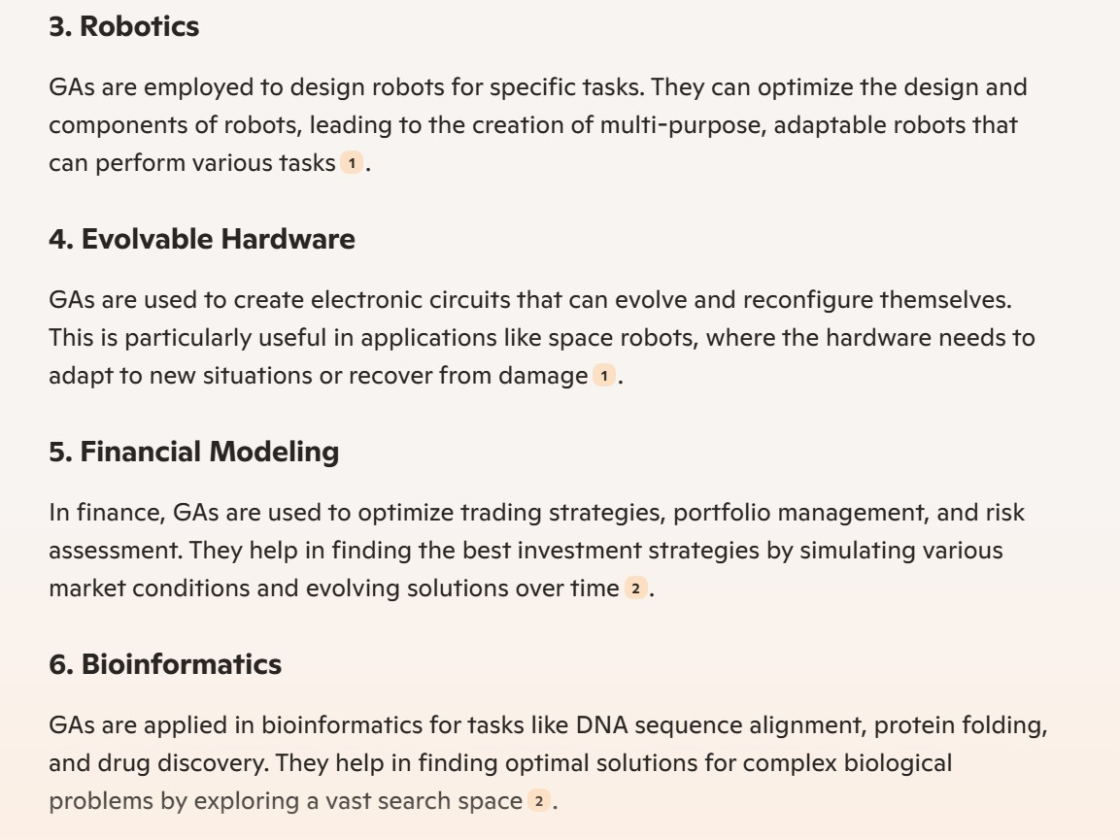

Slide 9
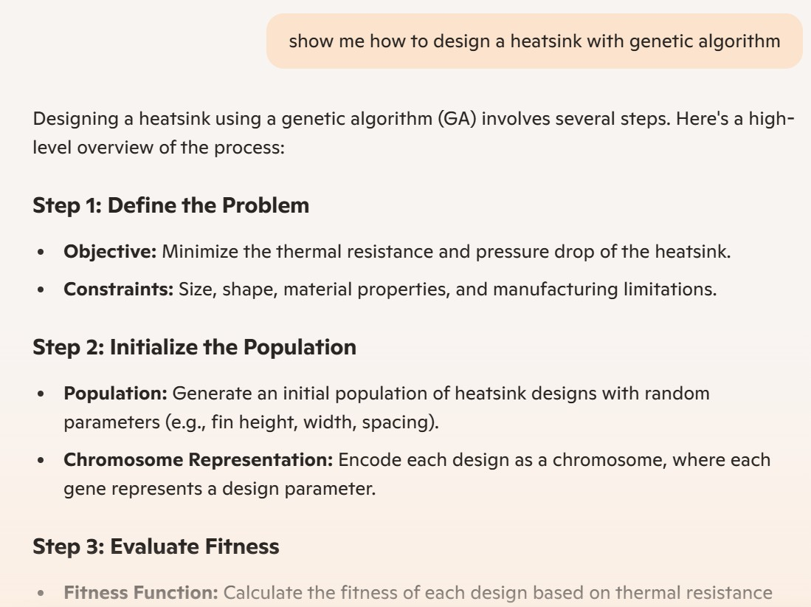

Slide 10
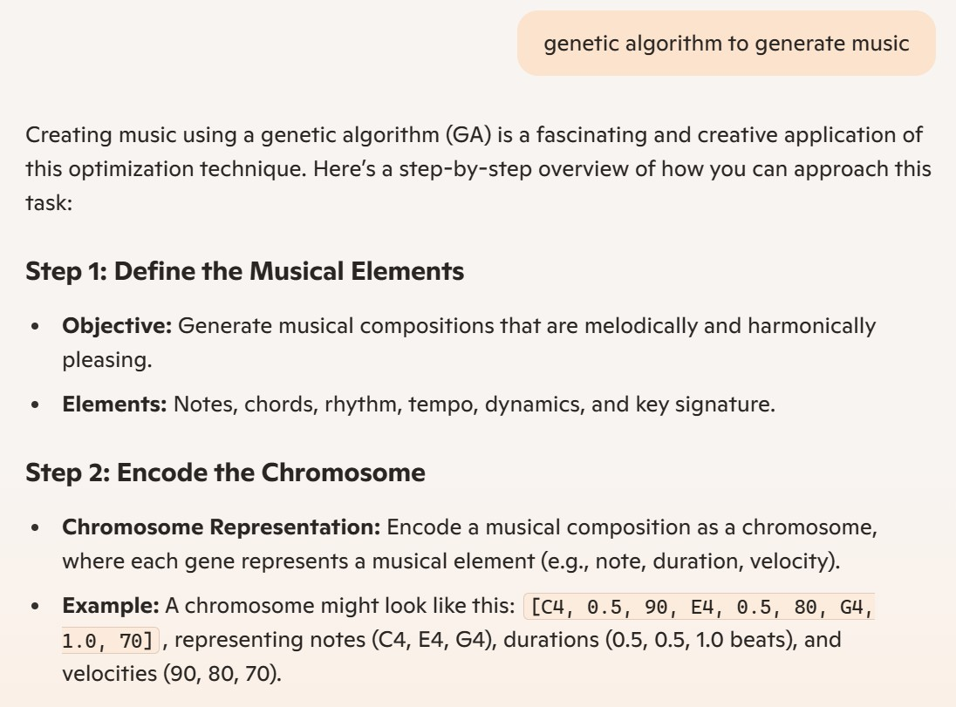

Slide 11
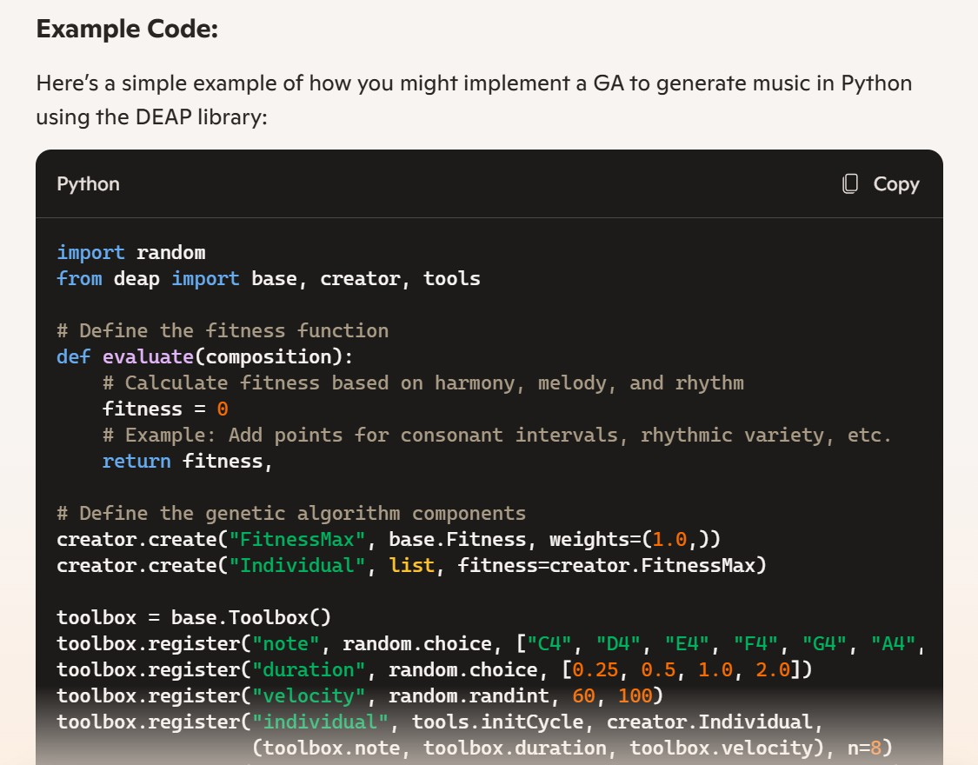

Slide 12
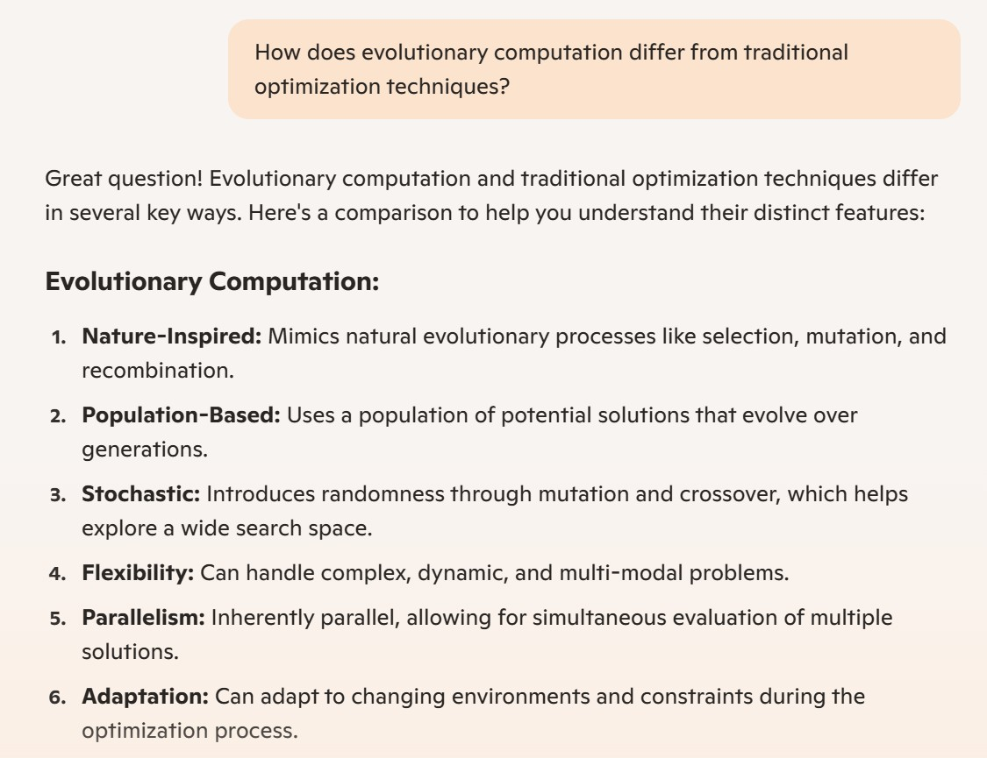

Slide 13
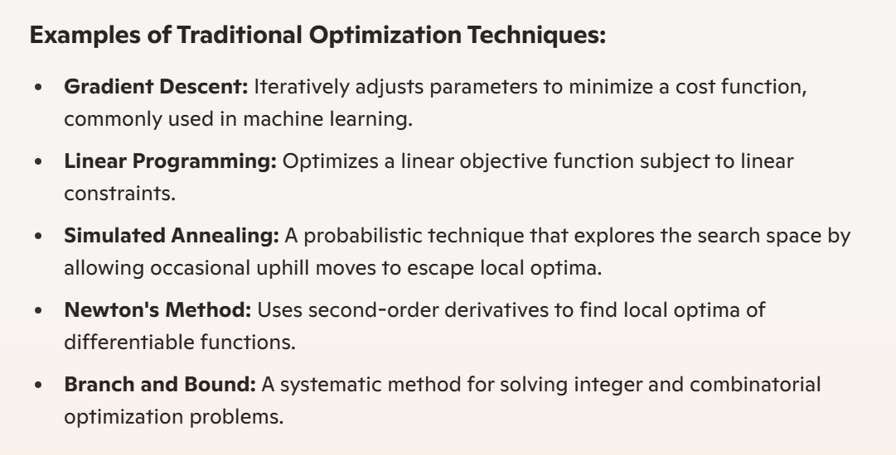

Slide 14
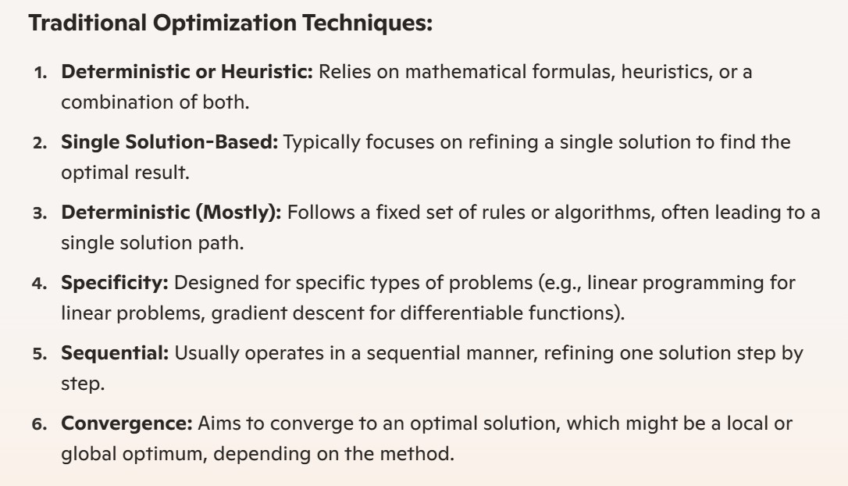

Slide 15
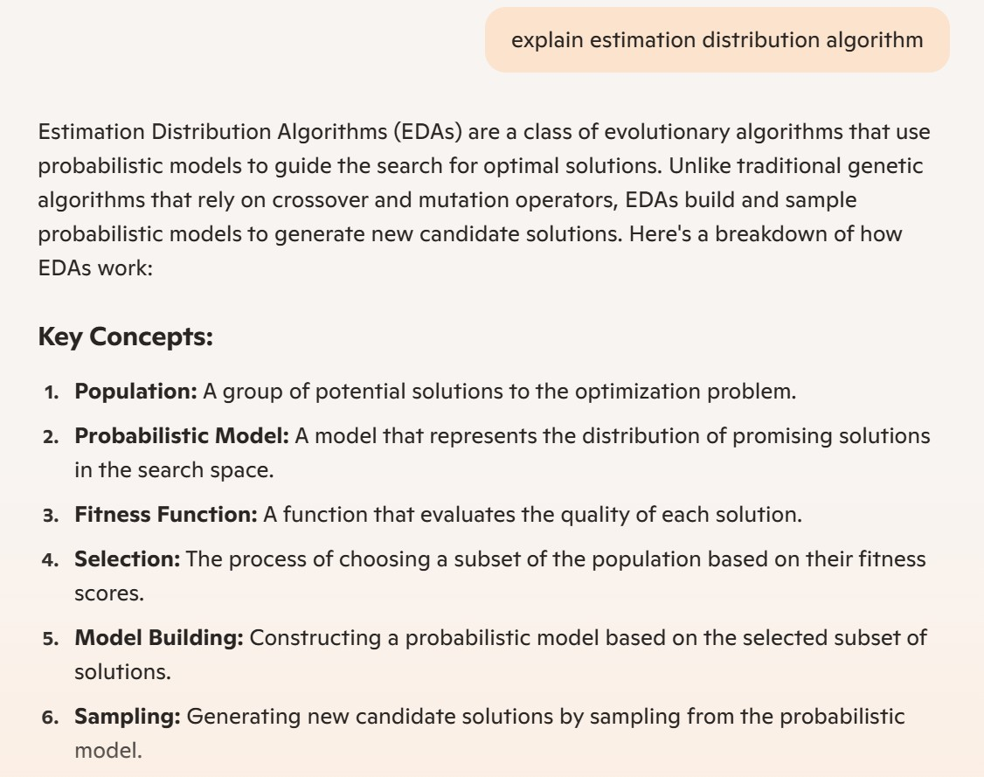

Slide 16
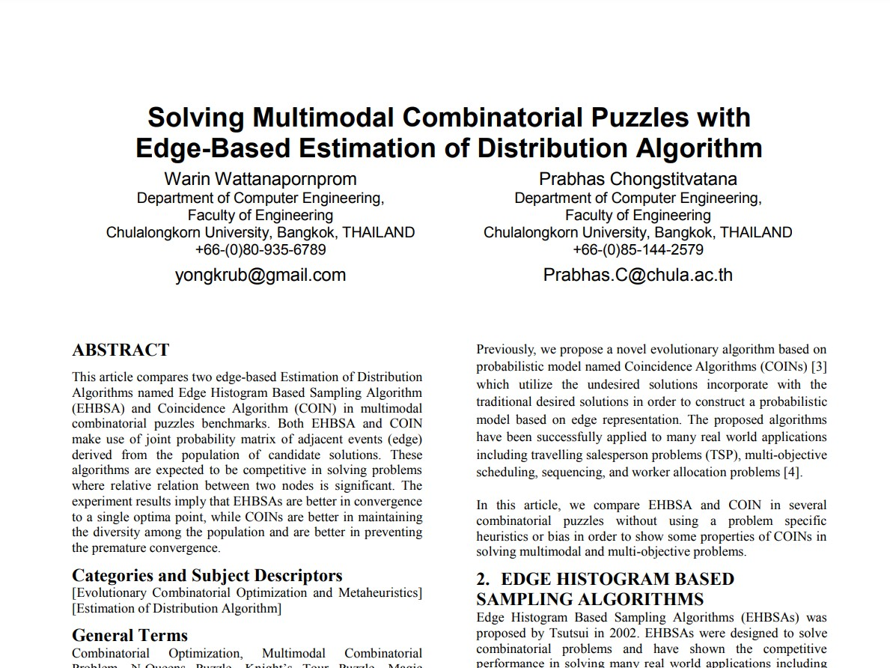

Slide 17
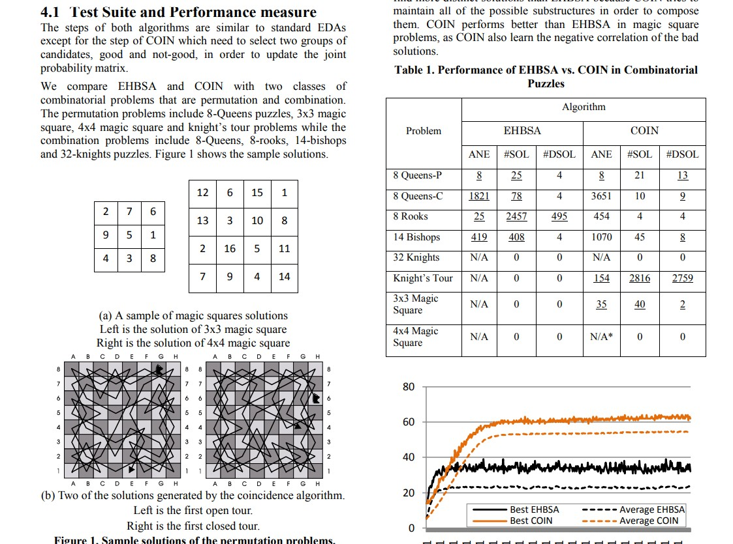

Slide 18
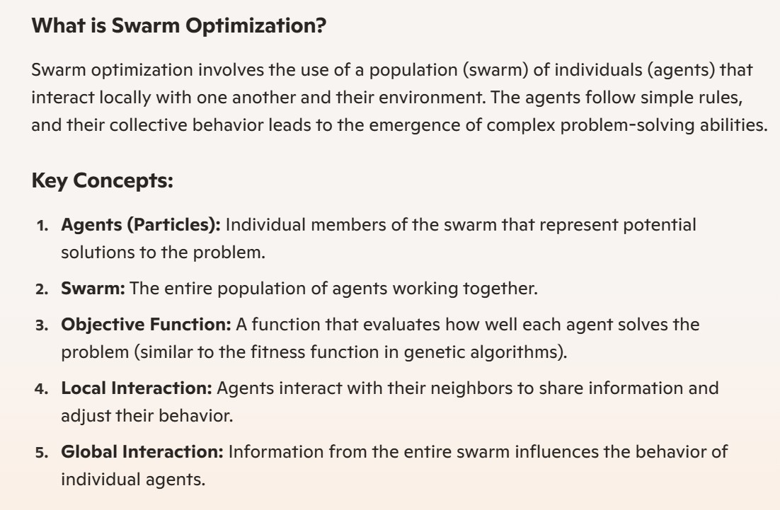

Slide 19
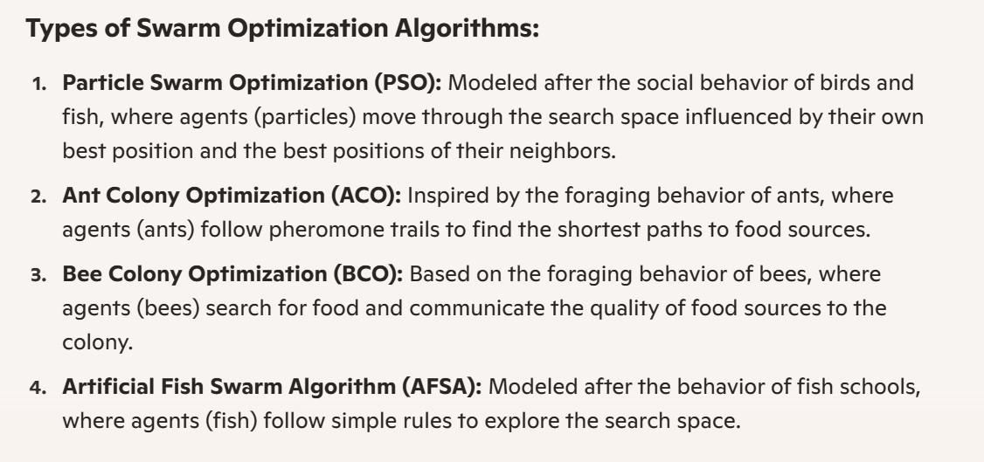

Slide 20
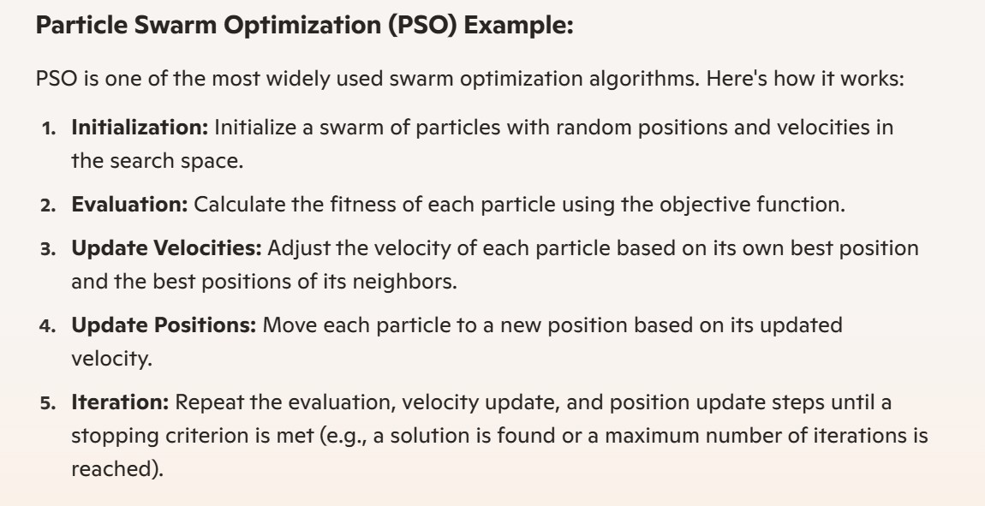

Slide 21
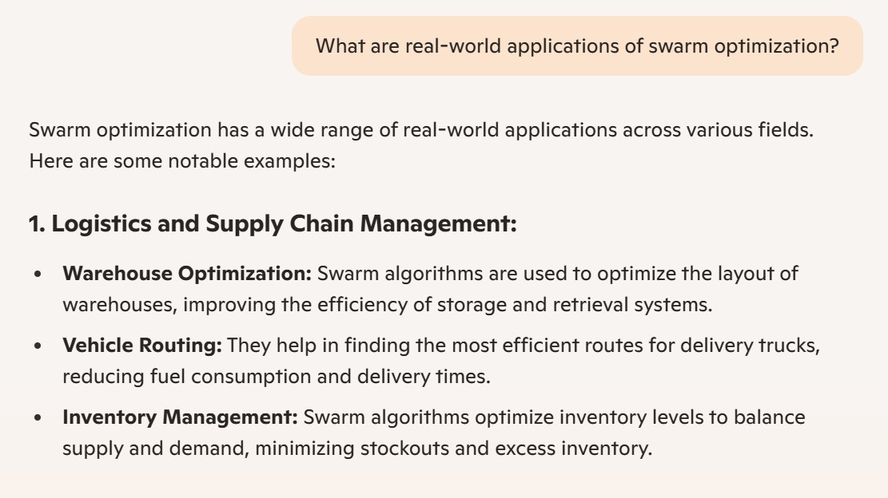

Slide 22
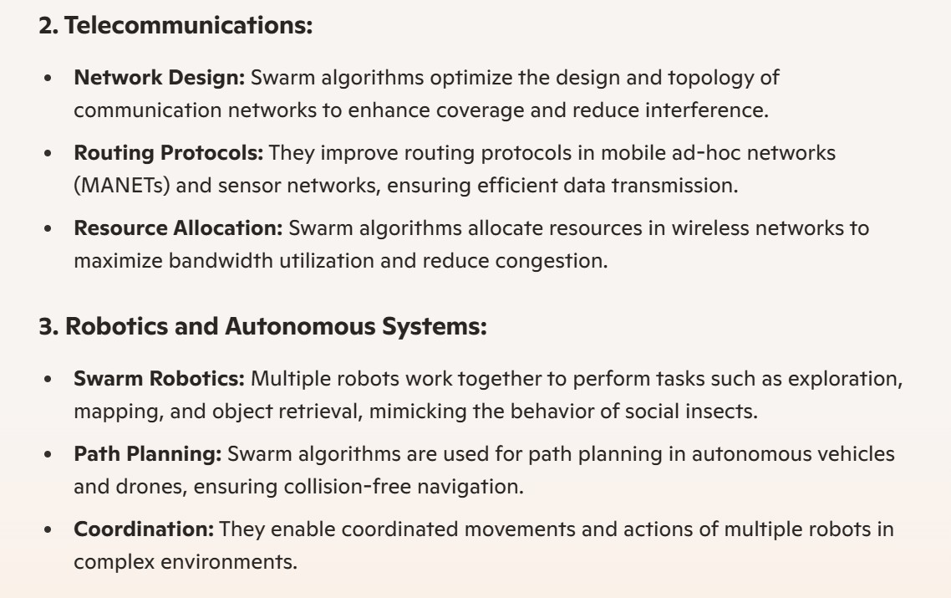

Slide 23
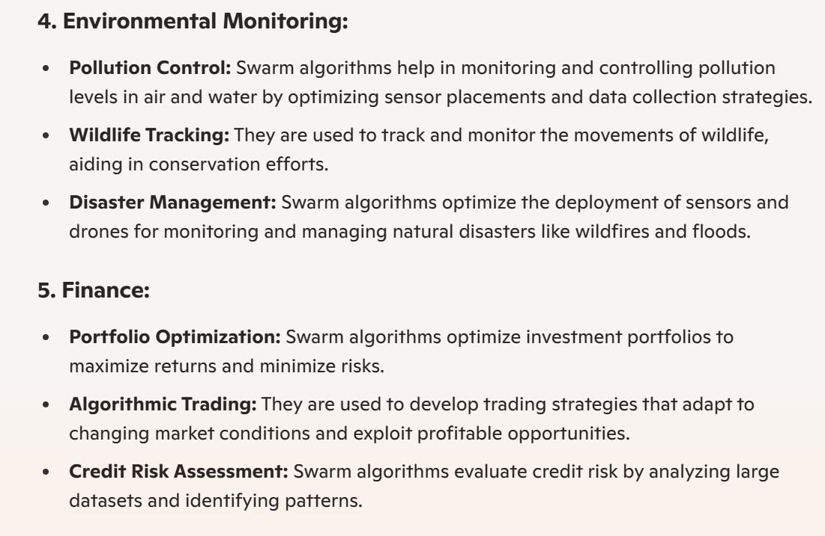

Slide 24
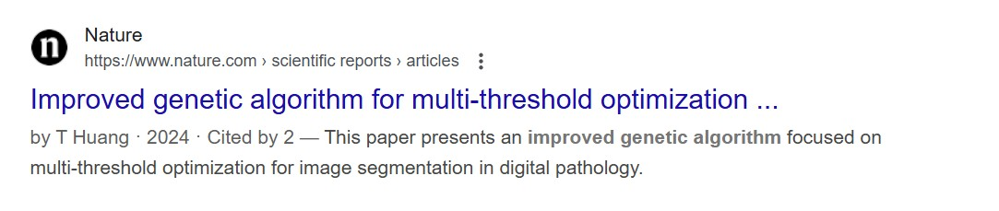

Slide 25
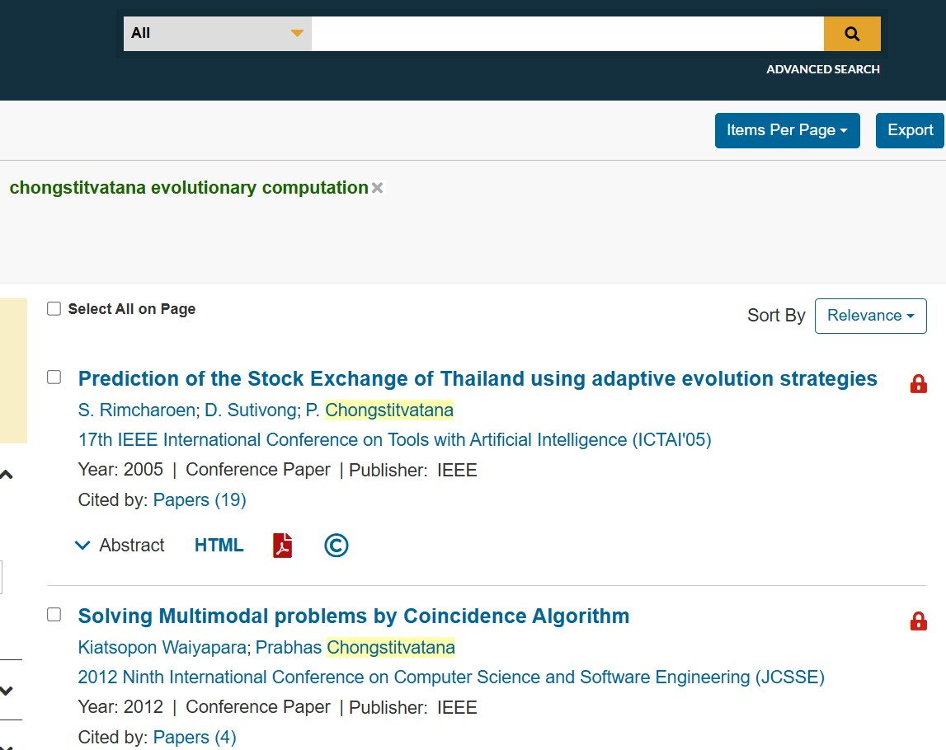

Slide 26
Alternative AI
genetic algorithm demo Mathlab
https://www.mathworks.com/support/search.html/videos/optimizing-manufacturing-production-processes-68961.html
genetic algorithm is design
genetic algorithm generate music
https://www.youtube.com/watch?v=aOsET8KapQQ&t=590s
my research in evolutionary computation
ieeexplore.ieee.org "Chongstitvatana evolutionary computation"
Particle swarm optimization video
https://www.youtube.com/watch?v=8xycqWWqz50
at 1:08 to 1:46
next generation GA Estimation of Distribution Algorithm EDA
example: solving puzzle
https://www.cp.eng.chula.ac.th/~prabhas//paper/2011/GeccoPoster5.pdf

