Slide 1
Artificial Intelligence
Prabhas Chongstitvatana
Chulalongkorn University

Slide 2
More Information
Search “Prabhas Chongstitvatana”
Go to me homepage

Slide 3
AI Fundamentals

Slide 4
What is AI?
an intelligent agent that acts like human.
this includes software services (aka Apps) and automated machines (think smart robot vacuum, automated factory etc.).

Slide 5
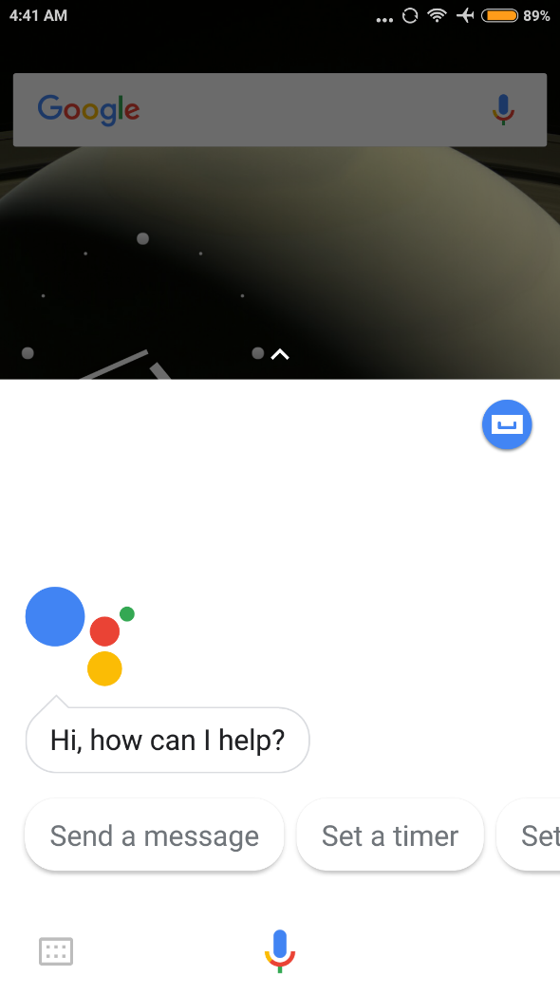
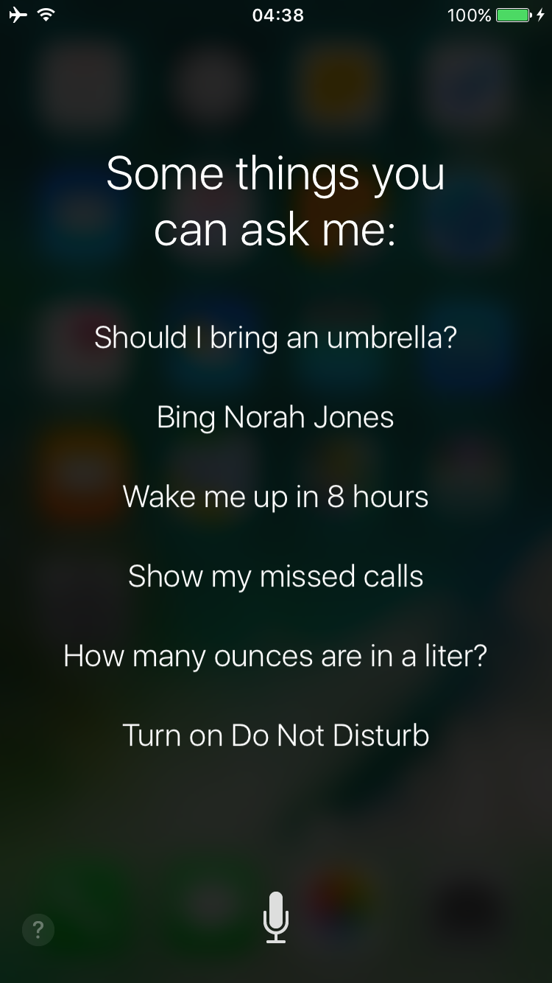

Slide 6
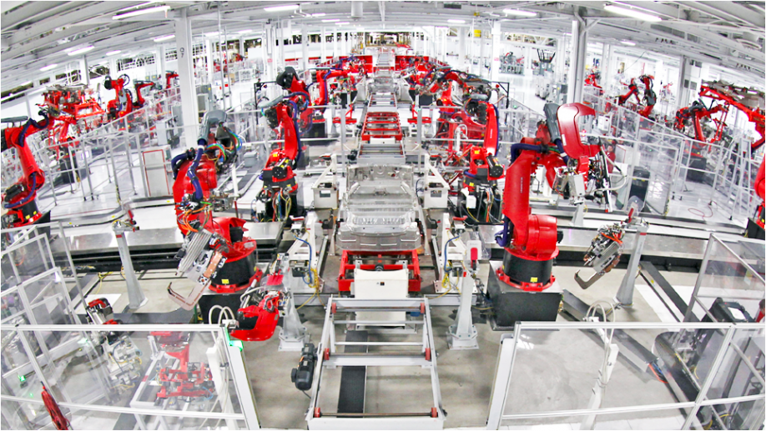

Slide 7
What can AI do?
understand human speech
identify objects from pictures
play games
analyse big financial data
drive cars
control robots
automate many jobs

Slide 8
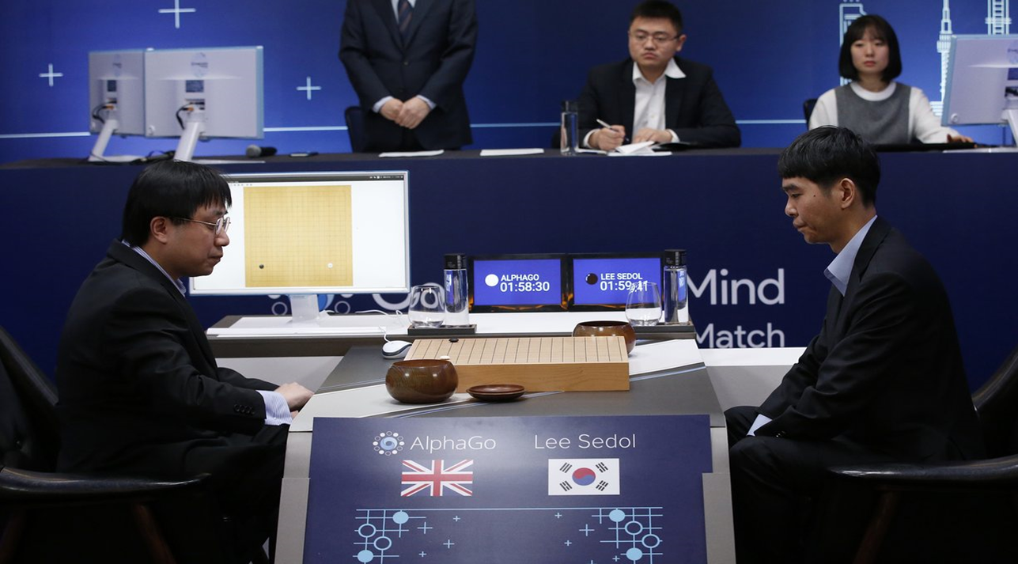

Slide 9
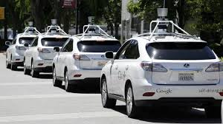

Slide 10
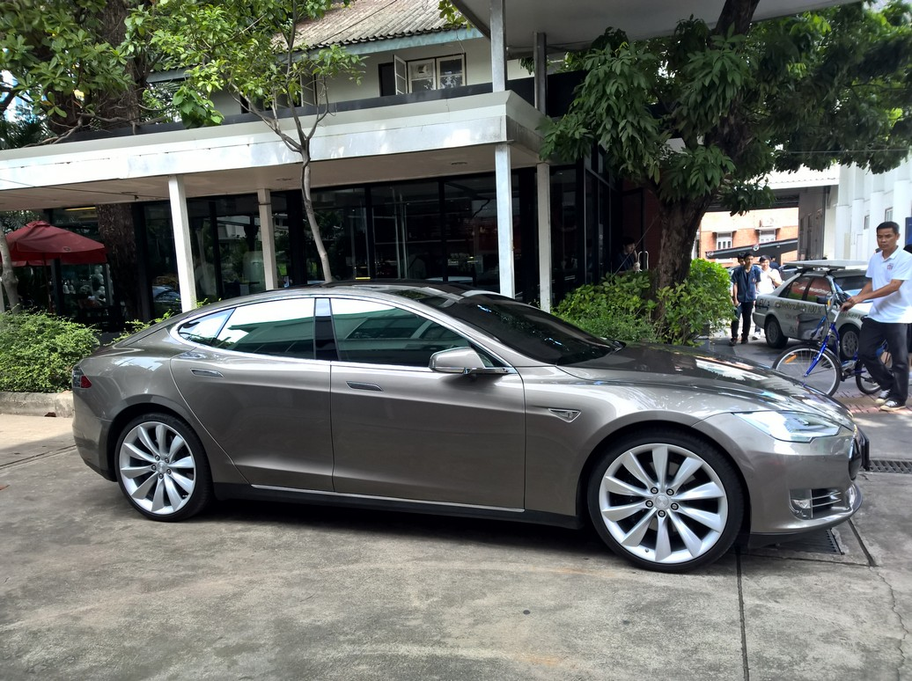
DriverLess car

Slide 11
How a computer program be intelligent?
There are two approaches in the development of AI.
Logic
Memory and learning

Slide 12
First, using logical reasoning.
Computer program can perform deductive reasoning such as
socrates is a human
human are motal
therefore socrates is mortal
We can use logic to encode situation in the real world
when it rains, you cannot play tennis outdoor.

Slide 13
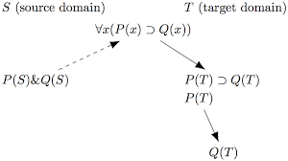

Slide 14
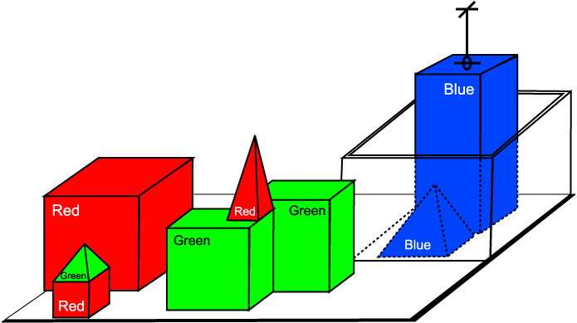

Slide 15
Using large amount of rules and facts, computer programs can deduce a lot of things.
Hence, it behaves intelligently.

Slide 16
Second, use memory and learning
We can imitate human brain by encoding information and memory into a large connected network.
This network responses to input with a correct output. The relationship of this input/output can be learn from large amount of data without human intervention.
This type of approach is called Artificial Neural Networks.

Slide 17
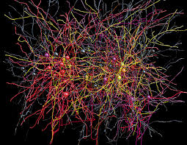

Slide 18
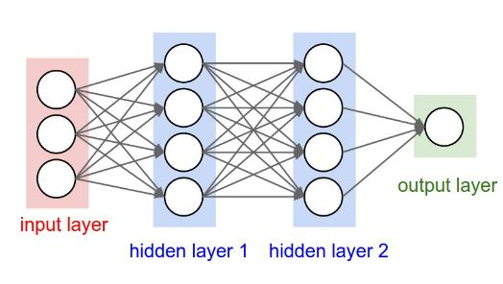
Artificial Neural Network 3-layer

Slide 19
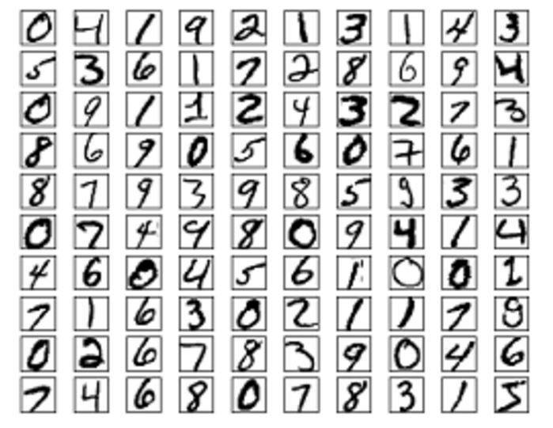

Slide 20
Example, recognise the picture of my wife
I can show a lot of pictures of my wife from many angles. Then I can train a kind of network to remember this face. I also train a lot of pictures of not-my-wife face. So, now the network can distinguish between my-wife and not-my-wife faces.

Slide 21
This is the most popular method today.
Multiple layers (update few hundreds) of this Network can be constructed
It is called Deep learning

Slide 22
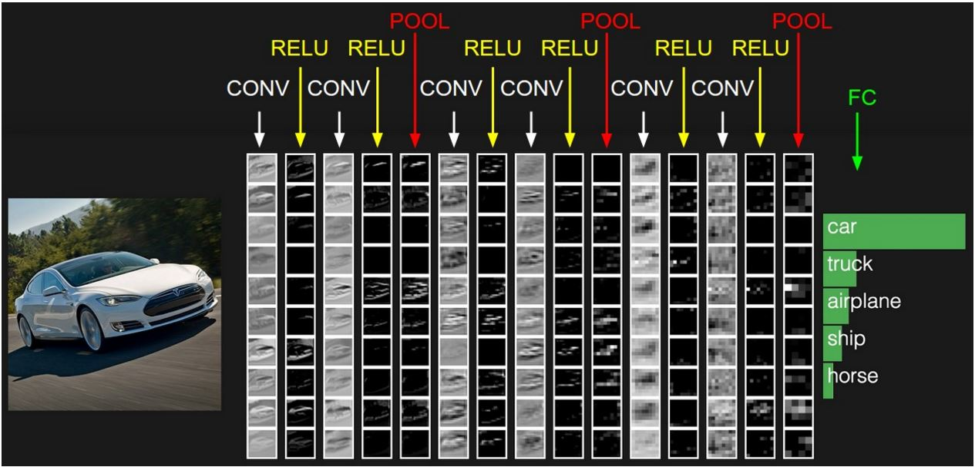
Example of NN layer

Slide 23
Most AI programs are written using "heuristic", i.e. the program behaves by some rule that is encoded "human" tactic.
For example, a program to play chess evaluate the board position according to rule created by human expert.

Slide 24
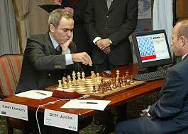

Slide 25
Another way to create AI program is by using "search".
The problem is encoded as many alternative way to solve it, and AI program looks at these alternatives (which can be enormously large in number) and choose a path carefully until a good solution is found.
For example, the sequence of chess moves can be "search" to maximise the possibility to win the game.

Slide 26
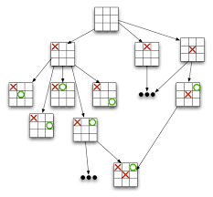

Slide 27
AI program can use evolution to find good solutions.
In this way, initial candidate solutions are created and then evaluate. The good solutions are selected and improve upon.
This step are repeated until solutions are found.
One of the popular method in this class is called Genetic Algorithm.

Slide 28
