Slide 1
Computer Organization
Prabhas Chongstitvatana
prabhas@chula.ac.th
Twitter @prabhas_c

Slide 2
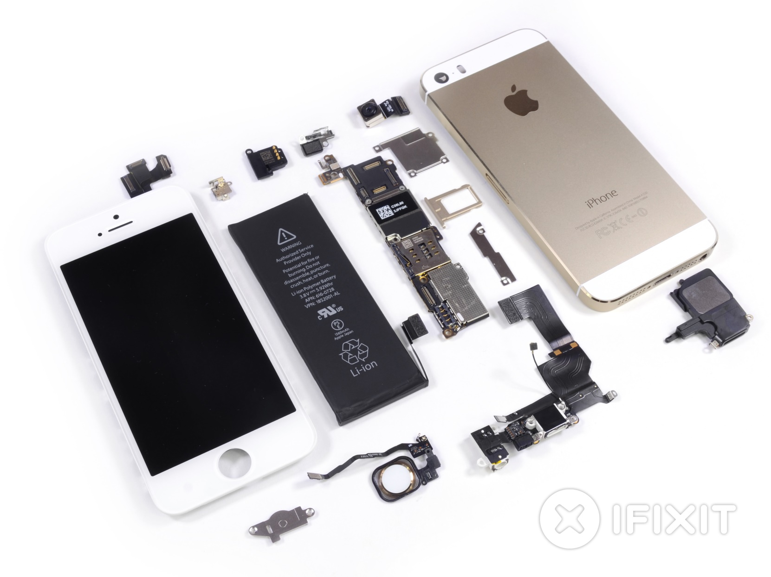
Cost of a cellphone

Slide 3
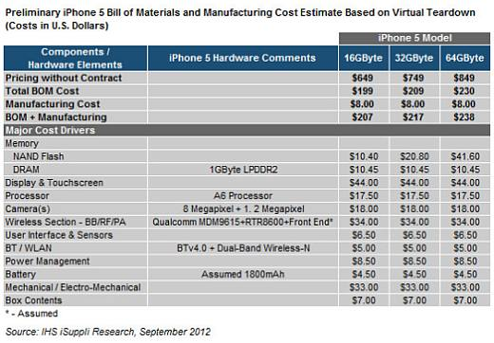
Cost of a cellphone

Slide 4
Cost of cellphones
iphone 5s 16GB
total cost $191 + assembly $8
price sim-free (unlock) $649
  display $41
  RF chips $32
  fingerprint sensor $7
  A7 processor (dual core) (64-bit) $19
  ROM (NAND Flash) 16G $10.40
  RAM 1G $10.45
Samsung Galaxy S4 cost $237
  5 inch display $75
  processor (quad core) (32-bit) $28

Slide 5
Cost of processors
ASUS zenphone 4 | Macbook Air 2014 | Mac Pro
atom z2520 1.2GHz 2 cores 4 threads 32 bit 32 nm power 2-4W $30 | intel core i5 4th gen (Haswell) 4260U dual core (3M Cache, up to 2.70 GHz) + GPU 5000 22 nm Max TDP 15W $315 | Intel® Xeon® Processor E5-1620 (10M Cache, 3.60 GHz) quad core 32 nm Max TDP 130W $294

Slide 6
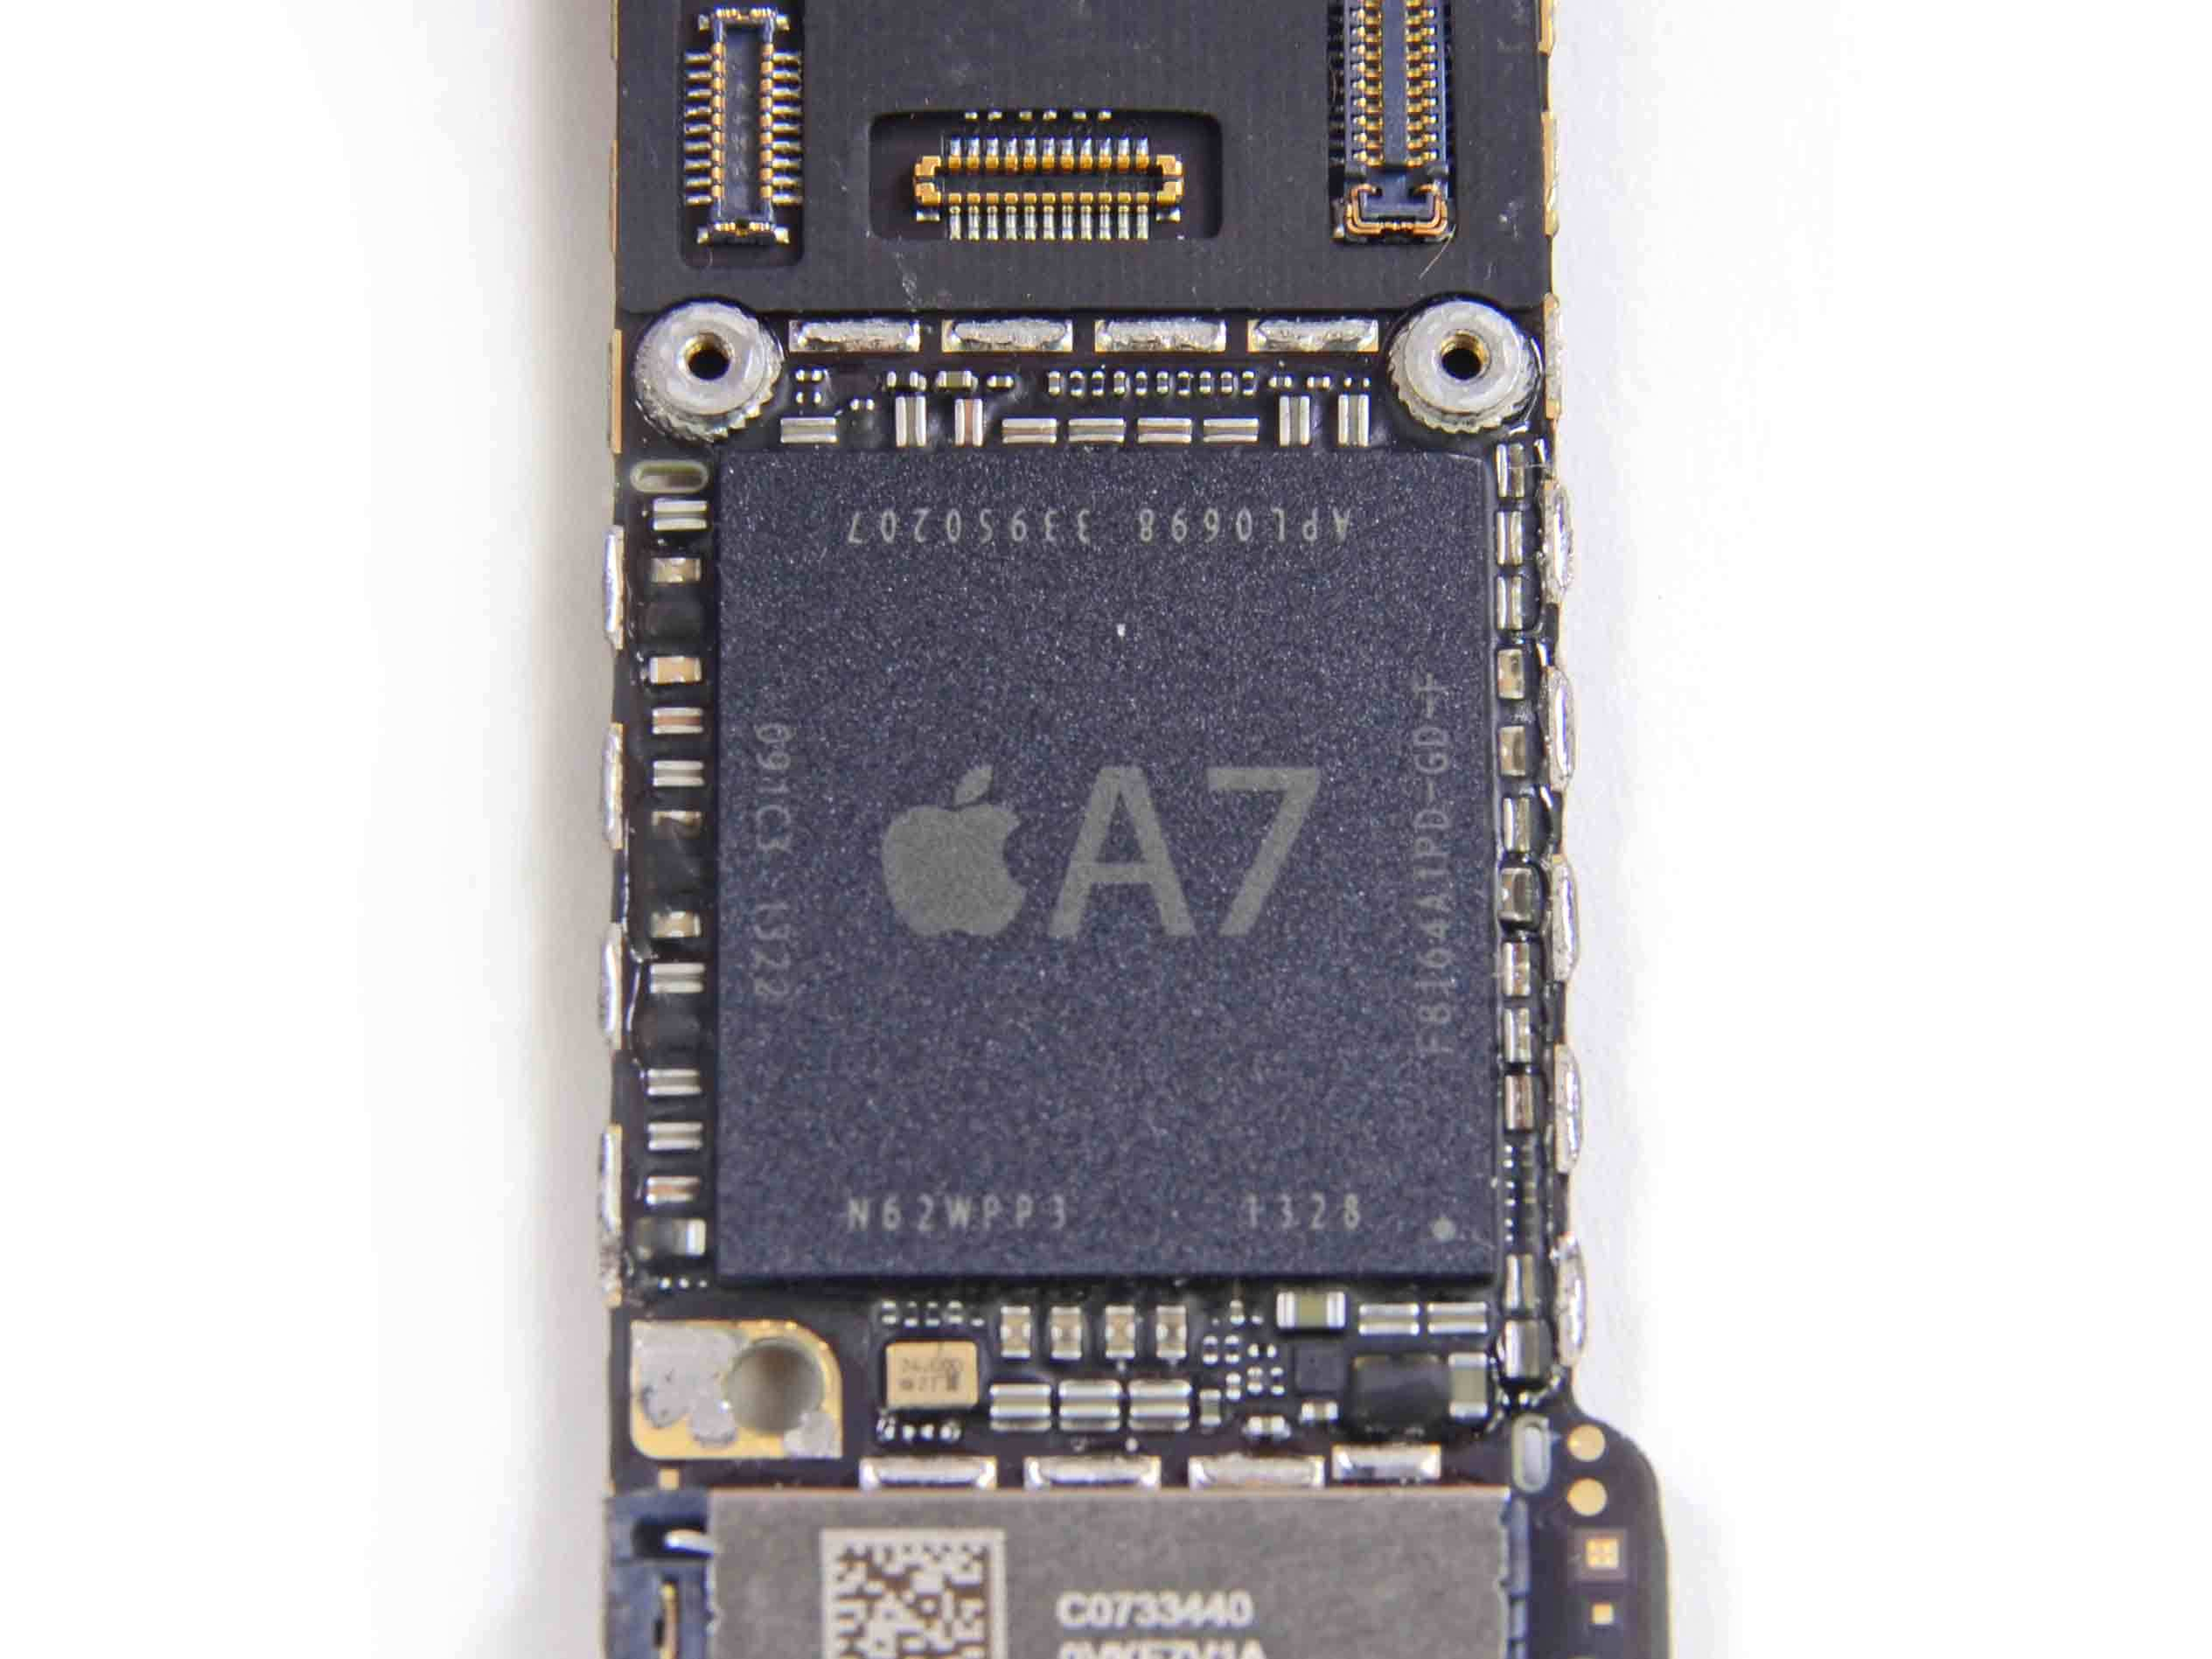
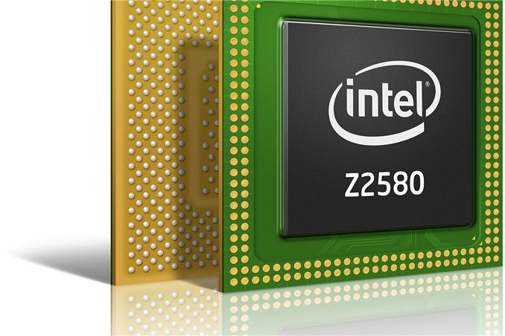
Processors

Slide 7

Cellphone

Slide 8

Graphics Workstation

Slide 9

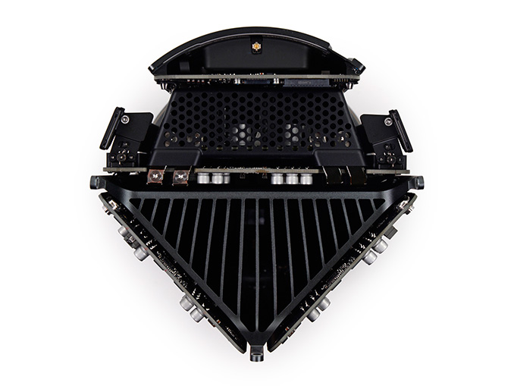
Inside Mac Pro

Slide 10
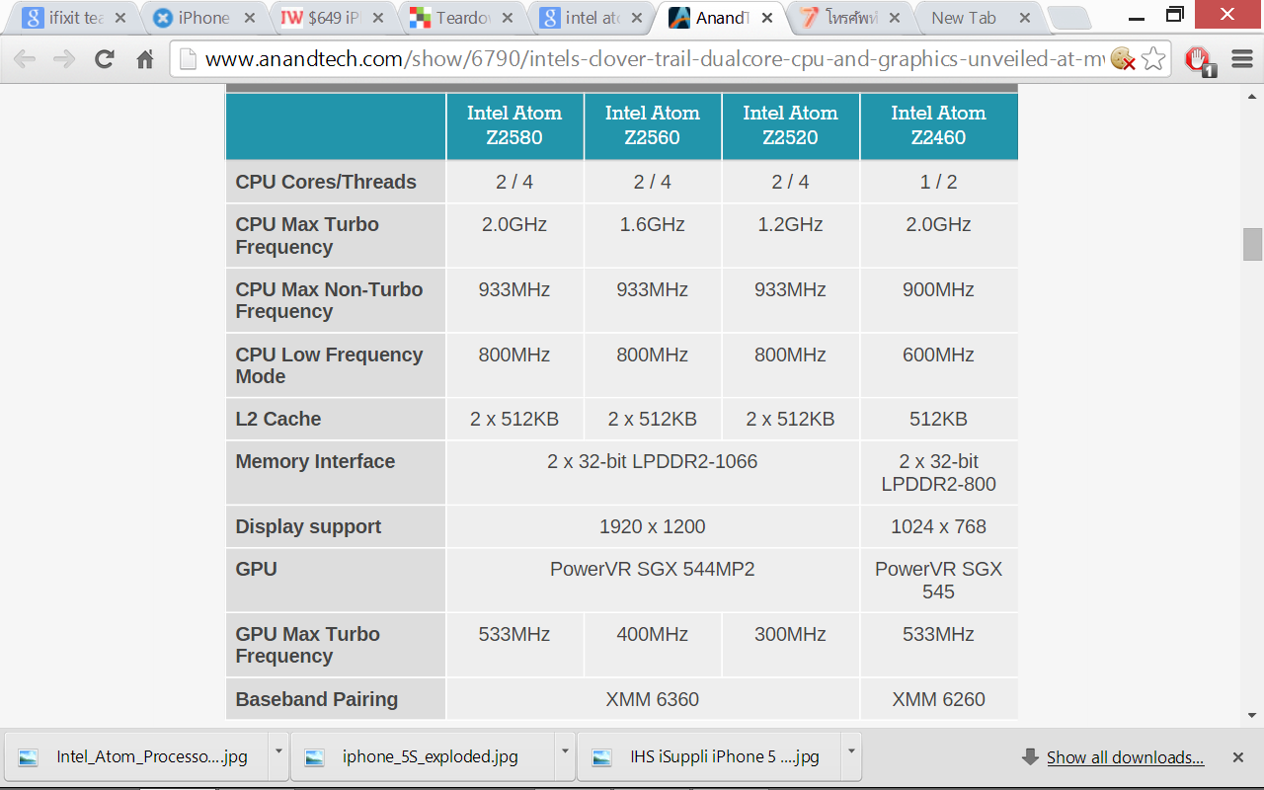
Family of processors

