Slide 1
Floating Point Arithmetic
Prabhas Chongstitvatana
Faculty of Engineering
Chulalongkorn University

Slide 2
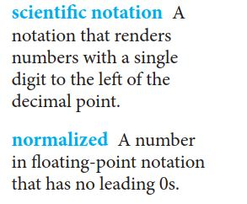

Floating point numbers

Slide 3

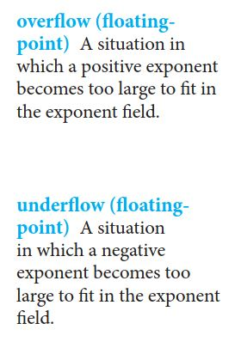
32-bit floating point number

Slide 4
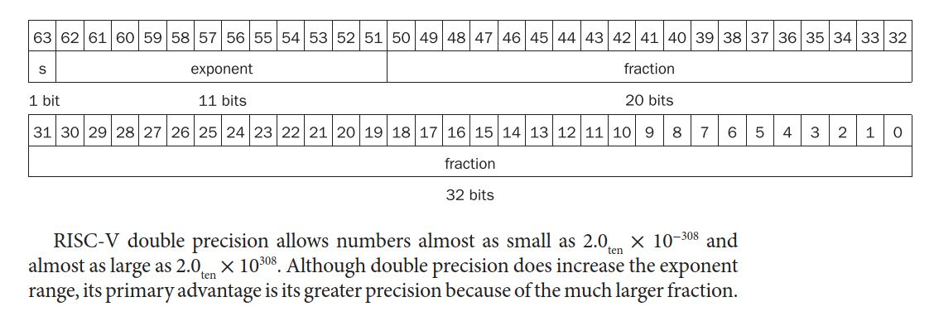
Double precision

Slide 5


IEEE 754 standard

Slide 6
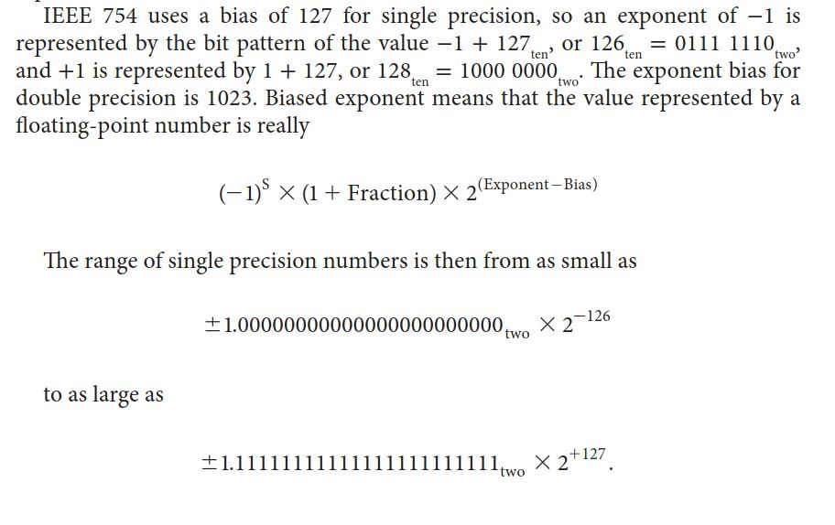

Slide 7
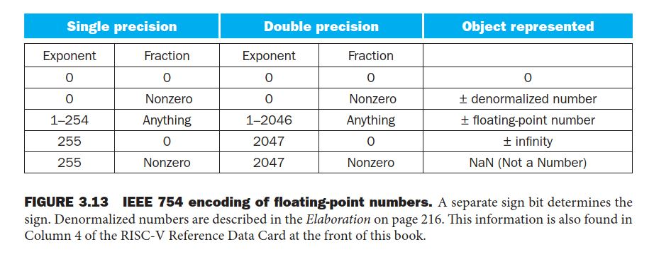
IEEE 754

Slide 8
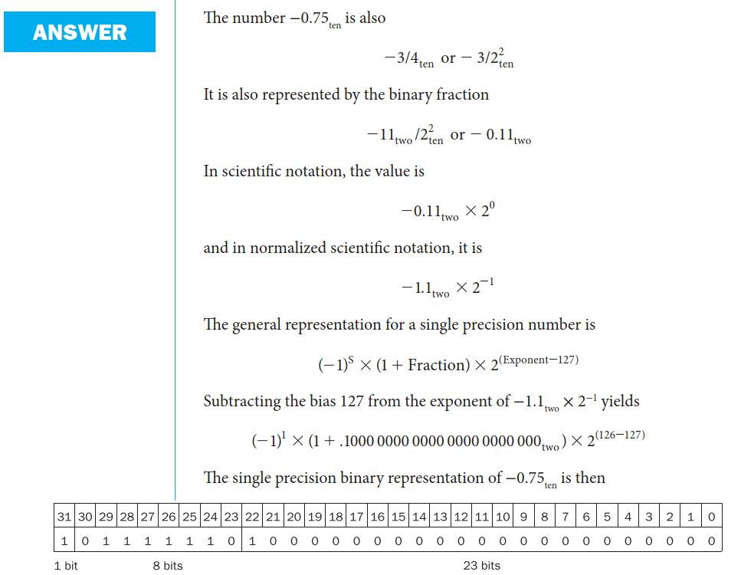
Convert Decimal to Binary in IEEE 754

Slide 9
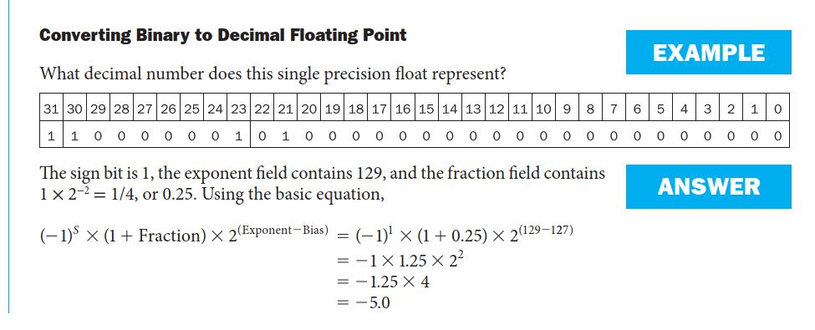
Convert Binary to Decimal

Slide 10
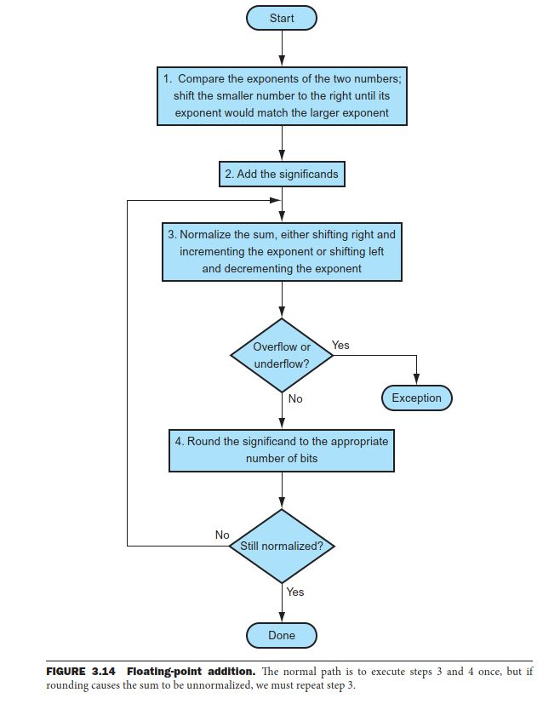
Floating point addition

Slide 11
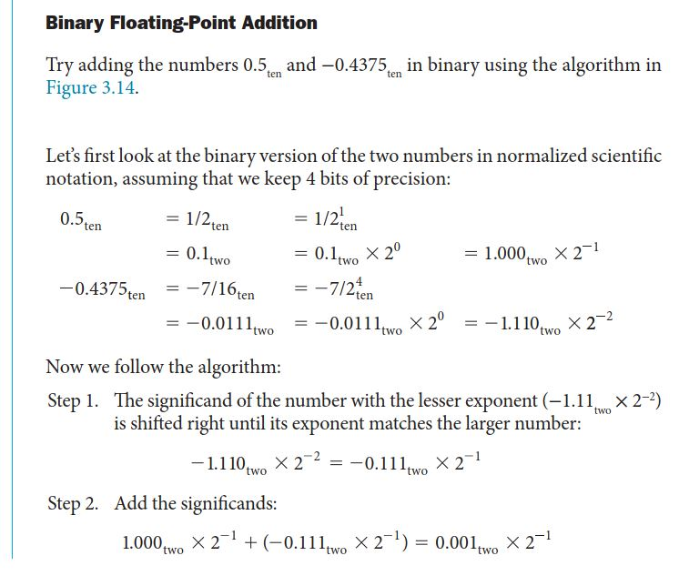

Slide 12
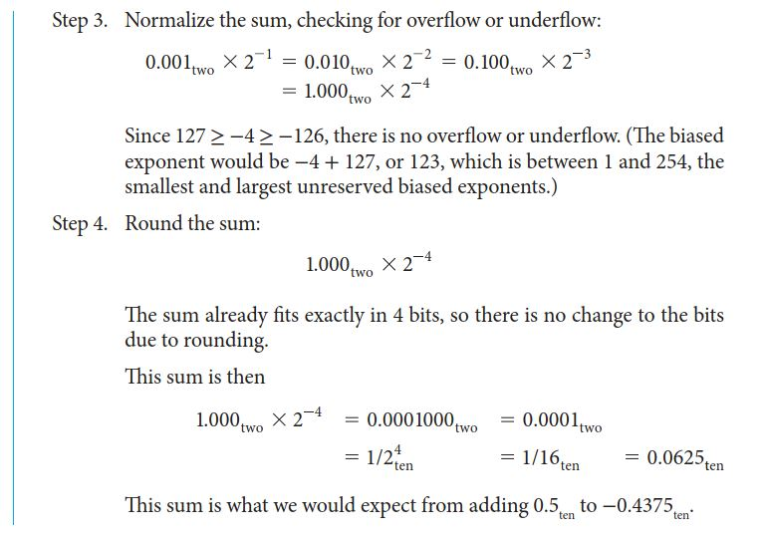

Slide 13
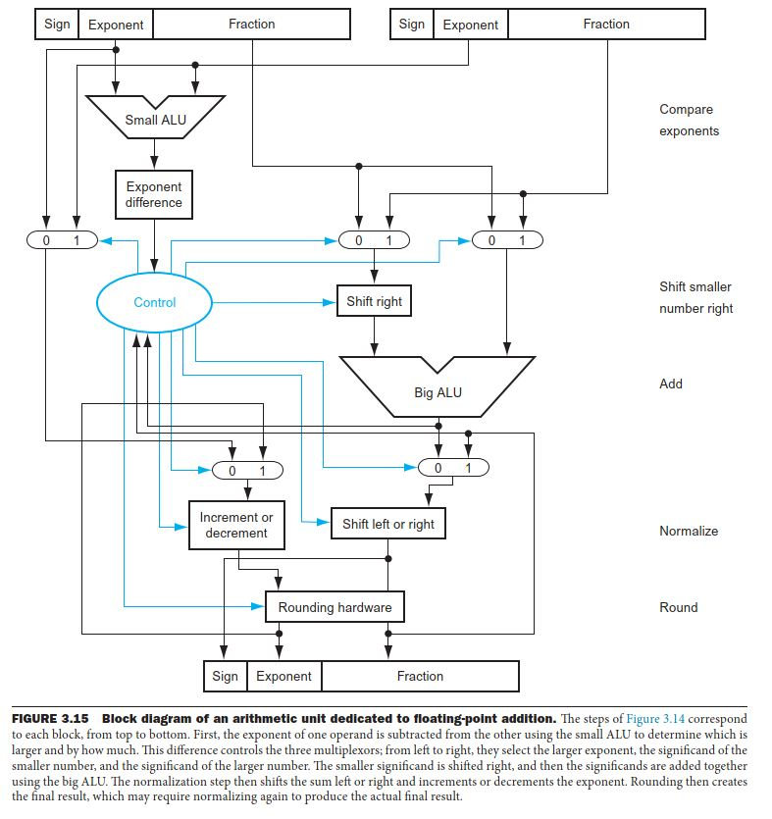
Floating point hardware

Slide 14
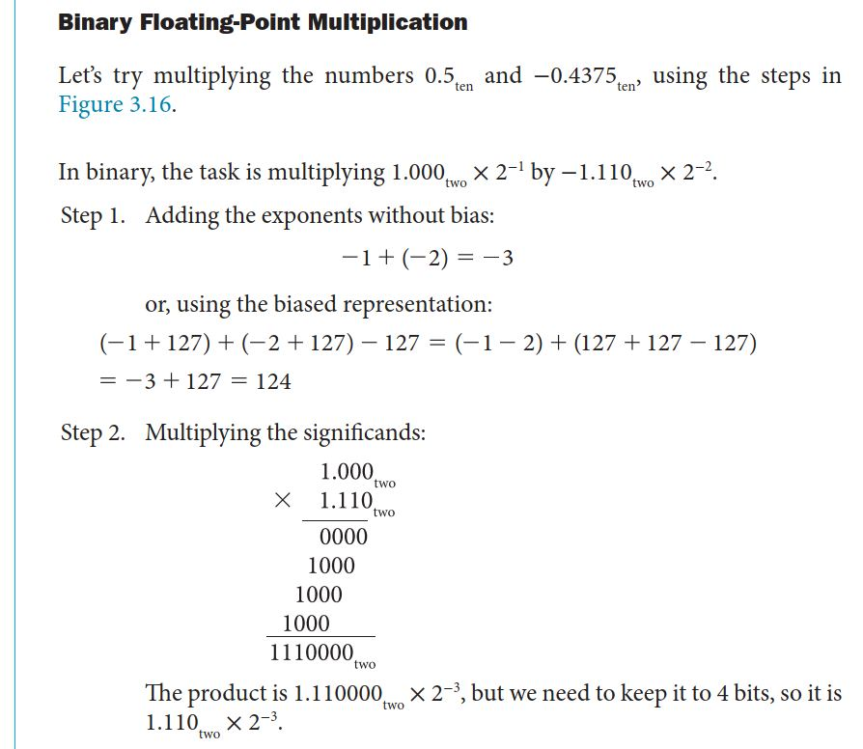

Slide 15

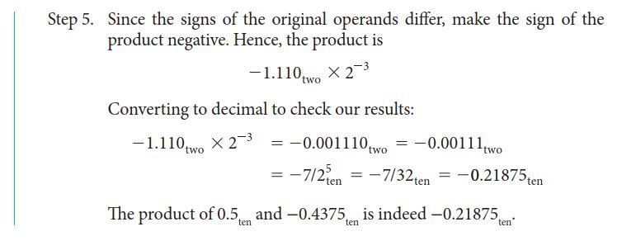

Slide 16
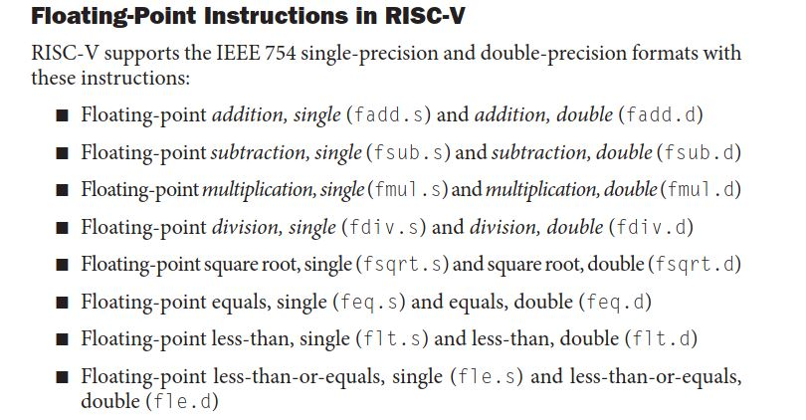

Slide 17
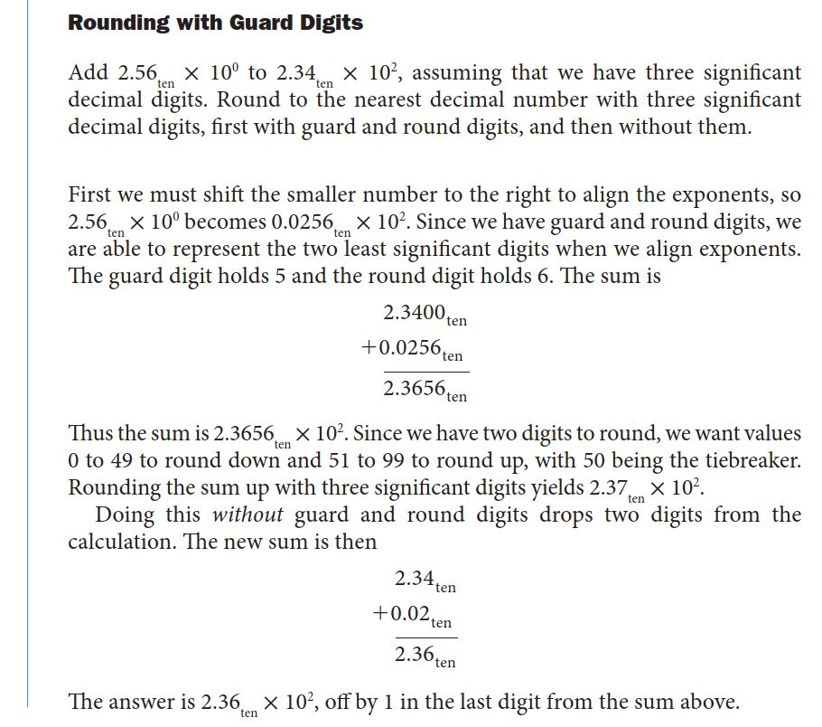

Slide 18
