Slide 1
Arithmetic
Prabhas Chongstitvatana
Chulalongkorn university

Slide 2
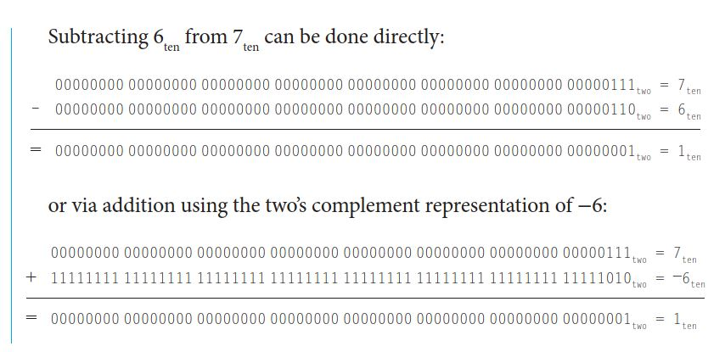
substract

Slide 3

overflow

Slide 4
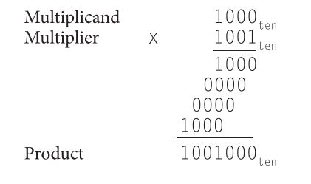
multiply

Slide 5
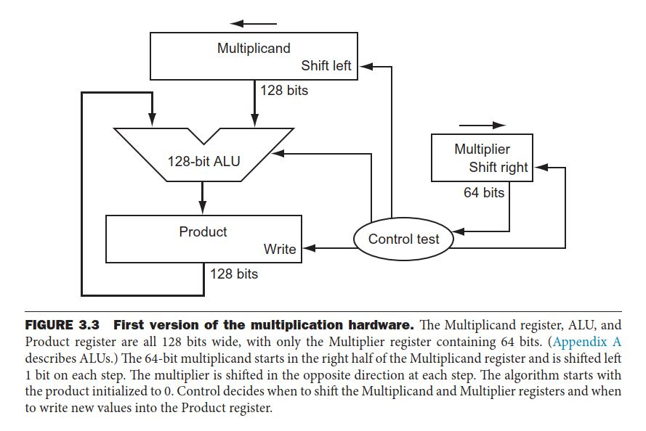
Multiplication hardware

Slide 6
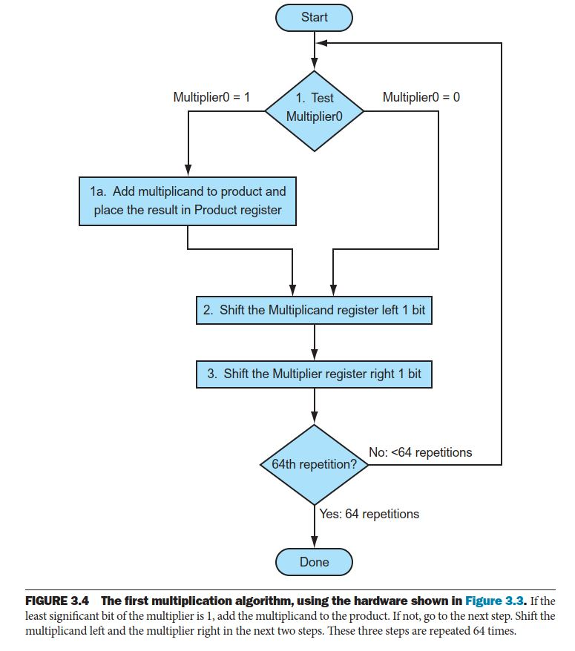
Multiplication algorithm

Slide 7
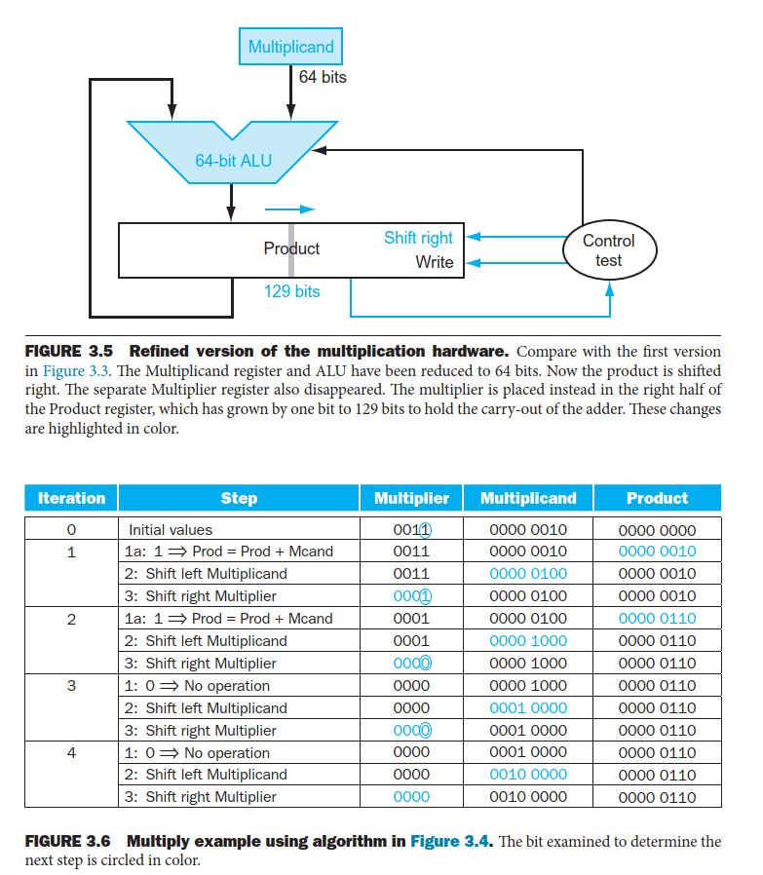

Slide 8
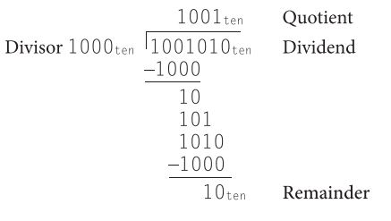

divide

Slide 9
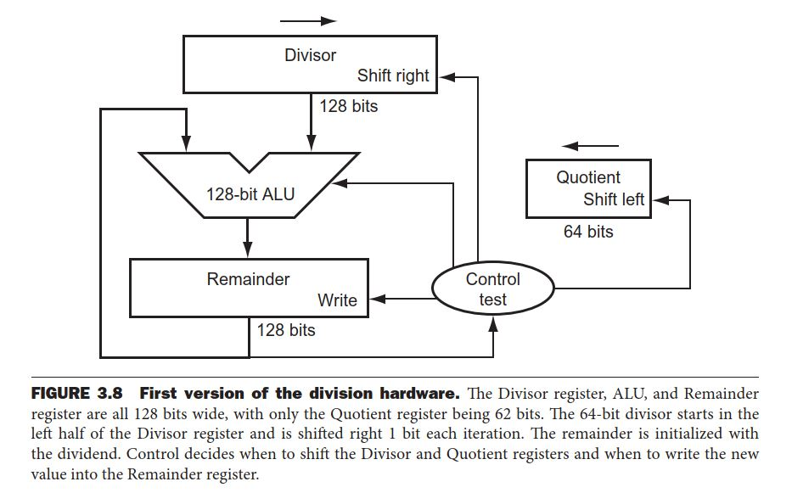
Division hardware

Slide 10
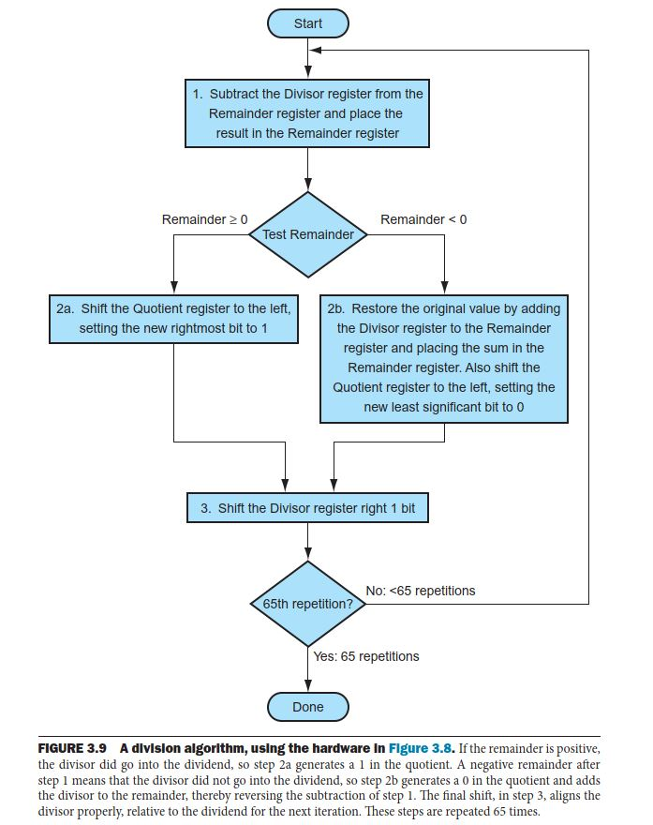
Division algorithm

Slide 11
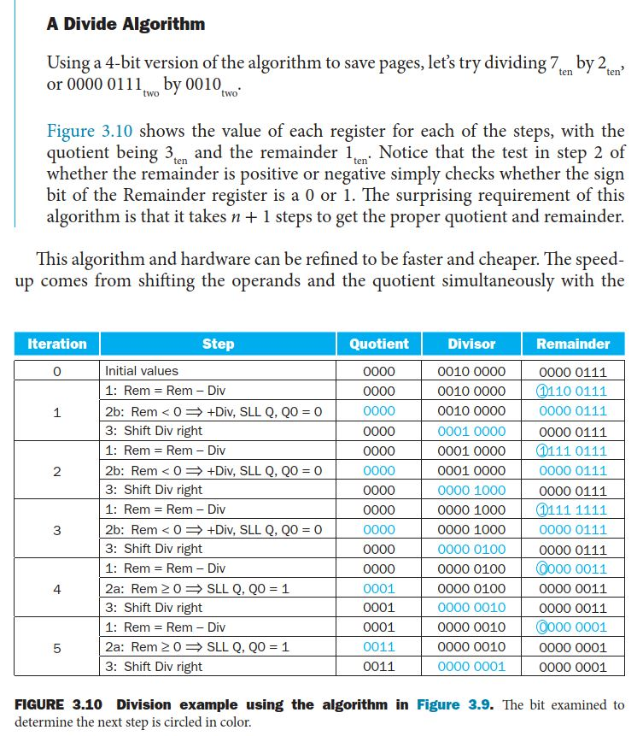

Slide 12
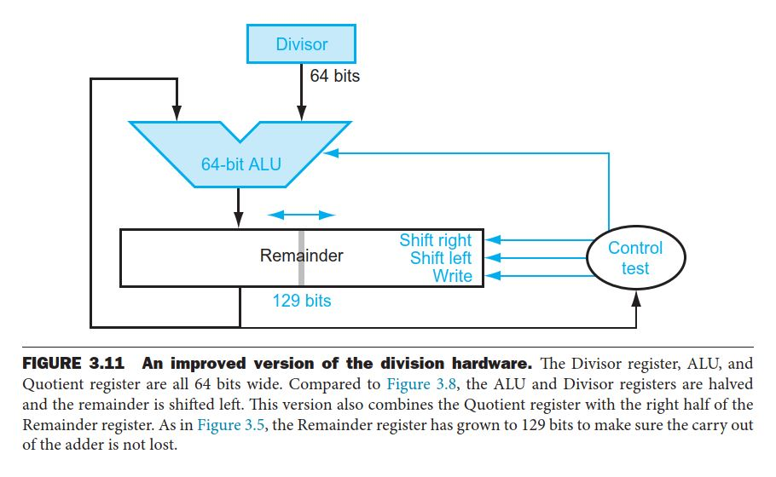
Improved division hardware

Slide 13
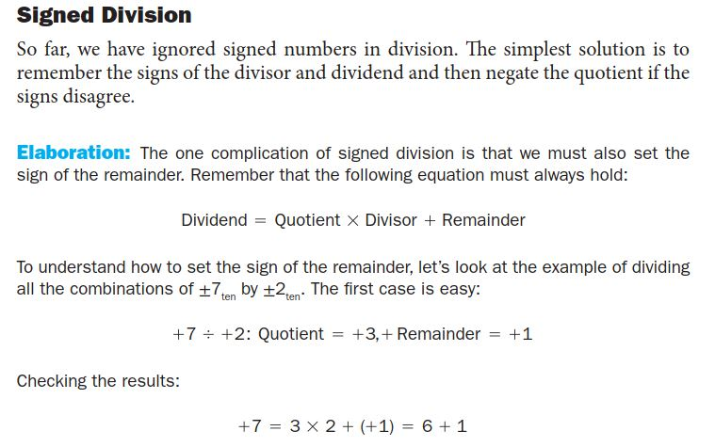
Signed division

Slide 14
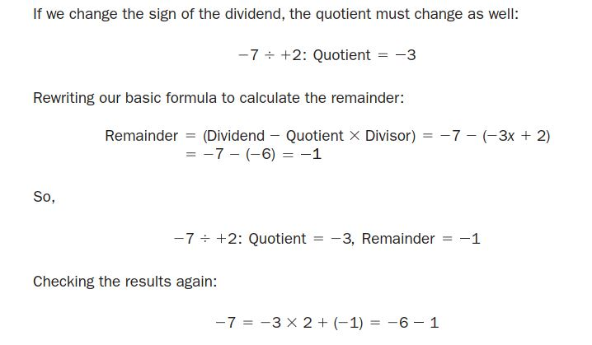

Slide 15
