Slide 1
General Purpose GPU
Prabhas Chongstitvatana

Slide 2
General Purpose GPU
no display, just Execution Units
Explosive growth in the applications
Speed up
Energy efficient

Slide 3
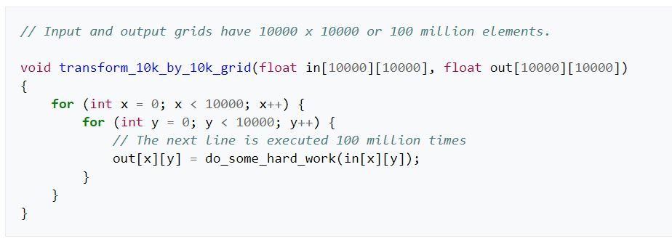
GPU Kernels

Slide 4
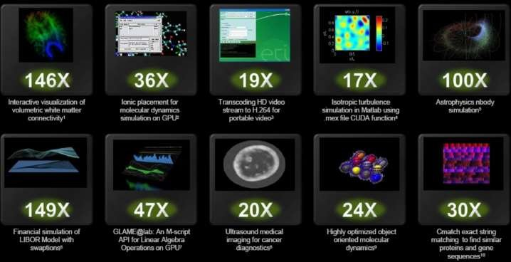
GPU speed up applications
From NVIDIA

Slide 5
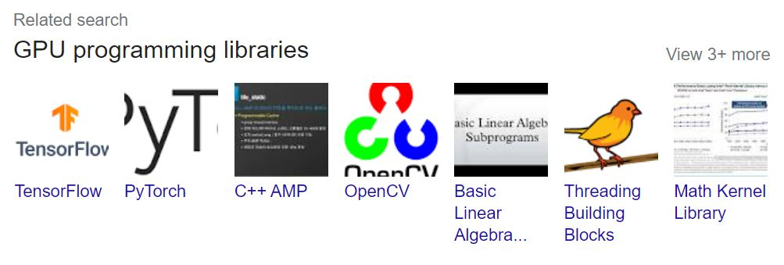
GPU programming Libraries

Slide 6
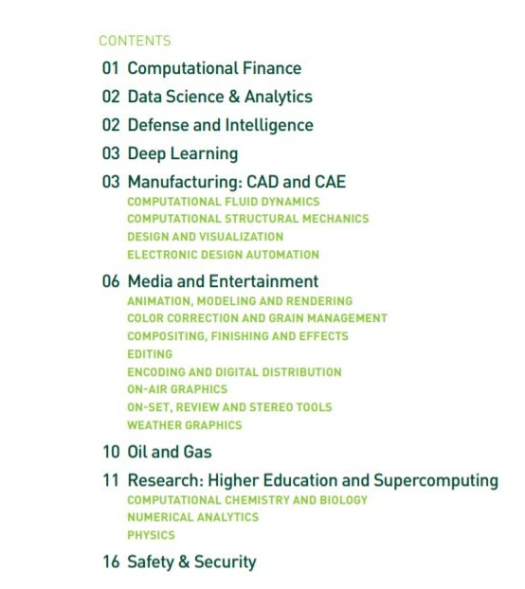
GPU applications

Slide 7
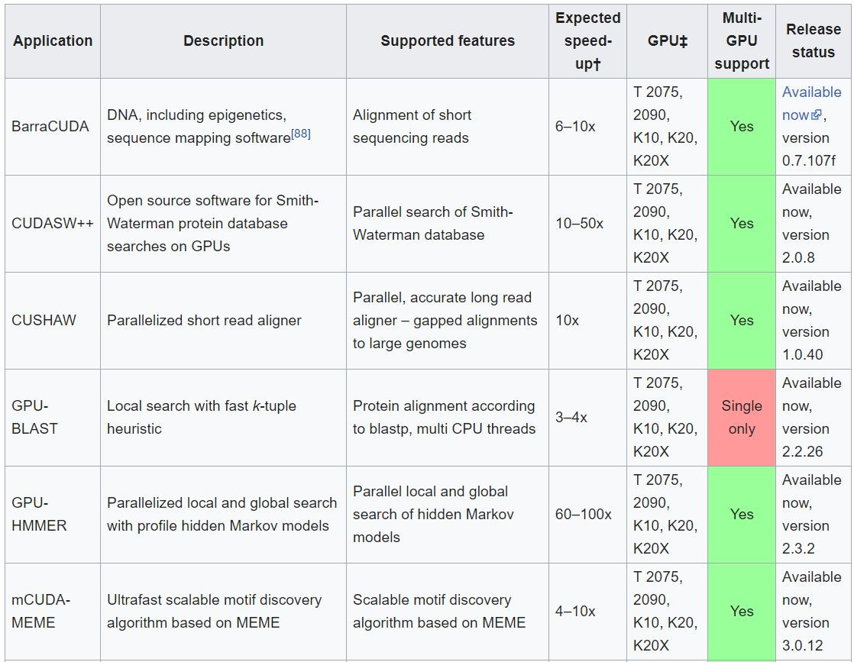
GPU compared to CPU in Bioinformatics
From Wiki, General-purpose computing on graphics processing units

Slide 8
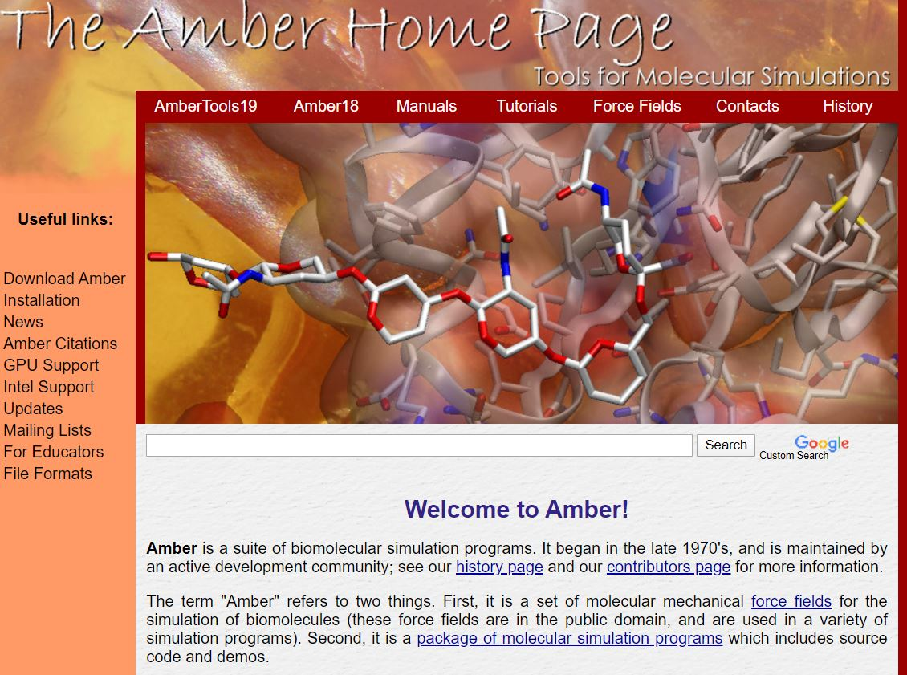
Concrete example: Amber
From https://ambermd.org/
video link https://www.youtube.com/watch?v=FqnPGHdh7iM

