Slide 1
Arithmetic
Prabhas Chongstitvatana
Chulalongkorn university

Slide 2
substract

Slide 3
overflow

Slide 4
multiply

Slide 5
Multiplication hardware

Slide 6
Multiplication algorithm

Slide 8
divide

Slide 9
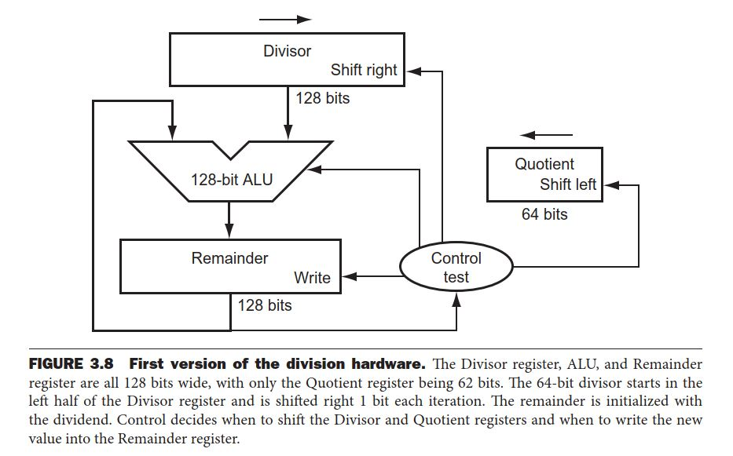
Division hardware

Slide 10
Division algorithm

Slide 12
Improved division hardware

Slide 13
Signed division

