Slide 1
RISC-V pipeline implementation
Prabhas Chongstitvatana
Faculty of Engineering
Chulalongkorn University
2021

Slide 2
Big picture
Pipeline improves instruction throughput, not instruction latency.
Hazard (that delay the pipeline)
  data harzard occurs by data dependency
  solve by data forwarding
  control harzard occurs by branch instruction
  solve by branch prediction

Slide 3
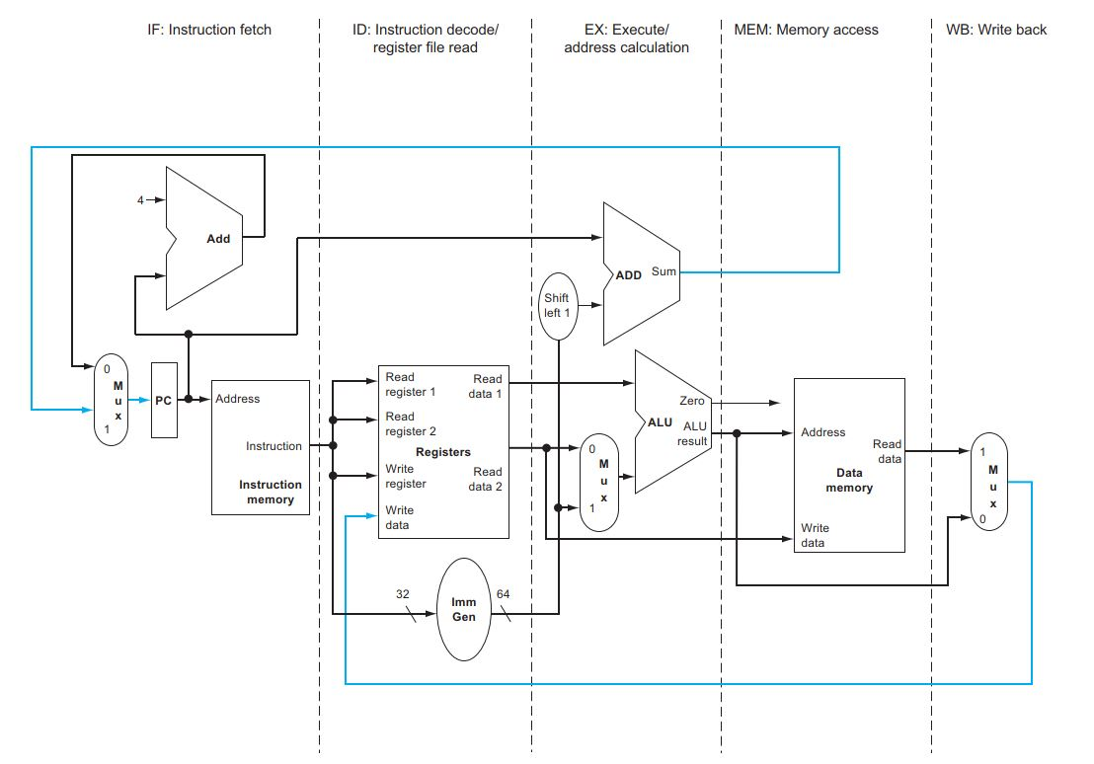
Five stages pipeline
RISC-V divide into five stages pipeline
the blue line in data going "backward" in time (w.r.t pipeline)

Slide 4
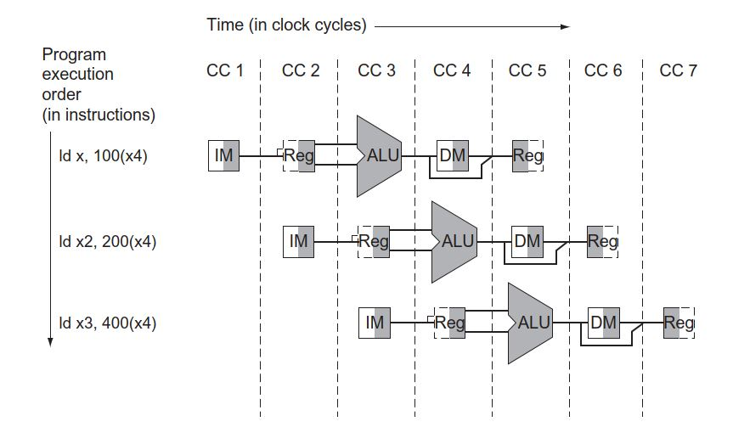
Each stage has two "phases".
First phase is when register is being written to.
Second phase is when register is read.
ALU is used all the time in execution stage.
Data memory is written to in the first phase by "ld" instruction.
At write back stage, register is written to in the first phase.

Slide 5
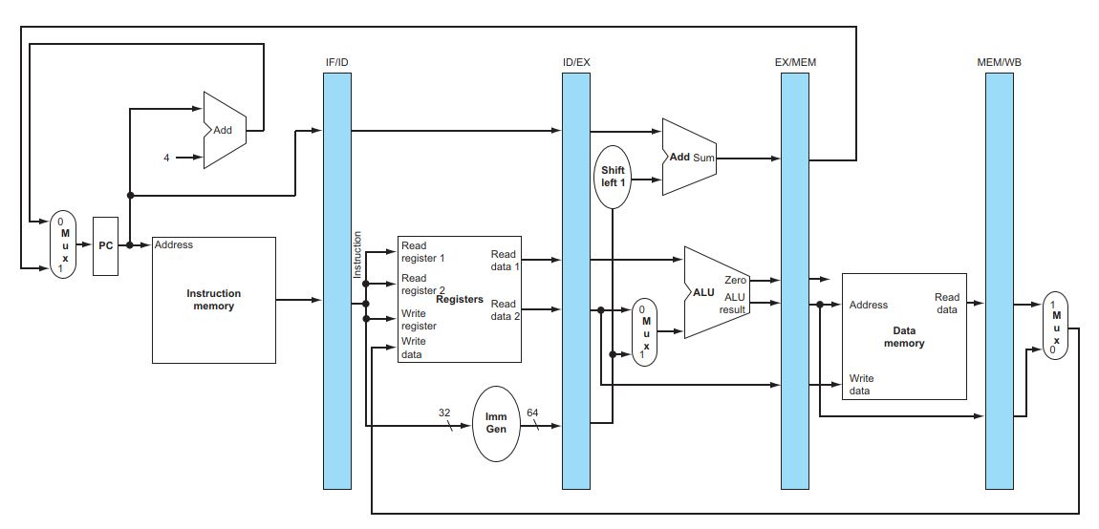
Between pipeline stages there are "pipeline register" to decoupling the signals between stages. Pipeline register connect the wires from left side to right side when appropriate control signals are asserted.

Slide 6
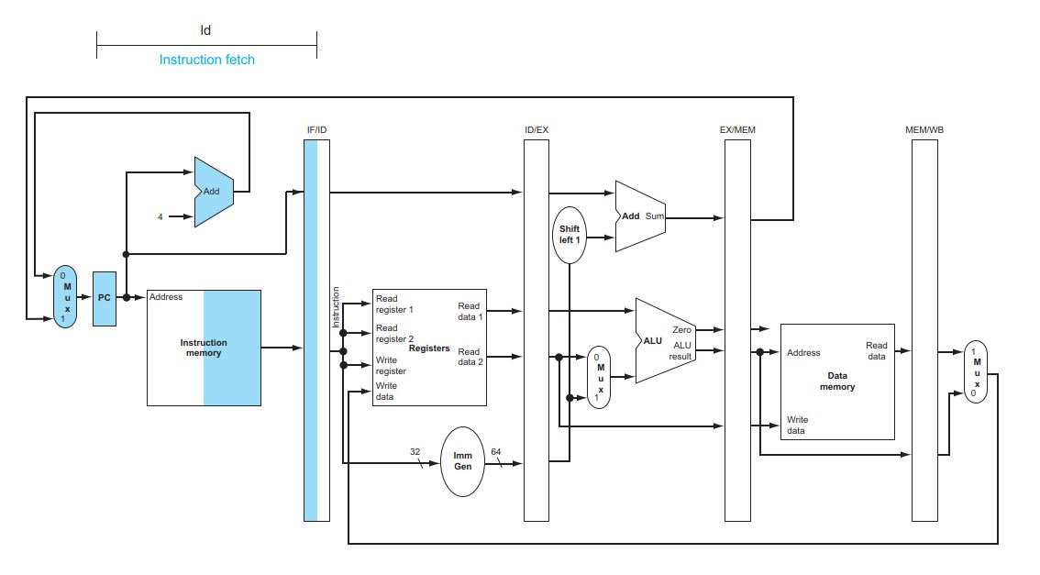
RISC-V pipeline implementation
Show execution of "ld" instruction through five stages:
instruction fetch, decode, execute, memory, writeback
Prabhas Chongstivatana
Faculty of Engineering
Chulalongkorn university
2021

Slide 7
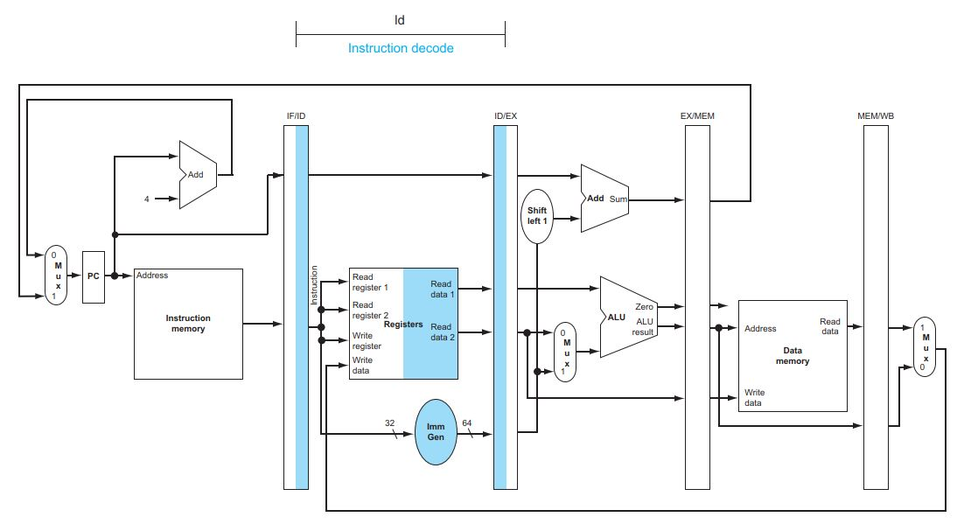

Slide 8
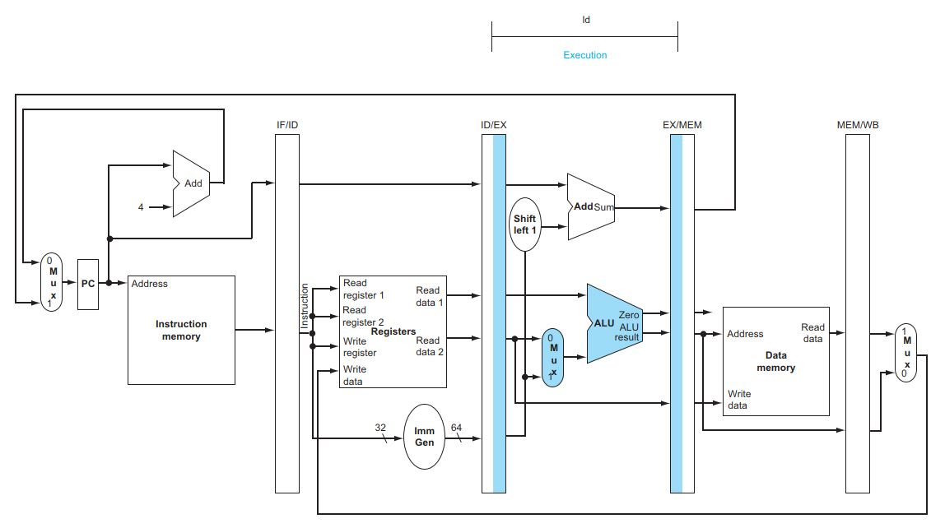

Slide 9
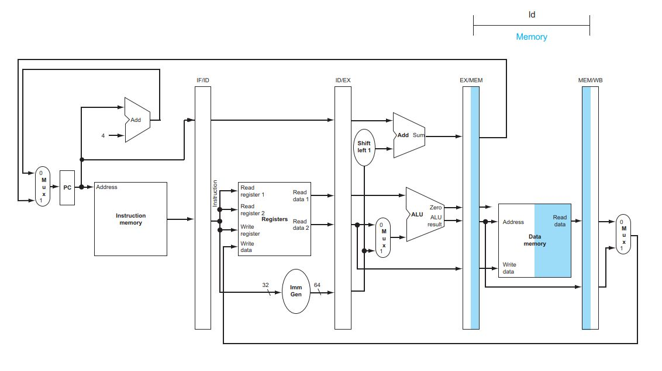

Slide 10
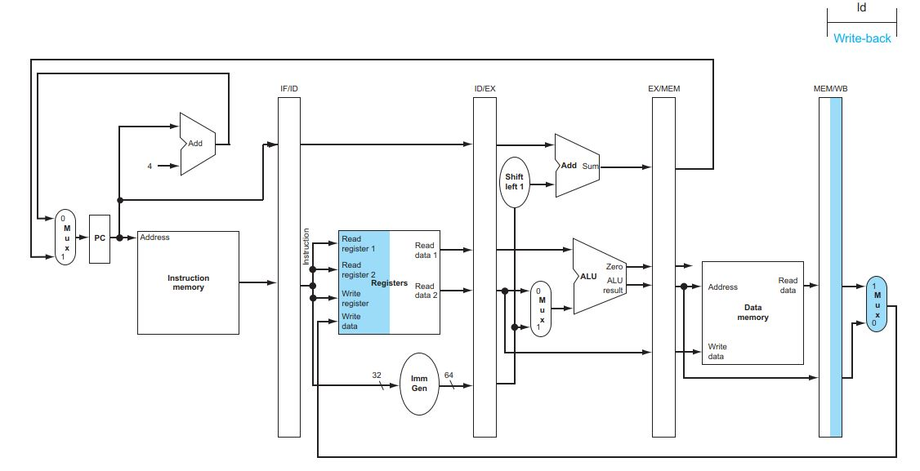

Slide 11

"sd" instruction execute, memory, writeback

Slide 12
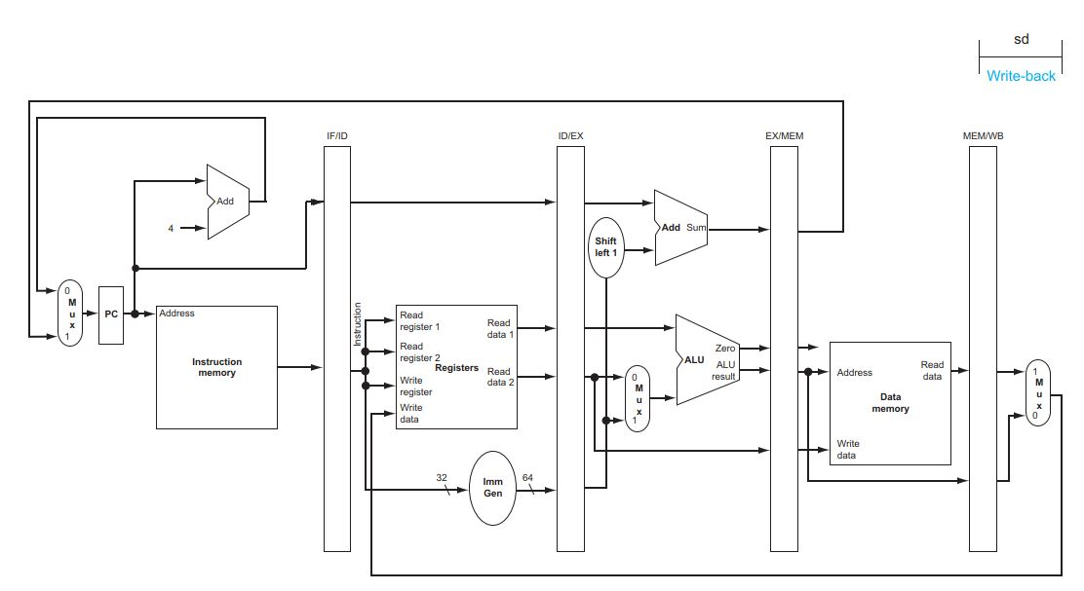
“sd” instruction, writeback does nothing

Slide 13
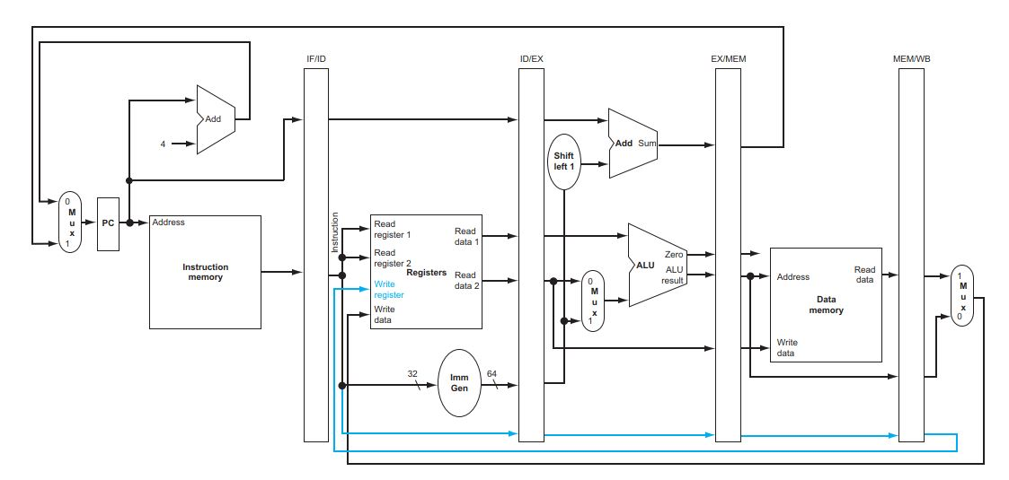
additional path (register number) is required in "ld" writeback action to specify which register to be written. (blue lines)

Slide 14
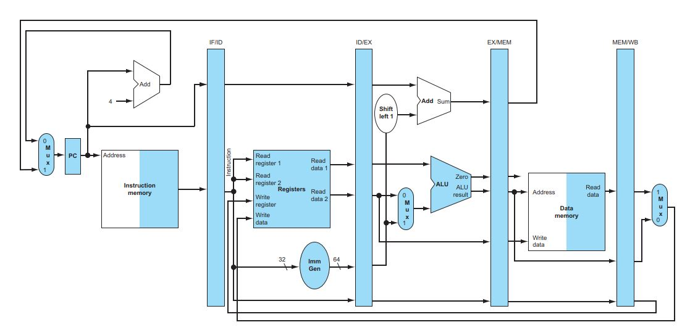
pipeline executing 5 instructions (note that there is no data depency nor branch)
ld x10, 40(x1)
sub x11, x2, x3
add x12, x3, x4
ld x13, 48(x1)
add x14, x5, x6

Slide 15
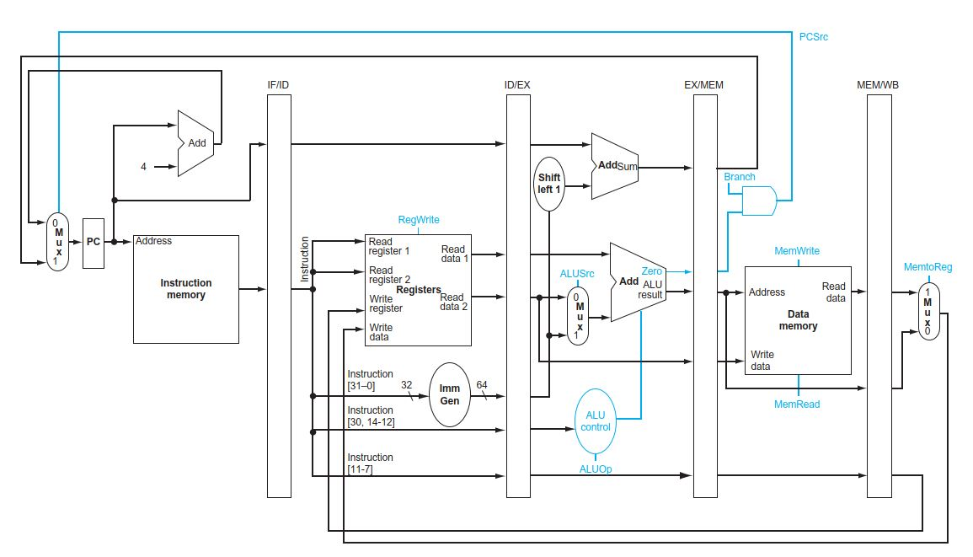
Pipeline Control
control signals (from simple RISC-V)

Slide 16
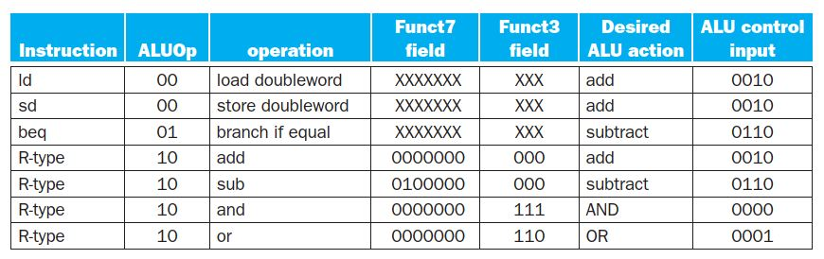
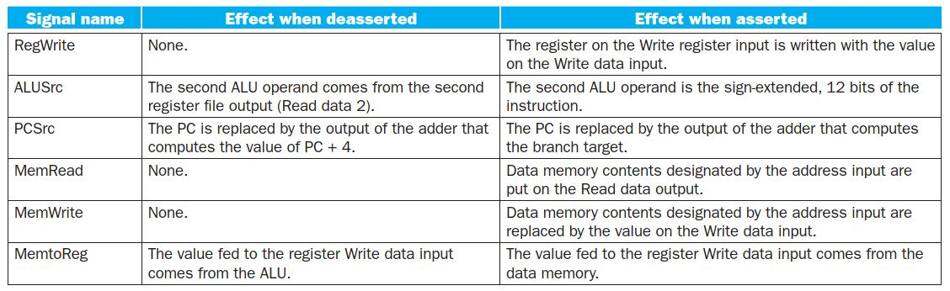
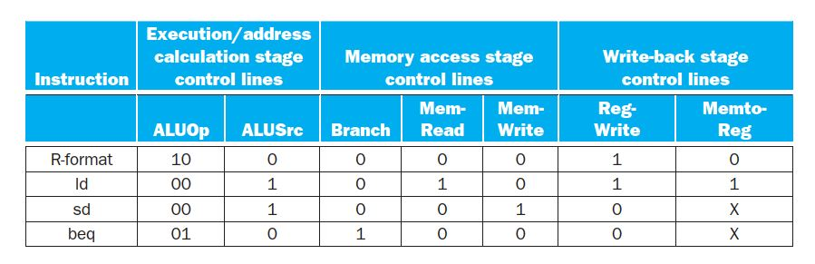

Slide 17
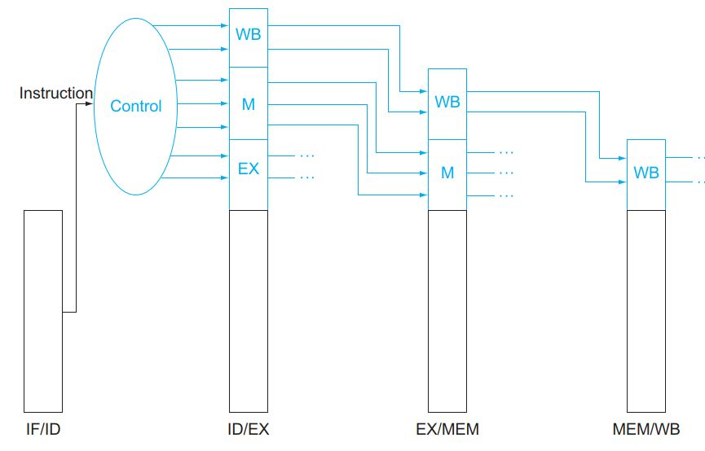
Control signals are sent down the pipeline stages

Slide 18
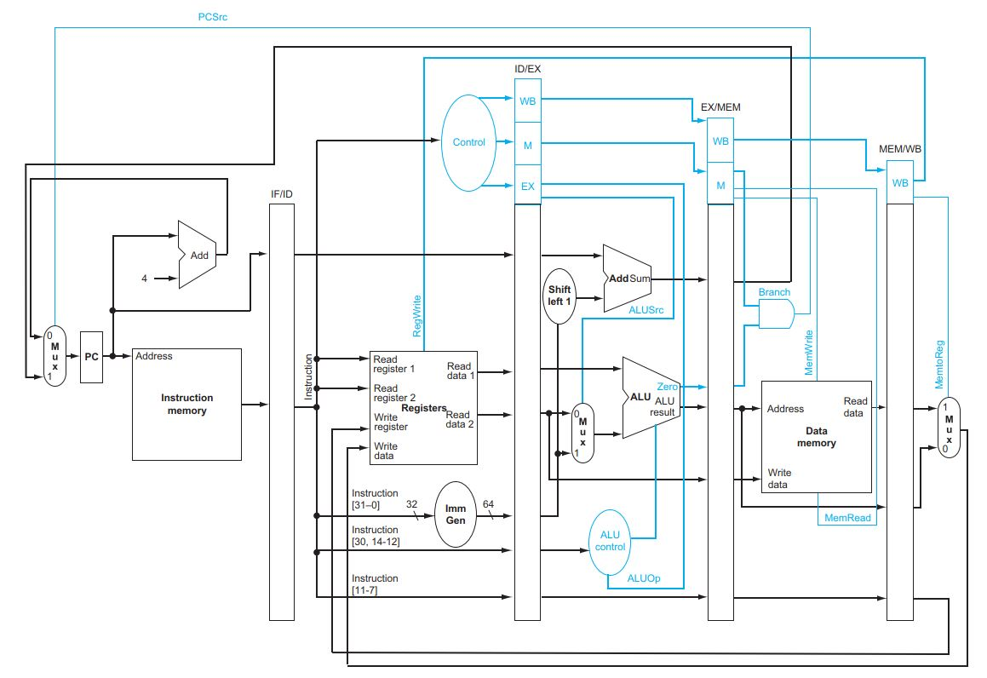
Full picture of RISC-V pipeline with control signals

Slide 19
Supplementary lecture
Data Forwarding in Pipeline

Slide 20
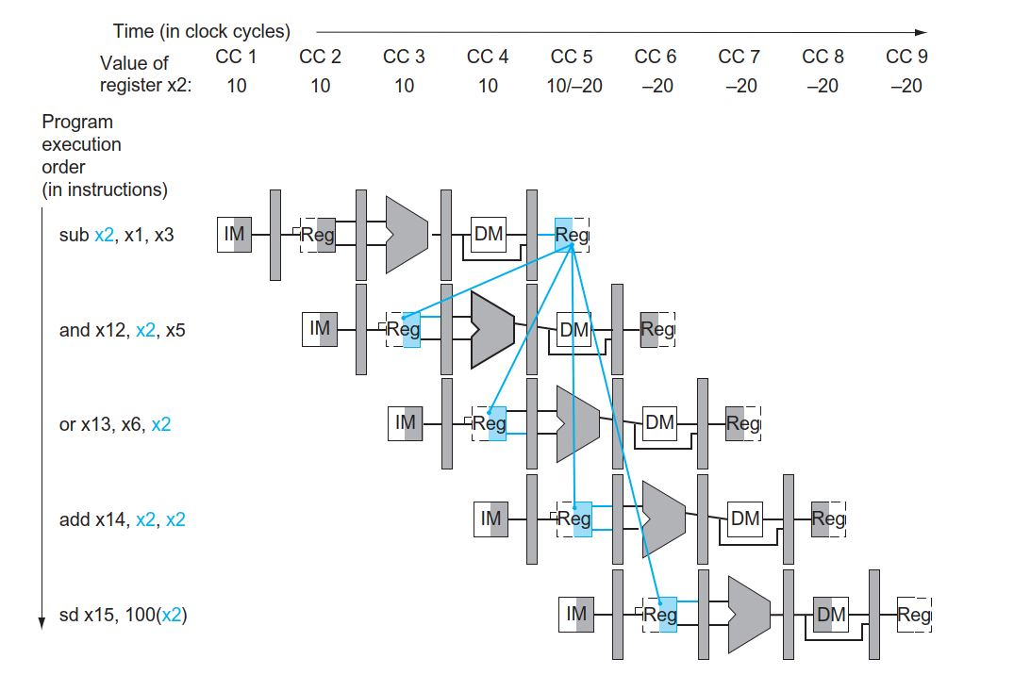
Four cases of data dependencies

Slide 21
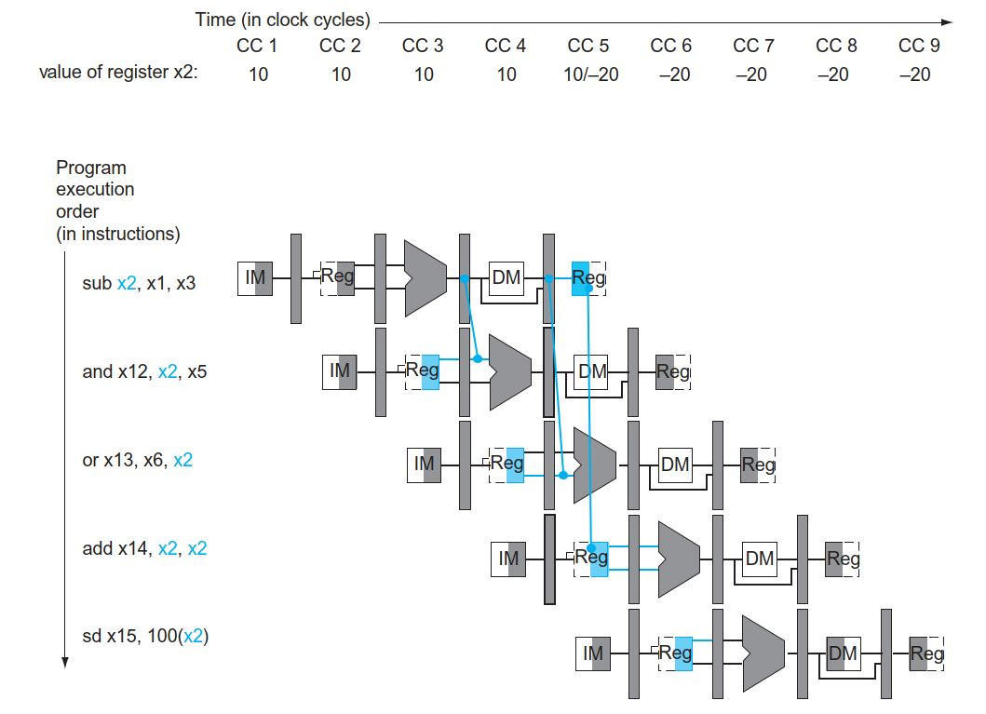
When and where to forward
forwarding case 1 (forwardA)
forwarding case 2 (forwardB)
forwarding case 3 (register write and read in the same cycle)
forwarding case 4 no need to act

Slide 22
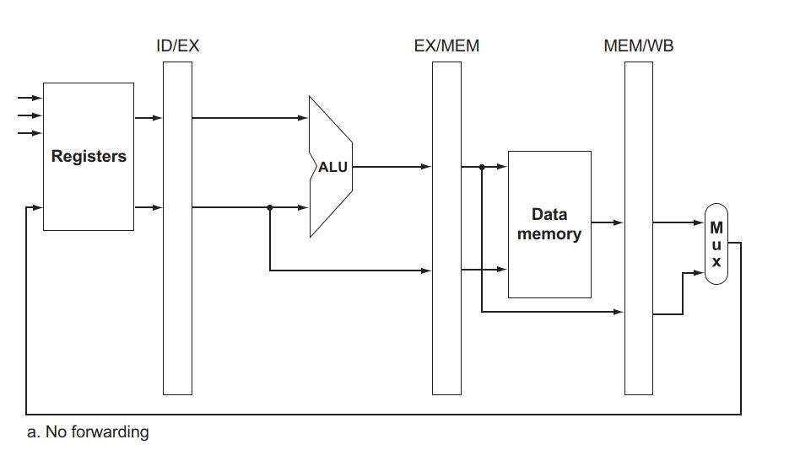
RISC-V without forwarding

Slide 23
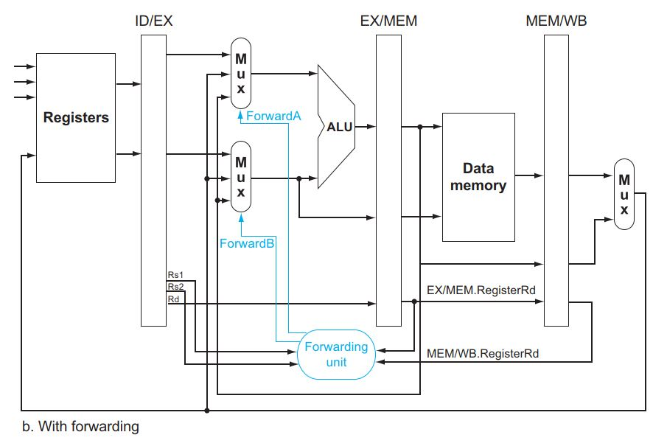
Forwarding units

Slide 24
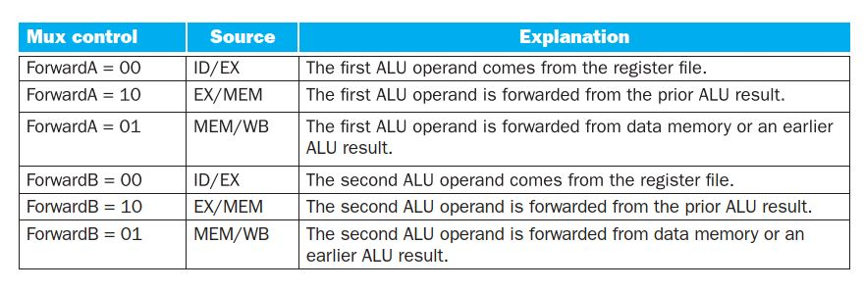
Forwarding control

Slide 25
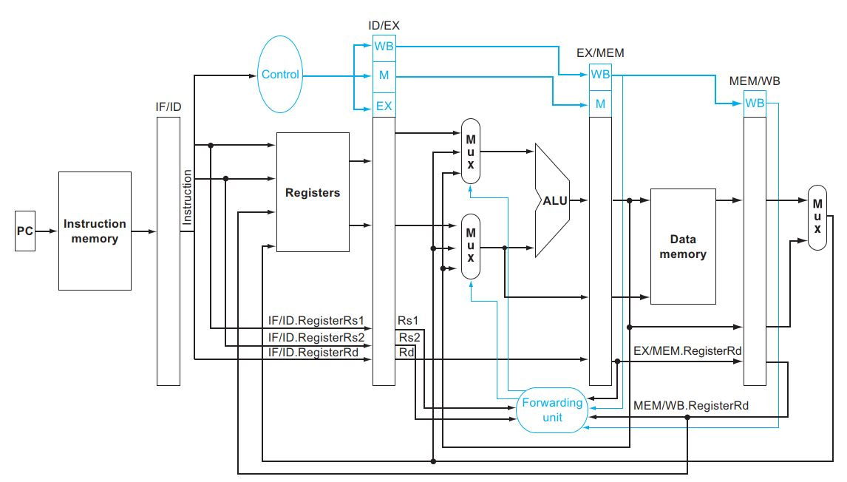
Full picture of RISC-V with forwarding and control

Slide 26
End

