Slide 1
Instructions
Prabhas Chongstitvatana
Faculty of Engineering
Chulalongkorn University

Slide 8
Literals

Slide 9
Binary number

Slide 10
Negative: 2’s complement number

Slide 13
Instruction encoding
R-type
I-type
S-type

Slide 16
Stored-program concept

Slide 17
Logic operations

Slide 18
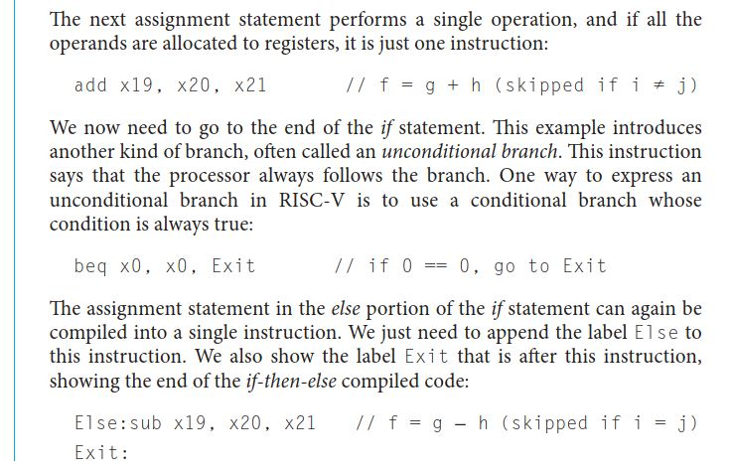
Branch operations

Slide 20
Compile and run

