Slide 1
Cache Memory
Prabhas Chongstitvatana
Faculty of Engineering
Chulalongkorn University

Slide 2
Direct map cache

Slide 3
Example of direct map cache accesses

Slide 6
Miss/hit in the cache

Slide 8
Miss rate vs block size

Slide 9
What to do when a cache miss

Slide 10
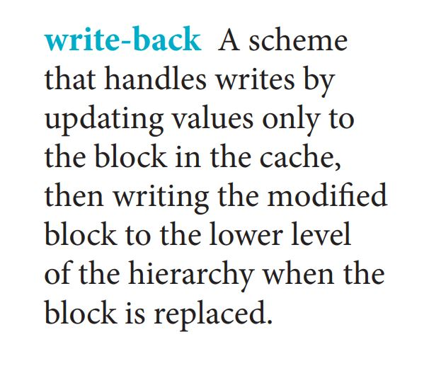
Cache write

Slide 11
Cache performance

Slide 15
Types of cache

Slide 16
Cache configuration: associativity

Slide 17
Miss rate vs associativity

Slide 18
4-way set associative cache

Slide 19
Where can a block be placed?

Slide 20
How is a block found?

Slide 21
Which block should be replaced on a cache miss?

Slide 22
What happen on a write?

Slide 23
Sources of cache misses

