Slide 1
Computer Architecture
Computer Technology
Prabhas Chongstitvatana
Chulalongkorn University

Slide 2
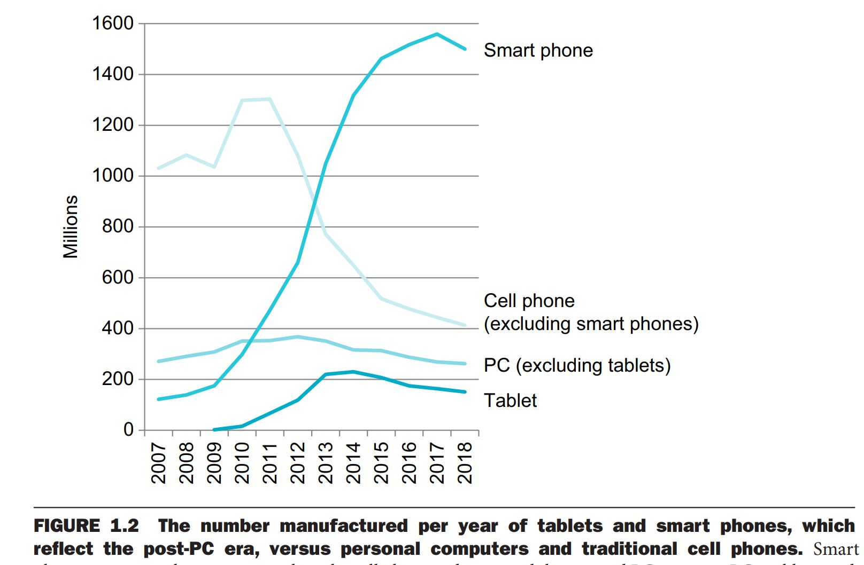
Post-PC era

Slide 3
Seven great ideas in computer architecture
use abstraction to simplify design
make the common case fast
performance via parallelism
performance via pipelining
performance via prediction
hierarchy of memories
dependability via redundancy

Slide 4
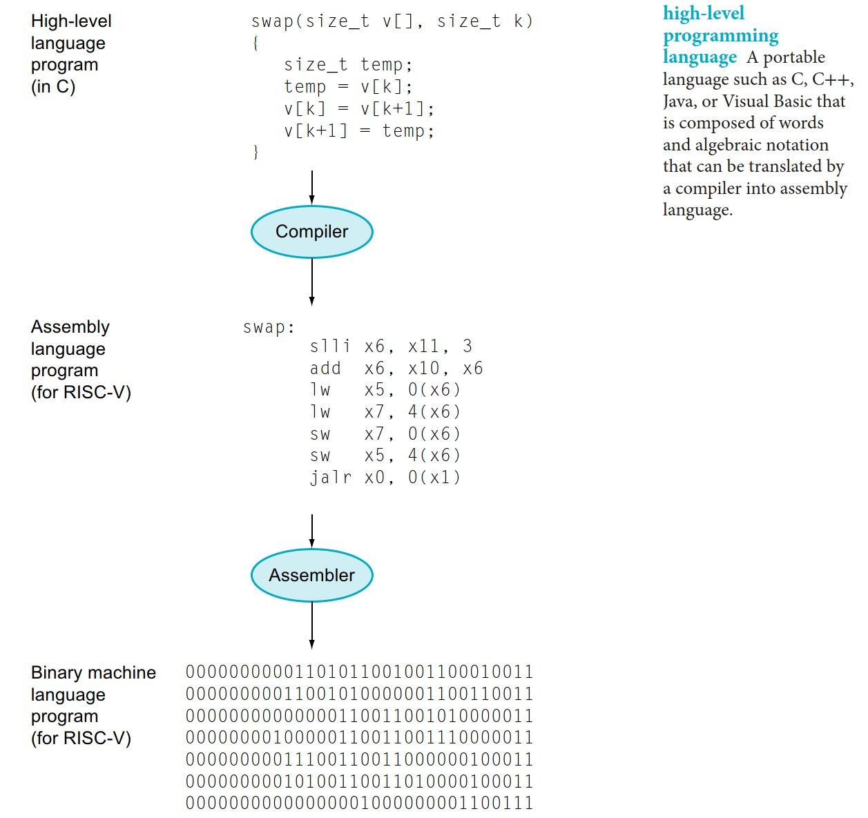
High level language to machine

Slide 5
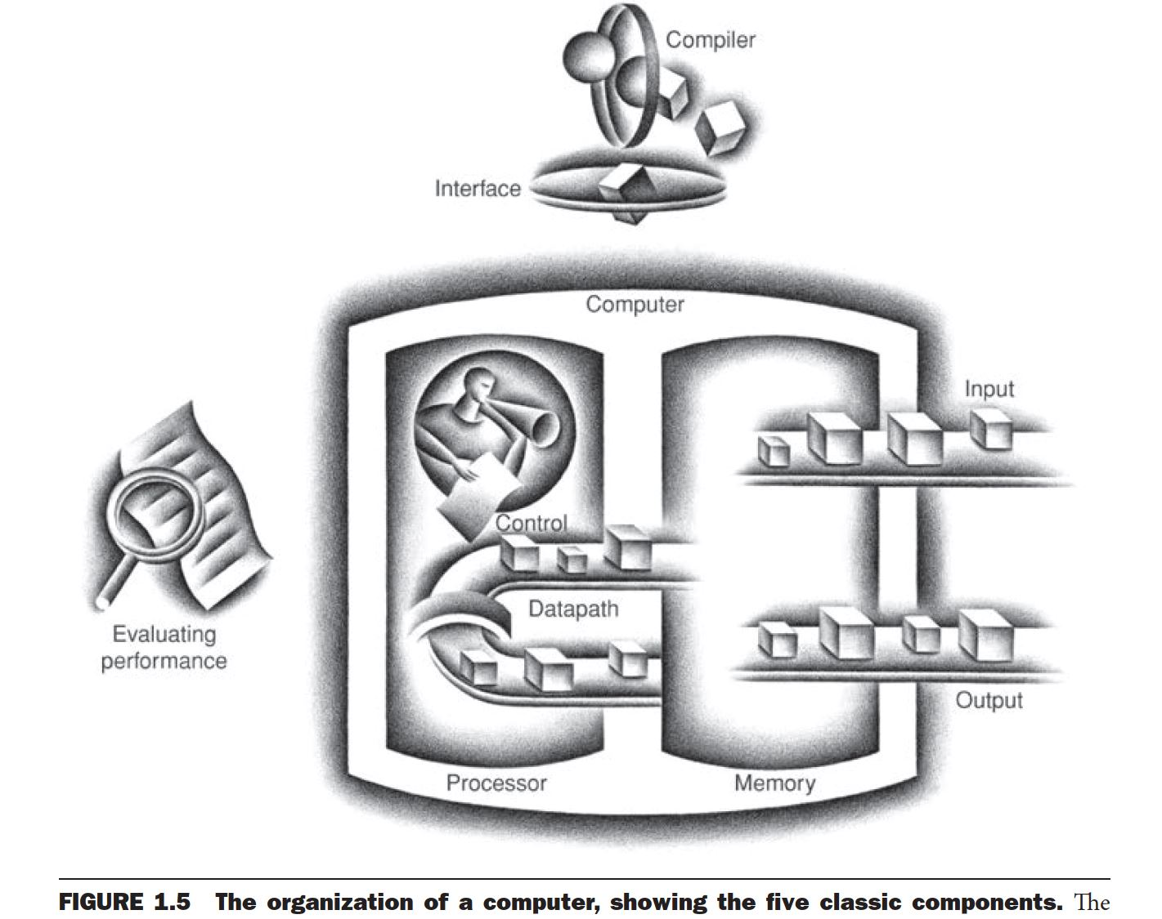
Organization of a computer

Slide 6
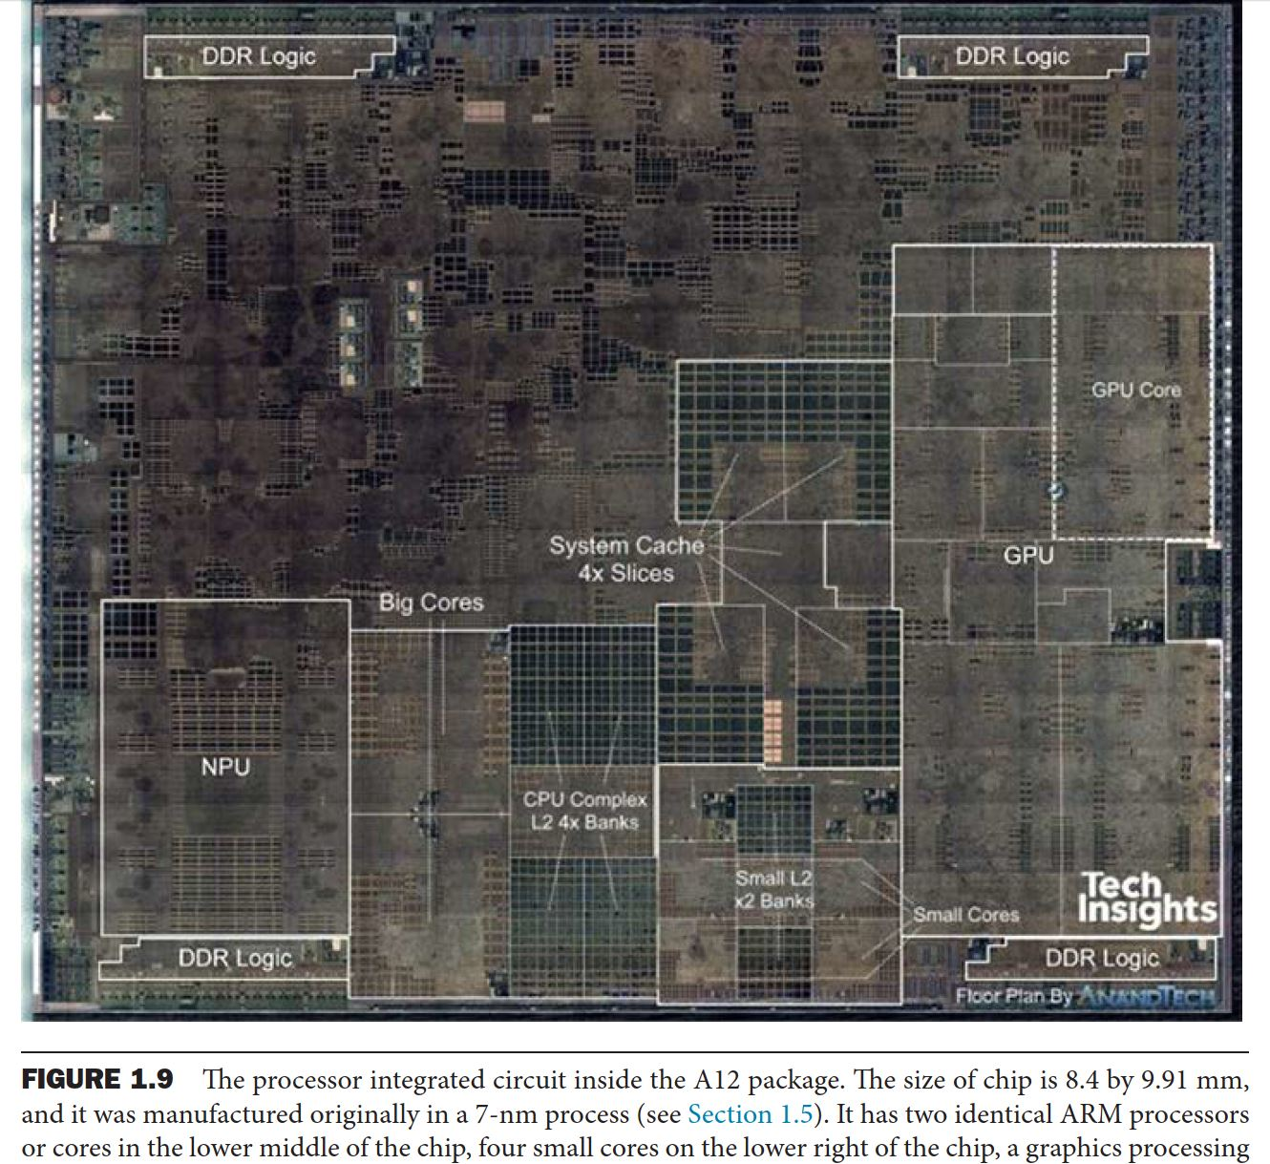
A12 chip (iphone xs)

Slide 7
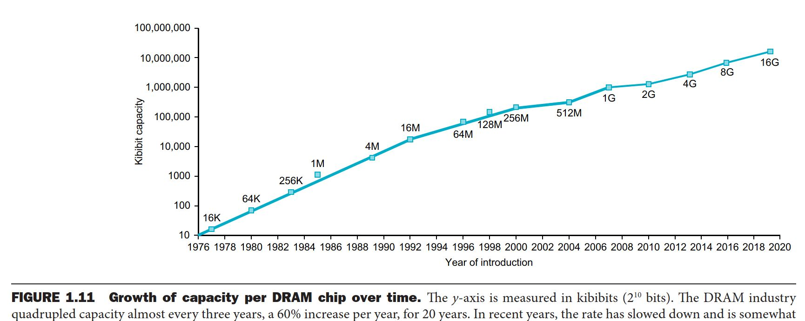
Growth of capacity per DRAM chip

Slide 8
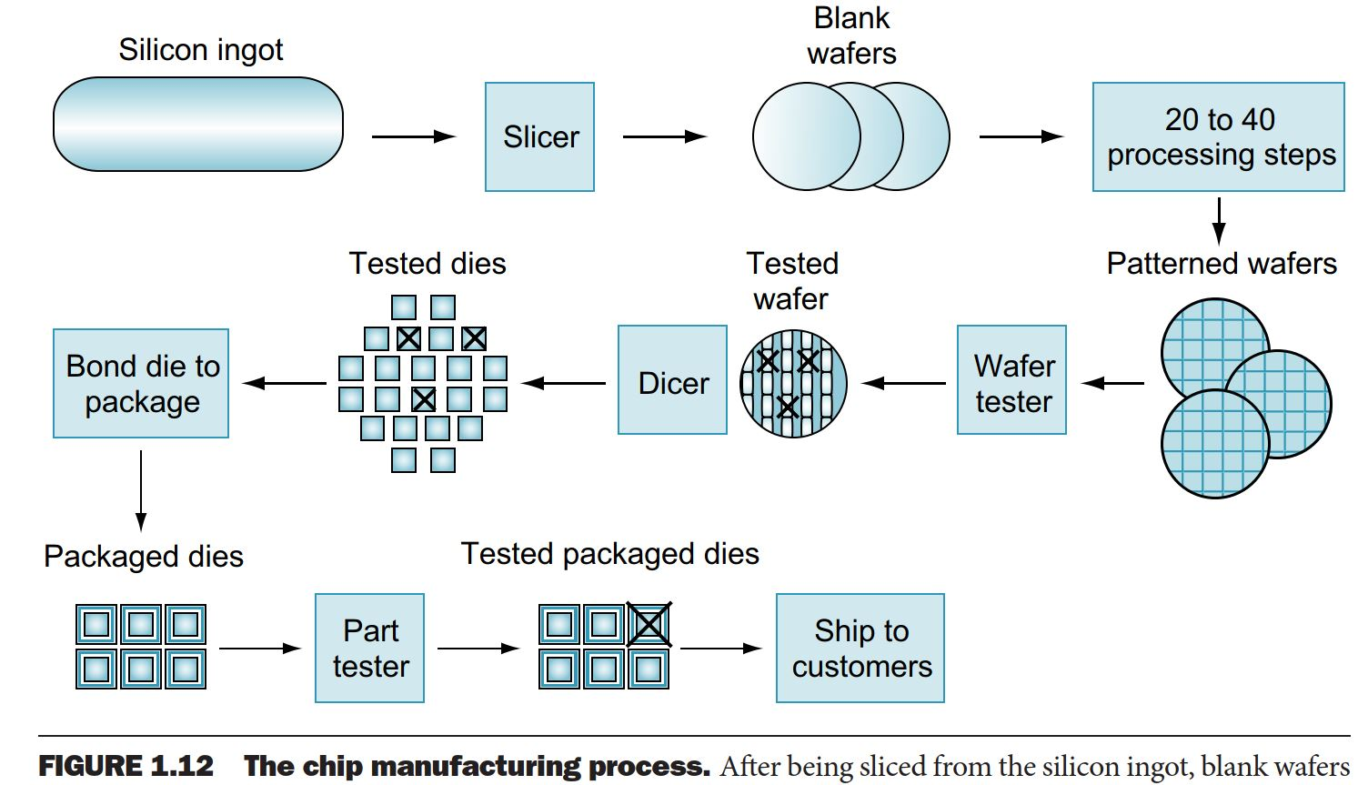
Chip manufacturing process

Slide 9
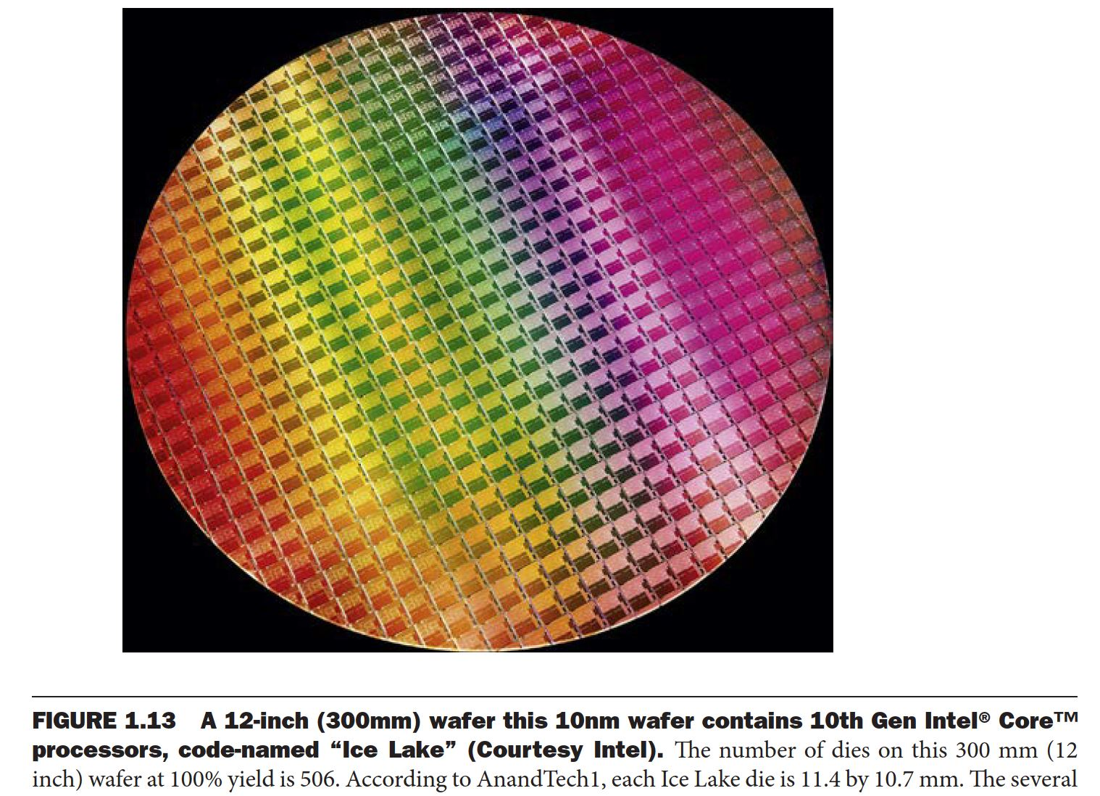
Wafer

Slide 10
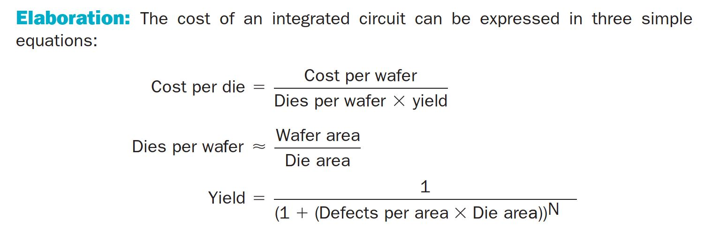
Cost of an integrated circuit

Slide 11
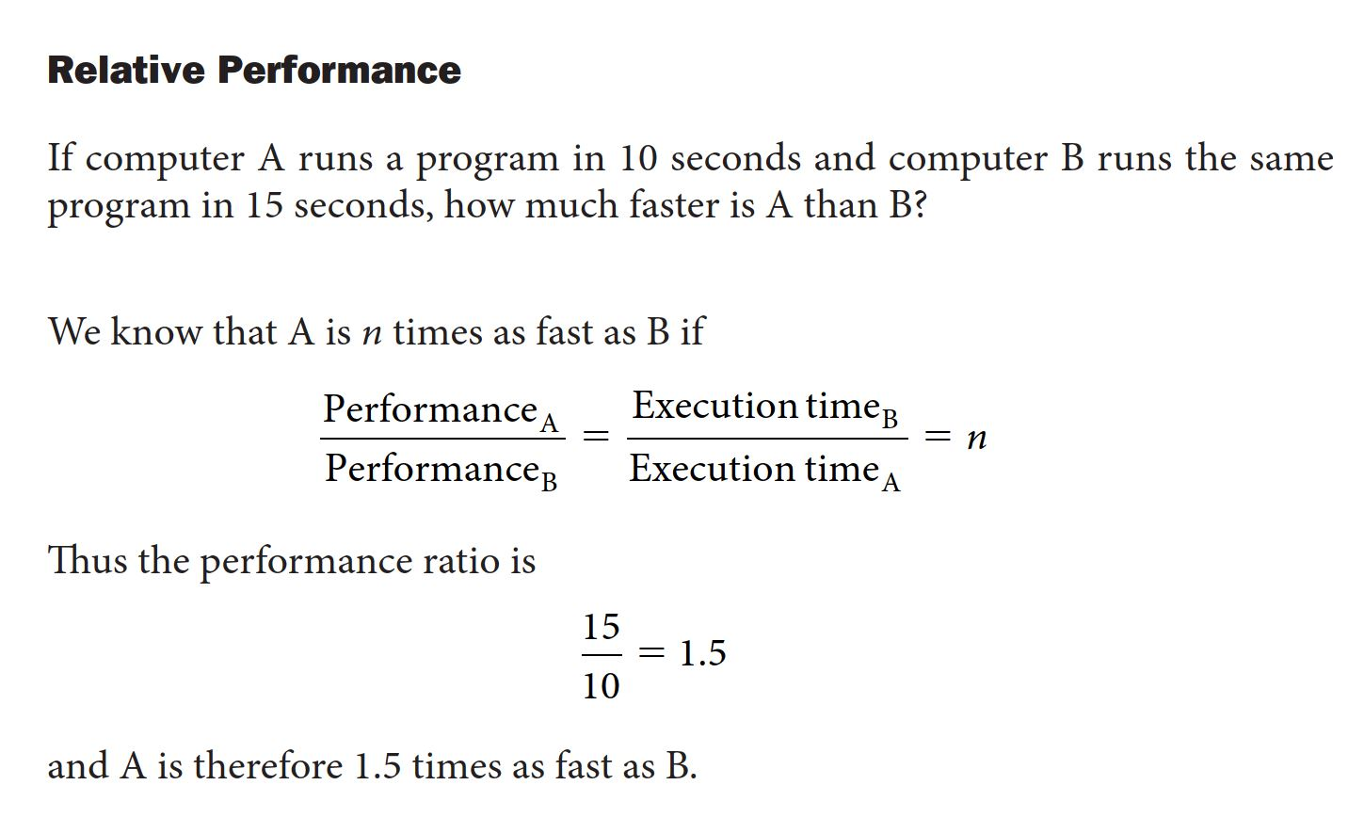
Performance

Slide 12
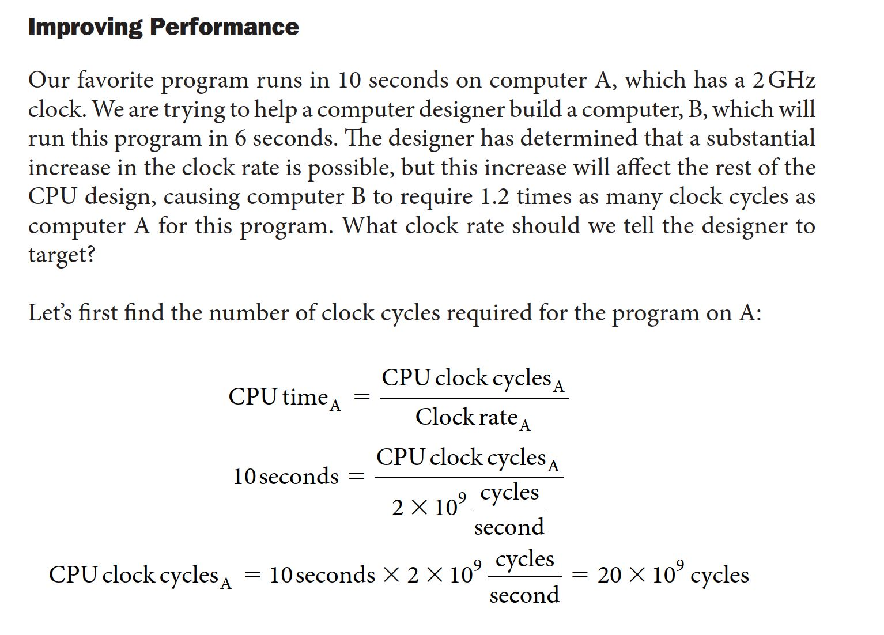
Measuring performance

Slide 13
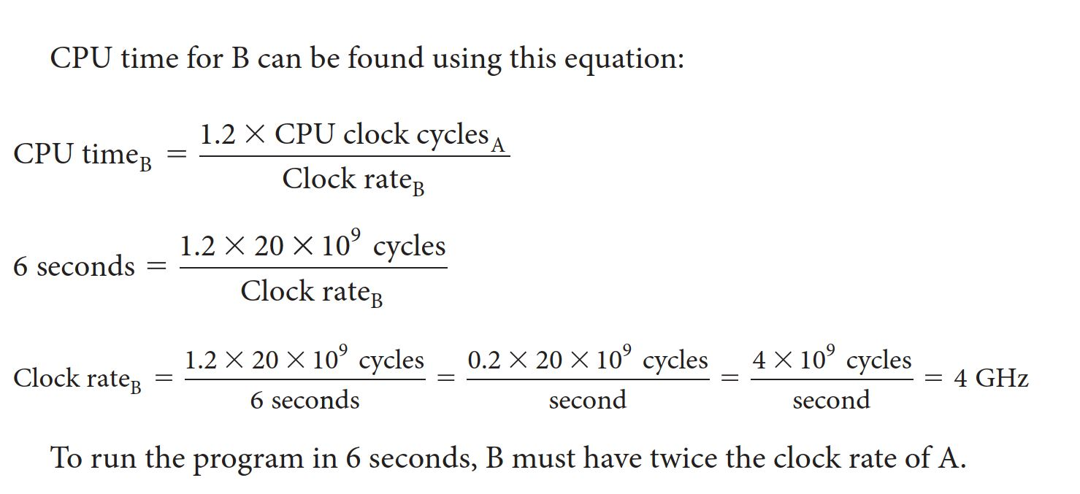

Slide 14
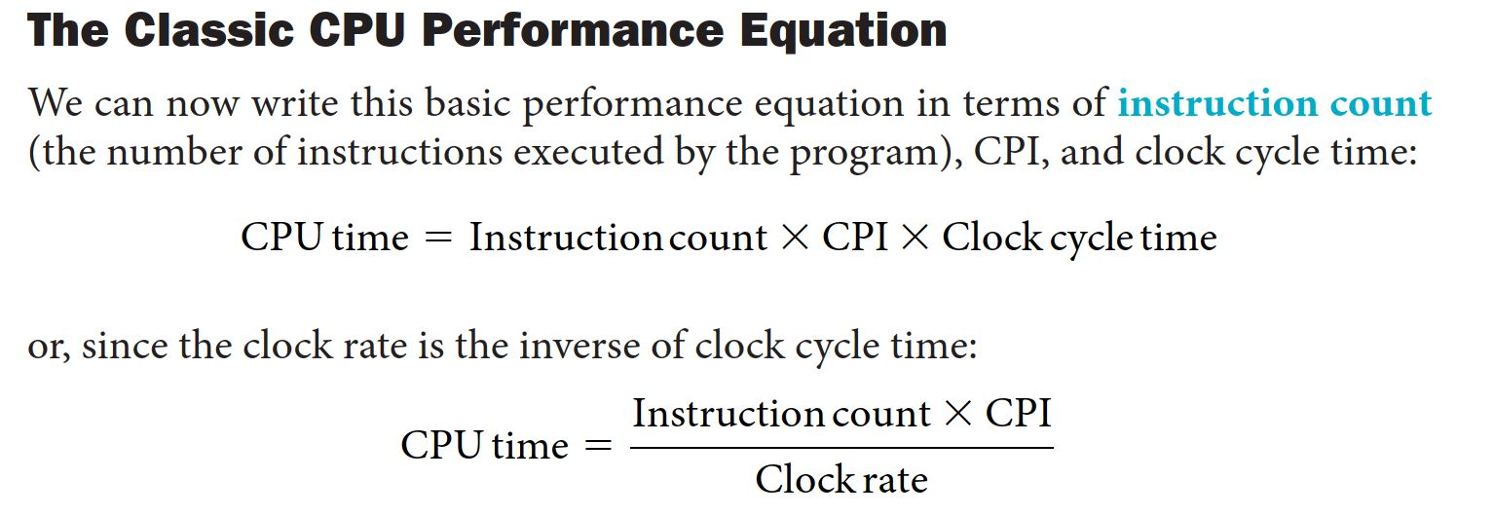
CPU performance equation

Slide 15
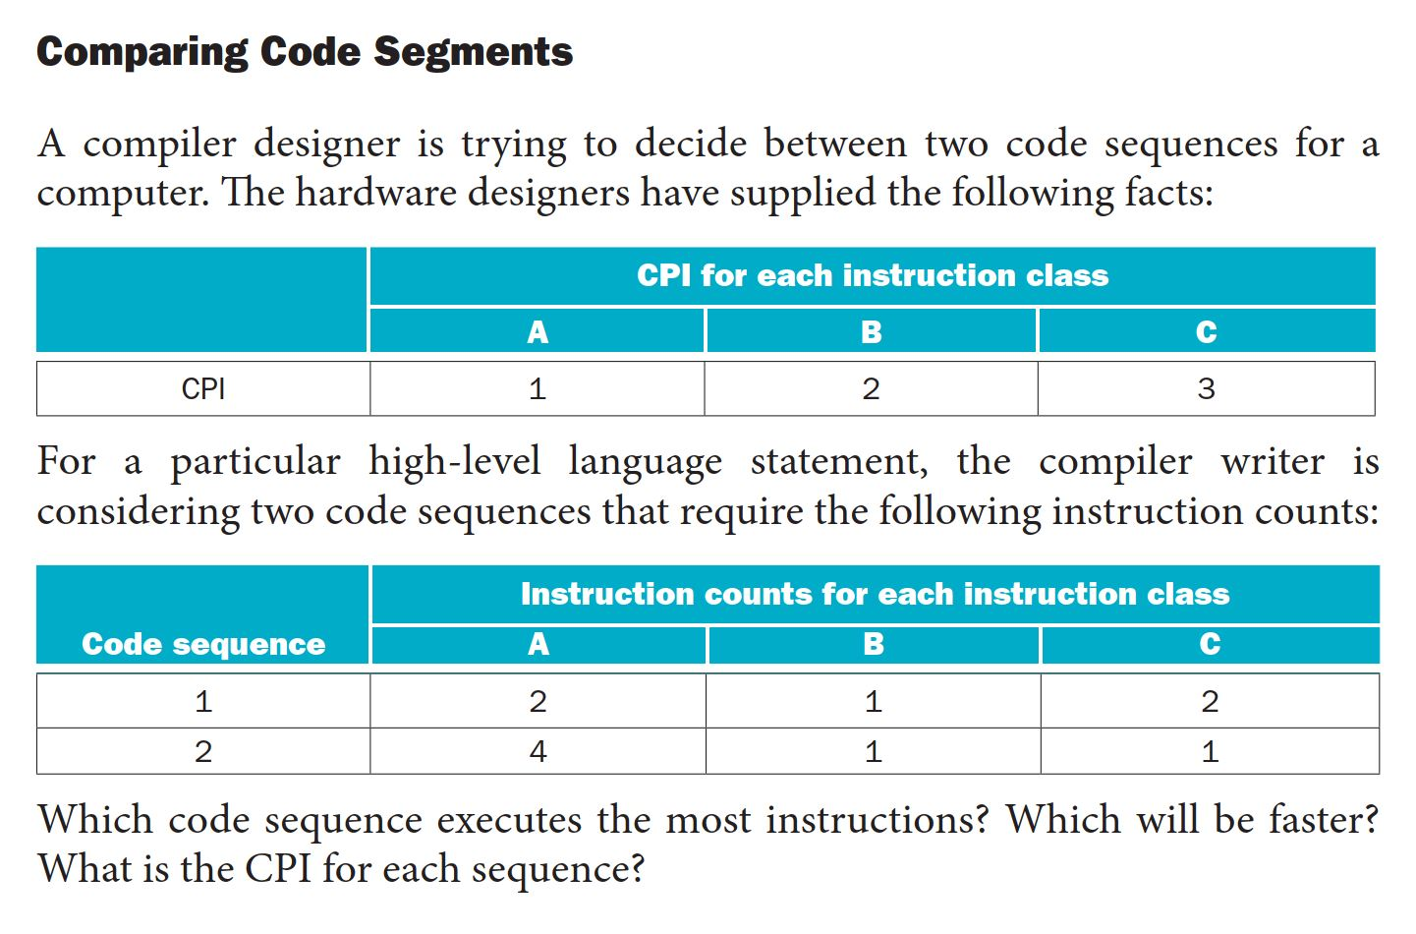
Comparing code

Slide 16
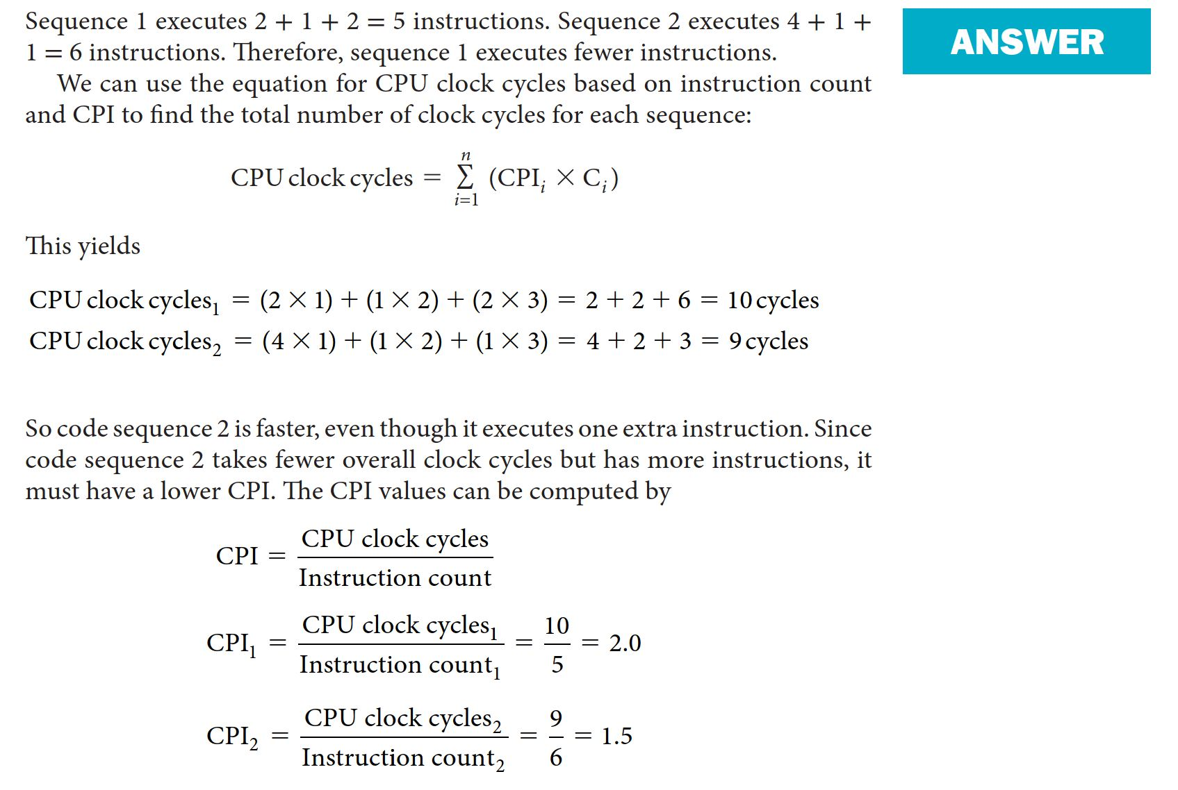

Slide 17
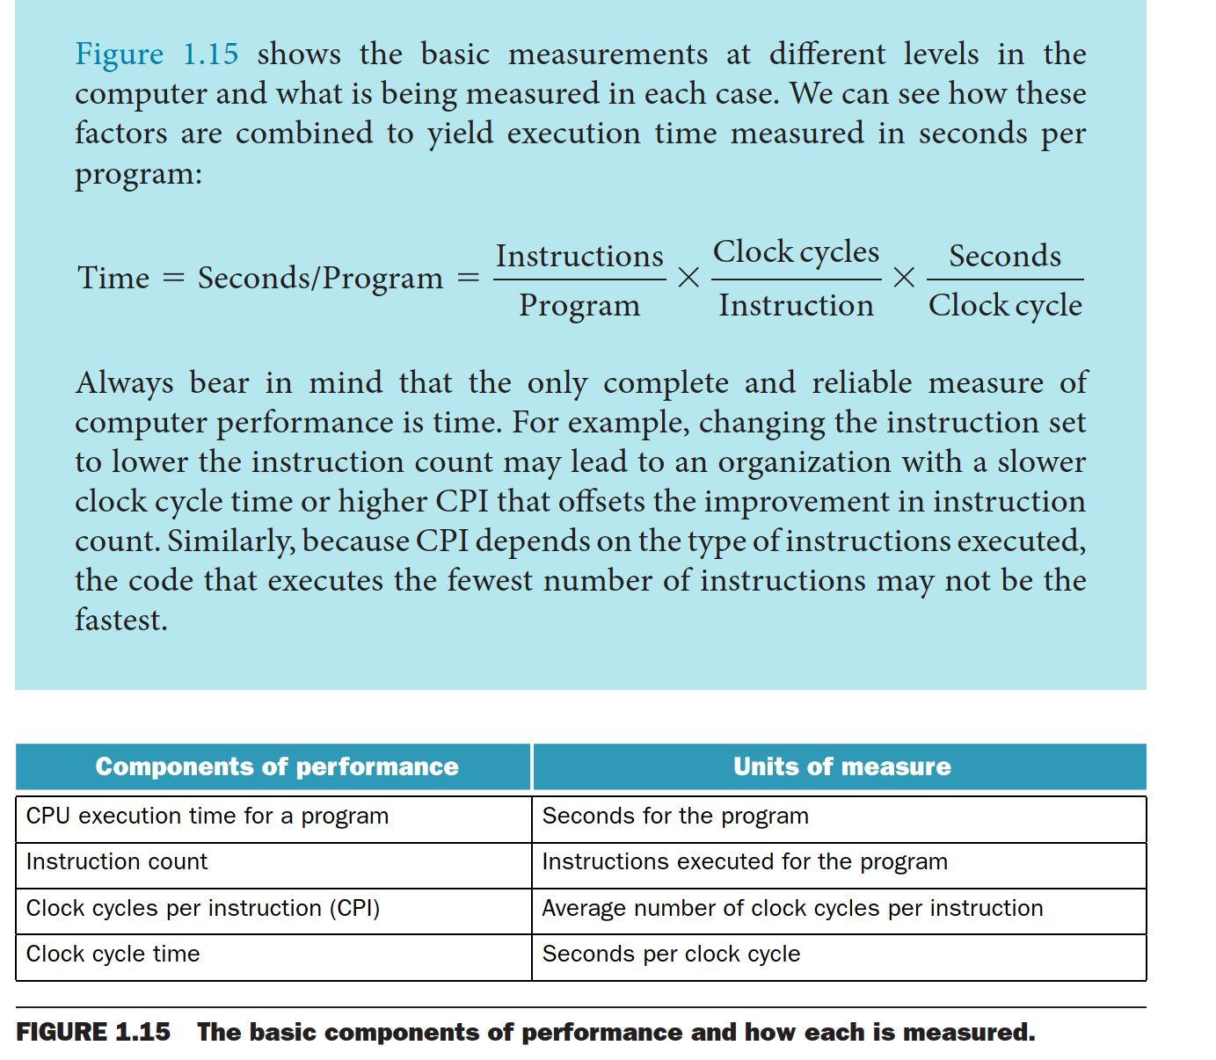

Slide 18
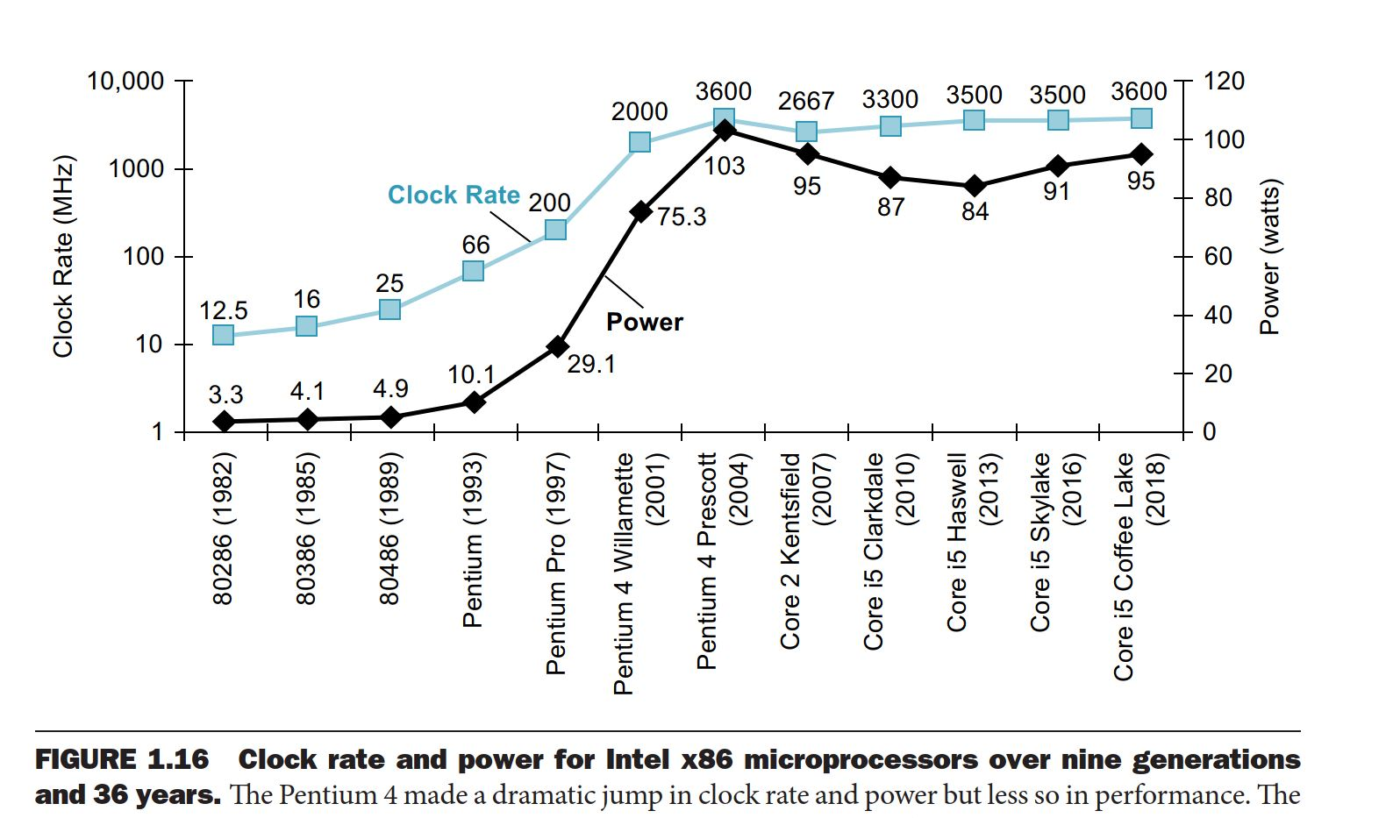
Power wall

Slide 19
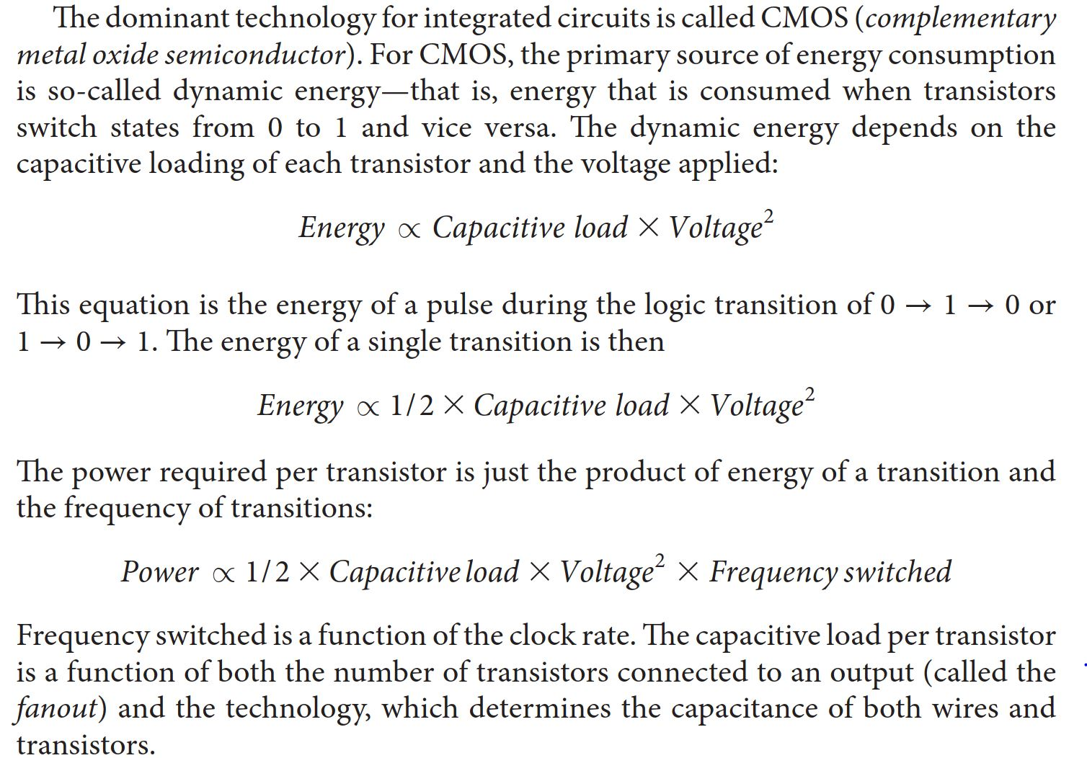
Power equation (CMOS)

Slide 20
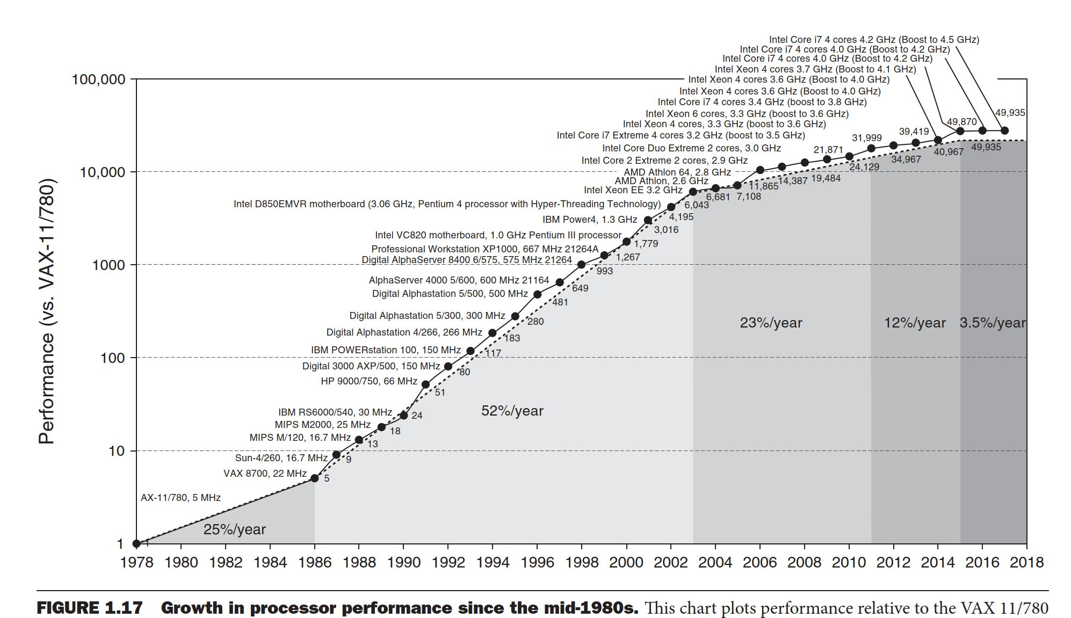
Limit of Moore’s law

