Slide 1
Intel CPU Generations

Slide 2
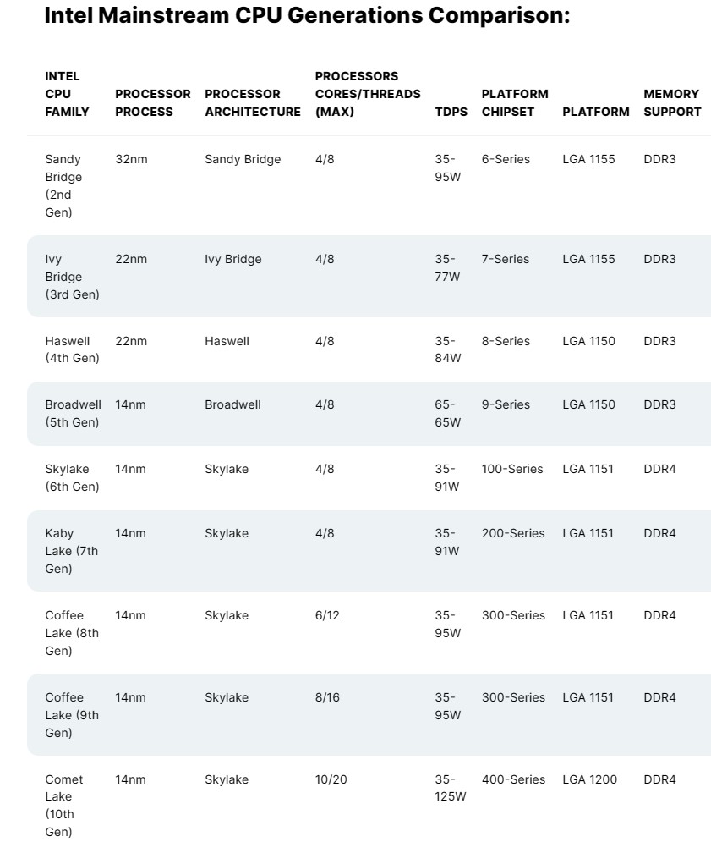
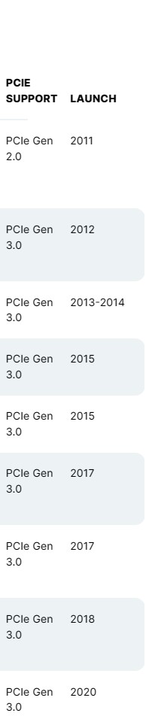

Slide 3
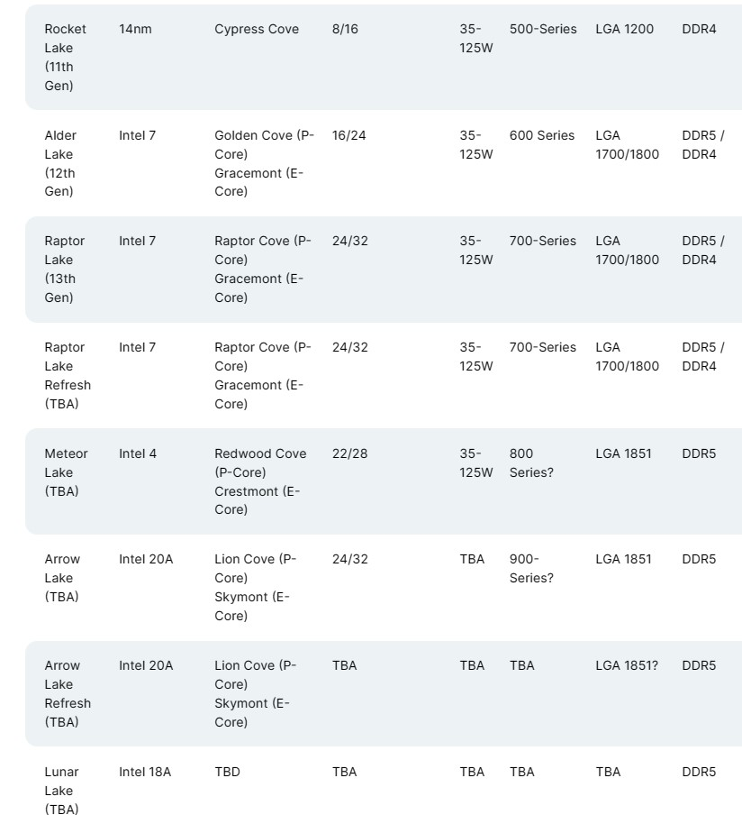
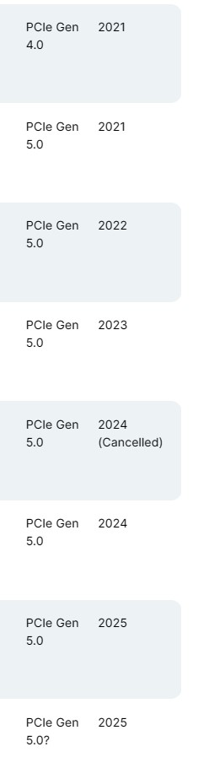

Slide 4
Intel's new "Intel 7" process, previously known as 10 nm Enhanced SuperFin (10ESF), is based on its previous 10 nm node.
The node will feature a 10-15% increase in performance per watt.
Their old 7 nm process, now called "Intel 4", is expected to be released in 2023.^{[94]}
Few details about the Intel 4 node have been made public, although its transistor density has been estimated to be at least 202 million transistors per square millimeter.
https://en.wikipedia.org/wiki/7_nm_process

Slide 5
For intel 20A and 18A process are the future processes.
You should read “2 nm” for more details.
https://en.wikipedia.org/wiki/2_nm_process

