Slide 1
Processor-2: Control
Prabhas Chongstitvatana

Slide 2
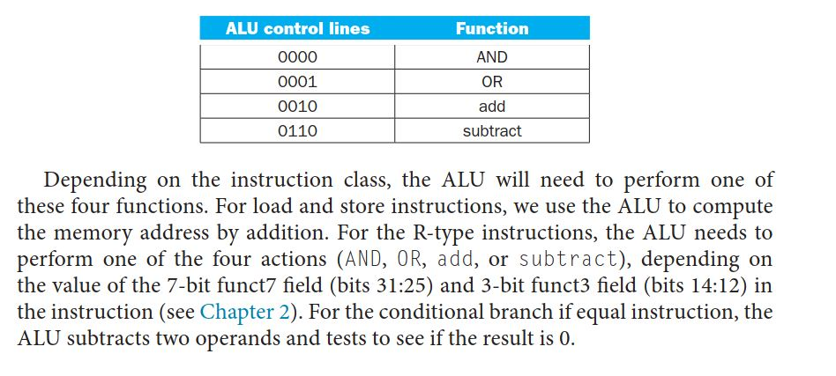
ALUops

Slide 3
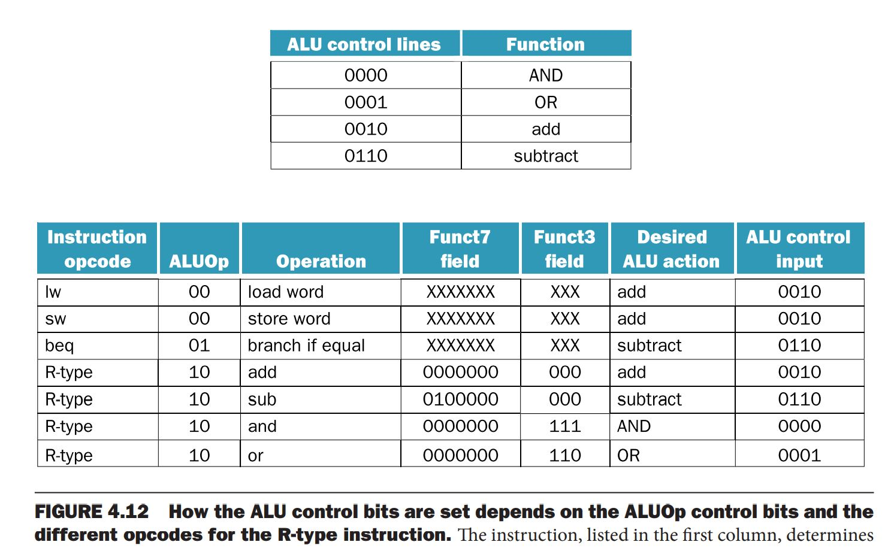

Slide 4
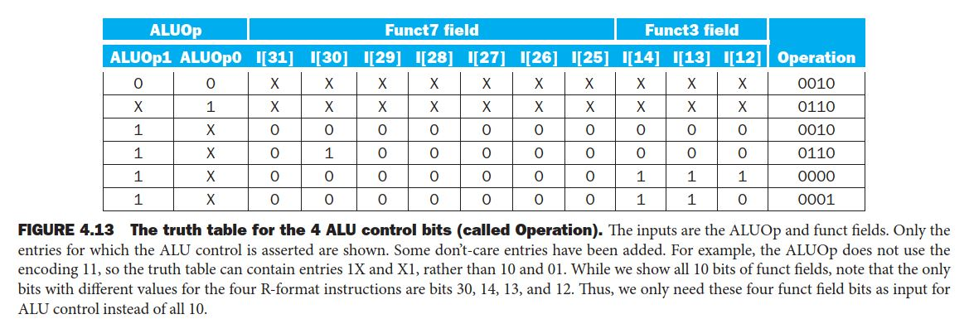
ALU control bits

Slide 5
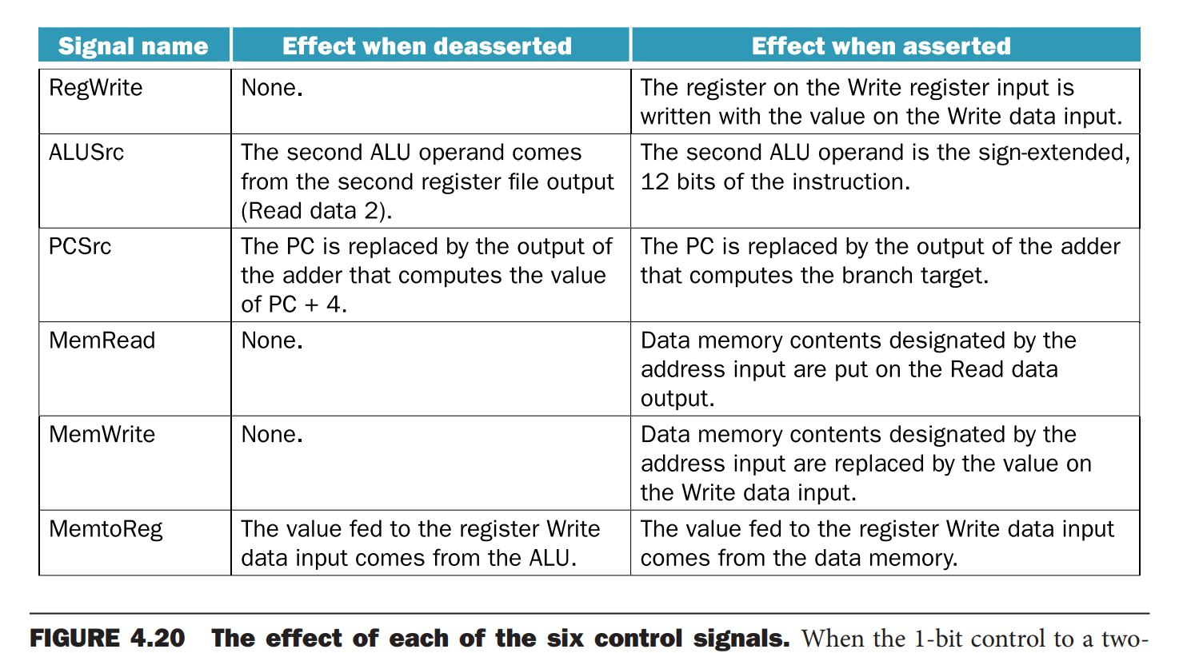
Control signals

Slide 6
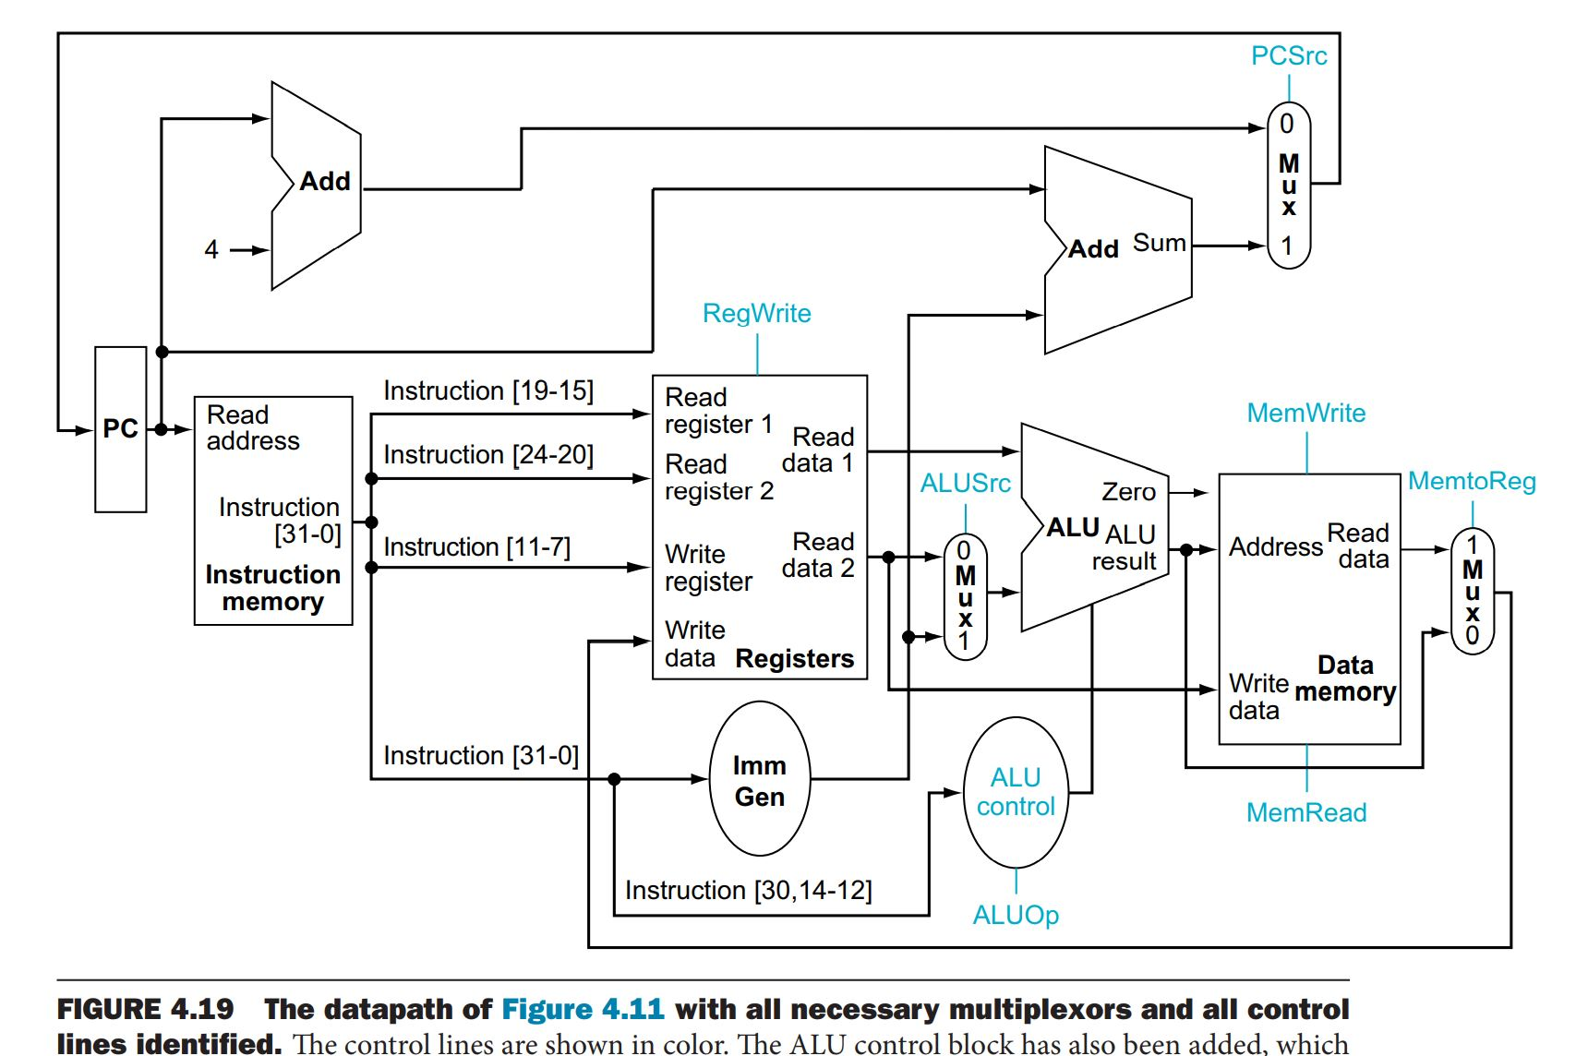
Datapath with Control lines

Slide 7
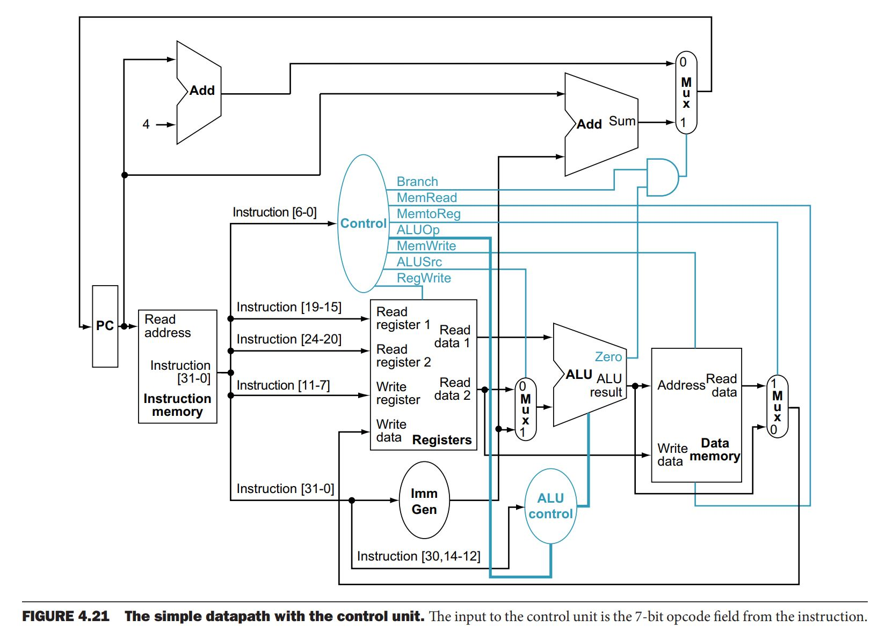
Datapath with control unit

Slide 8
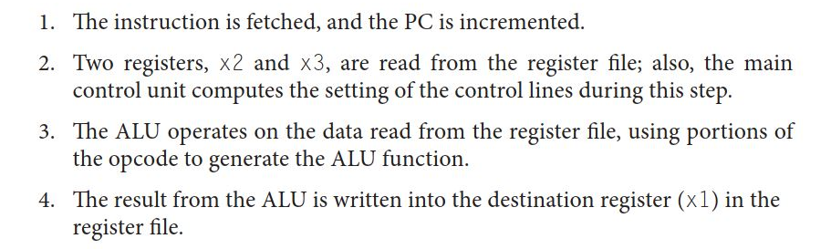
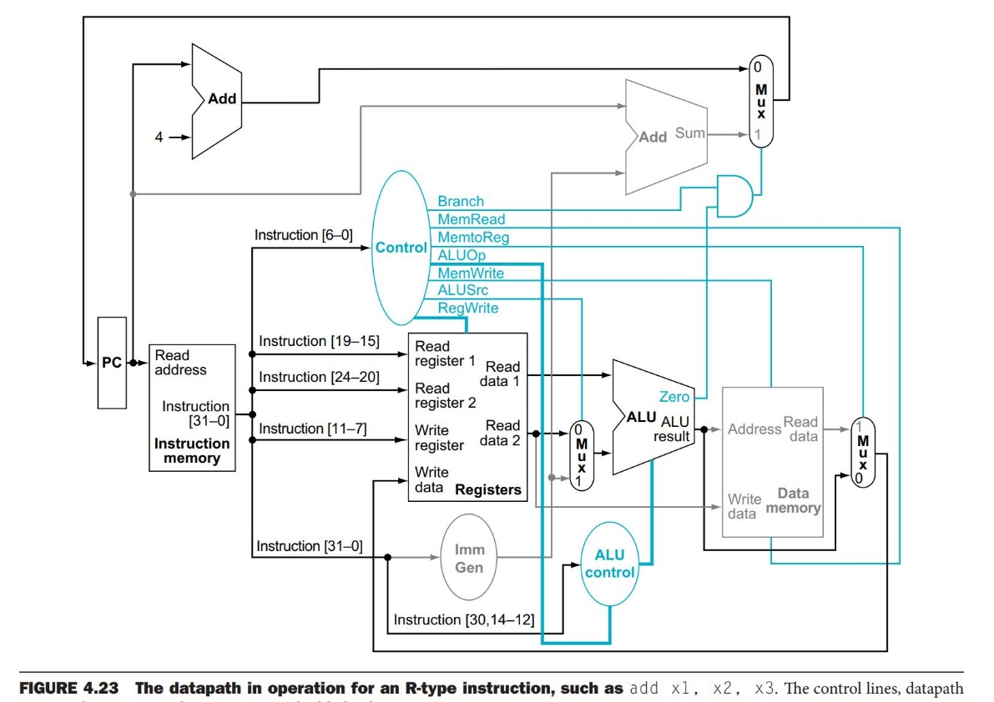
R-type control

Slide 9

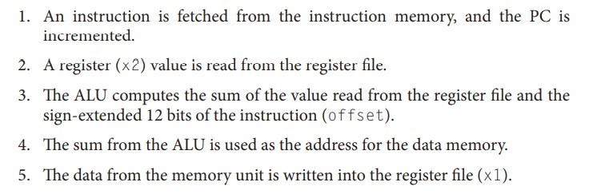
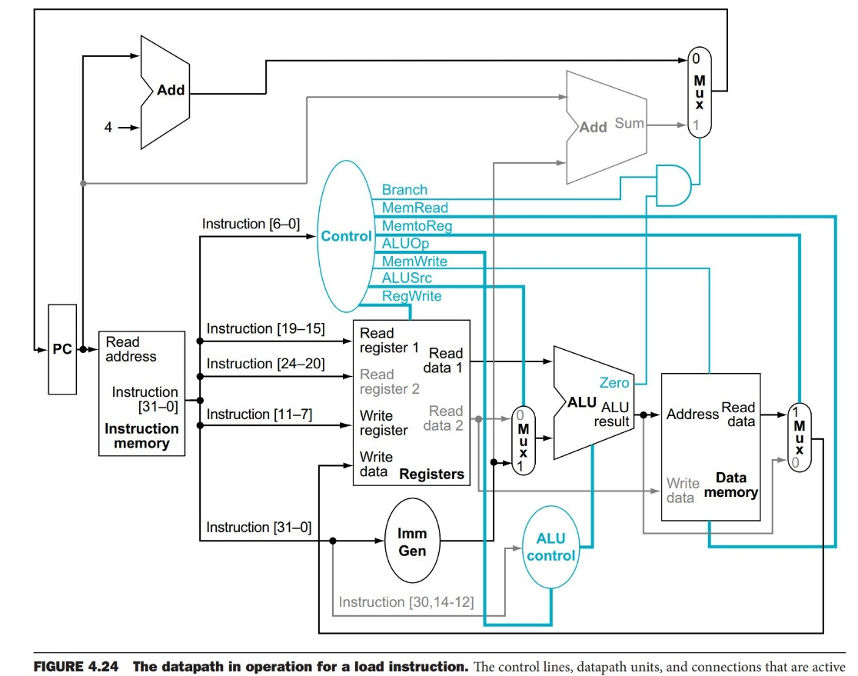
Load control

Slide 10
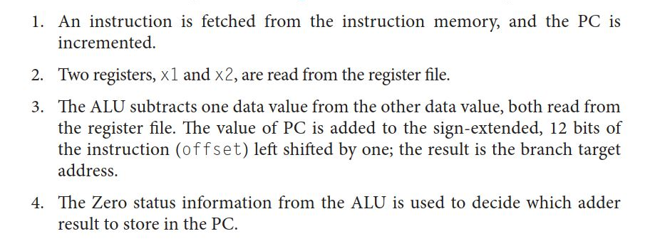
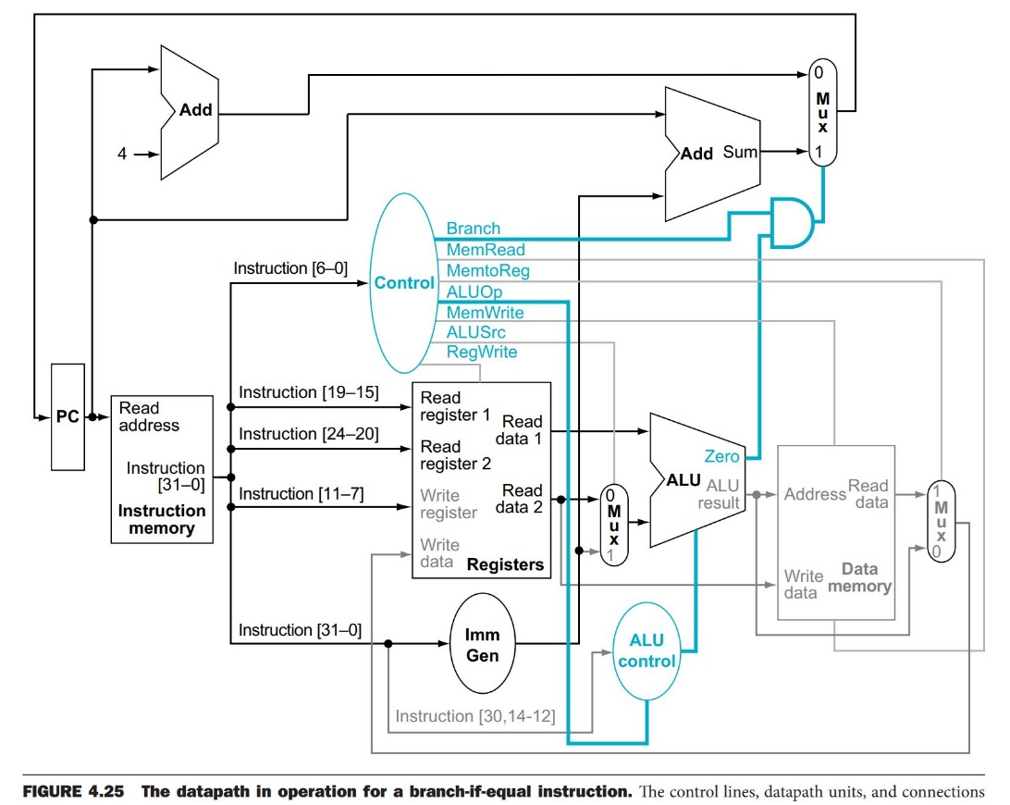
Branch control

Slide 11
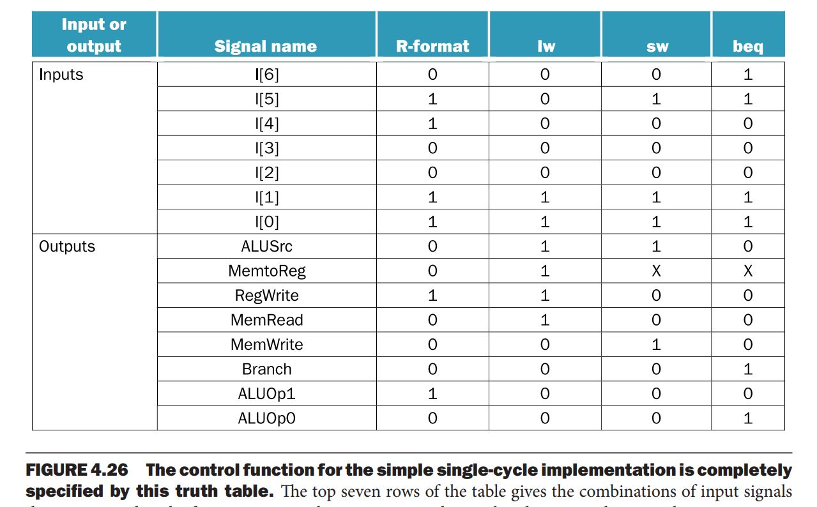

Slide 12
Single cycle is not used today
Not-efficient
Longest path determines clock cycle
Clock cycle is equal to the worst-case delay of all instructions
To improve this, use pipeline
Pipeline executes multiple instructions simultaneously

