Slide 1
RISC-V instruction set (32-bit)

Slide 2
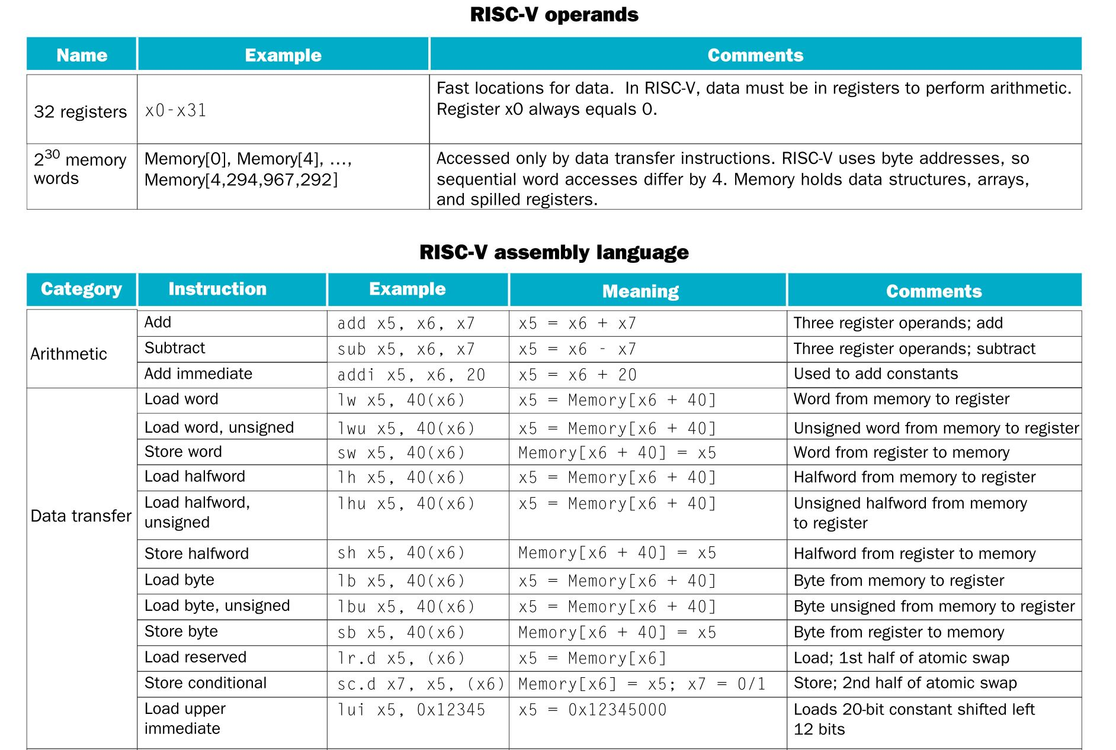

Slide 3
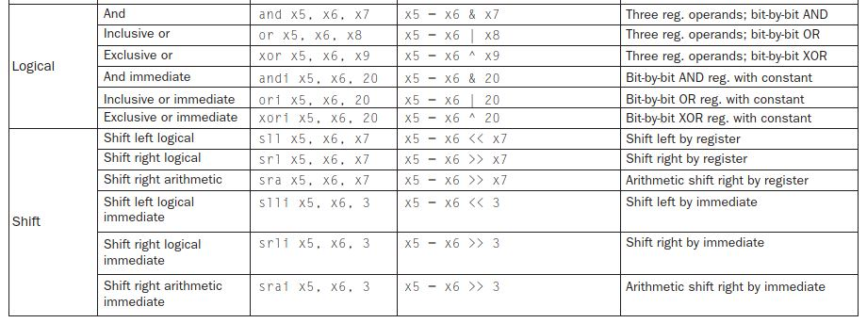


Slide 4
