Slide 1
Memory technologies
Prabhas Chongstitvatana
Faculty of Engineering
Chulalongkorn University

Slide 2
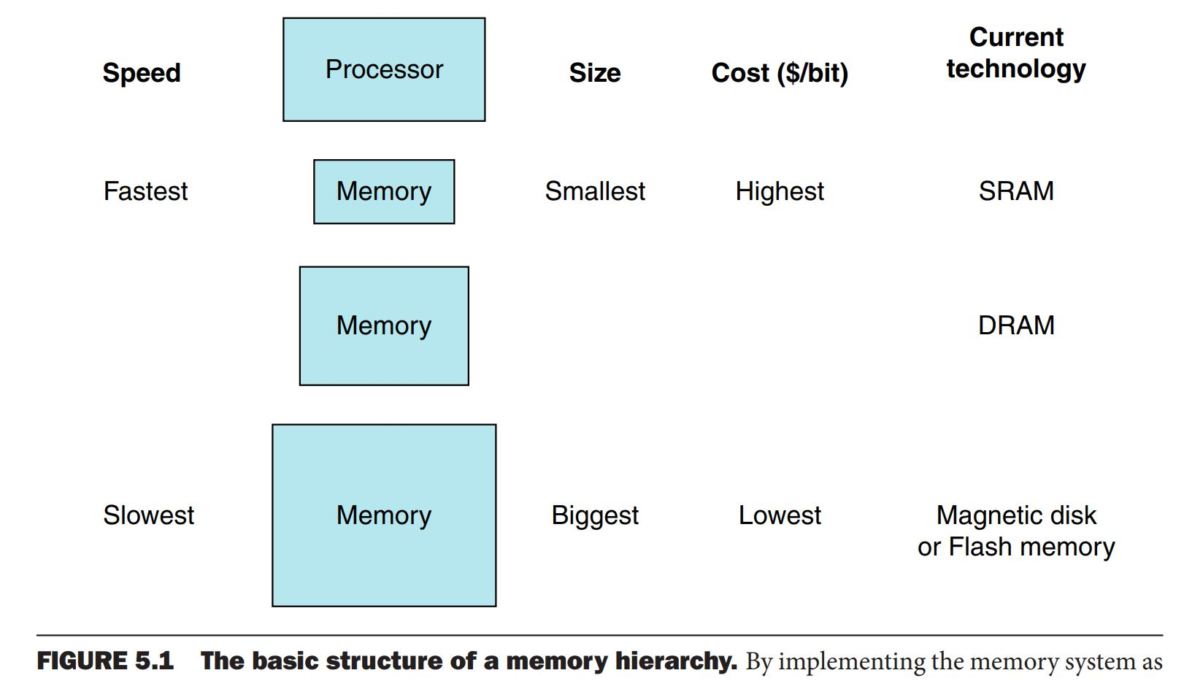
Basic structure of a memory hierachy

Slide 3
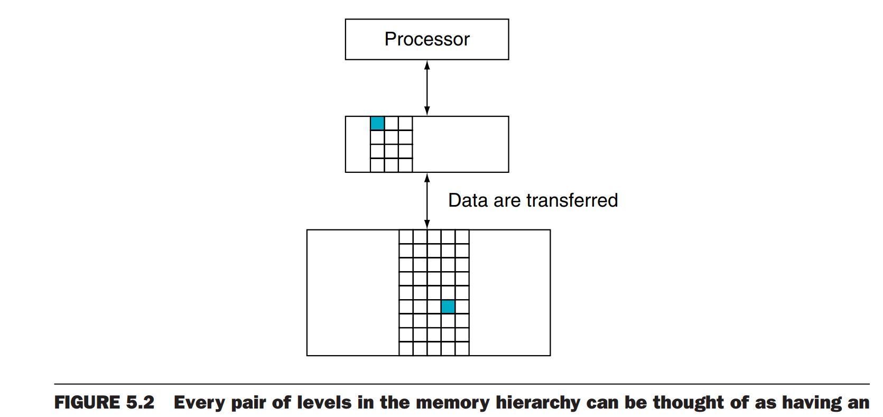
Levels in memory hierarchy

Slide 4
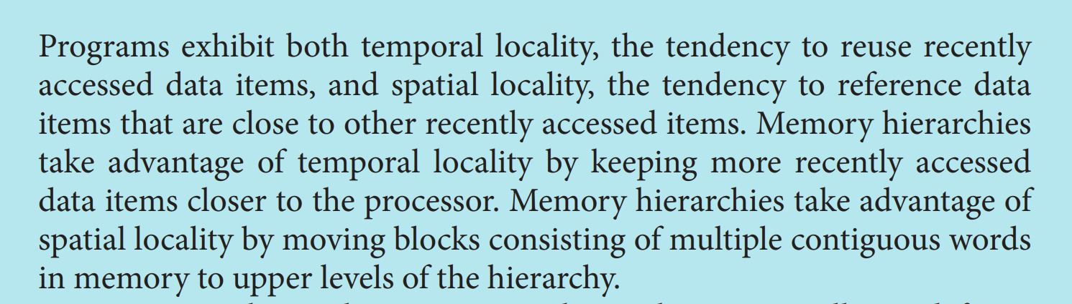
Temporal and spatial locality

Slide 5
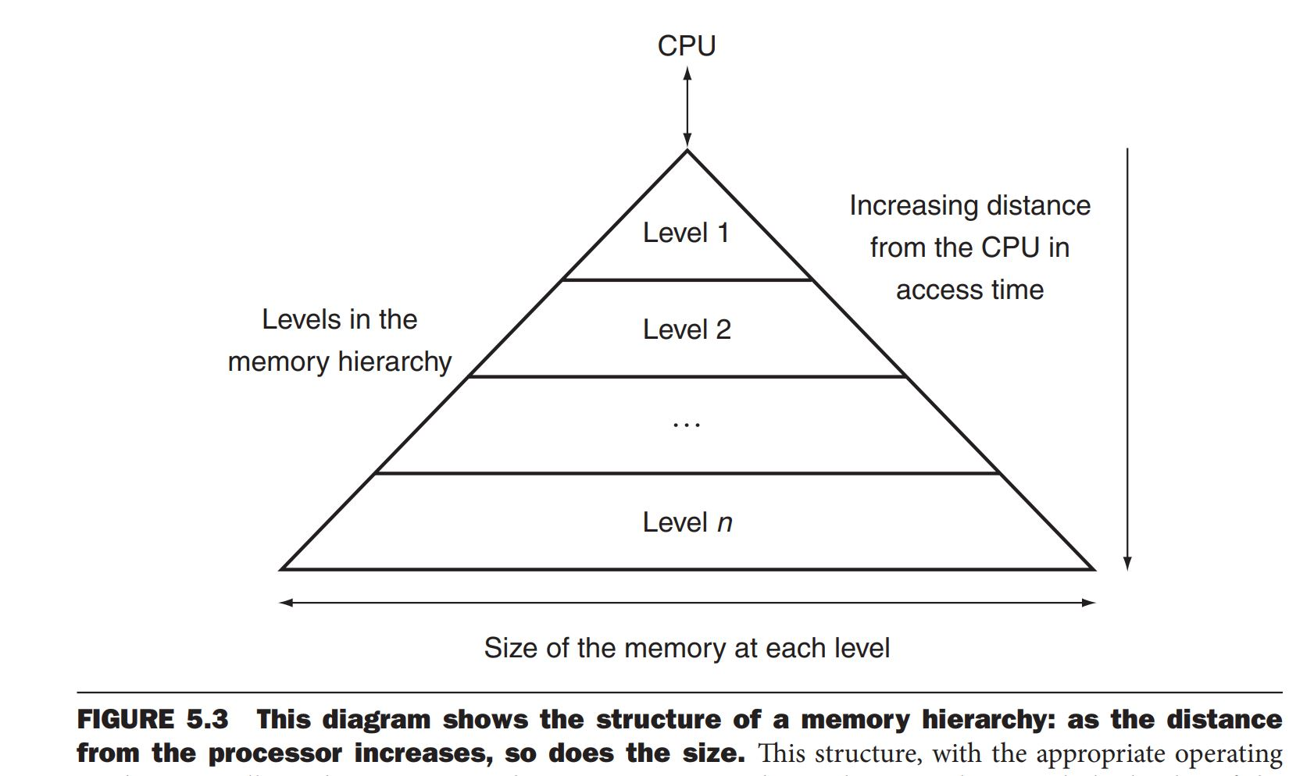
Structure of a memory hierarchy

Slide 6
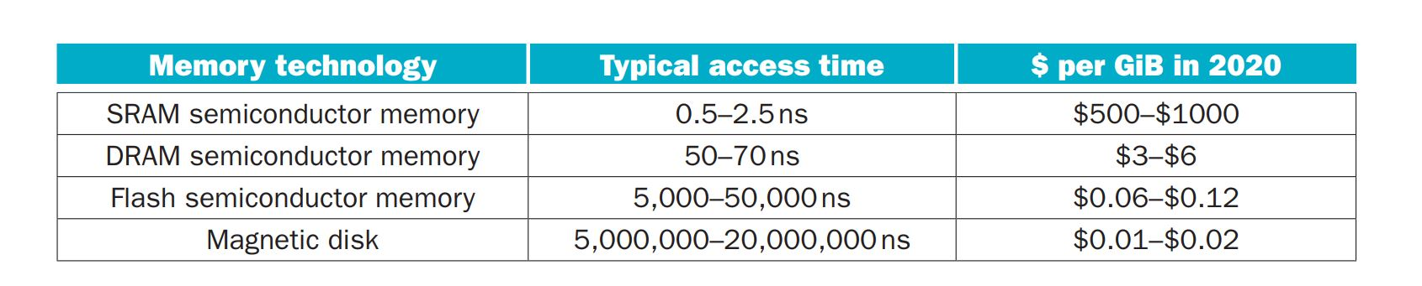
Memory technologies

Slide 7
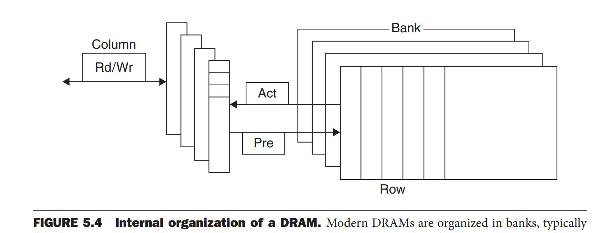
Internal organization of a DRAM

Slide 8
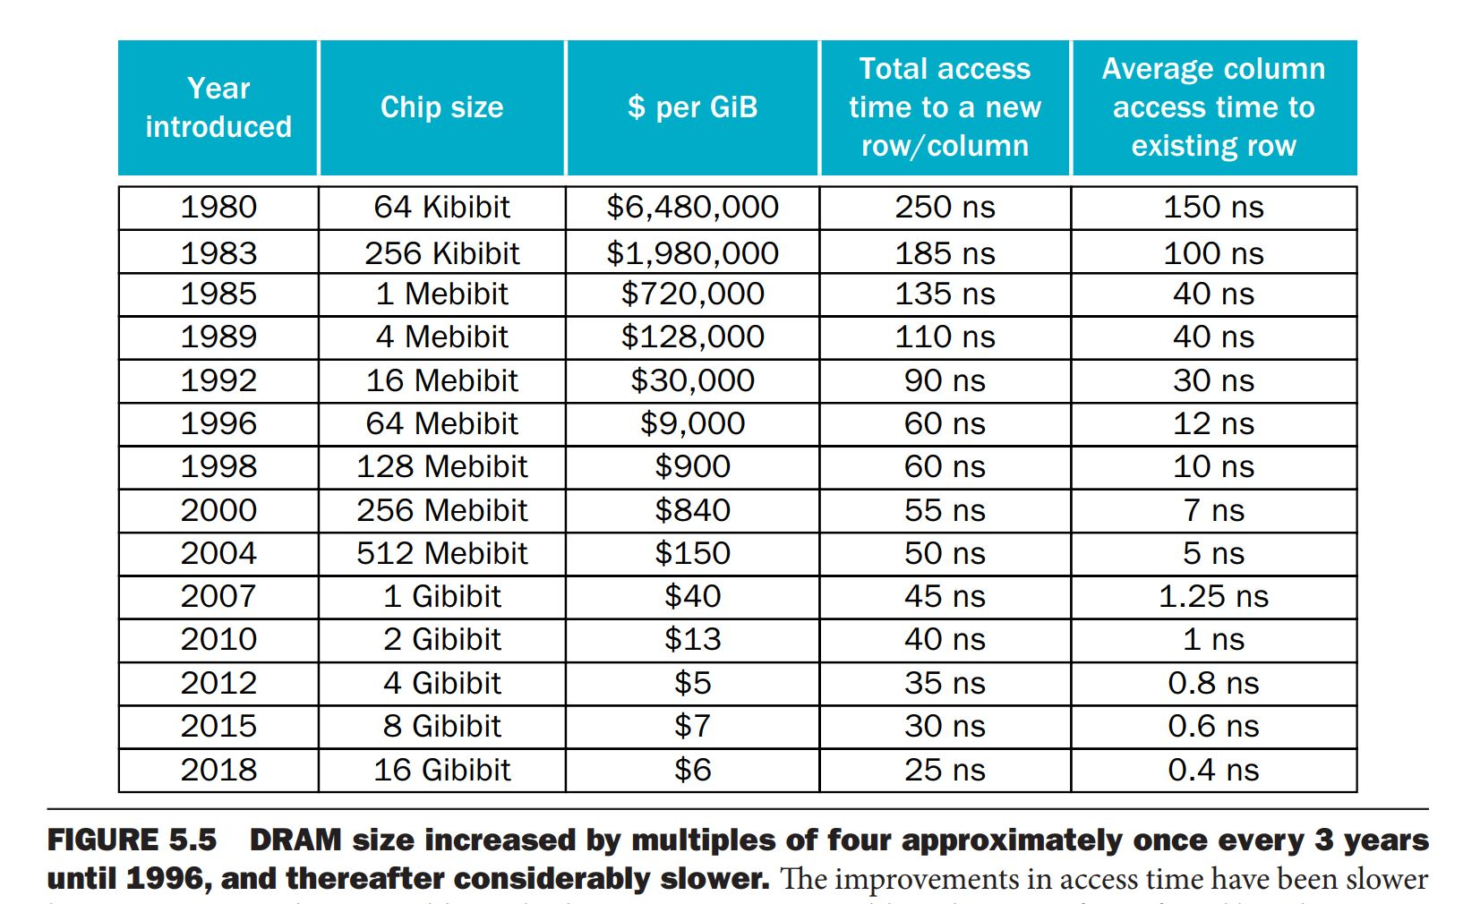
DRAM size increases 4x every 3 years

Slide 9
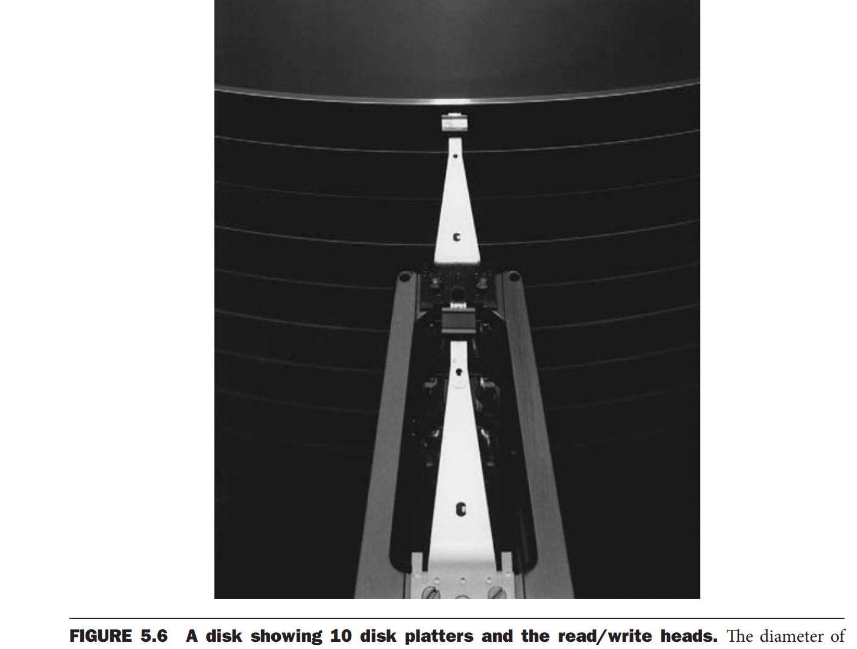
10 disks platter with read/write heads

Slide 10
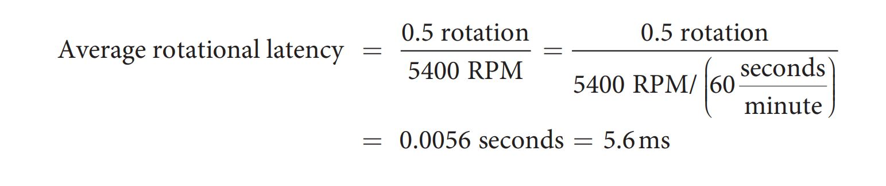
Hard disk parameters
Track
Sector
Cylinder
Seek time
Rotational latency
Transfer time {sector size, rotational speed, recording density}

