Slide 1
Data parallelism
Prabhas Chongstitvatana
Computer Architecture and Organization
February 2020

Slide 2
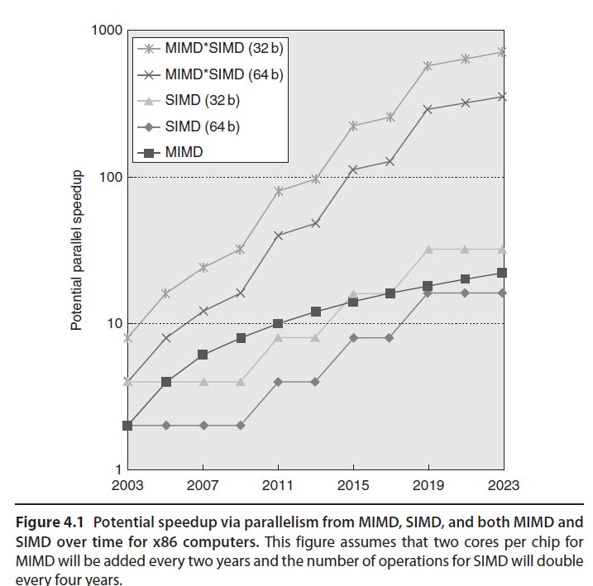
SIMD vs MIMD

Slide 3
Vector machines
Vector architectures grab sets of data elements scattered about memory, place them into large, sequential register files, operate on data in those register files, and then disperse the results back into memory.
A single instruction operates on vectors of data, which results in dozens of register–register operations on independent data elements.

Slide 4
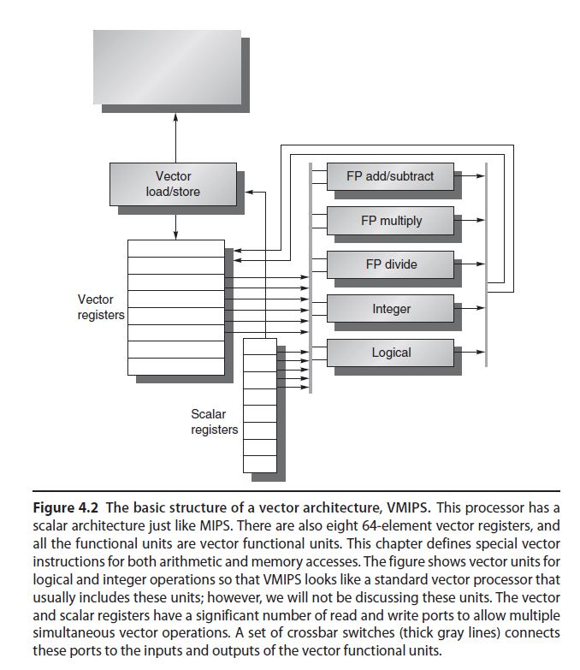
Example:
VMIPS vector registers vector functional units

Slide 5
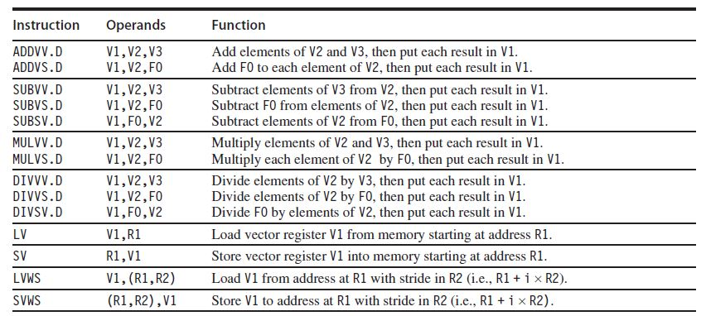
VMIPS instructions

Slide 6
How does it work?
Y = a*X + Y
call (SAXPY, DAXPY), a scalar , X Y vector
assembly program px 297 p 268
ld f0,a
dadd r4 rx #512
loop:
ld f2,0(rx) ; load X[i]
dmul f2 f2 f0
ld f4,0(ry) ; load Y[i]
dadd f4 f4 f2
st f4,9(ry) ; store Y[i]
dadd rx rx #8 ; next i for x
dadd ry ry #8 ; next i for y
dsub r20 r4 rx ; check bound
bnez r20 loop
VMIPS assembly
ld f0,a
lv v1 rx
vmul v2 v1 f0
lv v3 ry
vadd v4 v2 v3
sv v4 ry

Slide 7
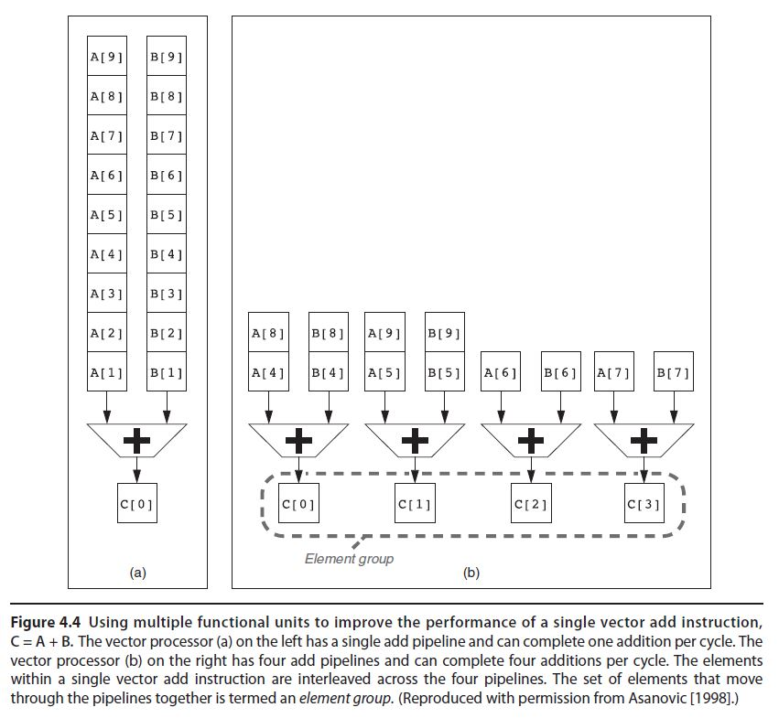
multiple lane, more than one element per clock multiple functional units

Slide 8
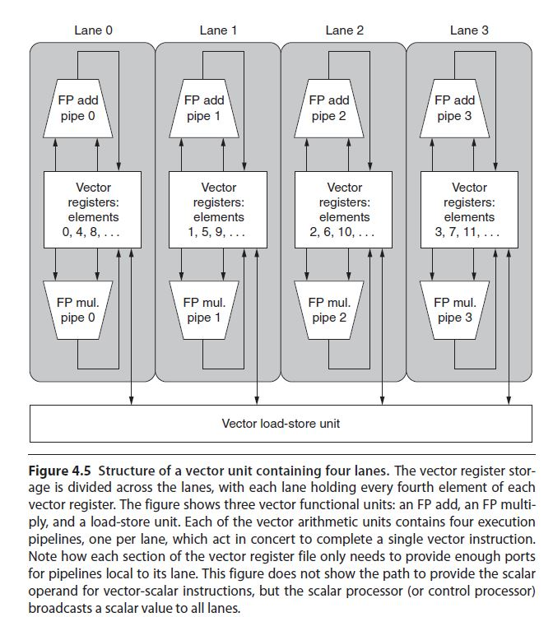
Multiple lanes

Slide 9
Vector length, strip mining
for i=0; i<n; i++
Y[i] = a*X[i] + Y[i]
striping
for i=0; i<n; i+=64
<v> Y[i] = a*X[i] + Y[i]
n may be larger than vector length

Slide 10
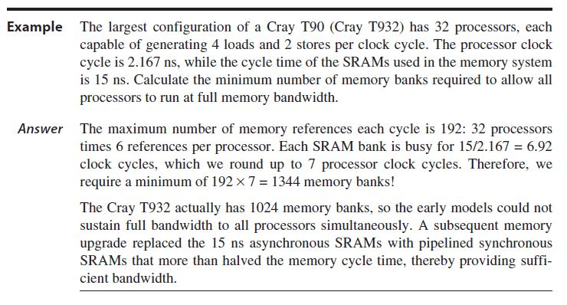
Memory banks, supply to vector load/store unit

Slide 11
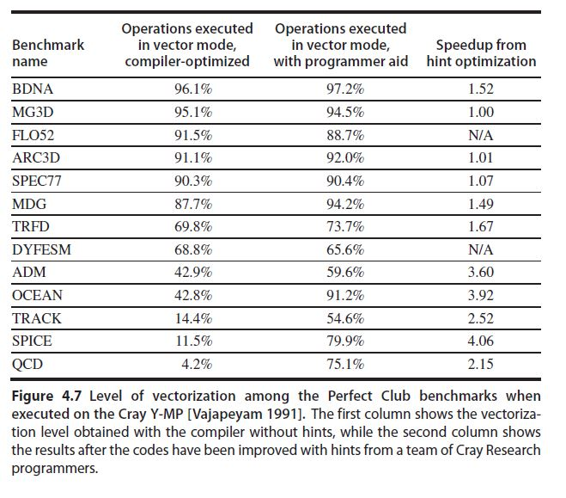
Real performance, not all programs can be vectorized

Slide 12
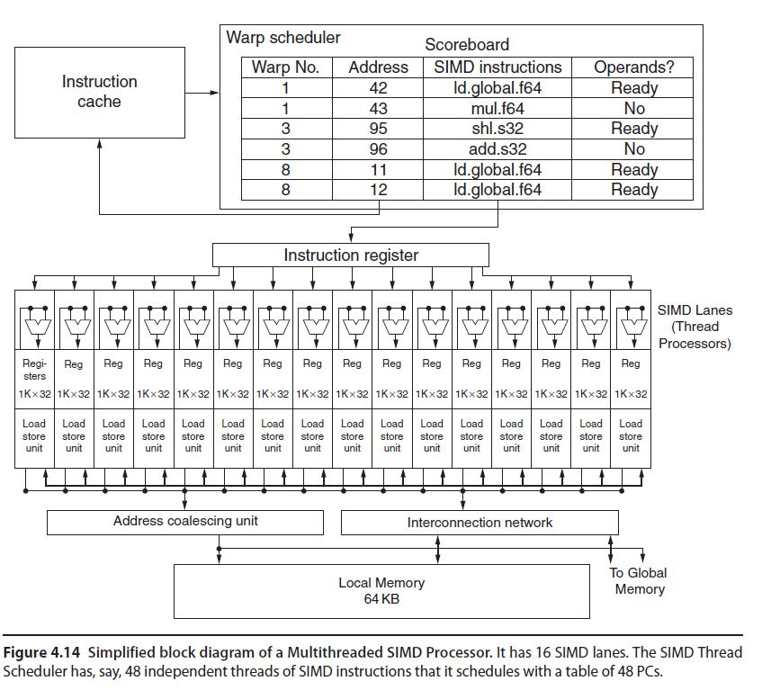
Graphic Processing Unit (GPU)

Slide 13
difference between CPU vs GPU
explain and demo NPU
https://www.cp.eng.chula.ac.th/~prabhas//project/npu/npu.htm

