Slide 1
Instruction set
Prabhas Chongstitvatana
Chulalongkorn university

Slide 2
S2 version 1: 32-bit Processor
a typical simple 32-bit CPU
three-address instruction
32 registers and load/store instructions

Slide 3
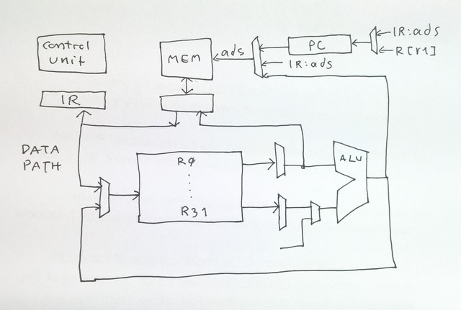
S2 processor

Slide 4
A general format of an instruction
(register to register operations)
op r1 r2 r3 means R[r1] = R[r2] op R[r3]
add r0 r2 r4 R[0] = R[2] + R[4]

Slide 5
Instruction type
arithmetic: add sub mul div mod
logic: and or xor eq ne lt le gt ge shl shr
control: jmp jt jf jal ret
data: ld st push pop mov

Slide 6
Arithmetic
two-complement integer arithmetic
n is 17-bit sign extended
add r1 r2 r3 R[r1] = R[r2] + R[r3]
add r1 r2 #n R[r1] = R[r2] + n
sub r1 r2 ... R[r1] = R[r2] - R[r3]
mul r1 r2 ... R[r1] = R[r2] * R[r3]
div r1 r2 ... R[r1] = R[r2] / R[r3] integer div
mod r1 r2 ... R[r1] = R[r2] % R[r3] modulo

Slide 7
Logic (bitwise)
n is 17-bit sign extended
and r1 r2 r3 R[r1] = R[r2] bit-and R[r3]
and r1 r2 #n R[r1] = R[r2] bit-and n
or r1 r2 r3 R[r1] = R[r2] bit-or R[r3]
or r1 r2 #n R[r1] = R[r2] bit-or n
xor r1 r2 r3 R[r1] = R[r2] bit-xor R[r3]
xor r1 r2 #n R[r1] = R[r2] bit-xor n
eq r1 r2 r3 R[r1] = R[r2] == R[r3]
eq r1 r2 #n R[r1] = R[r2] == n

Slide 8
Data
d is 17-bit sign extended
m is 22-bit sign extended
ld r1 ads is R[r1] = M[ads] absolute
ld r1 +r2 r3 is R[r1] = M[R[r2]+R[r3]] index
ld r1 @d r2 is R[r1] = M[d + R[r2]] displacement
st r1 ads is M[ads] = R[r1] absolute
st r1 +r2 r3 is M[R[r2]+R[r3]] = R[r1] index
st r1 @d r2 is M[d + R[r2]] = R[r1] displacement
mov r1 #m is R[r1] = m move constant
mov r1 r2 is R[r1] = R[r2] move value

Slide 9
Control
jmp ads pc = ads jump
jt r1 ads if R[r1]!=0 pc = ads jump if true
jf r1 ads if R[r1]==0 pc = ads jump if false
jal r1 ads R[r1] = PC; PC = ads jump and link
ret r1 PC = R[r1] return

Slide 10
Special
Stack operation
push r1 r2 is R[r1]++; M[R[r1]] = R[r2]
push r2, r1 as stack pointer
pop r1 r2 is R[r2] = M[R[r1]]; R[r1]--
pop to r2, r1 as stack pointer
Pseudo
  trap r1 #0 stop simulation
  trap r1 #1 print integer in R[r1]
  trap r2 #2 print character in R[r2]

Slide 11
Instruction format
L-format op:5 rd1:5 ads:22
D-format op:5 rd1:5 rs2:5 disp:17
X-format op:5 rd1:5 rs2:5 rs3:5 xop:12
(rd dest, rs source, ads 22-bit, disp 17-bit sign extended)
fixed length at 32 bits
32 registers.
address space is 32-bit.
access to memory is always on word boundary (no byte-access)
direct (absolute address) is 22-bit or the first 4M words.
index and indirect access can reach the whole 32-bit address space.
immediate value (d) is 17-bit. It is sign extended. jump instructions (jmp, jt, jf) have 22-bit address.

Slide 12
How to use instructions
a = b + c
let a,b,c be local variables
use r1, r2, r3 to store a,b,c
add r1 r2 r3 R[0] = R[1] + R[2]

Slide 13
Global variable
a = b + c
let a,b,c be global variables at 100,101,102
use r1, r2, r3 to store values temporary
ld r2 101
ld r3 102
add r1 r2 r3
st r1 100

Slide 14
simple loop
add 1..10
simple no-loop
use r1 as accumulator for sum
mov r1 #0
add r1 r1 #1
add r1 r1 #2
...
add r1 r1 #10

Slide 15
use normal loop
pseudo code
s = 0
i = 1
while i <= 10
  s = s + i
  i = i + 1
use r1 as s, r2 as i, r3 as flag
mov r1 #0
mov r2 #1
:loop
le r3 r2 #10
jf r3 exit
add r1 r1 r2
add r2 r2 #1
jmp loop
:exit

Slide 16
access to an array
add all elements in an array of 10 numbers
pseudo code
ax[10]
  s = 0
  i = 0
  while i < 10
    s = s + ax[i]
    i = i + 1

Slide 17
to access ax[i]. let ax is at 1000
use r1 as s, r2 as i, r3 as flag, r4 as base, r5 as ax[.]
mov r1 #0
mov r2 #0
mov r4 #1000
:loop
lt r3 r2 #10
jf r3 exit
ld r5 +r4 r2 ; get ax[i]
add r1 r1 r5
add r2 r2 #1
jmp loop
:exit

Slide 18
Next: assembly language programming

