Slide 1
Introduction to CUDA

Slide 2
CUDA
Programing system for machines with GPUs
Programming Language
Compilers
Runtime Environments
Drivers
Hardware

Slide 3
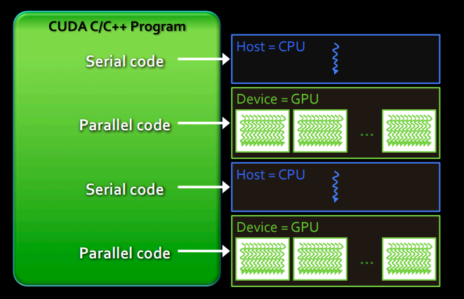
Behavior of CUDA program
Serial code executes in Host (CPU) thread
Parallel code executes in many concurrent Device (GPU) threads across multiple parallel processing elements

Slide 4
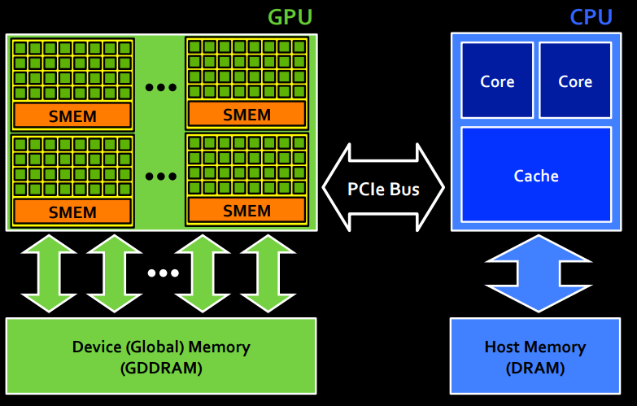
Execution flow

Slide 5
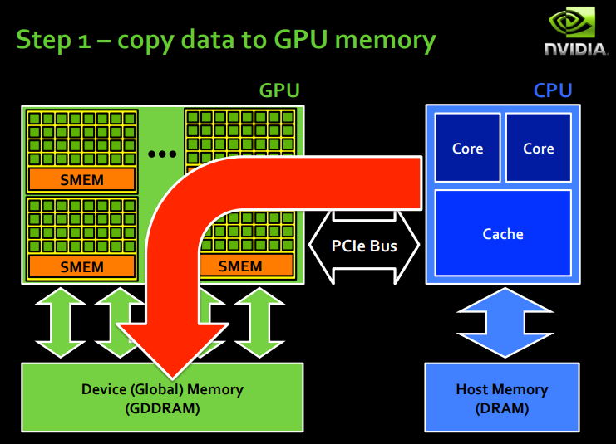

Slide 6
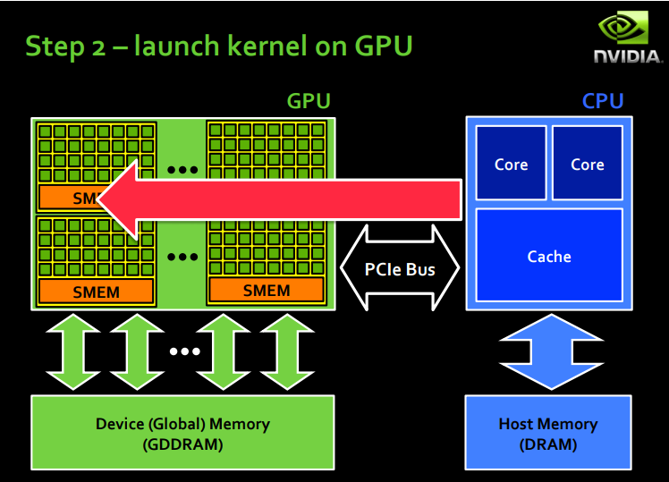

Slide 7
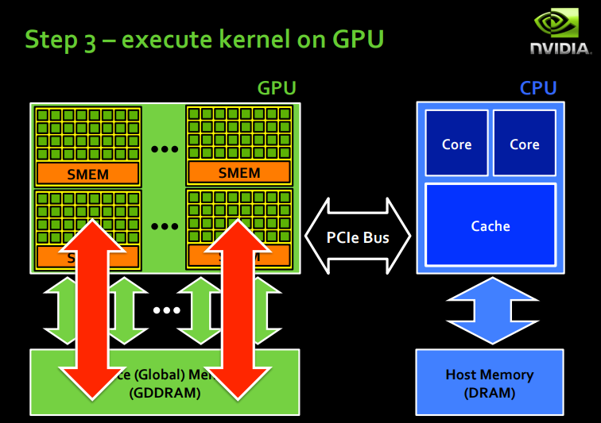

Slide 8
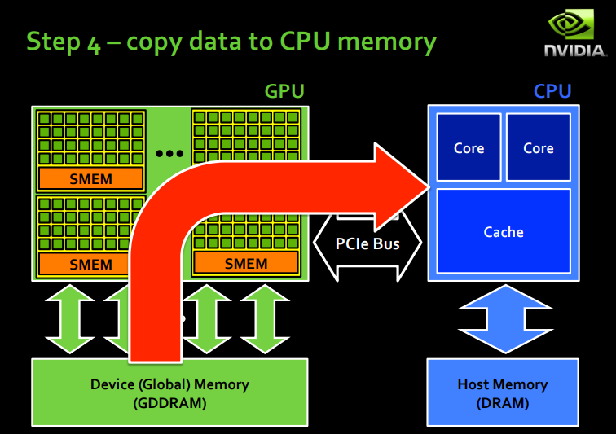

Slide 9
CUDA ARCHITECTURE

Slide 13
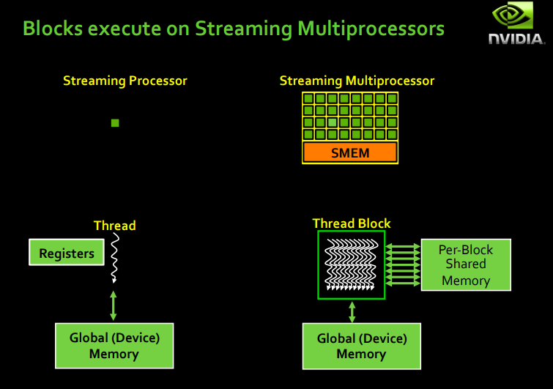

Slide 14
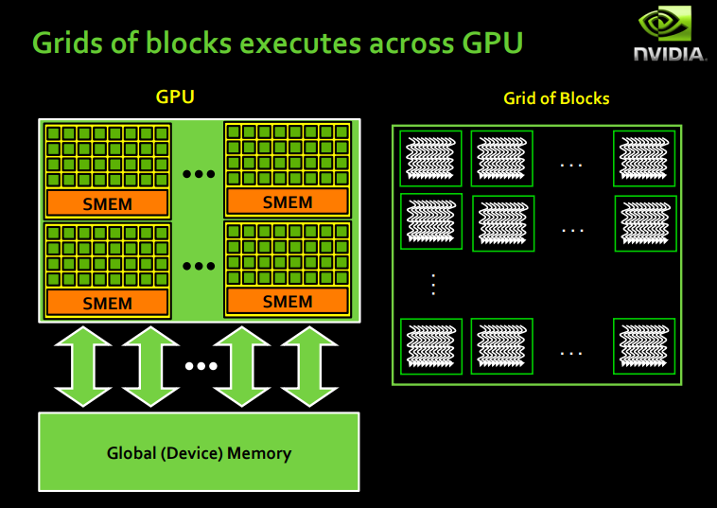

Slide 22
CUDA C

Slide 25
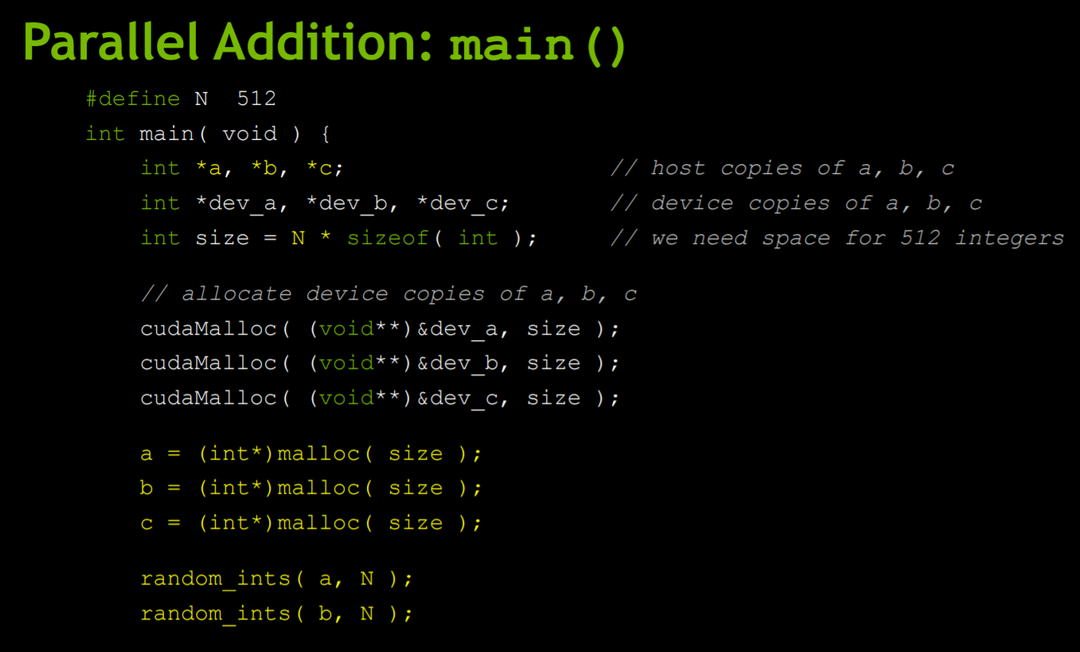

Slide 26
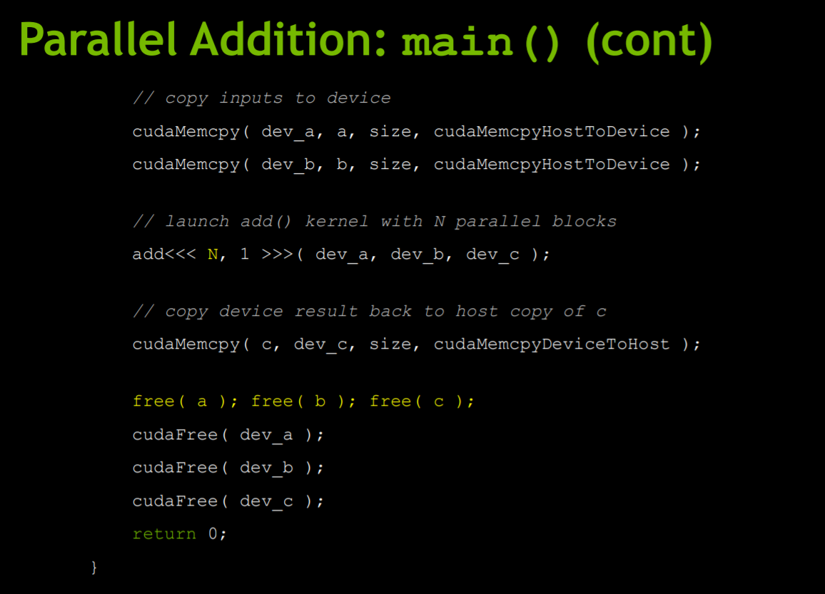

Slide 27
CUDA using Python
Anaconda/Python 3.6.1/Jupyter notebook
CUDA Toolkit
Numba package

Slide 28
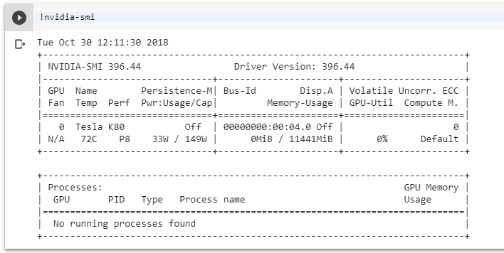
CUDA using Python

Slide 29
CUDA using Python

Slide 30
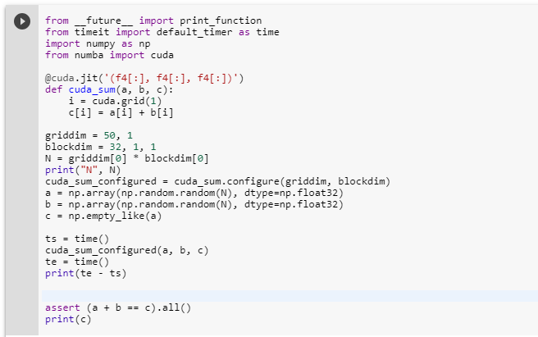
Vector add GPU
http://numba.pydata.org/numba-doc/0.13/CUDAJit.html

Slide 31
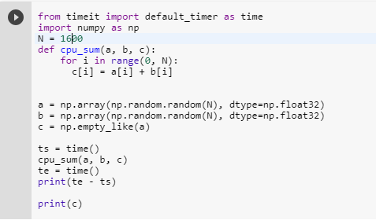
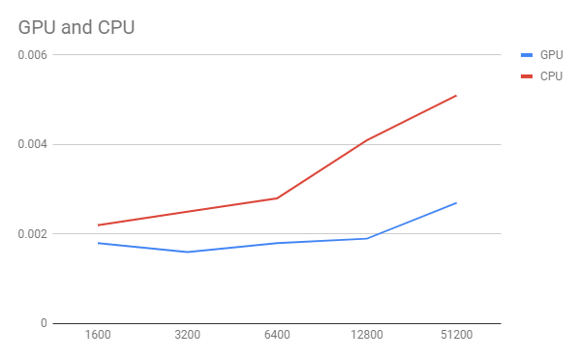
Vector add CPU

