Slide 1
Pipeline
Prabhas Chongstitvatana
11 Feb 2020

Slide 2
Performance in pipeline
Time per instruction in a pipelined processor,
Assume ideal condition (no stall)
Time per instruction on non-pipeline / no. of stages of pipeline
Pipeline = reduce number of clock per instruction

Slide 3
MIPS instruction set
Three group of operations
ALU ops
Load and store
Branch ops

Slide 4

Example of commercial MIPS
RISC-V an open, collaborative community of software and hardware innovators based on the RISC-V ISA
www.riscv.org

Slide 5
Instruction cycle
1. instruction fetch
2. instruction decode/register fetch
3. execution/effective address
4. memory access
write-back

Slide 6
Calculate execution time
Given a MIPS has the following execution time:
branch 2 cycles
store 4 cycles
all others 5 cycles
assume branch frequency 12%, store 10%
CPI = 4.54 (without pipeline)
[ 0.12 x 2 + 0.1 x 4 + 0.78 x 5 ]

Slide 7
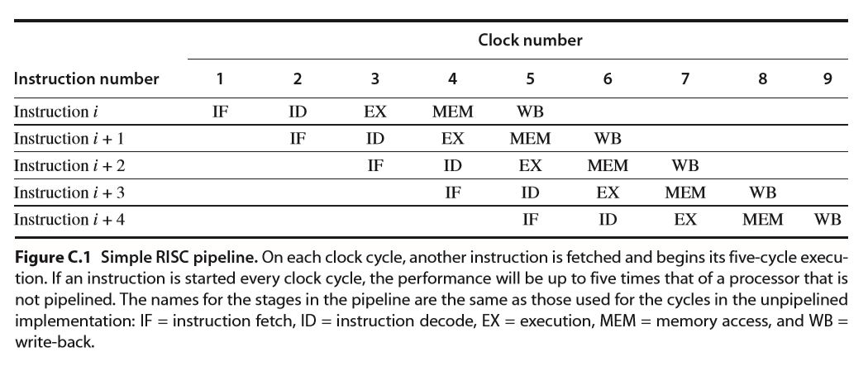
RISC pipeline

Slide 8
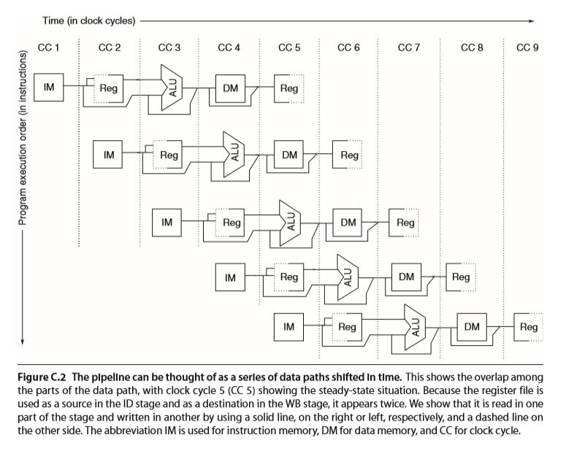

Slide 9
Stall in pipeline
Structural hazards
Data hazards
Control hazards

Slide 10
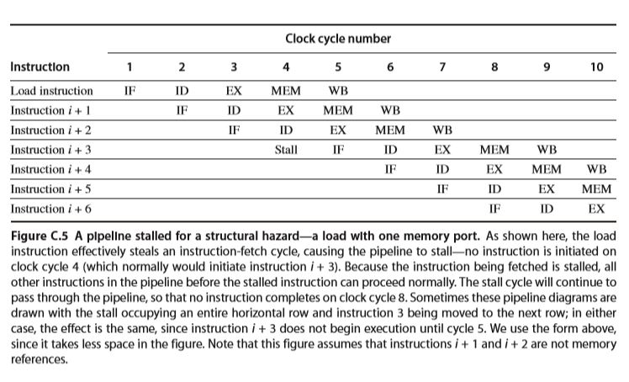
Structural hazard

Slide 11
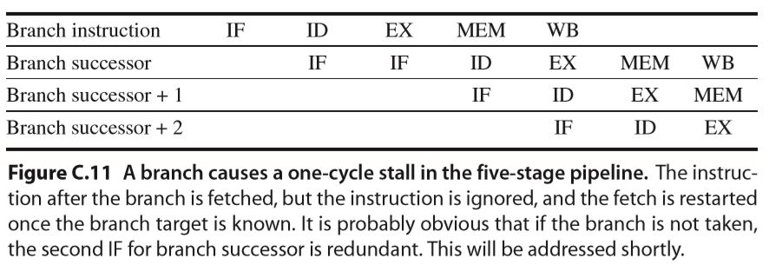
Branch prediction
Stall

Slide 12
branch-prediction-buffer
memory stores prediction bit (taken/not taken)
index by lower portion of the address of branch instruction
a cache, every access is a hit

Slide 13
one-bit predictor
one-bit predictor
if a branch is always taken, predict incorrectly twice

Slide 14
One-bit-predictor
1 0000 mov
2 0001 add
3 0010 jmp taken
4 0000 mov
5 0001 add
6 0010 jmp not-taken
7 0011 ld
8 0100 st
9 0101 jmp taken
10 0000 mov
11 0001 add
12 0010 jmp taken
branch prediction buffer
0010 [1] @3 hit,
[1] @6 miss flip,
[0] @12 miss flip -> [1]
0101 [1] @9 hit

Slide 15
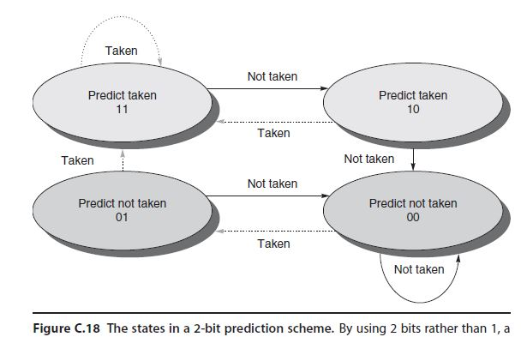
Two-bit-predictor

Slide 16
Quiz 1
Calculate average execution time (CPI)
a processor has 1 ns clock cycle non-pipeline. it uses 5 cycles for ALU ops, 4 cycles for branch,6 cycles MEM.
frequency of ops: ALU 50%, BR 20%, MEM 30%
What is it average instruction execution time?
average instruction execution time = clock cycle x average CPI
Answer
Assume 1 ns clock
1 ns x [(50%x5) + (20%x4) + (30%x6)]
2.5 + .8 + 1.8 = 5.1

Slide 17
Quiz 2
1 0000 add
2 0001 add
3 0010 ld
4 0011 jmp taken
5 0000 add
6 0001 add
7 0010 ld
8 0011 jmp not-taken
9 0100 sub
10 0101 st
11 0110 jmp taken
12 0000 add
13 0001 add
14 0010 ld
15 0011 jmp taken
16 0000 add
17 0001 add
18 0010 ld
19 0011 jmp not-taken
20 0100 sub
This is a trace of instruction execution. using one-bit branch prediction, how many miss?
branch prediction buffer
0011 [1] @4 hit
[1] @8 miss flip
[0] @15 miss flip
[1] @19 miss flip -> [1]
0110 [1] @11 hit
Answer 3 misses

Slide 18
Quiz 3
1 0000 add
2 0001 add
3 0010 ld
4 0011 jmp taken
5 0000 add
6 0001 add
7 0010 ld
8 0011 jmp not-taken
9 0100 sub
10 0101 st
11 0110 jmp taken
12 0000 add
13 0001 add
14 0010 ld
15 0011 jmp taken
16 0000 add
17 0001 add
18 0010 ld
19 0011 jmp not-taken
20 0100 sub
This is a trace of instruction execution. using two-bit branch prediction, how many miss?
Branch prediction buffer
0011 [11] @4 hit
[11] @8 miss -> [10]
[10] @15 hit -> [11]
[11] @19 miss -> [10]
0110 [11] @11 hit
Answer 2 misses

Slide 19
Example of pipeline in real processor
core i7 branch predictor
uses a two-level predictor that has a smaller first-level predictor, and a larger second-level predictor as a backup.
Each predictor combines three different predictors:
  (1) the simple two-bit predictor,
  (2) a global history predictor,
  (3) a loop exit predictor.
fig 3.5 px.196 p.167

Slide 20
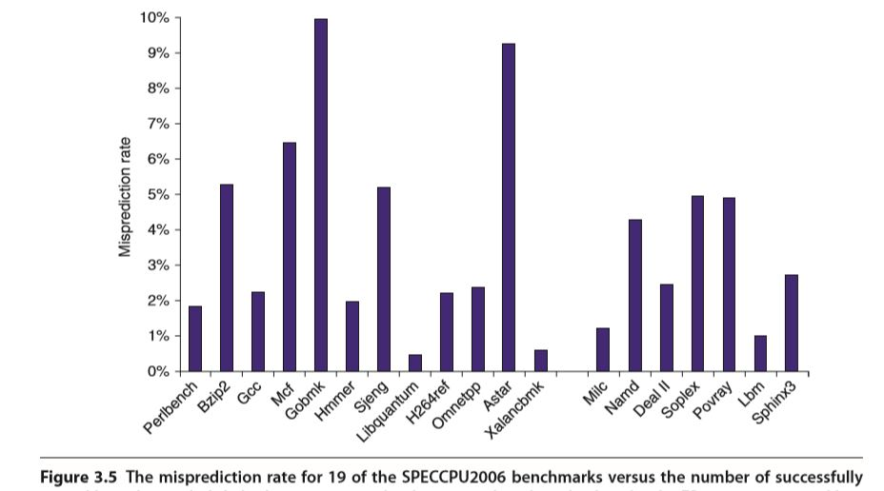
Core i7 predictor miss rate

Slide 21
Overcome data hazard
pptx ch3 slide 17
dynamic scheduling
px 197
Reorder instruction
div.d f0,f2,f4
add.d f10,f0,f8
sub.d f12,f8,f15
register renaming

