Slide 1
Introduction to Quantum Computing
by
Kamonluk Suksen

Slide 2
Overview
From bits to qubits: Dirac notation, density matrices, measurement, Bloch sphere
Quantum circuits: basic single-qubit & two-qubit gates, multipartite quantum states
Entanglement: Bell states, Teleportation

Slide 3
From bits to qubits
Superpositions allow to perform calculations on many states at the same time.
Quantum algorithms with exponential speed-up.
But: Once we measure the superposition state, it collapse to one of its states.
We can use interference effects to keep the right answer.

Slide 4
Dirac notation & density matrices
It used to describe quantum states: Let a, b are 2-dimensional vector with complex entries.
ket: $\left.\left|a\right.\right\rangle =\left({a_{0} \atop a_{1}}\right)$
bra: $\left\langle \left.b\right|\right.={\left.\left|b\right.\right\rangle }^{+}={\left({b_{0} \atop b_{1}}\right)}^{+}=(b_{0}^{∗} b_{1}^{∗})$
bra-ket: $\left\langle b | a\right\rangle ={a_{0}b_{0}}^{∗}+{a_{1}b_{1}}^{∗}={\left\langle a | b\right\rangle }^{∗}∈∁$ (inner product)
ket-bra: $\left|\left.a\right\rangle \right.\left\langle \left.b\right|\right.=\left(\begin{matrix}{a_{0}b_{0}}^{∗} & {a_{0}b_{1}}^{∗} \\ {a_{1}b_{0}}^{∗} & {a_{1}b_{1}}^{∗}\end{matrix}\right)$ (2x2 matrix)

Slide 5
Dirac notation & density matrices
The pure states are $\left.\left|0\right.\right\rangle =\left({1 \atop 0}\right),\left.\left|1\right.\right\rangle =\left({0 \atop 1}\right)$, which are orthogonal: $\left\langle 0 | 1\right\rangle =1.0+0.1=0$
$\left|\left.0\right\rangle \right.\left\langle \left.0\right|=\right.\left({1 \atop 0}\right)\left(1\right. \left.0\right)=\left(\begin{matrix}1 & 0 \\ 0 & 0\end{matrix}\right)$, $\left|\left.1\right\rangle \right.\left\langle \left.1\right|=\right.\left({0 \atop 1}\right)\left(0\right. \left.1\right)=\left(\begin{matrix}0 & 0 \\ 0 & 1\end{matrix}\right)$
$\text{}=\left(\begin{matrix}{\text{}}_{00} & {\text{}}_{01} \\ {\text{}}_{10} & {\text{}}_{11}\end{matrix}\right)={\text{}}_{00}\left|\left.0\right\rangle \right.\left\langle \left.0\right|\right.+{\text{}}_{01}\left|\left.0\right\rangle \right.\left\langle \left.1\right|\right.+{\text{}}_{10}\left|\left.1\right\rangle \right.\left\langle \left.0\right|\right.+{\text{}}_{11}\left|\left.1\right\rangle \right.\left\langle \left.1\right|\right.$
All quantum states can be described by density matrices.
All quantum states are normalized, i.e., $\left\langle  | \right\rangle =1$, e.g., $\left|\left.\right\rangle \right.=\frac{1}{\sqrt{2}}\left(\left|\left.0\right\rangle \right.+\left|\left.1\right\rangle \right.\right)=\left({\frac{1}{\sqrt{2}} \atop \frac{1}{\sqrt{2}}}\right)$
A density matrix is pure, if $\text{}=\left|\left.ψ\right\rangle \right.\left\langle \left.ψ\right|\right.$, otherwise it is mixed.
$\text{}=\left(\begin{matrix}1 & 0 \\ 0 & 0\end{matrix}\right)=\left|\left.0\right\rangle \right.\left\langle \left.0\right|\right.→Pure$, $\text{}=\left(\begin{matrix}0 & 0 \\ 0 & 1\end{matrix}\right)=\left|\left.1\right\rangle \right.\left\langle \left.1\right|\right.→Pure$
$\text{}=\frac{1}{2}\left(\begin{matrix}1 & 0 \\ 0 & 1\end{matrix}\right)=\frac{1}{2}(\left|\left.0\right\rangle \right.\left\langle \left.0\right|\right.+\left|\left.1\right\rangle \right.\left\langle \left.1\right|\right.)→Mixed$
$\text{}=\frac{1}{2}\left(\begin{matrix}1 & −1 \\ −1 & 1\end{matrix}\right)=\frac{1}{2}\left(\left|\left.0\right\rangle \right.\left\langle \left.0\right|\right.−\left|\left.0\right\rangle \right.\left\langle \left.1\right|\right.−\left|\left.1\right\rangle \right.\left\langle \left.0\right|\right.+\left|\left.1\right\rangle \right.\left\langle \left.1\right|\right.\right)=\frac{1}{2}(\left.\left|0\right.\right\rangle −\left.\left|1\right.\right\rangle )(\left.\left|0\right.\right\rangle −\left.\left|1\right.\right\rangle )→Pure$

Slide 6
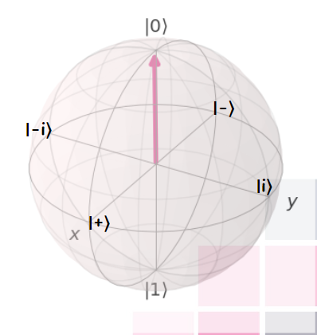
Measurement
We choose orthogonal base to describe and measure quantum states (projective measurement).
During a measurement onto the basis $\left\{\left.\left|0\right.\right\rangle ,\left.\left|1\right.\right\rangle \right\}$, the states will collapse into either state $\left.\left|0\right.\right\rangle$ or $\left.\left|1\right.\right\rangle$, as those are the eigenstates of $σ_{Z}$, we call this a Z-measurement.
Other different bases are:
$\left.\left|+\right.\right\rangle =\frac{1}{\sqrt{2}}(\left.\left|0\right.\right\rangle +\left.\left|1\right.\right\rangle )$, $\left.\left|−\right.\right\rangle =\frac{1}{\sqrt{2}}(\left.\left|0\right.\right\rangle −\left.\left|1\right.\right\rangle )$, corresponding to the eigenstates of $σ_{x}$,
$\left.\left|+i\right.\right\rangle =\frac{1}{\sqrt{2}}(\left.\left|0\right.\right\rangle +\left.i\left|1\right.\right\rangle )$, $\left.\left|−i\right.\right\rangle =\frac{1}{\sqrt{2}}(\left.\left|0\right.\right\rangle −\left.i\left|1\right.\right\rangle )$, corresponding to the eigenstates of $σ_{y}$.

Slide 7
Measurement
Born rule: the probability that a state $\left.\left|\right.\right\rangle$ collapses during a project measurement onto the basis $\left\{\left.\left|X\right.\right\rangle , \left|\left.X^{⊥}\right\rangle \right. \right\}$ to the state $\left.\left|X\right.\right\rangle$ is given by $P\left(X\right)={\left|\left\langle X | \right\rangle \right|}^{2}$, $\sum_{i}{P}\left(X_{i}\right)=1$
Examples:
$\left.\left|\right.\right\rangle =\frac{1}{\sqrt{3}}\left(\left.\left|0\right.\right\rangle +\sqrt{2}\left.\left|1\right.\right\rangle \right)$ is measured in the basis $\left\{\left.\left|0\right.\right\rangle ,\left.\left|1\right.\right\rangle \right\}$:
$P\left(0\right)={\left\langle 0 | \frac{1}{\sqrt{3}}\left.(\left|0\right.\right\rangle +\sqrt{2} | 1\right\rangle )}^{2}={\left|\frac{1}{\sqrt{3}}\left\langle 0 | 0\right\rangle +\frac{\sqrt{2}}{\sqrt{3}}\left\langle 0 | 1\right\rangle \right|}^{2}=\frac{1}{3} → P\left(1\right)=\frac{2}{3}$
$\left.\left|\right.\right\rangle =\frac{1}{\sqrt{2}}\left(\left.\left|0\right.\right\rangle −\left.\left|1\right.\right\rangle \right)$ is measured in the basis $\left\{\left.\left|+\right.\right\rangle ,\left.\left|−\right.\right\rangle \right\}$:
$P\left(+\right)={\left|\left\langle + | \right\rangle \right|}^{2}={\left|\frac{1}{\sqrt{2}}\left.(\left|0\right.\right\rangle +\left.\left|1\right.\right\rangle )\frac{1}{\sqrt{2}}\left.(\left|0\right.\right\rangle −\left.\left|1\right.\right\rangle )\right|}^{2}=\frac{1}{4}{\left|\left(\left\langle 0 | 0\right\rangle −\left\langle 0 | 1\right\rangle +\left\langle 1 | 0\right\rangle −\left\langle 1 | 1\right\rangle \right)\right|}^{2}=0→expected as$ $\left\langle + | −\right\rangle =0$,
$P\left(−\right)=$ ${\left|\left\langle − | −\right\rangle \right|}^{2}=1$

Slide 8
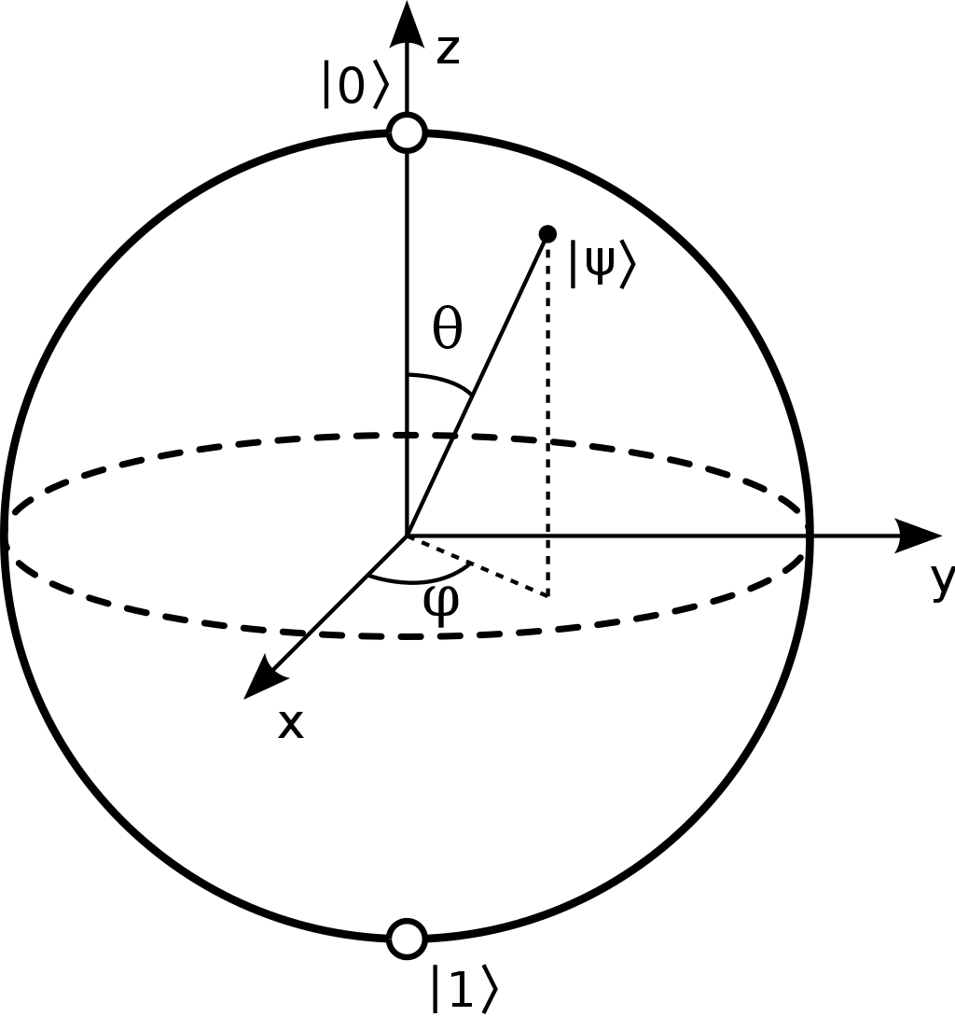
Bloch sphere
We can write any normalized pure state as $\left.\left|\right.\right\rangle =\cos{\frac{θ}{2}\left.\left|0\right.\right\rangle +e^{iφ}\sin{\frac{θ}{2}}}\left.\left|1\right.\right\rangle$, where $φ∈\left[0, 2π\right]$ describes the relative phase and $θ∈\left[0, π\right]$ determines the probability to measure $\left.\left|0\right.\right\rangle$, $\left.\left|1\right.\right\rangle$: $P\left(\left.\left|0\right.\right\rangle \right)=\cos^{2}{\frac{θ}{2}}$, $P\left(\left.\left|1\right.\right\rangle \right)=\sin^{2}{\frac{θ}{2}}$.
All normalized pure states can be illustrated on the surface of a sphere with radius $\left|\overset{⃑}{r}\right|=1$, which we call the Bloch sphere.
The coordinates of such a state are given by the Bloch vector: $\overset{⃑}{r}=\left(\begin{matrix}\sin{θ\cos{φ}} \\ \sin{θ}\sin{φ} \\ \cos{θ}\end{matrix}\right)$

Slide 9
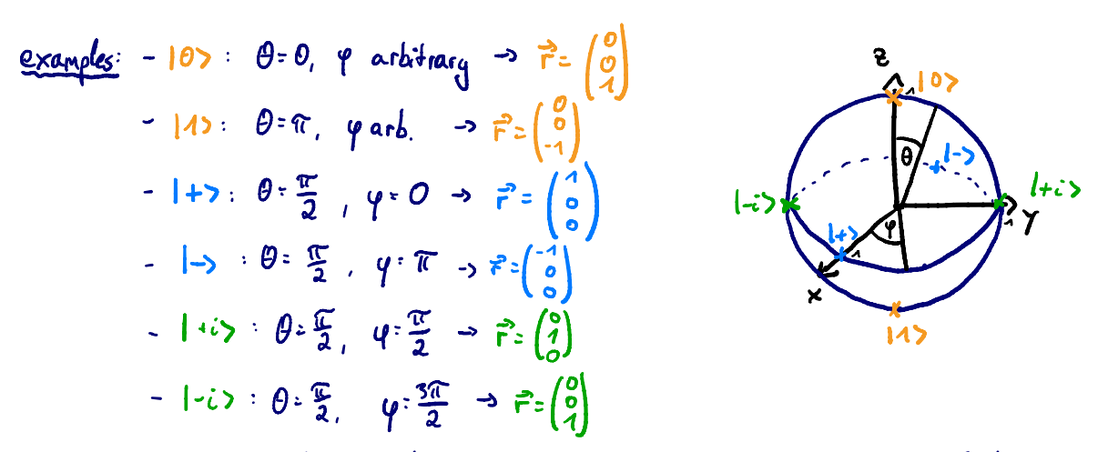
Bloch sphere
Be careful: On the Bloch sphere, angles are twice as big as in Hilbert space:
e.g., $\left.\left|0\right.\right\rangle$ & $\left.\left|1\right.\right\rangle$ are orthogonal, but on the Bloch sphere their angle is ${180}^{o}$.
For a general state, $\left.\left|\right.\right\rangle =\cos{\frac{θ}{2}\left.\left|0\right.\right\rangle +…}→θ$is the angle on the Bloch sphere, while $\frac{θ}{2}$ is the actual angle in Hilbert space!

Slide 10
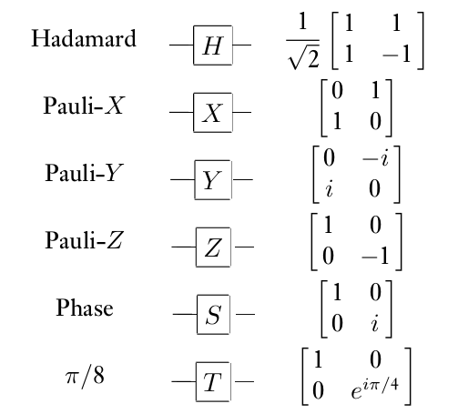
Quantum circuits: single qubit gates
Circuit model: sequence of building block that carry out computations, called gates.
Quantum gates are represented by unitary matrices, A unitary matrix is a square matrix of complex numbers, whose inverse is equal to its conjugate transpose.
Single qubit gates:
input
algorithm
output
creates superposition
rotation around X-axis by $π$
bit flip
rotation around Y-axis by $π$
bit & phase flip
rotation around Z-axis by $π$
phase flip
used to change from Z to Y-basis

Slide 11
Quantum circuits: single qubit gates

Slide 12
Quantum circuits: multipartite quantum states
We use tensor product to describe multiple states:
$\left.\left|a\right.\right\rangle ⊗\left.\left|b\right.\right\rangle =\left({a_{1} \atop a_{2}}\right)⊗\left({b_{1} \atop b_{2}}\right)=\left({a_{1}b_{1} \atop \begin{matrix}a_{1}b_{2} \\ \begin{matrix}a_{2}b_{1} \\ a_{2}b_{2}\end{matrix}\end{matrix}}\right)$
Example: system A is in state ${\left.\left|1\right.\right\rangle }_{A}$ and system B is in state ${\left.\left|0\right.\right\rangle }_{B}=\left({0 \atop 1}\right)⊗\left({1 \atop 0}\right)=\left({0 \atop \begin{matrix}0 \\ \begin{matrix}1 \\ 0\end{matrix}\end{matrix}}\right)$, states of this form are called uncorrelated.
But there are also bipartite states that cannot be written as ${\left.\left|\right.\right\rangle }_{a}⊗{\left.\left|ψ\right.\right\rangle }_{b}$. These states are correlated and sometimes even entangled (very strong correlation), e.g. ${\left.\left|\right.\right\rangle }_{AB}^{(00)}=\frac{1}{\sqrt{2}}({\left.\left|00\right.\right\rangle }_{AB}+{\left.\left|11\right.\right\rangle }_{AB})=\frac{1}{\sqrt{2}}$ $\left({1 \atop \begin{matrix}0 \\ \begin{matrix}0 \\ 1\end{matrix}\end{matrix}}\right)$, it so called Bell state, used for teleportation, cryptography, Bell tests, etc.

Slide 13
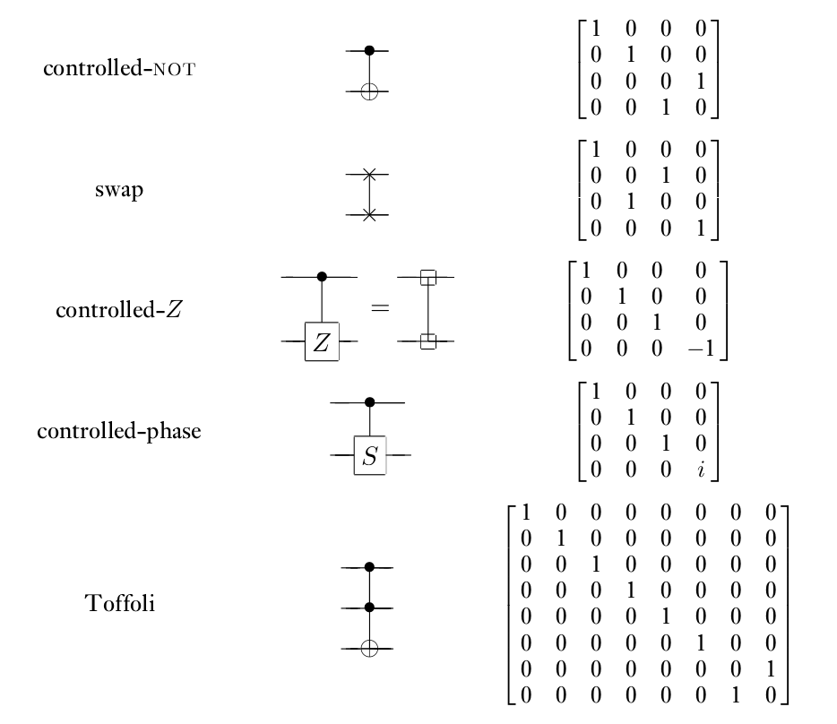
Quantum circuits: multiple-qubit gates

Slide 14
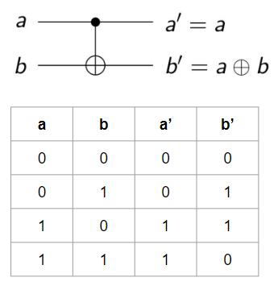
Quantum circuits: two-qubit gates
Classical example: XOR
But as quantum theory is unitary, we only consider unitary and therefore reversible gates
Quantum example: CNOT gate
X
XOR
X⊕Y
irreversible: given the output, we cannot recover the input.
Y
Quantum circuits can perform all function
that can be calculated classically.

Slide 15
Entanglement
If a pure state${\left.\left|\right.\right\rangle }_{AB}$on system A,B cannot be written as ${\left.\left|\right.\right\rangle }_{a}⊗{\left.\left|φ\right.\right\rangle }_{b}$, it is entangled.
These are four so called Bell states that are maximally entangled and build on orthonormal basis:
$\left|\left.^{00}\right\rangle \right.≔\frac{1}{\sqrt{2}}\left(\left.\left|00\right.\right\rangle +\left.\left|11\right.\right\rangle \right)$,
$\left|\left.^{01}\right\rangle \right.≔\frac{1}{\sqrt{2}}\left(\left.\left|01\right.\right\rangle +\left.\left|10\right.\right\rangle \right)$,
$\left|\left.^{10}\right\rangle \right.≔\frac{1}{\sqrt{2}}\left(\left.\left|00\right.\right\rangle −\left.\left|11\right.\right\rangle \right)$,
$\left|\left.^{11}\right\rangle \right.≔\frac{1}{\sqrt{2}}\left(\left.\left|01\right.\right\rangle −\left.\left|10\right.\right\rangle \right).$

Slide 16
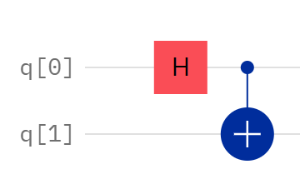
Entanglement
Creation of Bell states:
$${\left.\left|q_{0}q_{1}\right.\right\rangle }_{00} H_{0}→\frac{1}{\sqrt{2}}\left(\left.\left|00\right.\right\rangle +\left.\left|10\right.\right\rangle \right) {CNOT}_{01}→\frac{1}{\sqrt{2}}\left(\left.\left|00\right.\right\rangle +\left.\left|11\right.\right\rangle \right)=\left|\left.ψ^{00}\right\rangle \right.,$$
$${\left.\left|q_{0}q_{1}\right.\right\rangle }_{01} H_{0}→\frac{1}{\sqrt{2}}\left(\left.\left|01\right.\right\rangle +\left.\left|11\right.\right\rangle \right){ CNOT}_{01}→\frac{1}{\sqrt{2}}\left(\left.\left|01\right.\right\rangle +\left.\left|10\right.\right\rangle \right)=\left|\left.ψ^{01}\right\rangle \right.,$$
$${\left.\left|q_{0}q_{1}\right.\right\rangle }_{10} H_{0}→\frac{1}{\sqrt{2}}\left(\left.\left|00\right.\right\rangle −\left.\left|10\right.\right\rangle \right){ CNOT}_{01}→\frac{1}{\sqrt{2}}\left(\left.\left|00\right.\right\rangle −\left.\left|11\right.\right\rangle \right)=\left|\left.ψ^{10}\right\rangle \right.,$$
$${\left.\left|q_{0}q_{1}\right.\right\rangle }_{11} H_{0}→\frac{1}{\sqrt{2}}\left(\left.\left|01\right.\right\rangle −\left.\left|11\right.\right\rangle \right){ CNOT}_{01}→\frac{1}{\sqrt{2}}\left(\left.\left|01\right.\right\rangle −\left.\left|10\right.\right\rangle \right)=\left|\left.ψ^{11}\right\rangle \right..$$

Slide 17
Teleportation
Goal:
Alice want to send her (unknown) state ${\left.\left|\right.\right\rangle }_{s}≔α{\left.\left|0\right.\right\rangle }_{s}+β{\left.\left|1\right.\right\rangle }_{s}$ to Bob.
She can only send him two classical bits though.
They both share the maximally entangled state ${\left.\left|\right.\right\rangle }_{AB}^{(00)}=\frac{1}{\sqrt{2}}({\left.\left|00\right.\right\rangle }_{AB}+{\left.\left|11\right.\right\rangle }_{AB})$.
Initial states of the total system:

Slide 18
Teleportation
Protocol:
Alice’s state collapsed during the measurement, so she doesn’t have the initial state ${\left.\left|\right.\right\rangle }_{s}$ anymore. This is expected due to the no-cloning theorem, as she cannot copy her state, but just send her state to Bob when destroying her own.

Slide 19
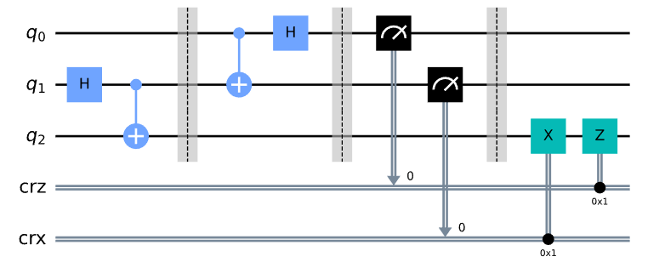
Teleportation
Quantum circuit:
two classical bits
The qubit she is trying to send Bob.
Alice’s qubit
Bob’s qubit
00 → Do nothing
01 → Apply X gate
10 → Apply Z gate
11 → Apply ZX gate

Slide 20
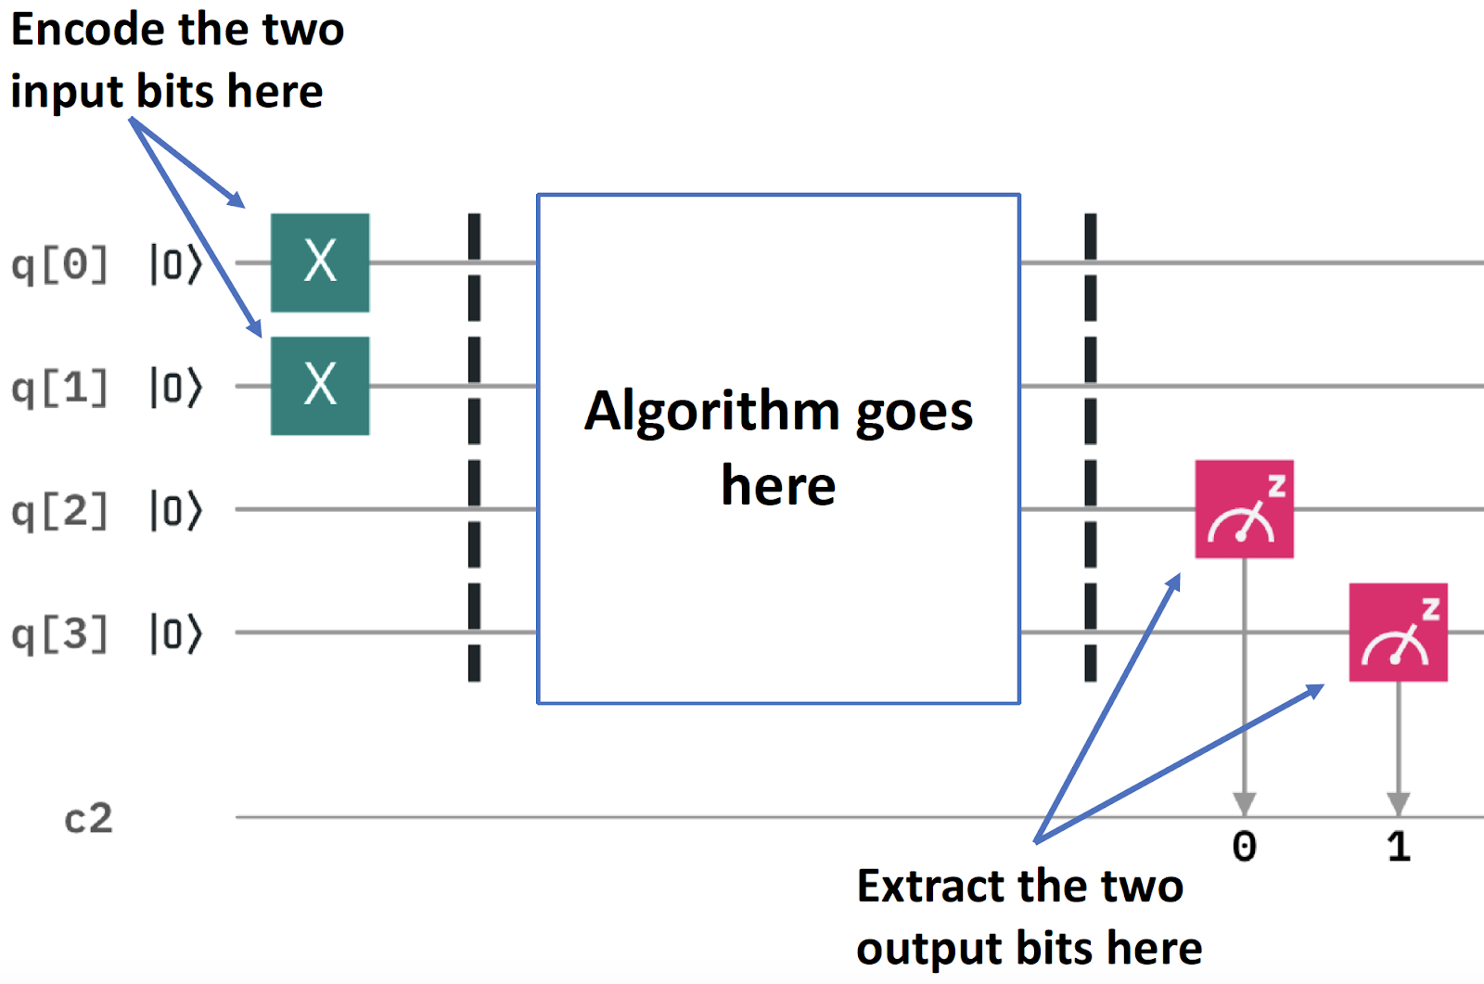
Quantum programming using Qiskit
Half adder circuit for input 11
0+0 = 00 (in decimal, this is 0+0 = 0)
0+1 = 01 (in decimal, this is 0+1 = 1)
1+0 = 01 (in decimal, this is 1+0 = 1)
1+1 = 10 (in decimal, this is 1+1 = 2)

Slide 21
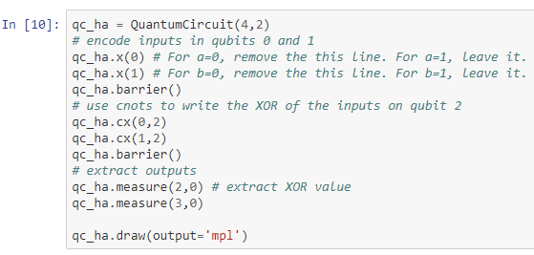
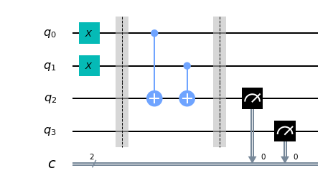
Quantum programming using Qiskit
Half adder circuit for input 11

Slide 22
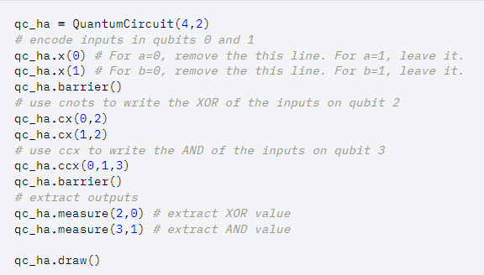
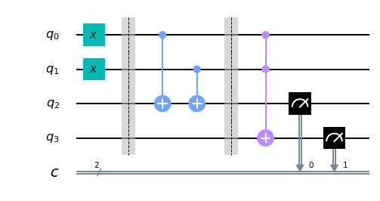
Quantum programming using Qiskit
Half adder circuit for input 11
Add toffoli gate

Slide 23
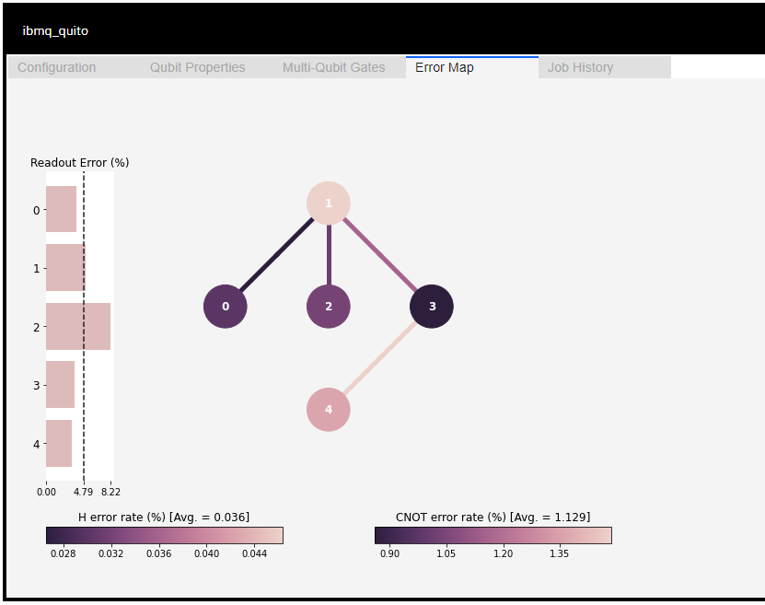
How the noise properties affect the result
There are often optimizations that the transpiler can perform that reduce the overall gate count, and thus total length of the input circuits.
Qiskit library has a command “backend” to show the chosen backend information graphically such as “Error Map”.
We can select a good initial layout considering connectivity and error information that you can find from the map to initial layout onto the physical qubits with at least noise.
Notes:
การสูญเสียความเป็นคลื่นของสถานะทางควอนตัมที่เกิดจากสัญญาณรบกวนโดยธรรมชาติ และความไม่สมบูรณ์ของระบบที่ใช้ควบคุม สามารถแก้ไขได้โดยการทำ error correction หรือง่ายกว่านั้นคือ ถ้าเรารู้ topology ของเครื่องที่เราใช้งานอยู่ เราสามารถเลือกที่จะใช้งาน qubit ที่มี error ต่ำได้

Slide 24
Assignment I
Required:
Go to https://quantum-computing.ibm.com/
Register IBMid account or sign in with Google, Github, LinkedIn, and Twitter.
Download source codes at t.ly/M8Qg and upload files “Lab-1.ipynb” and “Lab-2.ipynb” into IBM Quantum Lab.

