Slide 1
Embedded Processors

Slide 2
Processors
Microprocessors for PCs
Embedded processors or Microcontrollers for embedded systems
  Often with lower clock speeds
  Integrated with memory and
  I/O devices e.g. A/D D/A PWM CAN
  Higher environmental specs
Introduction to Embedded Systems Setha Pan-ngum

Slide 3
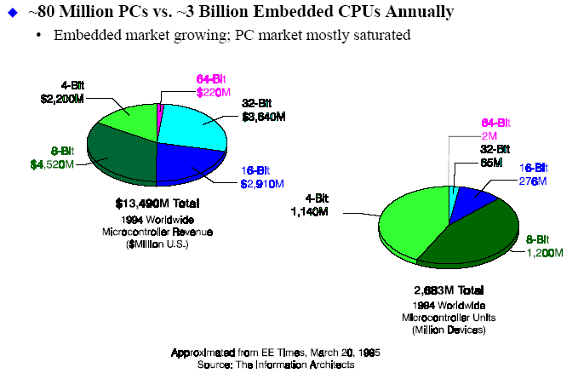
Microcontrollers dominates processor market
Introduction to Embedded Systems Setha Pan-ngum

Slide 4
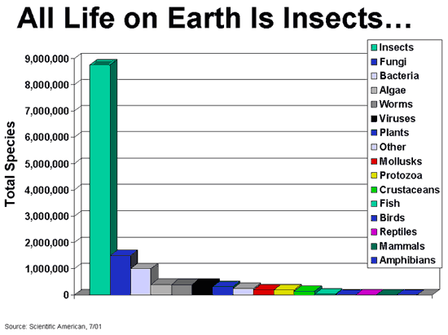
There are so many microcontrollers in the world
Introduction to Embedded Systems Setha Pan-ngum

Slide 5
Types of Embedded Processors
Computational micros (32- or 64-bit datapaths)
  CPU of workstations, PCs, or high-end portable devices (PDAs)
  x86, PA-RISC, PowerPC, SPARC, etc.
Embedded general purpose micros (32-bit datapaths)
  Designed for a wide range of embedded applications
  Often scaled-down version of computational micros
  ARM, PowerPC, MIPS, x86, 68K, etc.
Microcontrollers (4-, 8-, or 16-bit datapaths)
  Integrate processing unit, memory, I/O buses, and peripherals
  Often low-cost, high-volume devices
Domain-specific processors (datapath size varies greatly)
  Designed for a particular application domain
  Digital signal processors, multimedia processors, graphics processors, network processors, security processors, etc.
Slide credit - Mike Schulte
Introduction to Embedded Systems Setha Pan-ngum

Slide 6
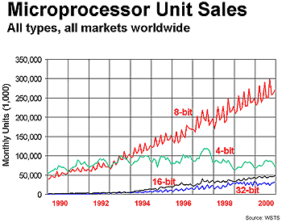
Processor Sales Data
Slide credit - Mike Schulte
Introduction to Embedded Systems Setha Pan-ngum

Slide 7
Processor Market
2001 processor market by volume:
  Computational micros: 2%
  Embedded general-purpose micros: 11%
  DSPs: 10%
  Microcontrollers: 80%
2001 processor market by revenue:
  Computational micros: 51%
  Embedded general-purpose micros: 8%
  DSPs: 13%
  Microcontrollers: 28%
Higher growth expected for embedded micros, DSPs, and microcontrollers
Slide credit - Mike Schulte
Introduction to Embedded Systems Setha Pan-ngum

Slide 8
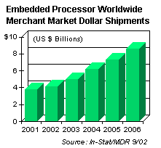
Growing Demand
Embedded processors account for
  Over 97% of total processors sold
  Over 60% of total sales from processors
Sales expected to increase by roughly 15% each year
Slide credit - Mike Schulte
Introduction to Embedded Systems Setha Pan-ngum

Slide 9
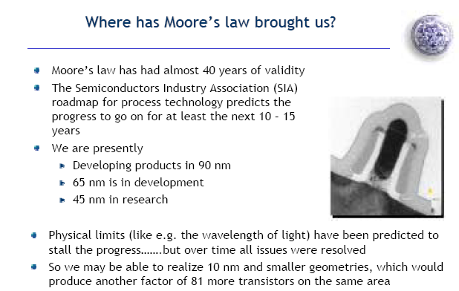
Moore’s Law
Slide credit – W Fornaciari
Introduction to Embedded Systems Setha Pan-ngum

Slide 10
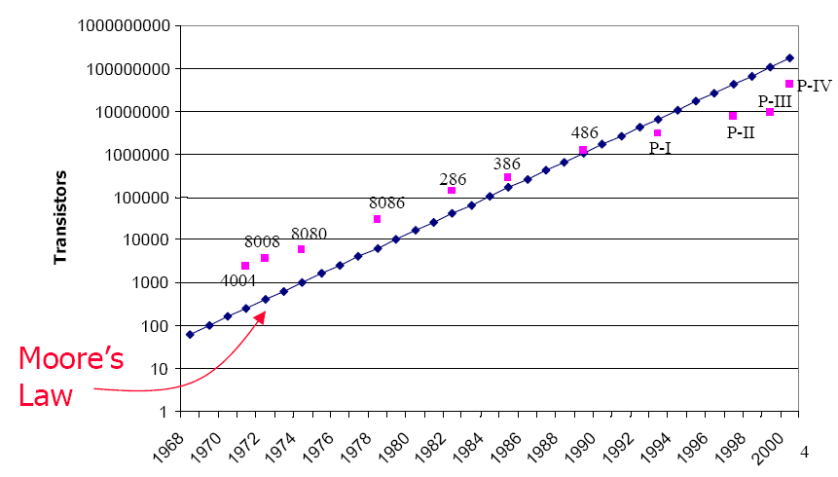
Number of Transistors on Chips
Slide credit – T Givargis
Introduction to Embedded Systems Setha Pan-ngum

Slide 11
Graphical illustration of Moore’s law
1981
1984
1987
1990
1993
1996
1999
2002
10,000
transistors
150,000,000
transistors
Leading edge
chip in 1981
Leading edge
chip in 2002
Slide credit Vahid/Givargis, Embedded Systems Design: A Unified Hardware/Software Introduction, 2000
Introduction to Embedded Systems Setha Pan-ngum

Slide 12
Some common characteristics of embedded systems
Single-functioned
  Executes a single program, repeatedly
Tightly-constrained
  Low cost, low power, small, fast, etc.
Reactive and real-time
  Continually reacts to changes in the system’s environment
  Must compute certain results in real-time without delay
Slide credit Vahid/Givargis, Embedded Systems Design: A Unified Hardware/Software Introduction, 2000
Introduction to Embedded Systems Setha Pan-ngum

Slide 13
Characteristics of Embedded Systems
Application-specific functionality – specialized for one or one class of applications
Deadline constrained operation – system may have to perform its function(s) within specific time periods to achieve successful results
Resource challenged – systems typically are configured with a modest set of resources to meet the performance objectives
Power efficient – many systems are battery-powered and must conserve power to maximize the usable life of the system.
Form factor – many systems are light weight and low volume to be used as components in host systems
Manufacturable – usually small and inexpensive to manufacture based on the size and low complexity of the hardware.
Slide credit Y William, GWU
Introduction to Embedded Systems Setha Pan-ngum

