Slide 2
Introduction to Embedded Systems

Slide 3
Objectives
Introduction to embedded systems
Embedded system components
  Hardware
  Software
Embedded system programming
Introduction to Embedded Systems Setha Pan-ngum

Slide 4
Contents
Introduction to embedded systems
Software engineering
Computer architecture
Operating systems
Digital systems
Programming practice
Theory for practical works
Introduction to Embedded Systems Setha Pan-ngum

Slide 5
Slide credit Y Williams, GWU
Introduction to Embedded Systems Setha Pan-ngum

Slide 6
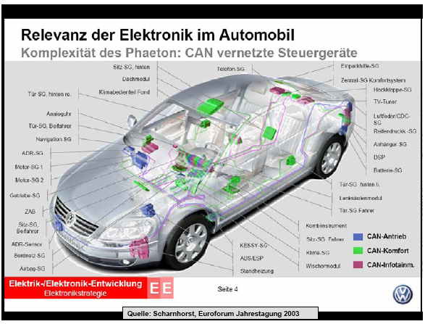
Slide credit S. Kowalewski Aachen University
Introduction to Embedded Systems Setha Pan-ngum

Slide 7
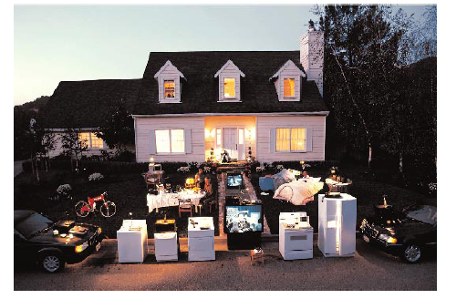
Slide credit P Koopman, CMU
Introduction to Embedded Systems Setha Pan-ngum

Slide 8
Definition
“Any sort of device which includes a programmable computer but itself is not intended to be a general-purpose computer”
      Wayne Wolf
Introduction to Embedded Systems Setha Pan-ngum

Slide 9
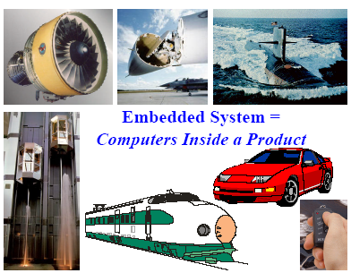
Definition
Slide credit P Koopman, CMU
Introduction to Embedded Systems Setha Pan-ngum

Slide 10
Embedded systems overview
Computing systems are everywhere
Most of us think of “desktop” computers
  PC’s
  Laptops
  Mainframes
  Servers
But there’s another type of computing system
  Far more common...
Slide credit Vahid/Givargis, Embedded Systems Design: A Unified Hardware/Software Introduction, 2000
Introduction to Embedded Systems Setha Pan-ngum

Slide 11

Embedded systems overview
Embedded computing systems
  Computing systems embedded within electronic devices
  Hard to define. Nearly any computing system other than a desktop computer
  Billions of units produced yearly, versus millions of desktop units
  Perhaps 50 per household and per automobile
Slide credit Vahid/Givargis, Embedded Systems Design: A Unified Hardware/Software Introduction, 2000
Computers are in here...
and here...
and even here...
Lots more of these, though they cost a lot less each.
Introduction to Embedded Systems Setha Pan-ngum

Slide 12
A “short list” of embedded systems
Anti-lock brakes
Auto-focus cameras
Automatic teller machines
Automatic toll systems
Automatic transmission
Avionic systems
Battery chargers
Camcorders
Cell phones
Cell-phone base stations
Cordless phones
Cruise control
Curbside check-in systems
Digital cameras
Disk drives
Electronic card readers
Electronic instruments
Electronic toys/games
Factory control
Fax machines
Fingerprint identifiers
Home security systems
Life-support systems
Medical testing systems
Modems
MPEG decoders
Network cards
Network switches/routers
On-board navigation
Pagers
Photocopiers
Point-of-sale systems
Portable video games
Printers
Satellite phones
Scanners
Smart ovens/dishwashers
Speech recognizers
Stereo systems
Teleconferencing systems
Televisions
Temperature controllers
Theft tracking systems
TV set-top boxes
VCR’s, DVD players
Video game consoles
Video phones
Washers and dryers
And the list goes on and on
Slide credit Vahid/Givargis, Embedded Systems Design: A Unified Hardware/Software Introduction, 2000
Introduction to Embedded Systems Setha Pan-ngum

Slide 13
How many do we use?
Average middle-class American home has 40 to 50 embedded processors in it
  Microwave, washer, dryer, dishwasher, TV, VCR, stereo, hair dryer, coffee maker, remote control, humidifier, heater, toys, etc.
Luxury cars have over 60 embedded processors
  Brakes, steering, windows, locks, ignition, dashboard displays, transmission, mirrors, etc.
Personal computers have over 10 embedded processors
  Graphics accelerator, mouse, keyboard, hard-drive, CD-ROM, bus interface, network card, etc.
- Mike Schulte
Introduction to Embedded Systems Setha Pan-ngum

Slide 14
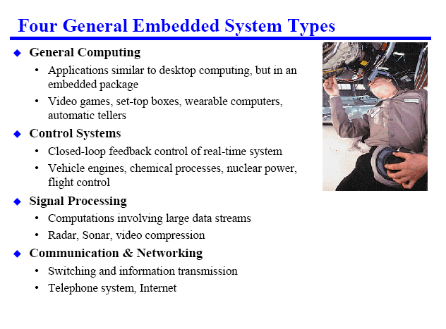
Types of Embedded Systems
Slide credit P Koopman, CMU
Introduction to Embedded Systems Setha Pan-ngum

Slide 15
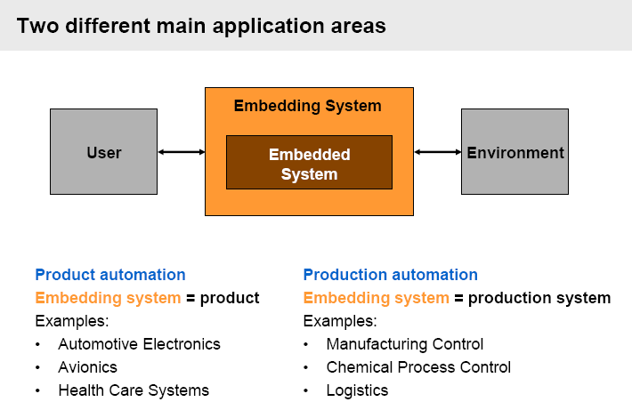
Types of Embedded Systems
Slide credit S. Kowalewski Aachen University
Introduction to Embedded Systems Setha Pan-ngum

Slide 16
Typical Embedded Systems
Are designed to observed (through sensors) and control something (through actuators)
  E.g. air condition senses room temperature and maintains it at set temperature via thermostat.
Introduction to Embedded Systems Setha Pan-ngum

Slide 17
Embedded System Block Diagram
Control
(Output)
Motor/Light
Processor
Observe
(Input)
System Bus
Temperature
Sensor
mem
Slide credit Y Williams, GWU
Introduction to Embedded Systems Setha Pan-ngum

