Slide 1
I2C Bus, Interface and Protocol
Prabhas Chongstitvatana
Information from: https://i2c.info/

Slide 2
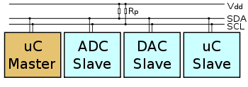
I2C Bus
serial protocol, two-wire interface, low speed, invented by Philips
control by a master using start and stop conditions

Slide 3
Each slave device has a unique address.
Transfer from and to master device is serial and it is split into 8-bit packets.
Speed 100 kHz,
400 kHz Fast mode,
3.4 MHz High speed mode,
5 MHz ultra-fast mode
.

Slide 4
I2C Interface and protocol
Two wires: SCL (serial clock) and SDA (serial data).
Both need to be pulled up with a resistor to +Vdd.
Transfers of 8 bits or bytes.
Each I2C slave device has a 7-bit address
10-bit address as allowed by the specification.

Slide 5
I2C protocol
normal state SCL and SDA are high.
master generates Start (S)
followed by the address of the slave device (B1)
If the bit 0 = 0, write otherwise read
Once all bytes are read or written (Bn) the master device generates Stop (P).

Slide 6
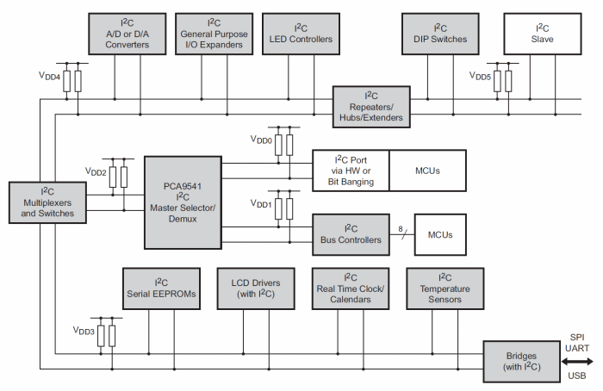
Example, I2C in a system

Slide 7
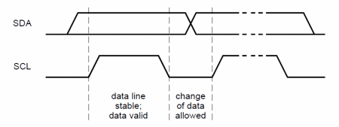
I2C specification
Serial data transfer
wired AND (open collector)
For each clock pulse one bit of data is transferred.
The SDA signal can only change when the SCL signal is low – when the clock is high the data should be stable.

Slide 8
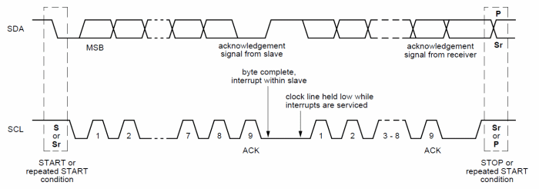
I2C data transfer
Data on the I2C bus is transferred in 8-bit packets.
There is no limitation on the number of bytes.
Master generates clock pulses.

Slide 9
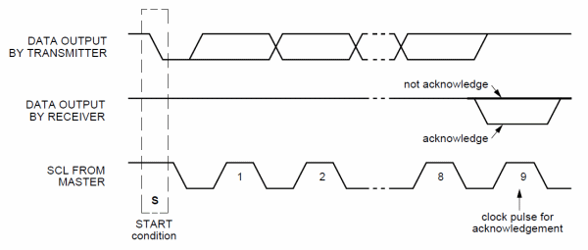
Each byte must be followed by an Acknowledge bit.

Slide 10
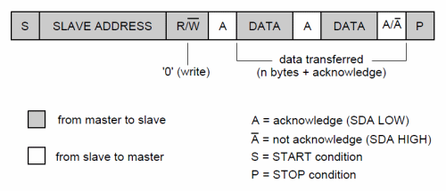
7-bit communication

Slide 11
Arbitration
If more than one master, they must arbitrate
Arbitration is performed on the SDA signal while the SCL signal is high.
Each master checks if the SDA signal on the bus corresponds to the generated SDA signal.
If the SDA signal on the bus is low but it should be high, then this master has lost arbitration.
It goes into slave mode.

