Slide 1
2110682 Embeded & Real time Systems
Prabhas Chongstitvatana
Faculty of Engineering
Chulalongkorn University

Slide 2
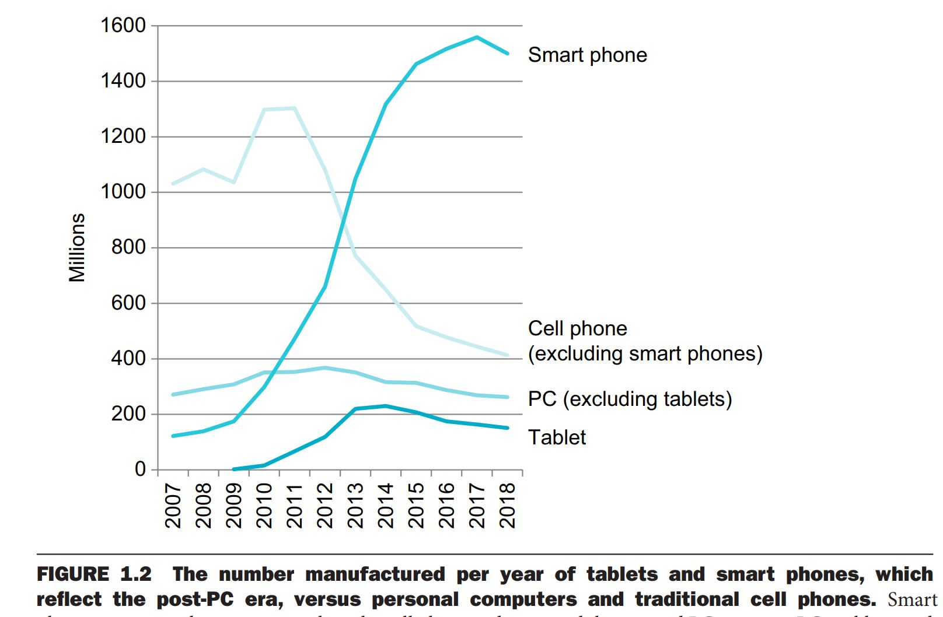
Post-PC era

Slide 3
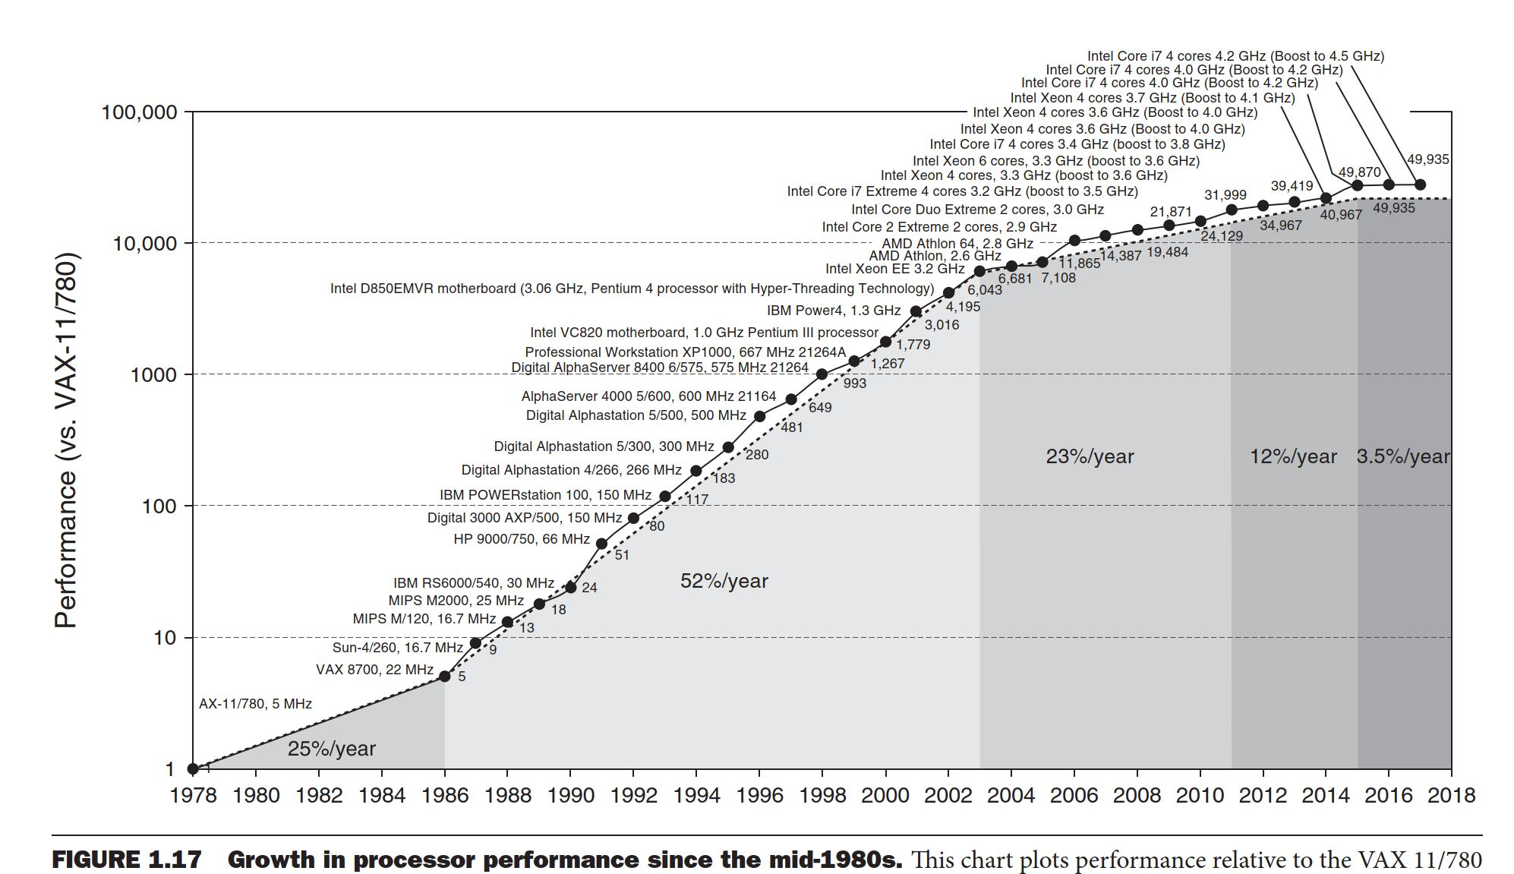
Limit of Moore’s law

Slide 4
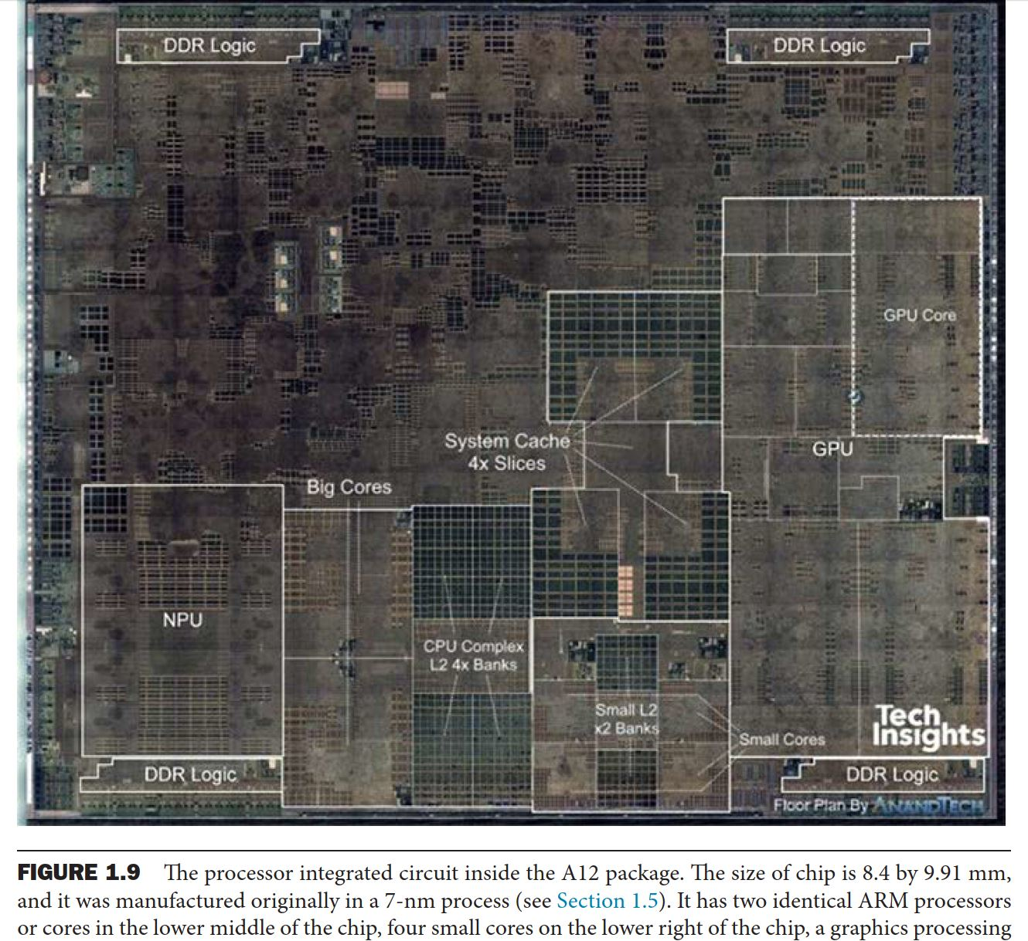
A12 chip (iphone xs)

Slide 5
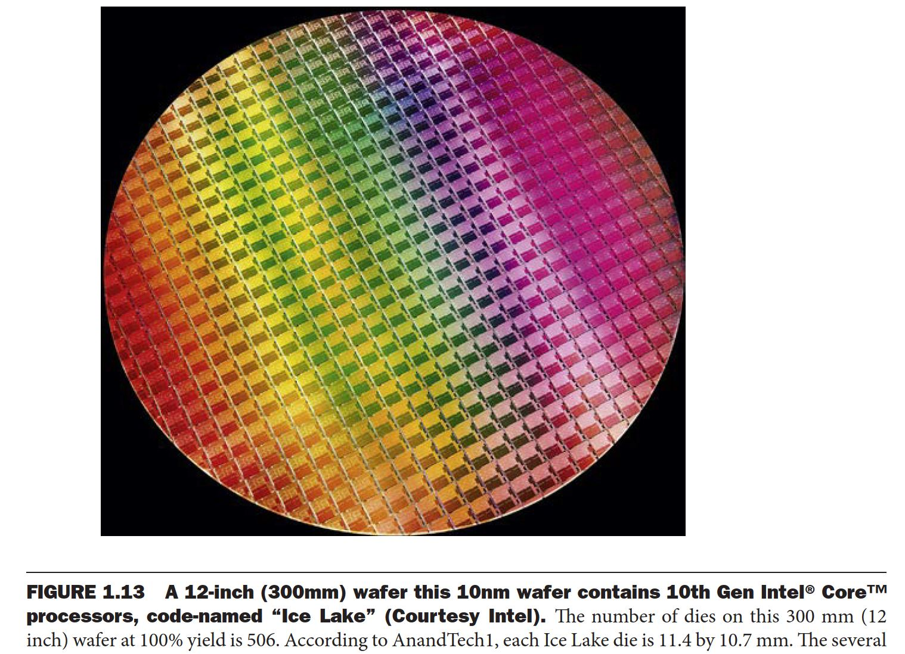
Wafer

