Slide 1
Exascale Computing

Slide 2
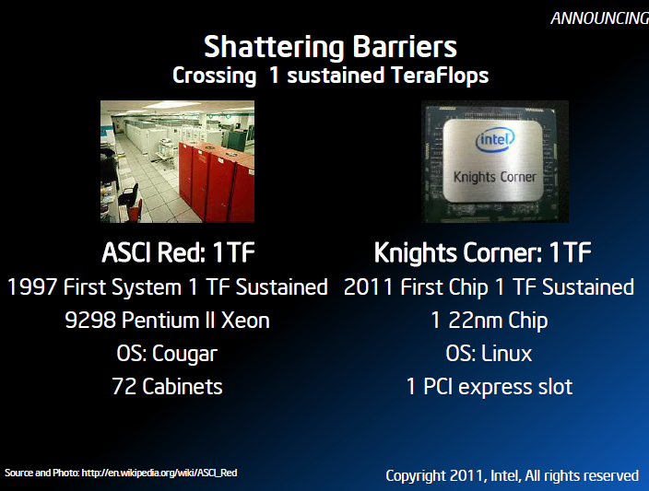
1 Teraflops Chip

Slide 3
Knight Corner will be manufactured with Intel’s 3-D Tri-Gate 22nm process and features more than 50 cores.

Slide 4
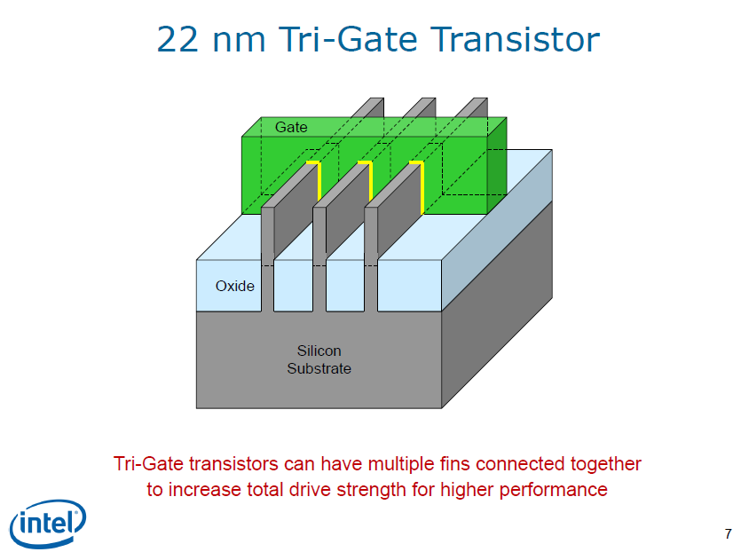
22 nm Tri-gate Transistor

Slide 5
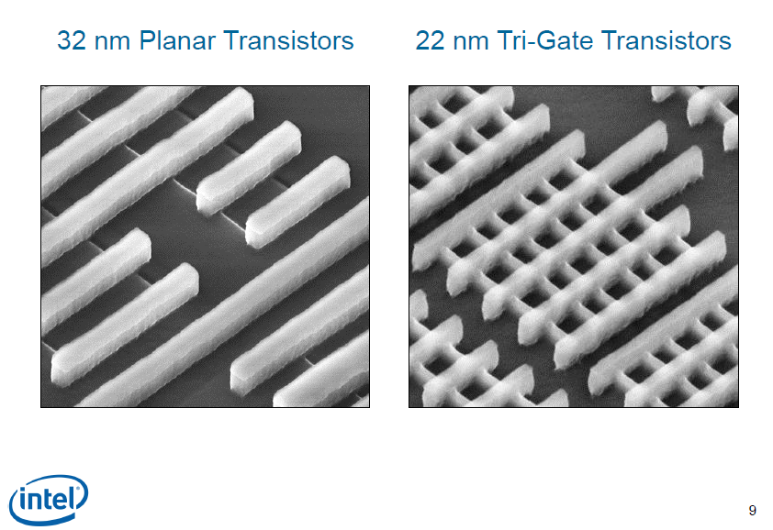

Slide 6
Advantages of 3D transistors
3-D Tri-Gate transistors will operate at lower voltage with less leakage. The upshot is that performance will improve.
Chip designers will be able to pick fins and choose transistors for low power or performance.
22nm Tri-Gate transistors will use less than half the power at the same performance as 2-D 32nm chips.
These 3-D transistors have a 10x lower depletion rate.
Applied to a CPU, you can have a lower clock rate with the same performance as higher speeds.

Slide 7
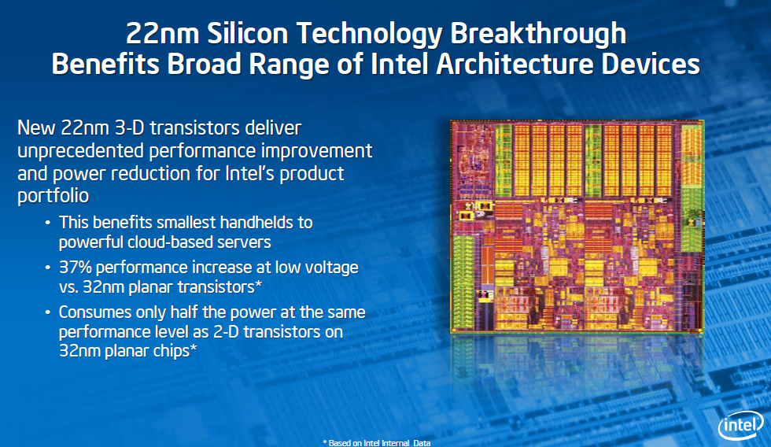

Slide 8
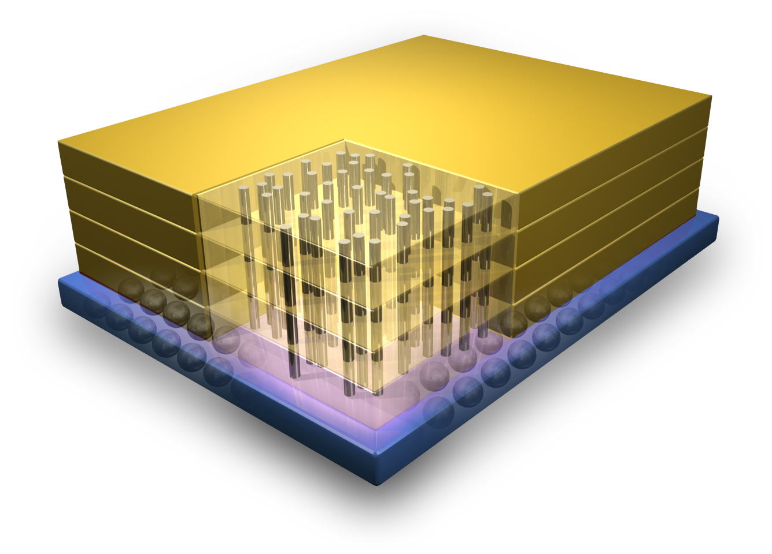
Micron's Hybrid Memory Cube

Slide 9
IBM to make Micron's Hybrid Memory Cube with its 3D chipmaking process
HMC prototypes can run at a rate of 128 gigabytes per second, compared to current memory chips that have 12.8 GB/s. HMC also uses 70 percent less energy.

