Slide 1
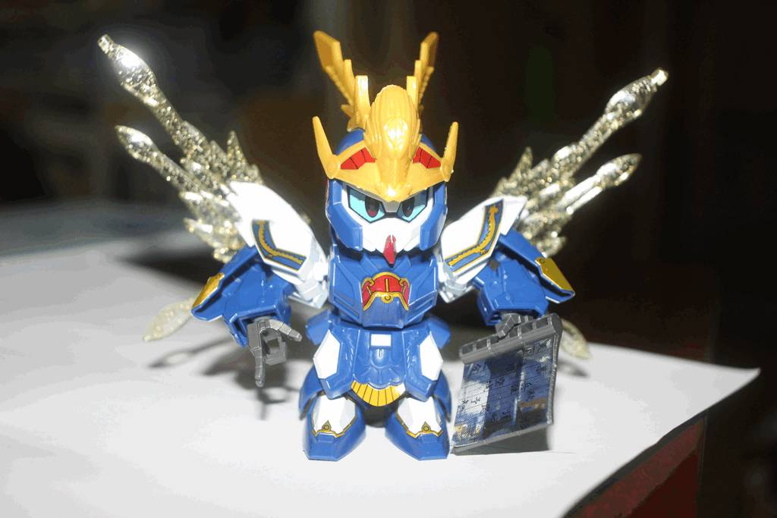
Digital Life

Slide 2
Prabhas Chongstitvatana
Professor in computer engineering since 2006
B.Eng. in EE from Kasetsart University, 1980
Ph.D. Artificial Intelligence, Edinburgh, U.K. 1992
Research
Robotics, Evolutionary Computation, Computer Architecture, Bioinformatics

Slide 3
Guest Speakers
Nattee Niparnan
Krek Piromsopa
Vishnu Kotrajarus

Slide 4
Digital Life
Digital Imaging
Digital Security
Digital Reality

Slide 5
What is computer engineering?

Slide 6
Digital imaging
photography: replace film and chemical with sensors and software magic

Slide 7
Digital security
super easy to use but need to be safe

Slide 8
Digital Reality
Games
New Reality

Slide 9

www.cp.eng.chula.ac.th/faculty/pjw

Slide 10
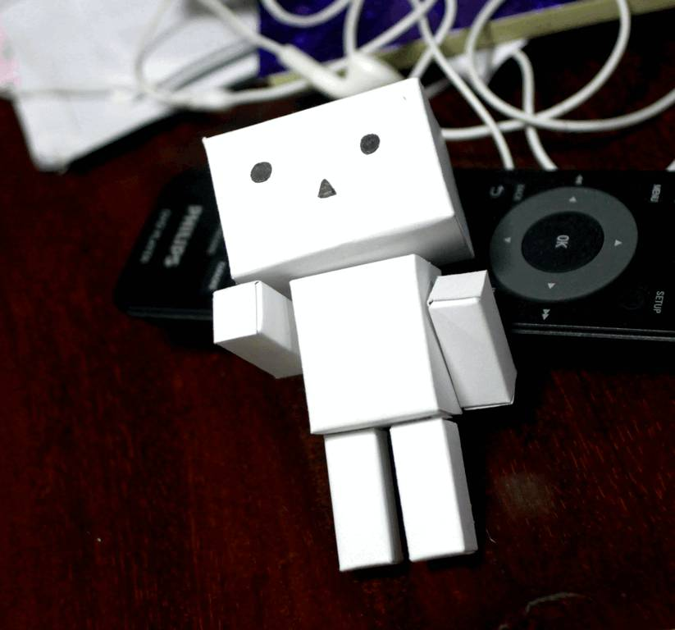
Enjoy!

Slide 11
Engineering Guy
  1 Compactness vs Usability
  2 Consumer preferences
  3 Availability of energy
  4 Economic resources: available infrastructure
  5 Knowledge of materials
  6 Societal needs
  7 Cultural constraints

