Slide 1
Internet of Things:
Connected World
Prabhas Chongstitvatana
Chulalongkorn University

Slide 2
IoT = Internet of Everything
M2M
Next information revolution

Slide 3
1% of physical world is connected to Internet
Huge potential
Potentials
Innovative business process
Operational efficiency
New customer services

Slide 4
What is IoT
Network of Physical Objects
Embedded systems with electronics, software, sensors
Enable objects to exchange data with manufacturer, operator, other devices through network infrastructure

Slide 5
Allow remote control
Direct integration = computer + physical world
Result: Automation in all fields

Slide 6
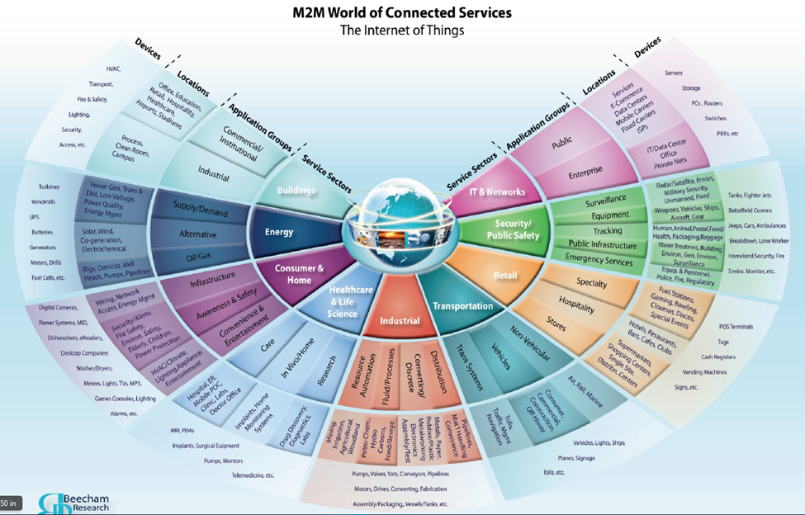

Slide 7
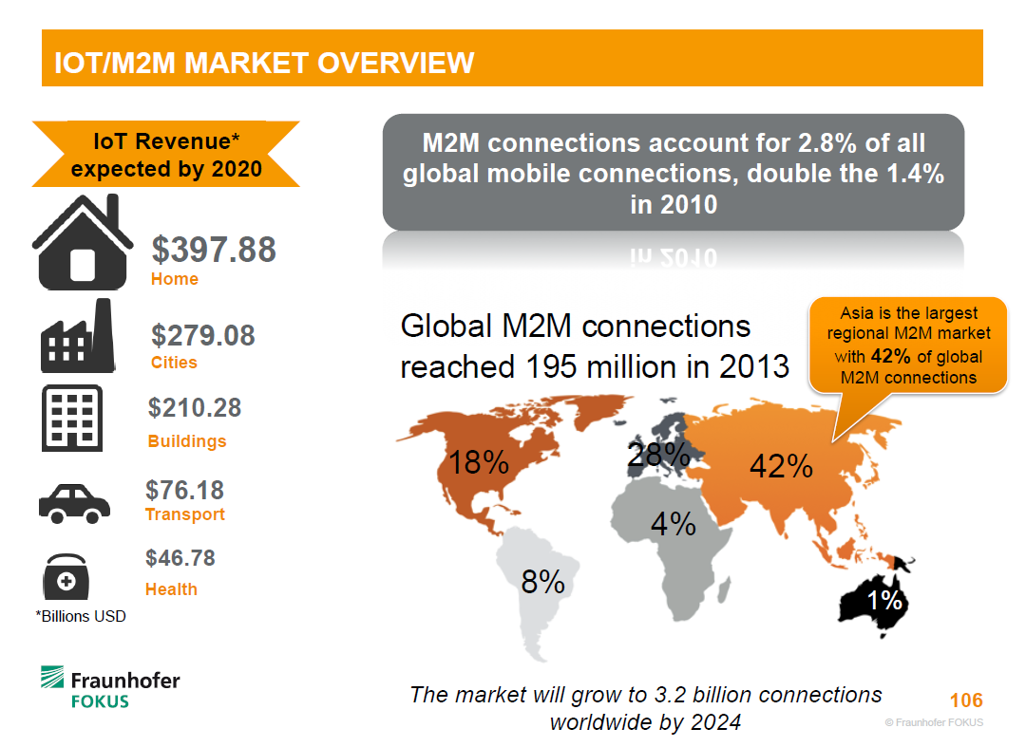

Slide 8
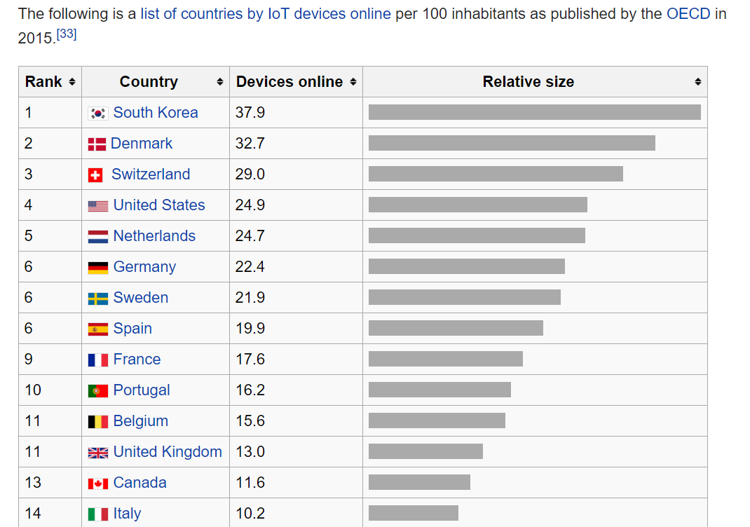

Slide 9
Rockwell Automation fuels the oil and gas industry with IoT
<video>

Slide 10
A bit of history
The term "Internet of Things" is coined by Kevin Ashton 1999.
Early example, 1982, Coke machine at Carnegie Mellon University was connected to internet: report its inventory and temperature

Slide 11
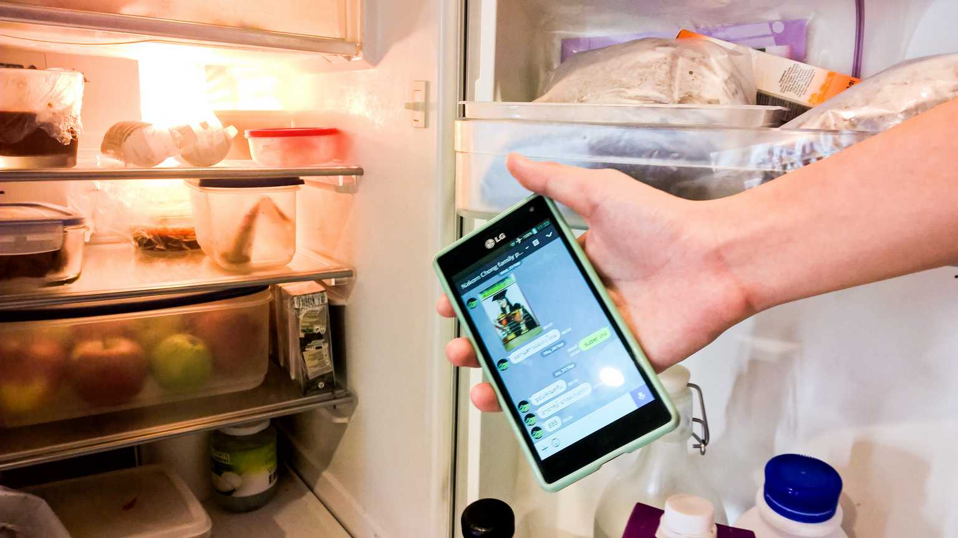

Slide 12
Applications
Media
Environmental monitoring
Infrastructure management
Manufacturing
Energy management
Medical and health care systems
Building and home automation
Transportation

Slide 13
Applications (cont.)
Media IoT + Big Data
  target advertisement to customized content
Infrastructure management
  monitoring structural condition, scheduling maintenance
Waste management
Safety management

Slide 14
Example: German Airport Problems

Slide 15
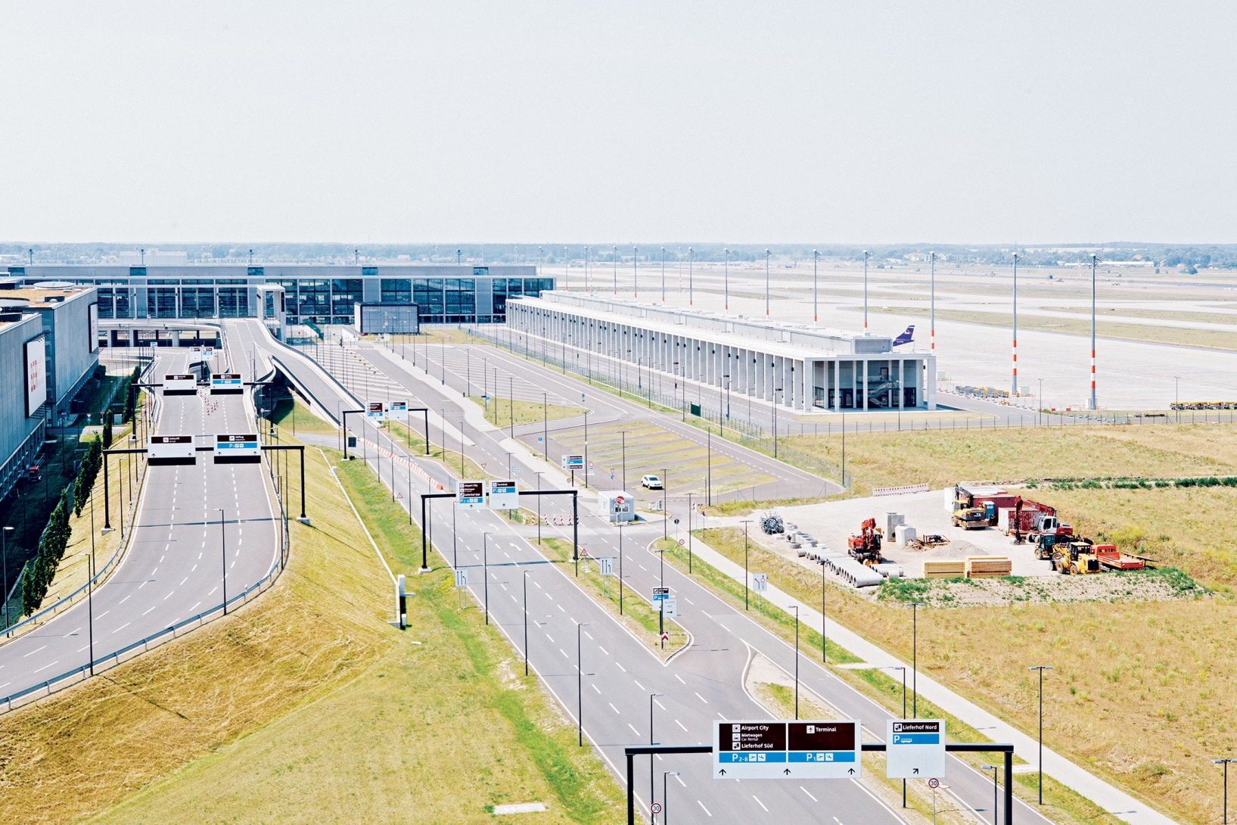
Berlin Brandenburg International Airport

Slide 16
Berlin Brandenburg International Airport
600 million euros project
schedule to be opened in June 2012, now expected to be completed in 2017
“Just months before the scheduled June 2012 opening, the terminal was a mess. Careless workers stepped on and shattered glass being installed by other companies. Heavy equipment rolled across the terminal floor, scratching expensive tiles. Tempers flared; small contractors complained they weren’t getting paid and threatened to walk off the job.”

Slide 17
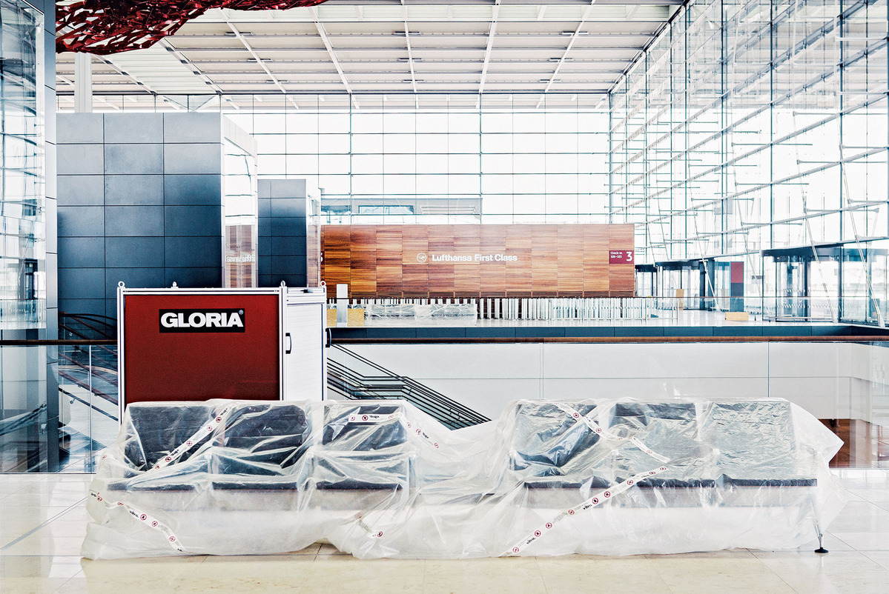
Germany spends €16 million a month just to maintain the unfinished facility.
Photographer: Eriver Hijano for Bloomberg Businessweek

Slide 18
IoT can be used to monitor and coordinate the construction site in real-time

Slide 19
Applications (cont.)
Manufacturing
  monitoring product demand
  real-time manufacturing production
  manage supply chain network
  <KuKa video>

Slide 20
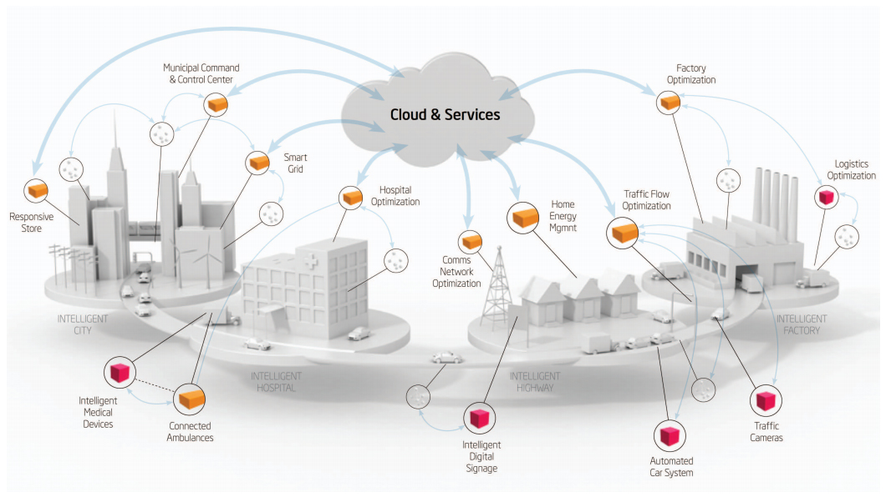
Smart Cities

Slide 21
Examples of Connected Devices

Slide 22
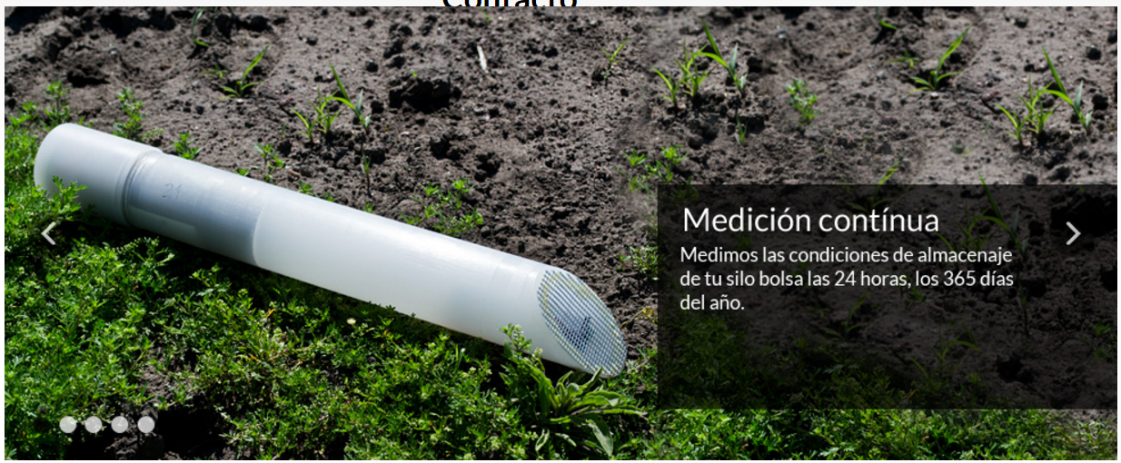
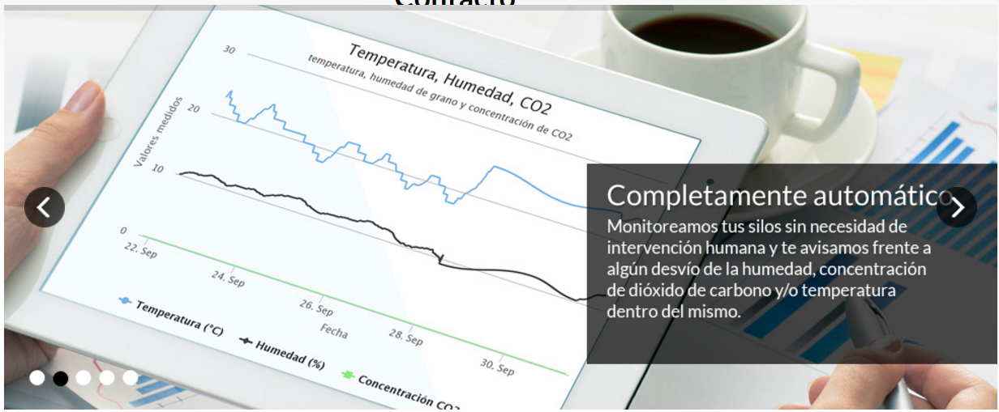
Agriculture

Slide 23
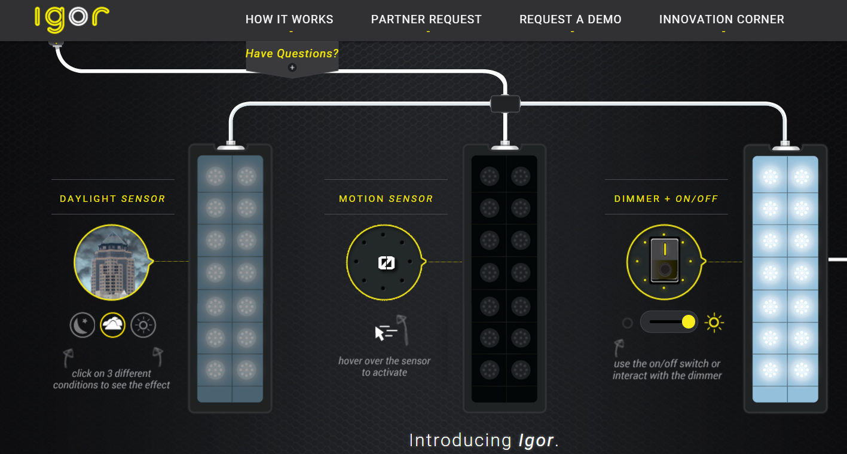
Intelligent Lighting

Slide 24
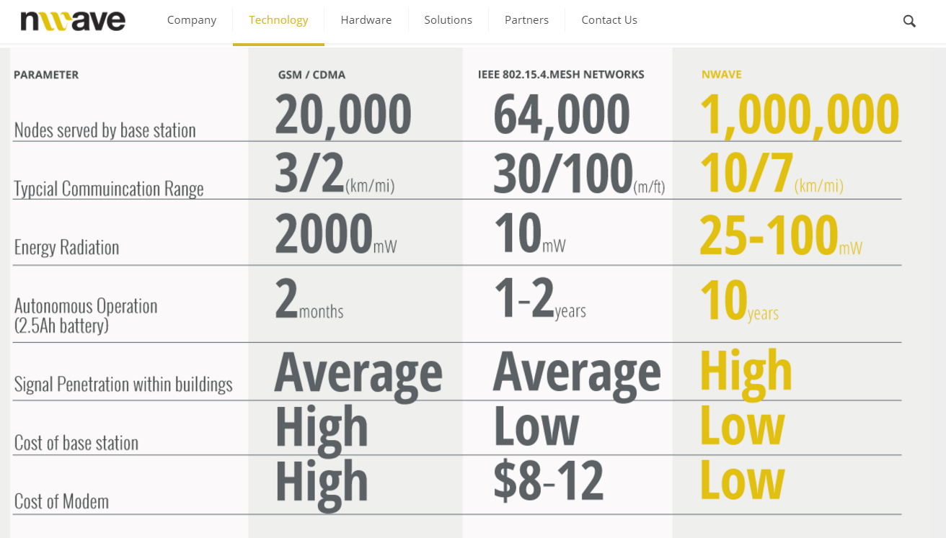
Ultra Narrow Band Communication

Slide 25
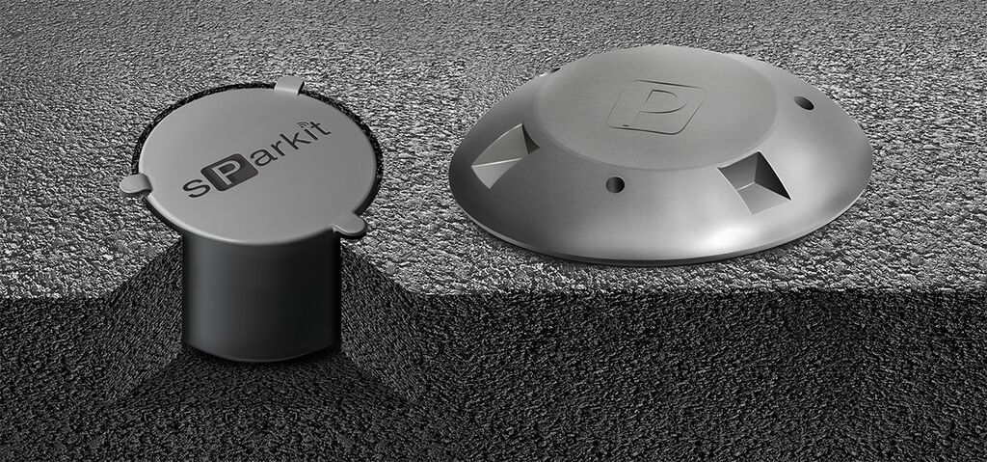
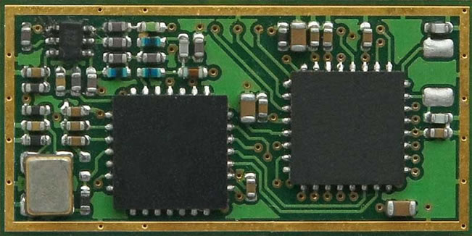
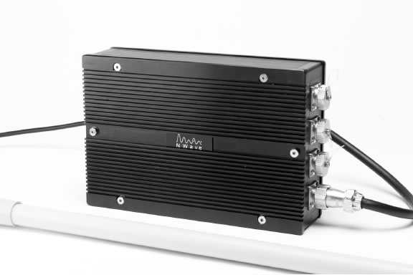

Slide 26
Intelligent Vision
Chronocam
<video>

Slide 27
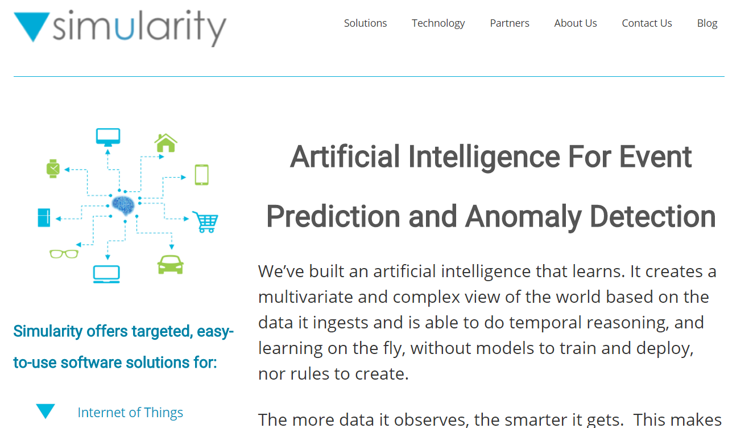

Slide 28


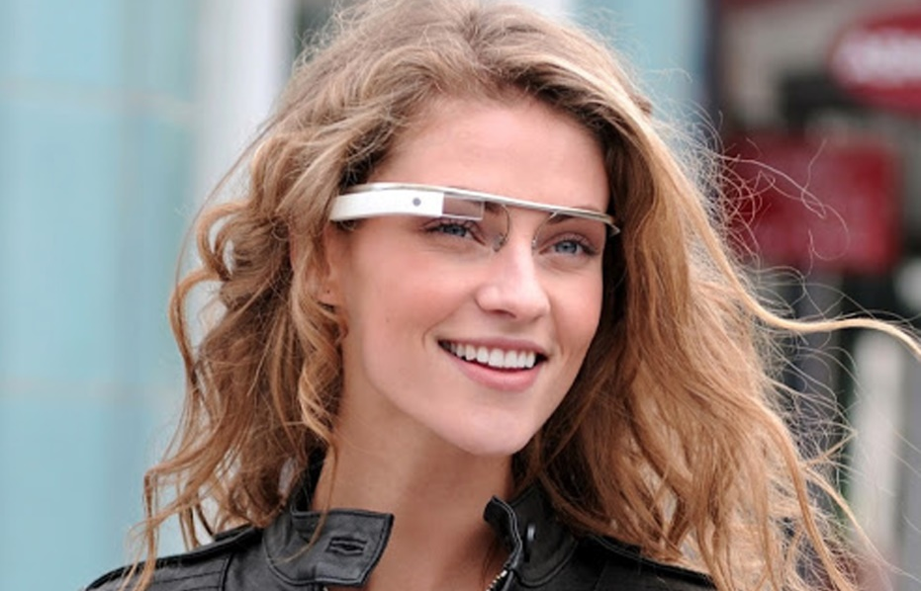
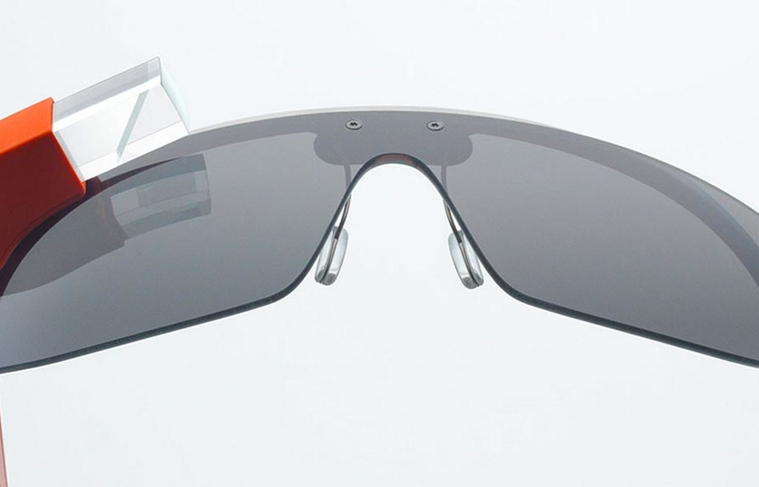
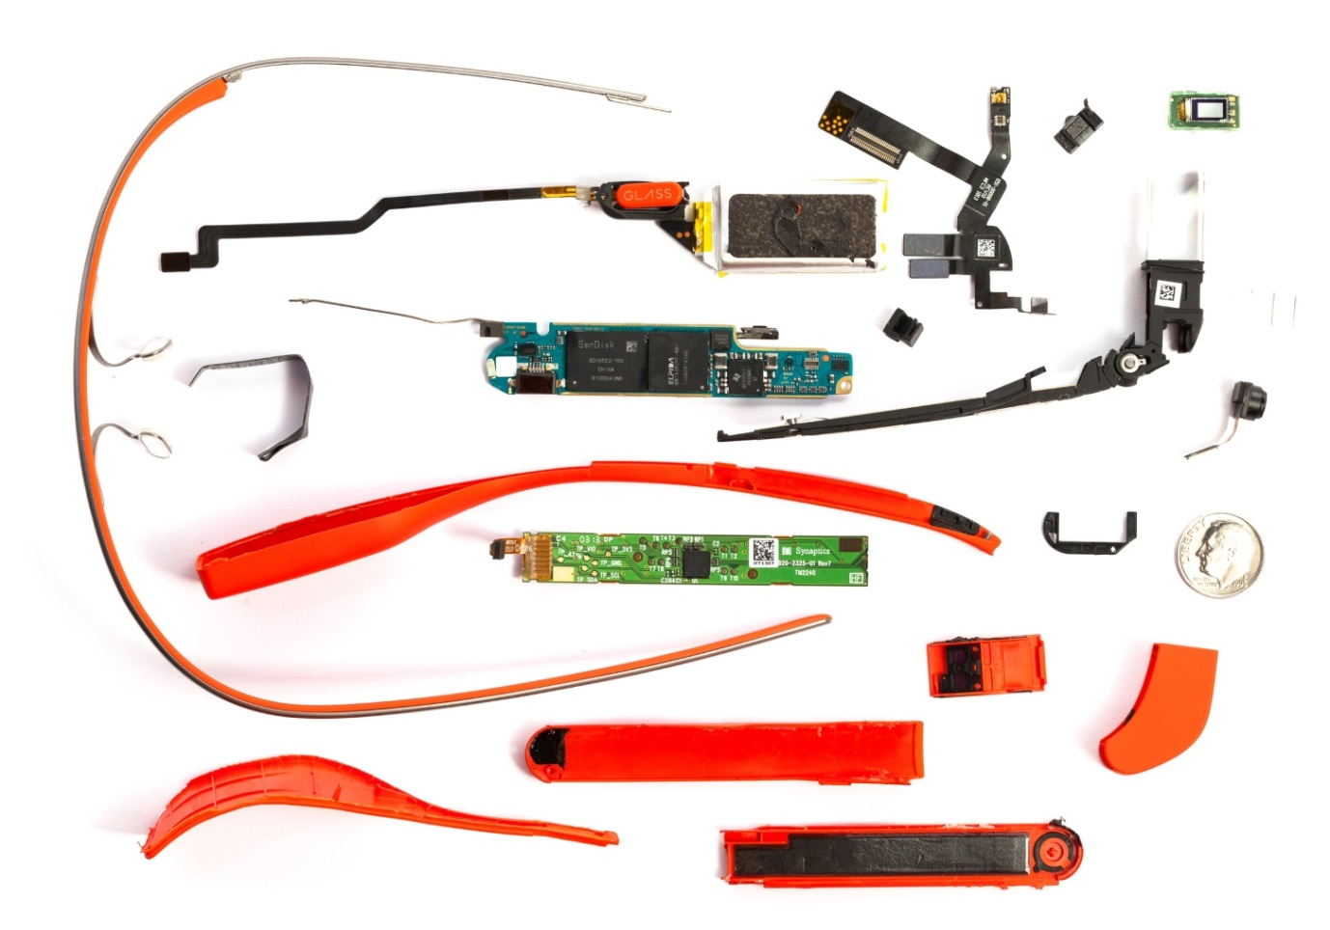

Slide 29
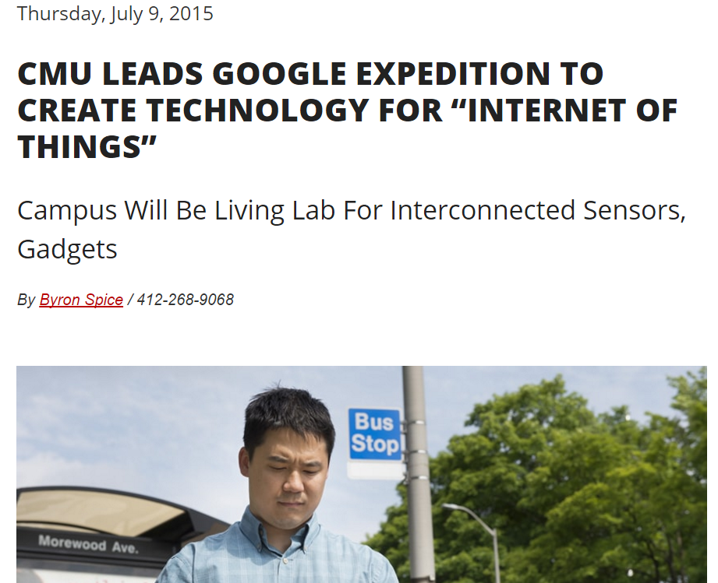

Slide 30
“The goal of our project will be nothing less than to radically enhance human-to-human and human-to­-computer interaction through a large-scale deployment of the Internet of Things (IoT) that ensures privacy, accommodates new features over time and enables people to readily design applications for their own use,” said Anind K. Dey, lead investigator of the expedition and director of CMU’s Human-Computer Interaction Institute.
“We will demonstrate the use of personalized privacy assistants that help users configure the many privacy settings necessary to ensure that they retain adequate control over their data,”

Slide 31
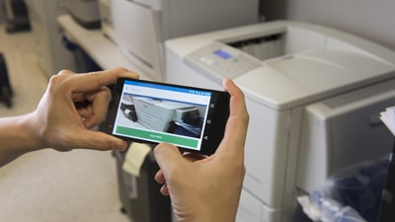
"Snap2It" lets users link to a printer or projector simply by taking a smartphone photo of it.

Slide 32
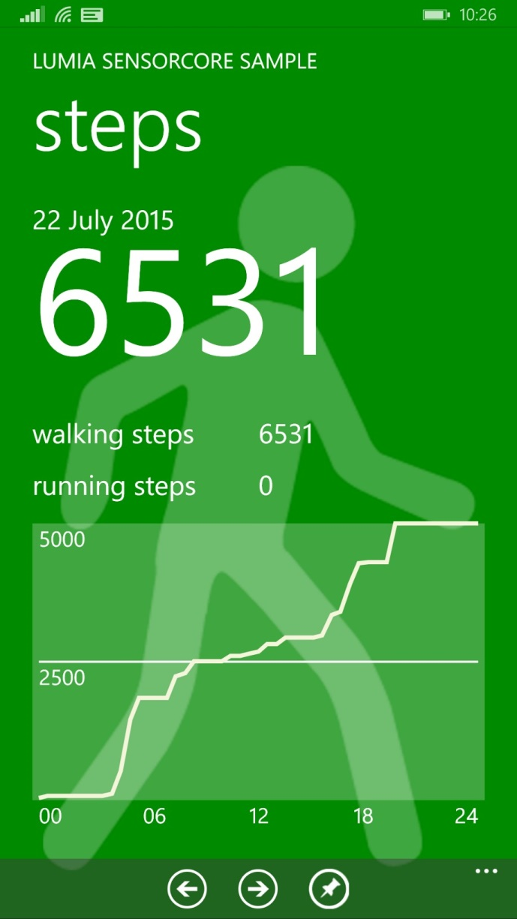
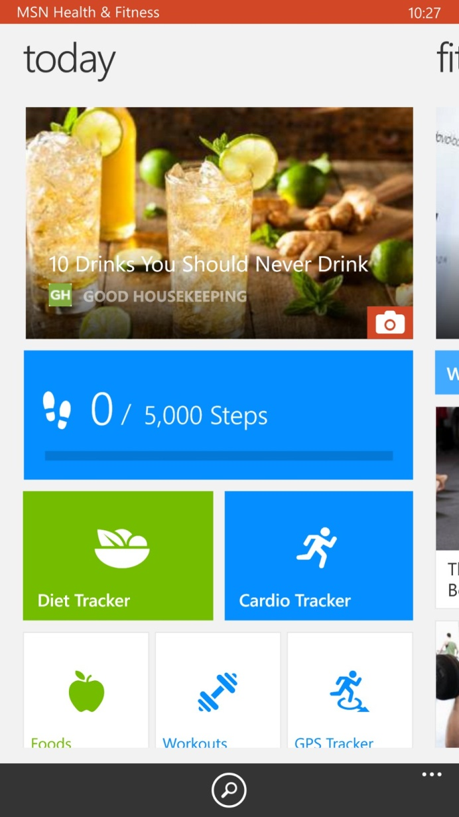
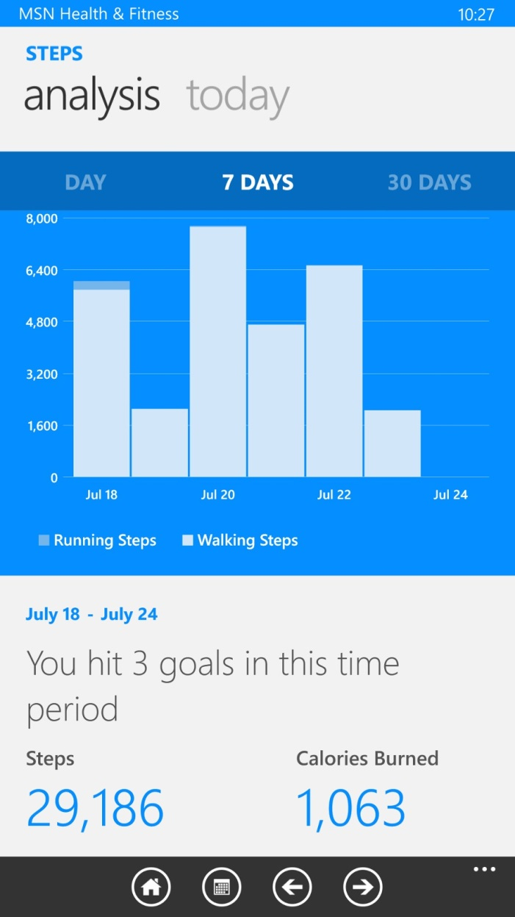

Slide 33
Impact
Civic engagement
Privacy, autonomy and control
technology <> just tools
technology = active agent
IoT = Human augmentation (Tim O Reilly)
data-driven decision making

Slide 34
Impact (cont.)
Security
  cyber attack in Physical world
  spy on people in their own homes
Increase in electronics waste 10x

Slide 35
Technology roadmap
50-100 Trillion objects,
each person carries 1000-5000 trackable objects
computer manage and inventory objects and people
transform daily life
bottom up, convergence of data from IoT into applications, web-of-things

Slide 36
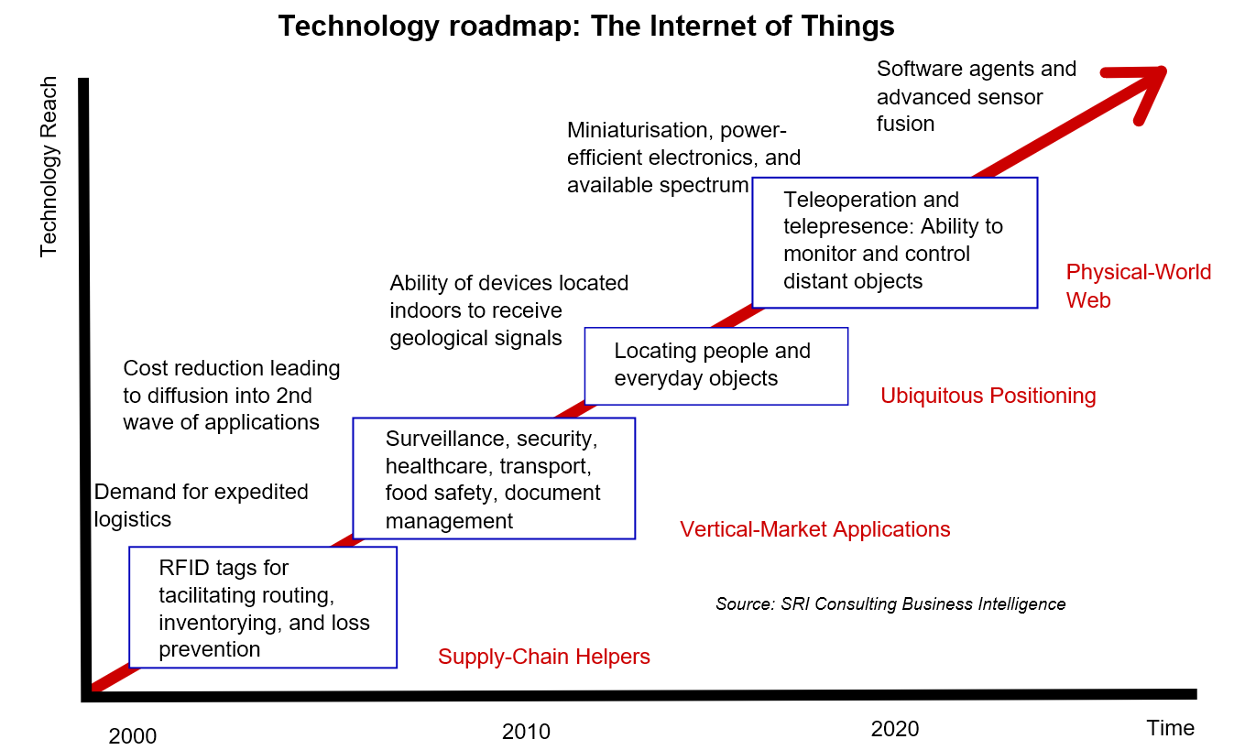

Slide 37
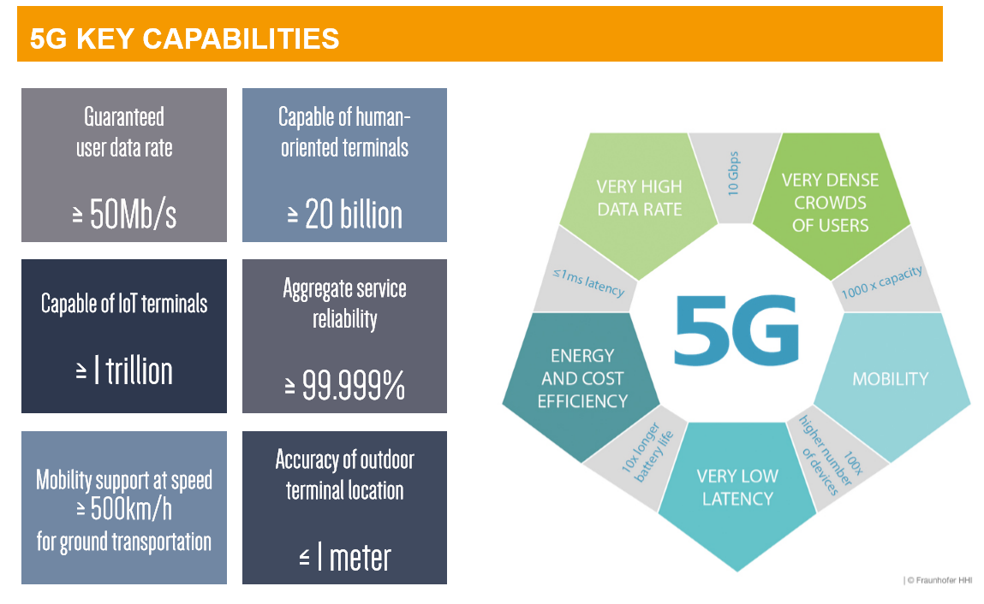
Backbone (5G)

Slide 38
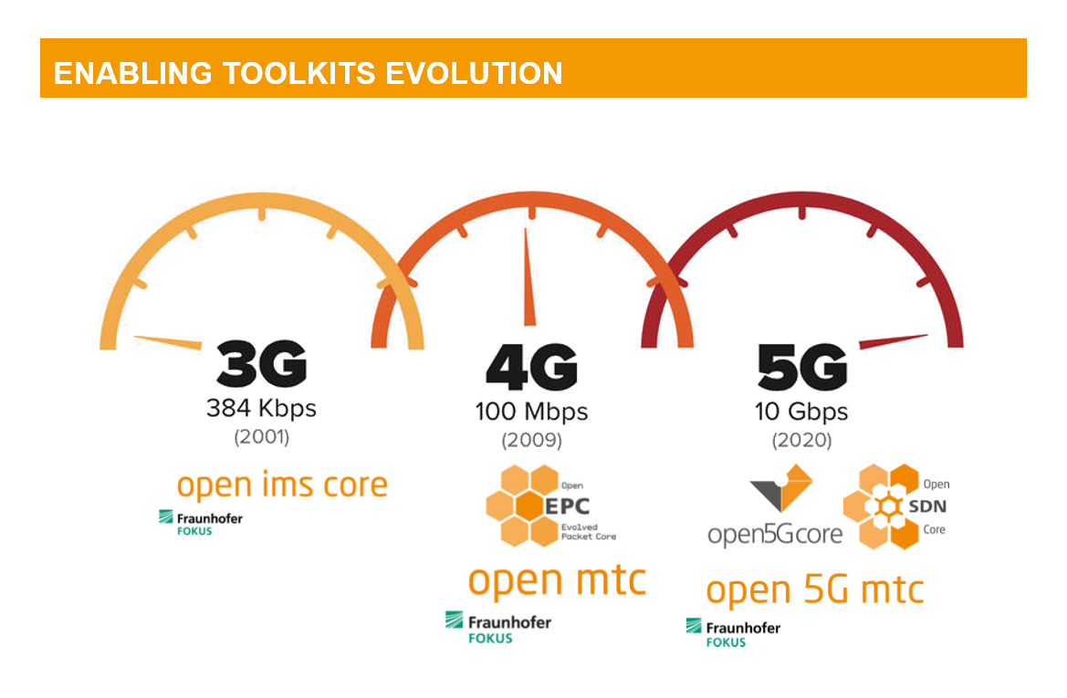

Slide 39
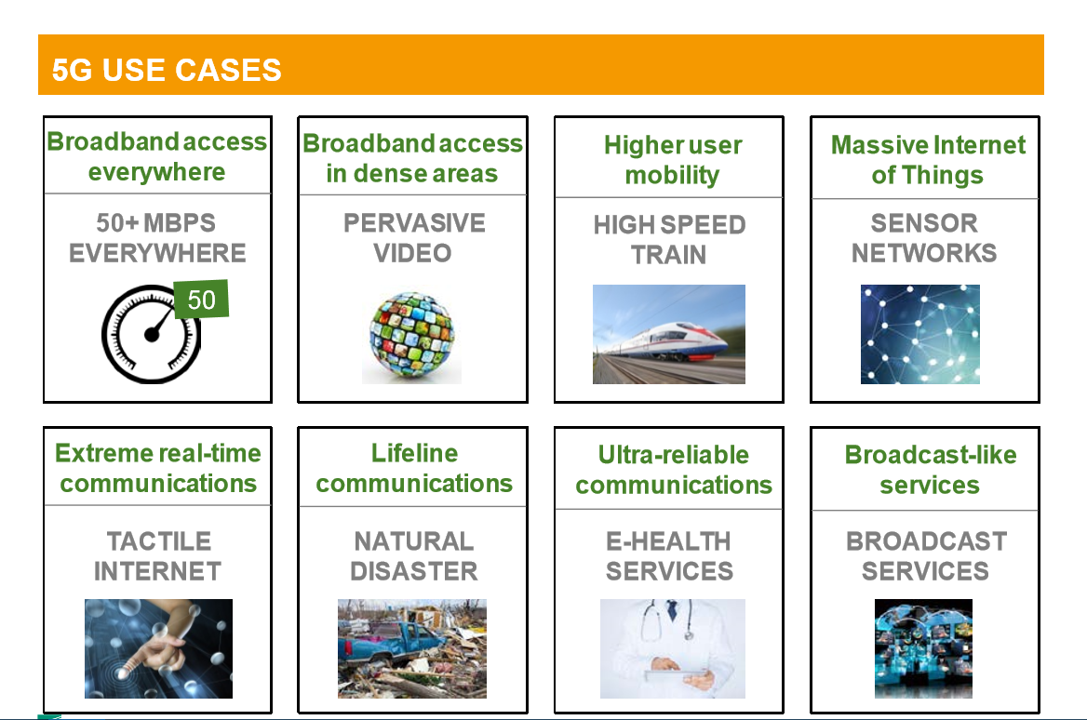

Slide 40
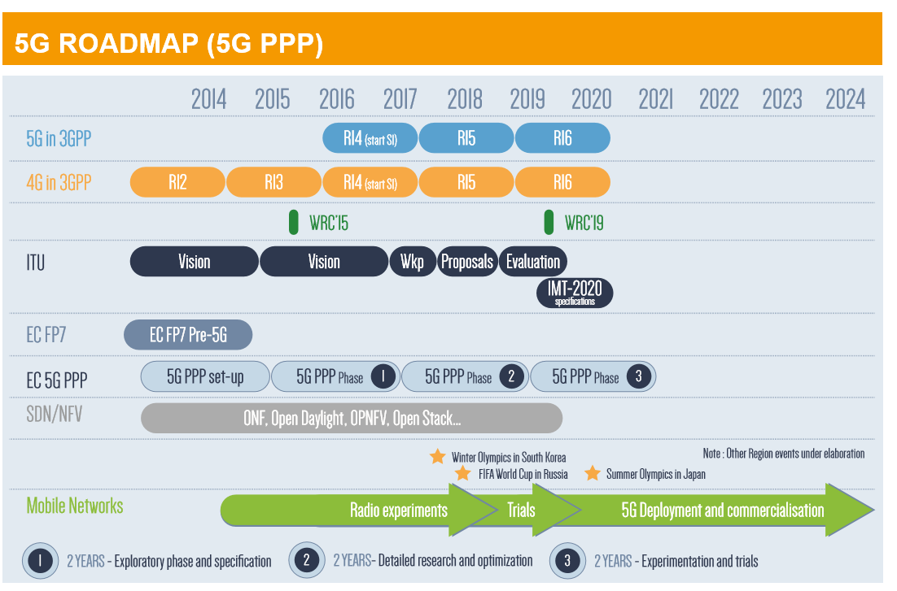

Slide 41
Trending
Cisco IoT Grand Challenge
IoT World Forum in Dubai
Intel IoT platform

Slide 42
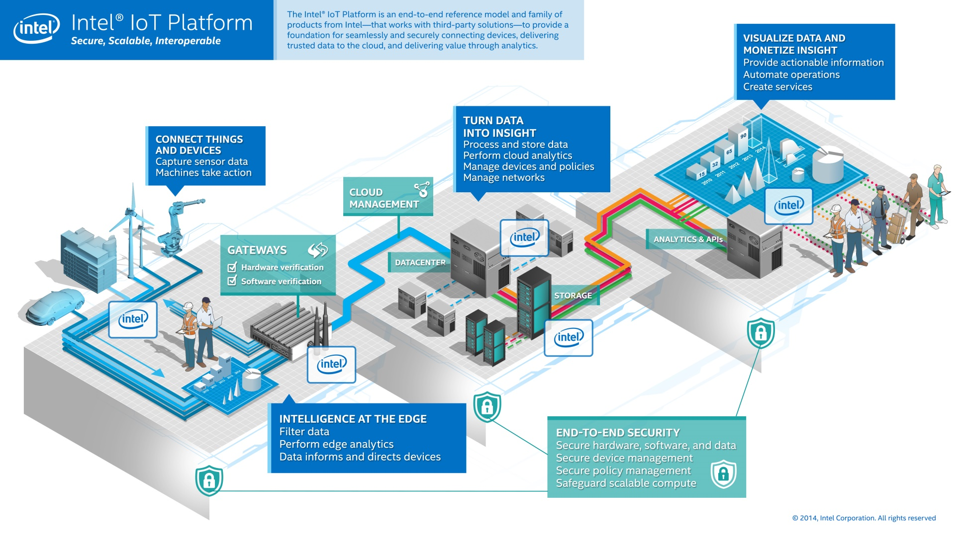

Slide 43
References
Zanella, Andrea; Bui, Nicola; Castellani, Angelo; Vangelista, Lorenzo & Zorzi, Michele. "Internet of Things for Smart Cities". IEEE Internet of Things Journal, VOL. 1, NO. 1, FEBRUARY 2014.
https://en.wikipedia.org/wiki/Internet_of_Things
http://www.bloomberg.com/news/features/2015-07-23/how-berlin-s-futuristic-airport-became-a-6-billion-embarrassment

Slide 44

More Information
Search “Prabhas Chongstitvatana”

