Slide 1
Microprocessor

Slide 2
General Purpose Processors
Sources: Intel, Motorola, MIPS, ARM, TI, and IBM Website/Datasheet; Embedded Systems Programming, Nov. 1998

Slide 3
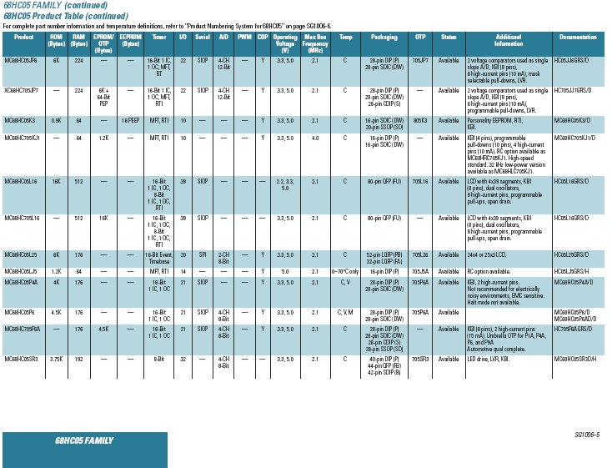

Slide 4
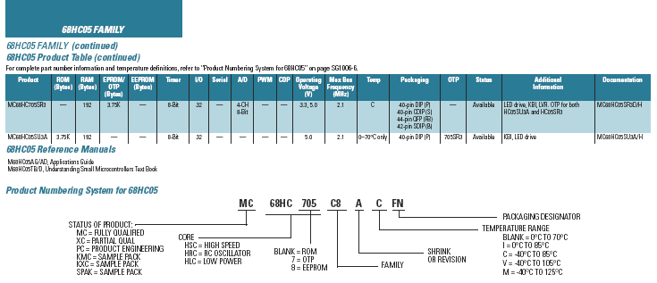
Microcontroller catalogue

Slide 5
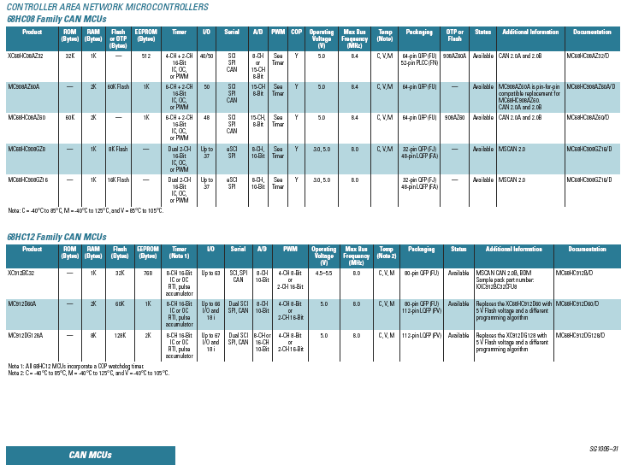

Slide 6
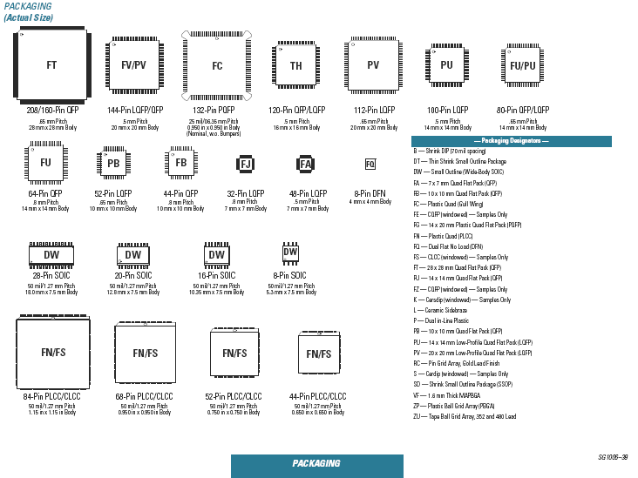

Slide 7
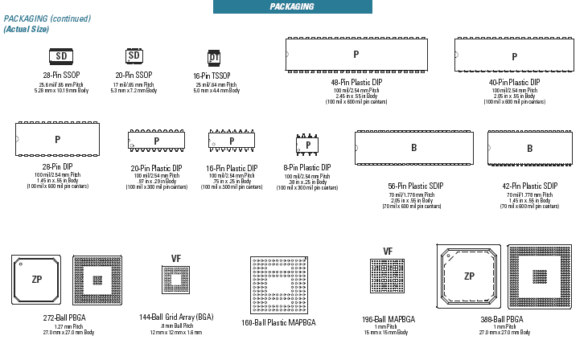
Microcontroller packaging

