Slide 1
SCALA

Slide 2
The Language
Statically typed
Runs on JVM (mix Java and SCALA)
OO & Functional

Slide 3
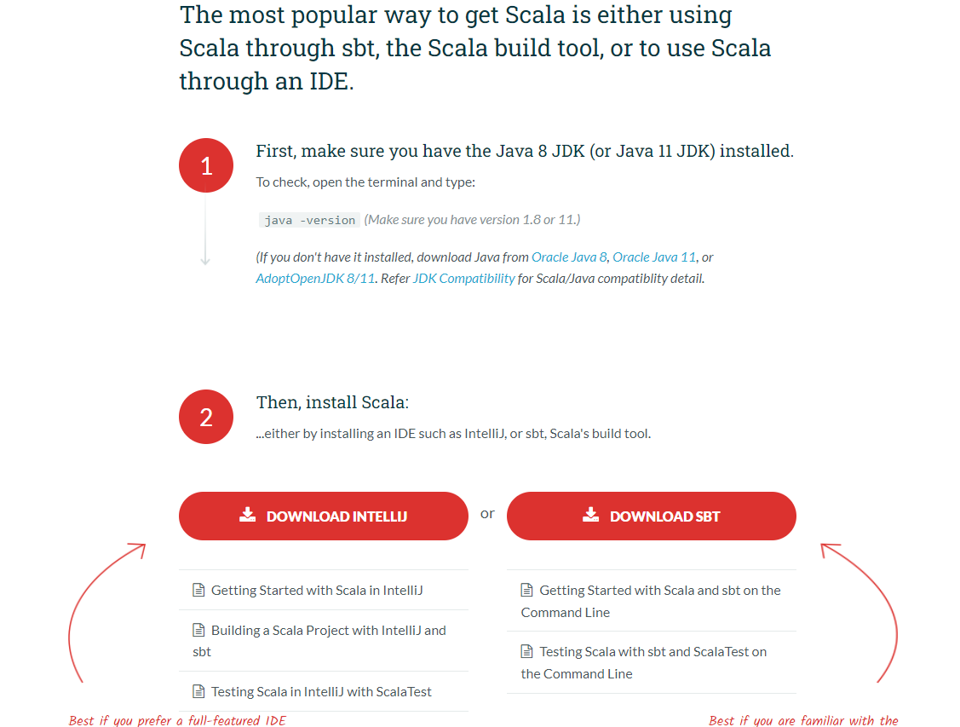

SBT (Scala build tool)
Compile, run, test!
It comes with REPL (Read-Eval_Print loop).
  Takes single input, executes it and returns the result of execution.
To install sbt
  Install Java.
  Set environment variable (System variables -> Path) to know the path to bin folder of jdk and jre.
  Set User Variable to have JAVA_HOME -> use path for the jdk folder.
  Then search scala download on google, or go to https://www.scala-lang.org/download/scala2.html
  I’m using version 2 for this course! (there is a version 3!)

Slide 4
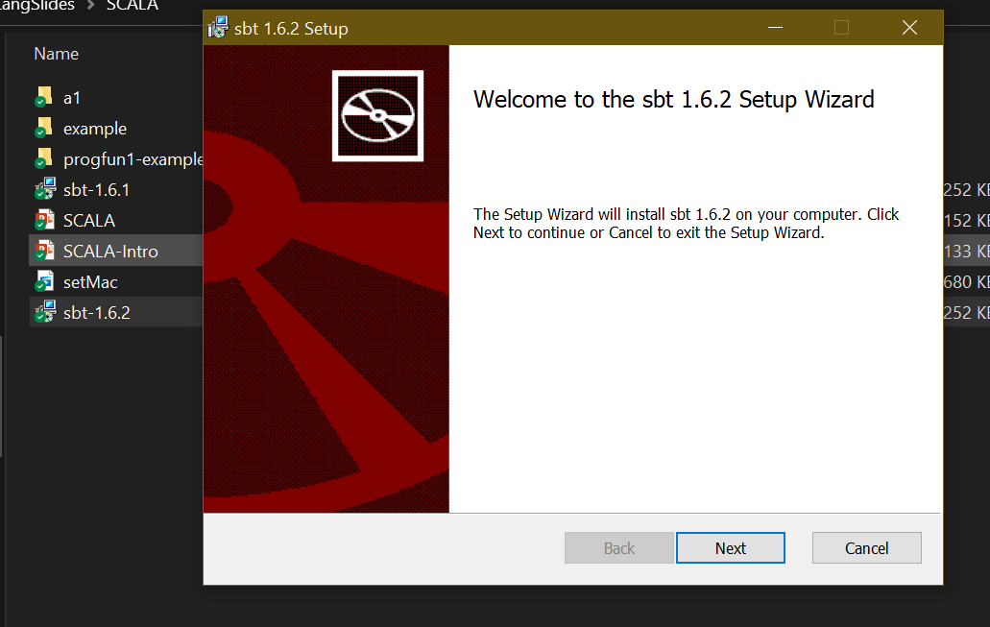

For windows, download and install MSI file.

Slide 5
Copy path for bin folder of sbt.
Set it as environment variable (System variables -> Path).

Slide 6
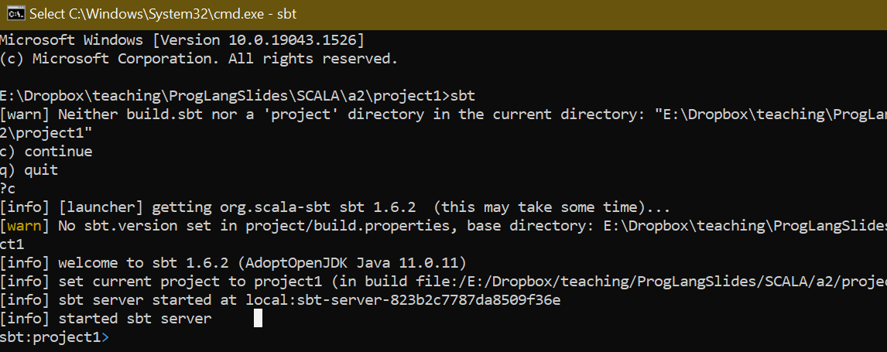
Your first Scala project
Let’s create folder a1.
Then use command line to go into folder a1, then create another folder. Let’s say “sbt_proj”
In that folder, run the command sbt. You may need to wait.

Slide 7
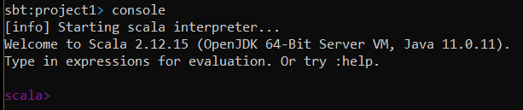
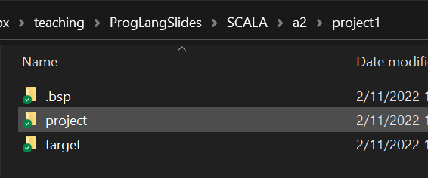


Getting ready to run REPL
In sbt, type in console.
You will get a Scala command prompt (we call it REPL).
Temp files are stored. Scala is a compiled language so it needs to create a code file in order to run.

Slide 8
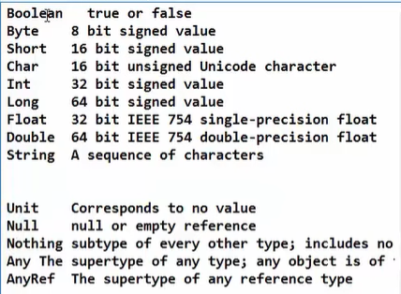
Data types

Slide 9

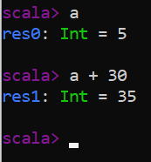


Declaring variables
1. using var
  This creates a normal (modifiable) variable.
  You can then use variable a in other statements
Separate type and name of a variable.
Don’t need a semicolon at the end !

Slide 10
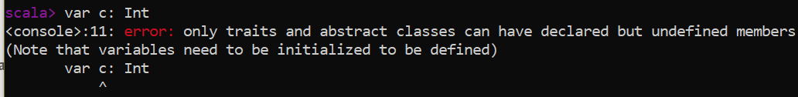
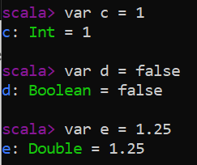

Variables need to be initialized when they are created.
But you do not need to give the data type. It can detect the type by the initial value!

Slide 11
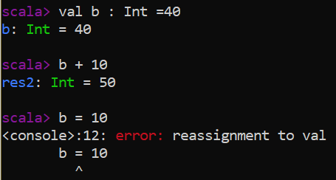
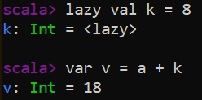
2. using val
  This is defining a constant.
Initialization of val can be delayed until the first read!
Not have value yet.
The initial value is assigned now.

Slide 12

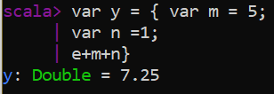
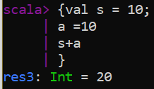
Execute a block of code
The code can be put on several lines.
Does not need to give a variable on LHS. It will create a temporary variable to store the result.

Slide 13
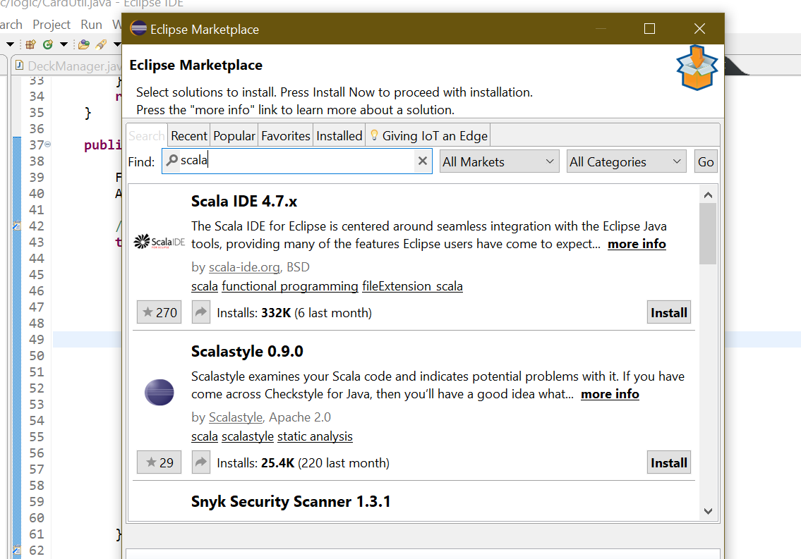

What about any IDE, Eclipse?
Let’s install Scala IDE for Eclipse.
Go to Eclipse Marketplace

Slide 14
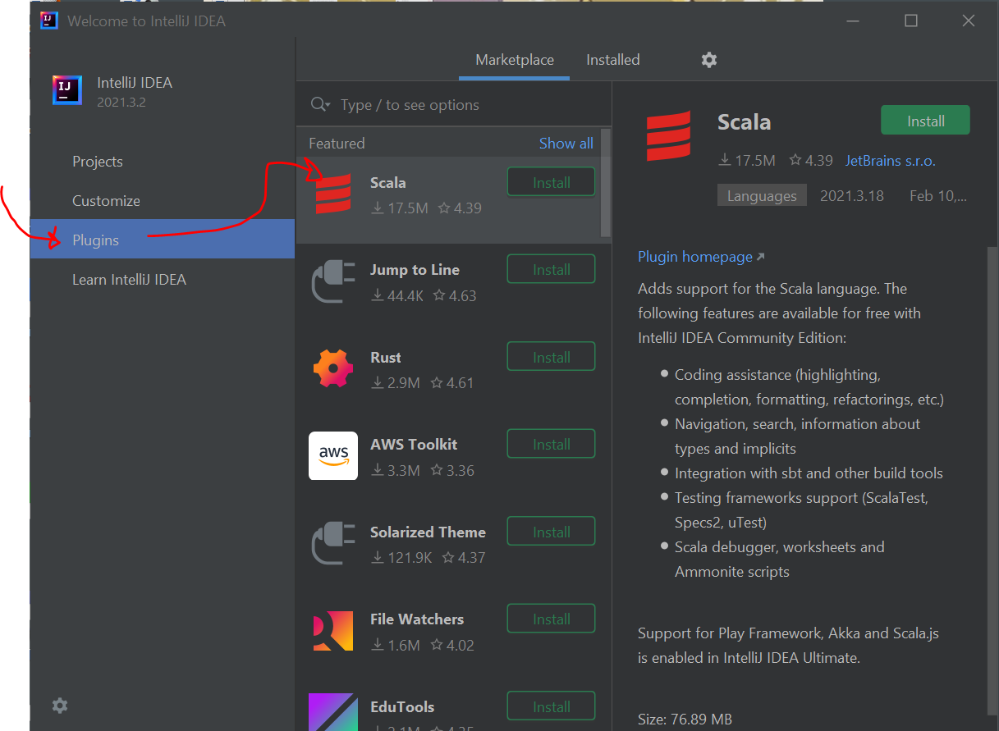
What about IntelliJ?
Install IntelliJ
Then install Scala plugin

Slide 15
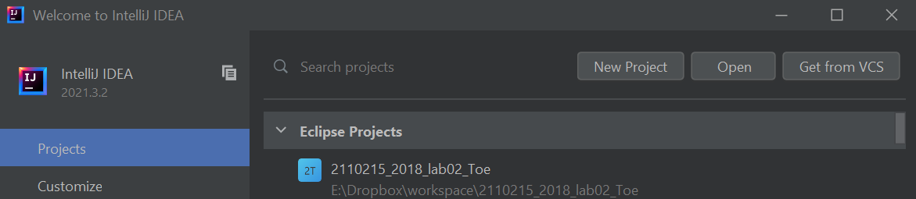

Your “Hello World” project
Open IntelliJ and click New Project

Slide 16
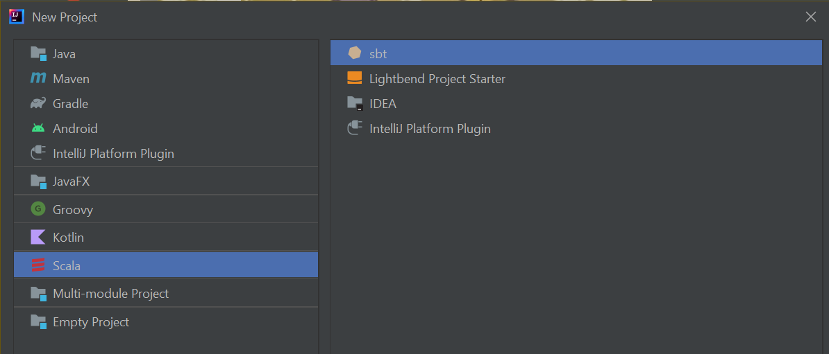


Select sbt project.

Slide 17
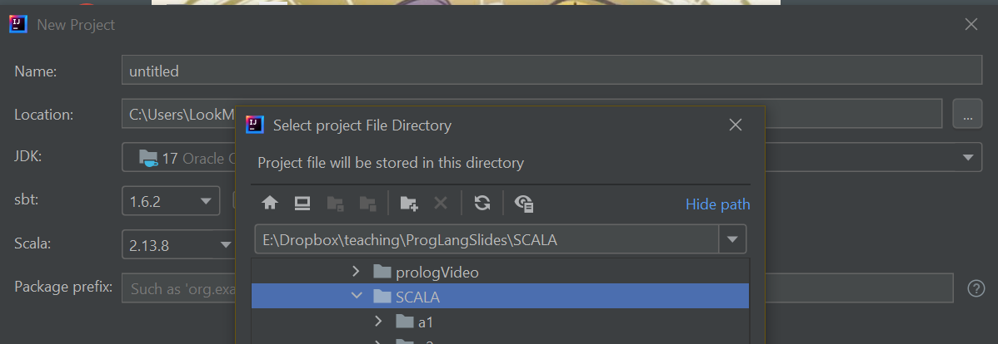
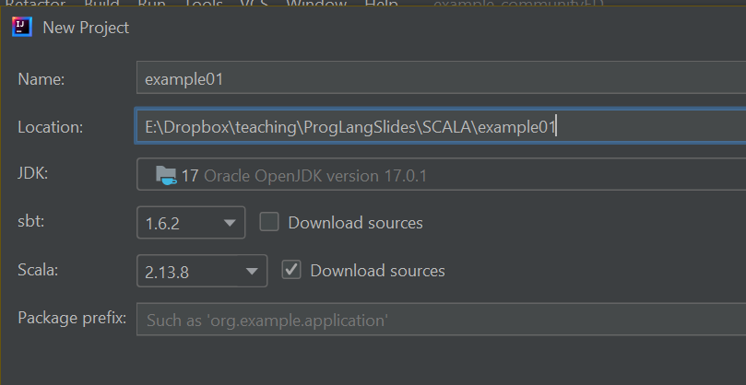


Name your project and choose its folder.

Slide 18
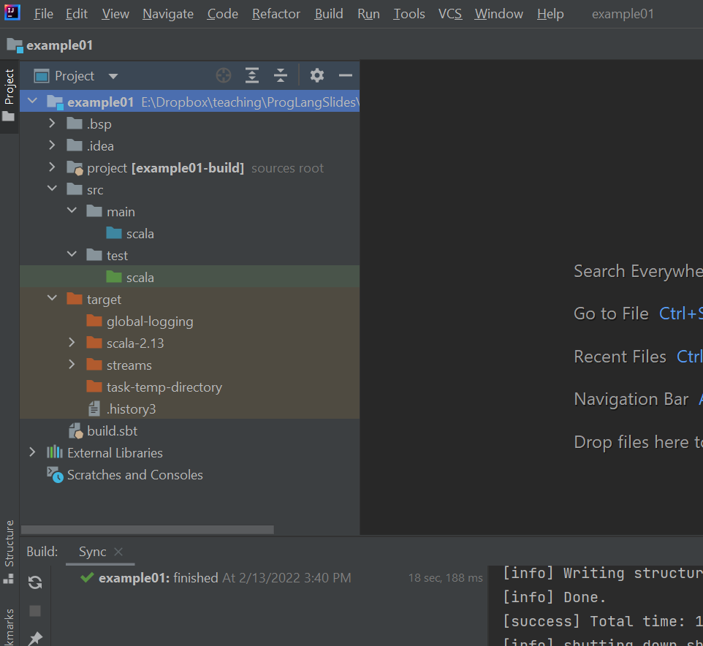

Slide 19
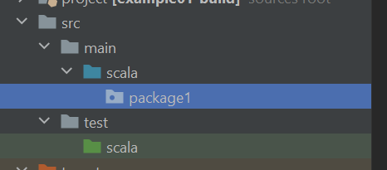
Let’s create a package
Right click and create a package
(I name it package1)

Slide 20
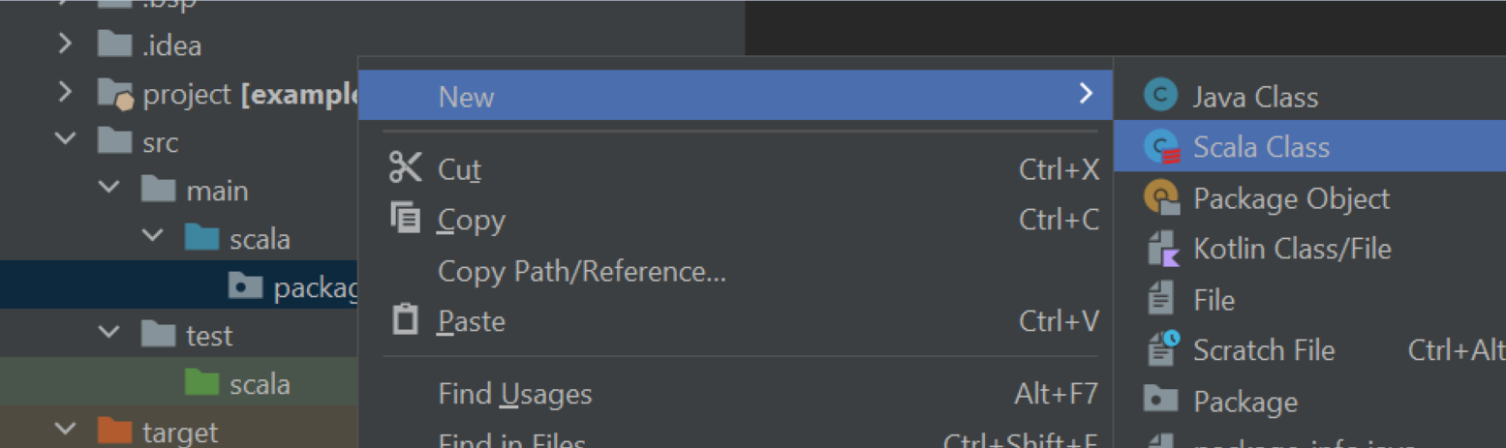
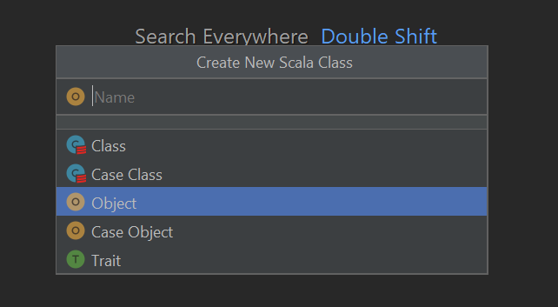
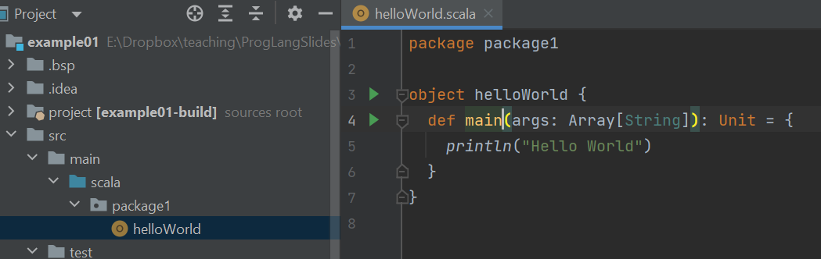


Then create a Scala object that has “Hello World”
In the pop up,
change it to object and name it!
Main method is similar to Java’s.

Slide 21
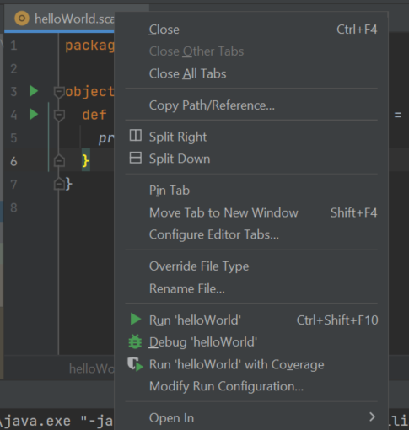
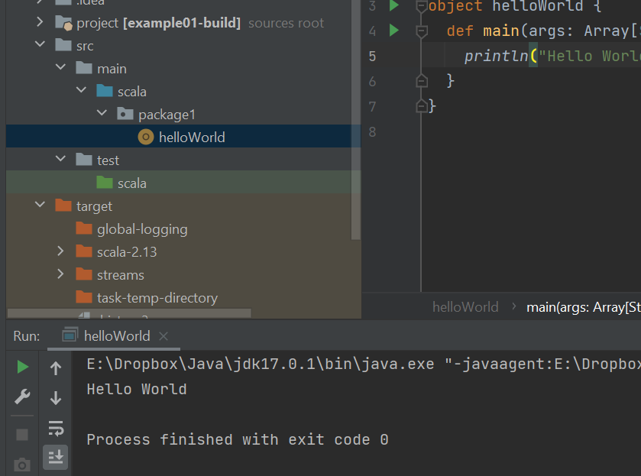

Now we run the program
Right click on the tab or inside the file.
Then choose Run ‘helloWorld’
If you run your program for the first time, it may take a while.

Slide 22
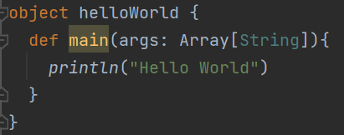


Let’s look at the code
An instance of class helloWorld. (A class like this cannot have another instance. It is a Singleton!)
Used to define method.

Slide 23
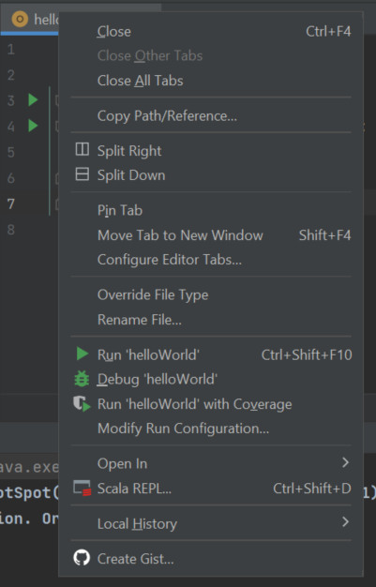
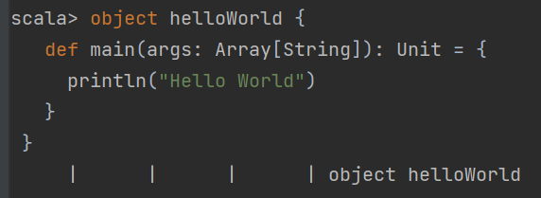


To run REPL in IntelliJ
It tells us what is defined.
Empty array

Slide 24
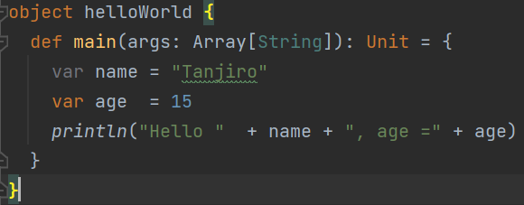



String interpolation
Concatanation: this is just like Java.

Slide 25
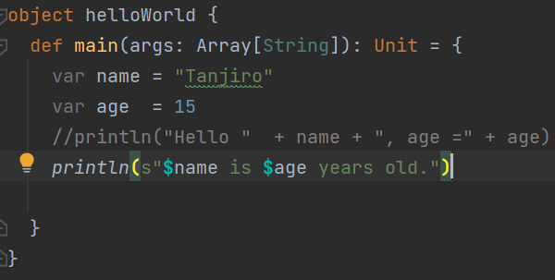



S string interpolation
Comment uses //
Or /* */ just like in Java.

Slide 26
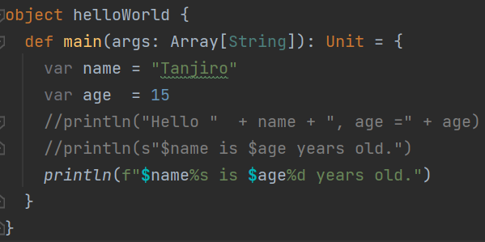
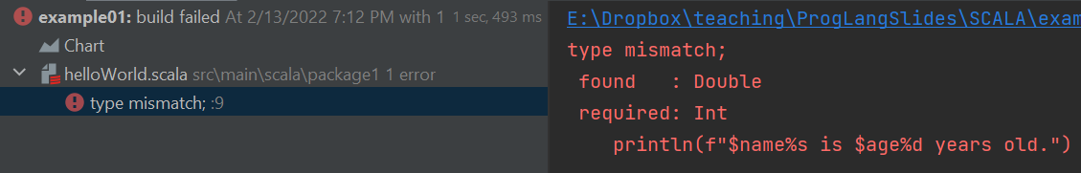
F string interpolation (type safe)
Note that the type here is not int.

Slide 27

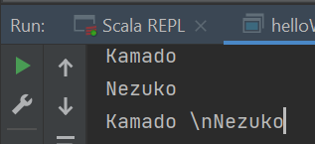
Raw string interpolation

Slide 28
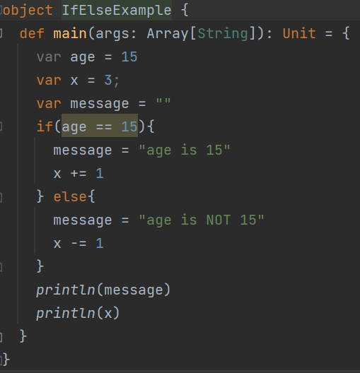
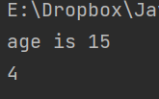

If-else
Don’t forget to initialize!

Slide 29
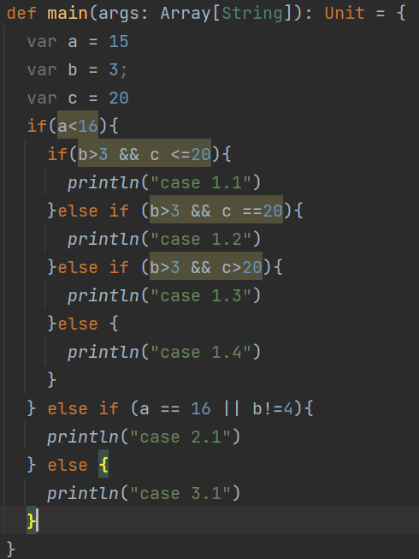
A more complex if example
And, or, not, nested if are just like Java!

Slide 30
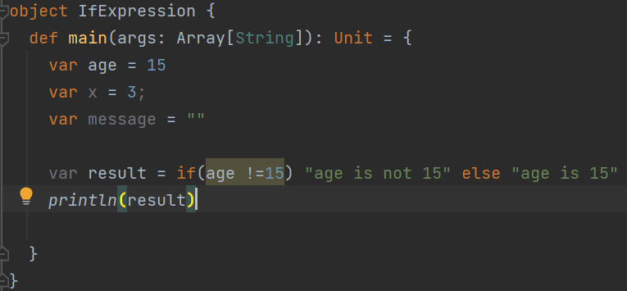

If expression
Very similar to C++

Slide 31
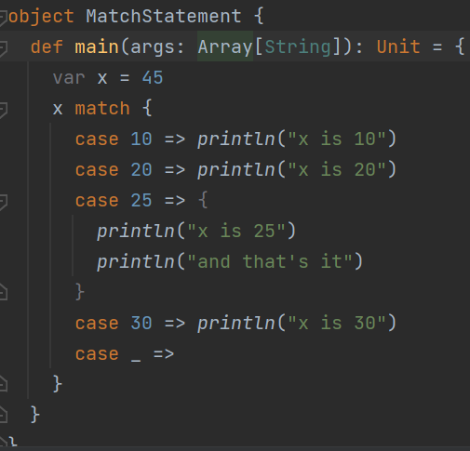
Match (switch statement)
Can be used with other data types like string
Does not need a “break” statement
Default is doing nothing

Slide 32
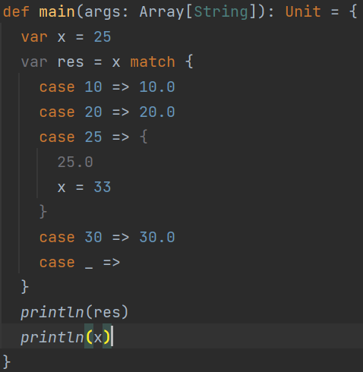







Match expression

Slide 33
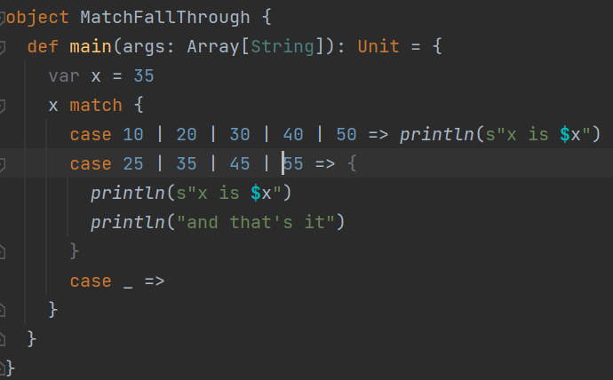
Match with multiple cases (fall through)

Slide 34
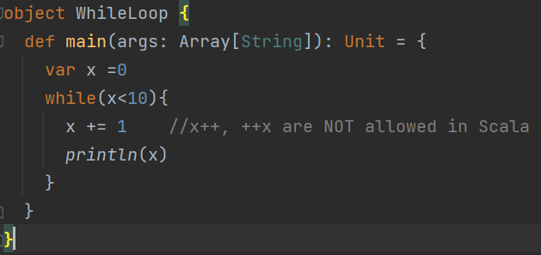
While loop

Slide 35
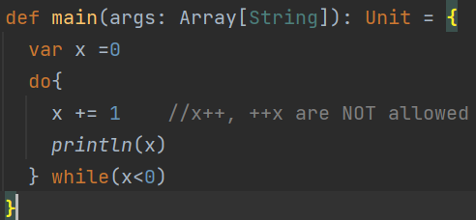
Do while
This loop executes only once!

Slide 36
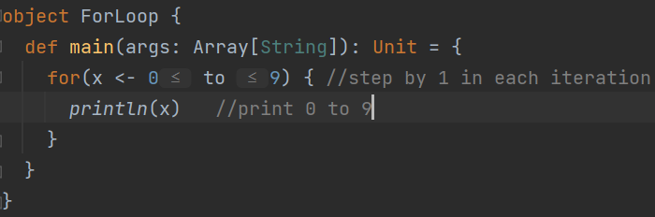


For loop
can also be used.

Slide 37
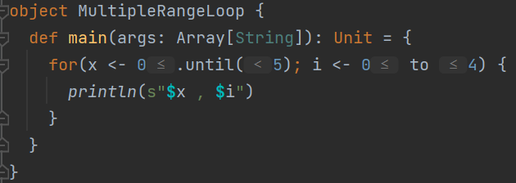

Multiple range for loop
This is like a nested loop.

Slide 38
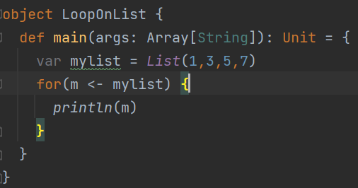
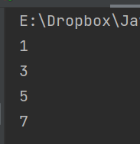
Loop on a list

Slide 39
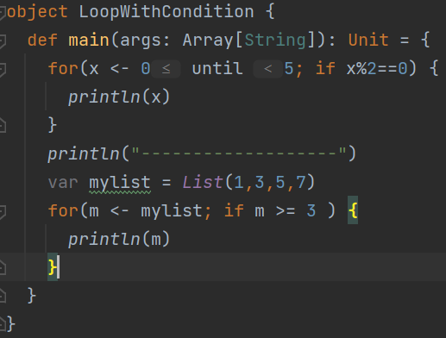
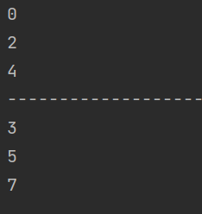

For loop with Boolean condition
It goes through every value, but only execute code inside the loop if the condition is satisfied.

Slide 40
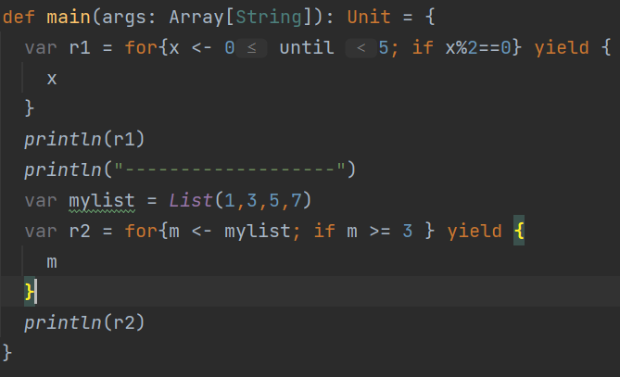

For loop expression

Slide 41



How to write your own function
Short function
Return type can even be removed if it is known for sure.

Slide 42





Function belongs to an object
You can use + here. It’s not operator overload. It’s just that it can be a function name. And it is used just like a function of object Math.
In fact +, -, * ,/ are not an operator in Scala. They are functions.

Slide 43

Function with 1 argument

Slide 44


Function can have default argument value
You can provide some first parameters too

Slide 45

Function that does not return value
void

Slide 46


Function as variable (Anonymous function)

