Slide 1
Research in Computing
สมชาย ประสิทธิ์จูตระกูล
Prabhas Chongstitvatana
Last update August 2019

Slide 2
Success Factors in Computing Research
Computing Knowledge
Determination
Funding
Motivation
Maturity
Research
Perseverance
Luck
Independence
English
Scientific Method
Analytical Skill
Reading & Writing Skills

Slide 3
Discipline in Computing
Artificial Intelligence
Bioinformatics
Data Science
Computer Graphics
Human-computer interaction
Machine Learning
Network
Scientific computing
Software Engineering
Security and Privacy
etc

Slide 4
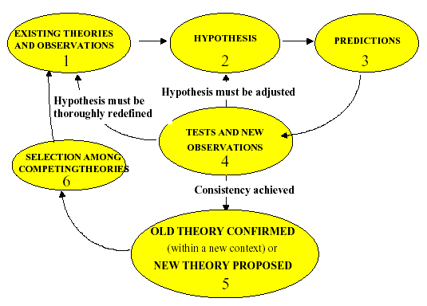
Scientific Method

Slide 5
Engineering
Construction of (useful) products
Solving problems
  understand the problem
  analyse the problem
Find solutions
  Constructing the solution from parts that address the problem's various aspects - do a synthesis
Engineers
  apply theories, methods and tools from different disciplines
  Search for solutions even when there is not theory or methods

Slide 6
Distinctions between S & T
Unchangeable vs. Changeable
Inherent vs. Imposed
General vs. Specific
End in Itself vs. End in Something Else
Abstracting vs. Modeling Complex Systems
Conceptualizing vs. Optimizing
Discovery vs. Invention
Long-term vs. Short-term

Slide 7
Research
Careful or diligent search
Studious inquiry or examination; especially : investigation or experimentation aimed at the discovery and interpretation of facts, revision of accepted theories or laws in the light of new facts, or practical application of such new or revised theories or laws
The collecting of information about a particular subject

Slide 8
Building Blocks for Research
Questions
Result
Validation
Feasibility
Qualitative model
Persuasion
Characterization
Technique
Implementation
Method / Means
System
Evaluation
Generalization
Empirical model
Analysis
Discriminization
Analytic model
Experience

Slide 9
Building Blocks for Research
Questions
Result
Validation
Feasibility
Qualitative model
Persuasion
Characterization
Technique
Implementation
Method / Means
System
Evaluation
Generalization
Empirical model
Analysis
Discriminization
Analytic model
Experience
A "Good" Plan

Slide 10
Building Blocks for Research
Questions
Result
Validation
Feasibility
Qualitative model
Persuasion
Characterization
Technique
Implementation
Method / Means
System
Evaluation
Generalization
Empirical model
Analysis
Discriminization
Analytic model
Experience
Common "Bad" Plan

Slide 11
Building Blocks for Research
Questions
Result
Validation
Feasibility
Qualitative model
Persuasion
Characterization
Technique
Implementation
Method / Means
System
Evaluation
Generalization
Empirical model
Analysis
Discriminization
Analytic model
Experience
Common Plan

Slide 12
Reading is Fundamental
Finding and reading related work is the foundation of good research
  ACM Guide to Computing Literature
  Computing Reviews
Developing a bibliography of related works
Background reading + Important reading
  Journal + Proceeding

Slide 13
Reading with care
Abstract, introduction, conclusion
Get important points
If relevant, read the whole thing
Take note during reading
(make your thought organized)

Slide 14
Reading with Care
Ask questions when reading
  what is the motivation ?
  what is the contribution ?
  How does this contribution realte to work previously encountered ?
  What are the important references cited ?
  What questions are left unanswered ?
  Can the results be generalized ?
  Can the specific result be improved ?

Slide 15
Writing is Fundamental
Good writing is the only lasting medium of the scientific process.
Mathematics or code are not substitutes for English
Document your work regularly

Slide 16
Working with Others
Success comes from work with others
Share ideas and let them develop in group atmosphere
Carefully consider criticism, use it as a guideline

Slide 17
Programming
A programming project is not research
It is a mechanism for performing experiment
Experiment
  Establish goals
  Think simple (develope manageble project)
  build prototype (not a complete product)
  use tools (perl, MathLab, Mathematica, Excel, SPSS, ...)
  Collaborate
  Document results

Slide 18
David Patterson's Six Steps
Selecting a problem
Picking a solution
Running a project
Finishing a project
Quantitative evaluation
Transferrring technology

Slide 19
Recommendation
Grad school is unstructured environment
  reading papers
  discussing ideas with colleagues
  writing and revising papers
  staring blankly in space
  having brillant idea and implementing them
Spend your time wisely

