Slide 1

How to write a good research paper
Prabhas Chongstitvatana
Chulalongkorn University

Slide 2
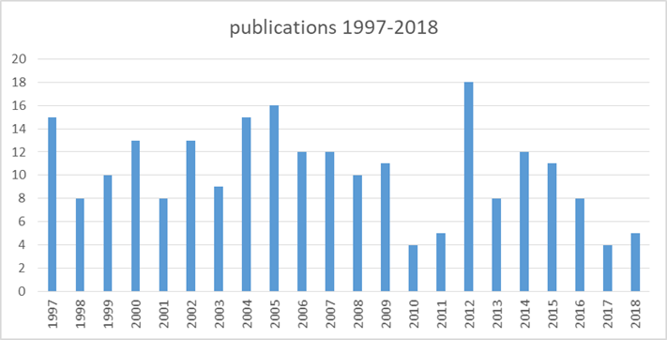
The speaker
Department of Computer Engineering
Chulalongkorn University

Slide 3
Fallacy
We write papers and give talks mainly to impress others, gain recognition, and get promoted

Slide 4
Papers communicate ideas
Your goal
to infect the mind of your reader with your idea
The greatest ideas are (literally) worthless if
you keep them to yourself

Slide 5
Writing papers: model 1
Idea >> Do research >> Write paper

Slide 6
Writing papers: model 2
Idea >> Write paper >> Do research

Slide 7
Writing a paper
Force us to be clear, focused
Crystallise what we don’t understand
Open the way to dialogue with others: reality check, critique, and collaboration

Slide 8
Do not be intimidated
Write a paper, and give a talk, about any idea, no matter how insignificant it may seem to you
Writing the paper is how you develop the idea in the first place
It usually turns out to be more interesting and challenging that it seemed at first

Slide 9
The purpose of your paper is...
To convey your idea
...from your head to your reader’s head

Slide 10
Conveying the idea
Here is a problem
It’s an interesting problem
It’s an unsolved problem
Here is my idea
My idea works (details, data)
Here’s how my idea compares to other people’s approaches

Slide 11
Structure
Abstract (short)
Introduction (1)
The problem (1)
My idea (2)
The details (4)
Related work (2)
Conclusions and further work (short)

Slide 12
The abstract
I usually write the abstract last
Used by program committee to decide which papers to read
Four sentences [Kent Beck]
1. State the problem
2. Say why it’s an interesting problem
3. Say what your solution achieves
4. Say what follows from your solution

Slide 13
The introduction (1)
Describe the problem
  Use an example to introduce the problem
State your contributions
  Contributions should be refutable
  Do not leave the reader to guess what your contributions are
...and that is all

Slide 14
The introduction
The introduction (including the contributions) should survey the whole paper

Slide 15
Content of your paper
Concentrate single-mindedly on a narrative that
Describe the problem, and why it is interesting
Describe your idea
Defend your idea, showing how it solves the problem, and filling out the details

Slide 16
Content of your paper
In a paper you MUST provide the details, but FIRST convey the idea
Don’t make your reader fall asleep!

Slide 17
Content of your paper
Introduce the problem, and your idea, using
EXAMPLES
and only then present the general case

Slide 18
Conveying the idea
Explain it as if you were speaking to someone using a whiteboard
Conveying the intuition is primary, not secondary
Once your reader has the intuition, she can follow the details (but not vice versa)
Even if she skips the details, she still takes away something valuable

Slide 19
Evidence
Your introduction makes claims
The body of the paper provides evidence to support each claim
Check each claim in the introduction, identify the evidence, and forward-reference it from the claim
Evidence can be: analysis and comparison, theorems, measurements, case studies

Slide 20
Related work
Fallacy
To make my work look good, I have to make other people’s work look bad

Slide 21
The truth
Giving credit to others does not diminish the credit you get from your paper
Warmly acknowledge people who have helped you
Be generous to the competition
Acknowledge weaknesses in your approach

Slide 22
Giving credit
Failing to give credit to others can kill your paper
If you imply that an idea is yours, and the referee knows it is not, then either
  You don’t know that it’s an old idea (bad)
  You do know, but are pretending it’s yours (very bad)

Slide 23
Listening to your reviewers
Every review is gold dust
Be (truly) grateful for criticism as well as praise
This is really hard
But it’s really, really important

Slide 24
Basics
Submit by the deadline
Keep to the length restrictions
On occasion, supply supporting evidence (e.g. experimental data, or a written-out proof) in an appendix
Always use a spell checker

Slide 25
Acknowledgement
How to write a great research paper
Simon Peyton Jones
Microsoft Research, Cambridge

